Slide 1
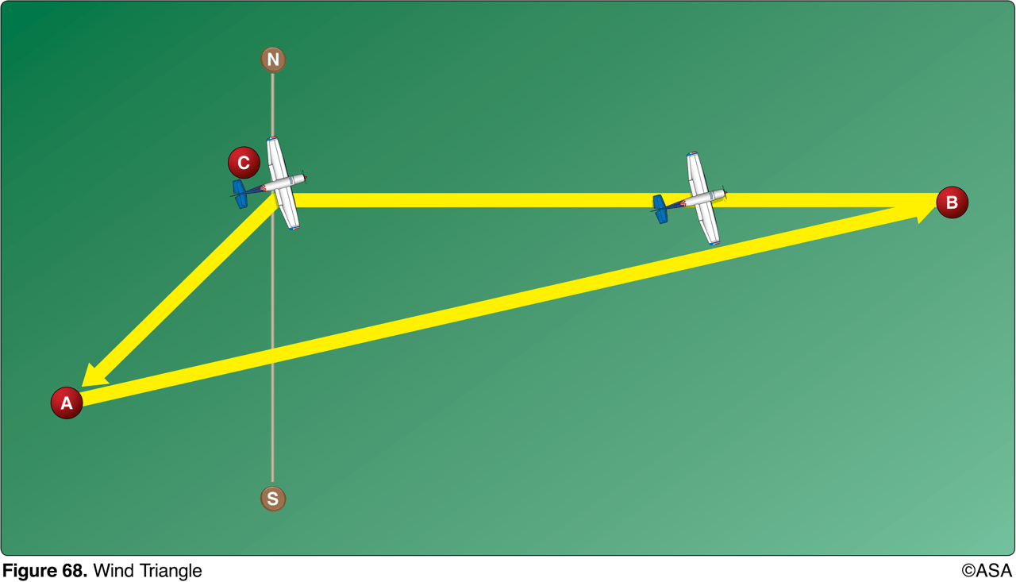
1. (2001) (Refer to Figure 68.) The line from point C to point A of the wind triangle represents
a. wind direction and velocity. b. true course and groundspeed. c. true heading and groundspeed.

Slide 2
1. (2001) (Refer to Figure 68.) The line from point C to point A of the wind triangle represents
*a. wind direction and velocity. b. true course and groundspeed. c. true heading and groundspeed.
The line from point C to A of the wind triangle represents the wind direction and speed (velocity).Answer (B) is incorrect because this is represented by the line from point C to B. Answer (C) is incorrect because these are the values found by using the wind triangle.

Slide 3
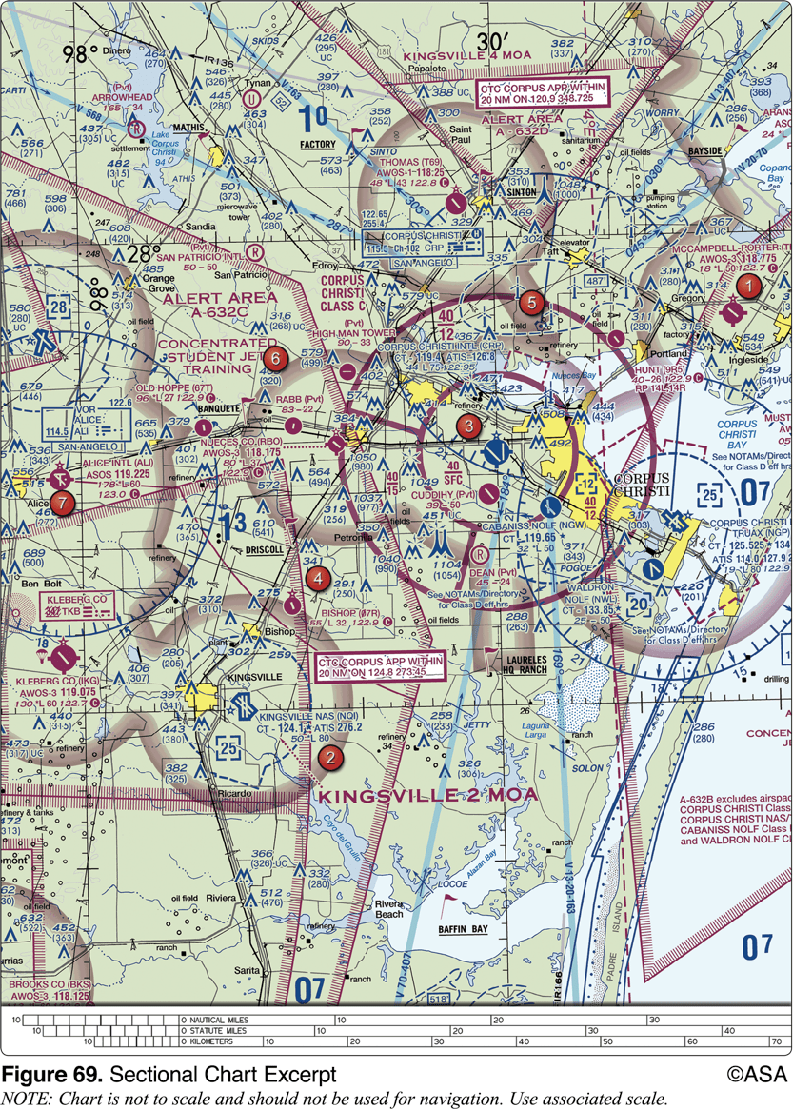
2. (2122) (Refer to Figure 69.) What minimum equipment is required for a flight from Kleberg Co. Airport (area 7) to Corpus Christi Intl. Airport (area 3)?
a. ADS-B. b. Two-way radio equipment. c. Two-way radio and Mode C transponder with altitude reporting equipment.

Slide 4
2. (2122) (Refer to Figure 69.) What minimum equipment is required for a flight from Kleberg Co. Airport (area 7) to Corpus Christi Intl. Airport (area 3)?
a. ADS-B. b. Two-way radio equipment. *c. Two-way radio and Mode C transponder with altitude reporting equipment.
A flight from Kleberg County Airport to Corpus Christi International requires flight into Class C airspace. This is shown by the magenta circle around Corpus Christi International Airport. Minimum required equipment for flight into Class C airspace is two-way radio and Mode C transponder with automatic altitude reporting equipment. Answer (A) is incorrect because ADS-B is not required equipment for flight into Class C airspace. Answer (B) is incorrect because besides a two-way radio a Mode C transponder with altitude reporting equipment is required.

Slide 5
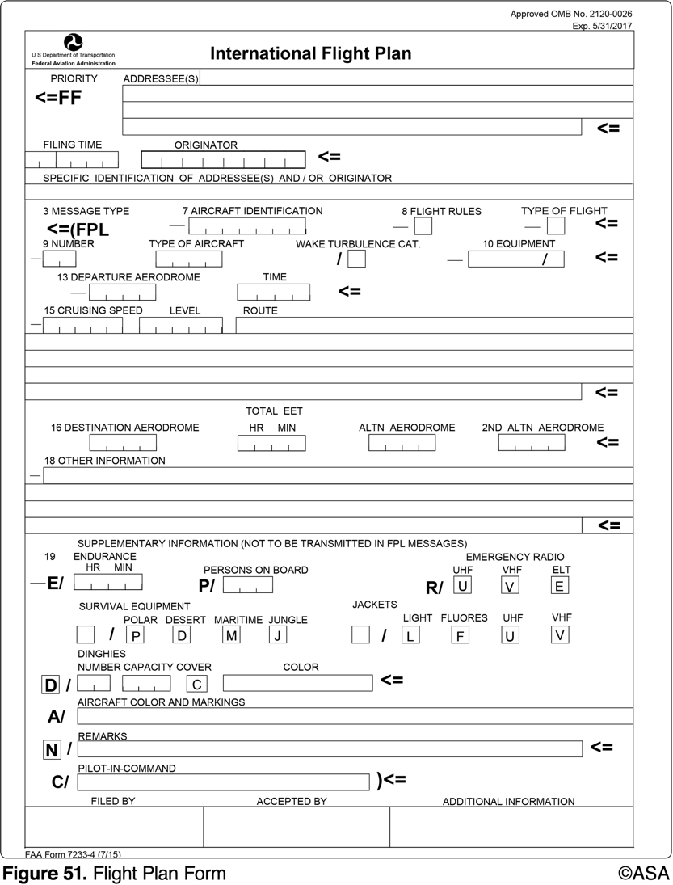
3. (2175.1) (Refer to Figure 51.) What information should be entered for Item 15, level, on the flight plan form?
a. VFR cruising altitude. b. Aircraft service ceiling. c. Aircraft center of gravity.

Slide 6
3. (2175.1) (Refer to Figure 51.) What information should be entered for Item 15, level, on the flight plan form?
*a. VFR cruising altitude. b. Aircraft service ceiling. c. Aircraft center of gravity.
Insert the planned cruising altitude in hundreds of feet for the first or the whole portion of the route to be flown expressed as "A" followed by three figures: A075 for 7,500 feet MSL.

Slide 7
4. (3068) Unless otherwise specified, Federal Airways include that Class E airspace extending upward from
a. 700 feet above the surface up to and including 17,999 feet MSL. b. 1,200 feet above the surface up to and including 17,999 feet MSL. c. the surface up to and including 18,000 feet MSL.

Slide 8
4. (3068) Unless otherwise specified, Federal Airways include that Class E airspace extending upward from
a. 700 feet above the surface up to and including 17,999 feet MSL. *b. 1,200 feet above the surface up to and including 17,999 feet MSL. c. the surface up to and including 18,000 feet MSL.
Federal airways are part of Class B, C, D, or E airspace. They are 8 miles wide, 4 miles either side of centerline. They usually begin at 1,200 AGL and continue up to but not including 18,000 feet MSL, or FL180.

Slide 9
5. (3068.1) With certain exceptions, Class E airspace extends upward from either 700 feet or 1,200 feet AGL to, but does not include,
a. 10,000 feet MSL. b. 14,500 feet MSL. c. 18,000 feet MSL.

Slide 10
5. (3068.1) With certain exceptions, Class E airspace extends upward from either 700 feet or 1,200 feet AGL to, but does not include,
a. 10,000 feet MSL. b. 14,500 feet MSL. *c. 18,000 feet MSL.
Class E airspace extends upward to (but not including) 18,000 feet MSL.

Slide 11
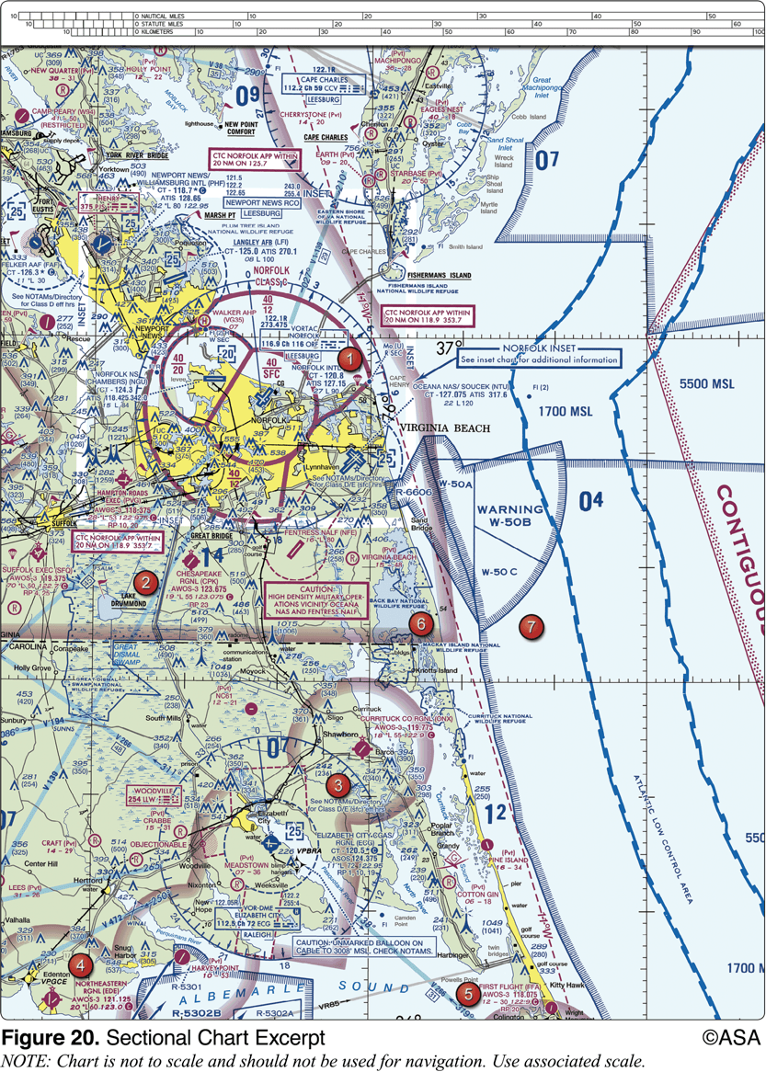
6. (3068.2) (Refer to figure 20, area 1.) The NALF Fentress (NFE) Airport is in what type of airspace?
a. Class C. b. Class E. c. Class G.

Slide 12
6. (3068.2) (Refer to figure 20, area 1.) The NALF Fentress (NFE) Airport is in what type of airspace?
a. Class C. *b. Class E. c. Class G.
The Nalf Fentress (NFE) airport is halfway between areas 1 and 2 in Figure 20. It is inside a magenta dashed line indicating Class E airspace starts at the surface. Answer (A) is incorrect because Class C airspace is indicated with a solid magenta line. Answer (C) is incorrect because Class G airspace would be indicated with solid (shaded) magenta or blue lines.

Slide 13
7. (3069) Normal VFR operations in Class D airspace with an operating control tower require the ceiling and visibility to be at least
a. 1,000 feet and 1 mile. b. 1,000 feet and 3 miles. c. 2,500 feet and 3 miles.

Slide 14
7. (3069) Normal VFR operations in Class D airspace with an operating control tower require the ceiling and visibility to be at least
a. 1,000 feet and 1 mile. *b. 1,000 feet and 3 miles. c. 2,500 feet and 3 miles.
Except as provided in 14 CFR 91.157, no person may operate an aircraft, under VFR, within the lateral boundaries of the surface areas of Class B, Class C, Class D, or Class E airspace designated for an airport when the ceiling is less than 1,000 feet. The flight visibility and cloud clearance for VFR operations in Class D airspace is 3 SM visibility, and 500 feet below, 1,000 feet above, 2,000 feet horizontal from all clouds.

Slide 15
8. (3117) A blue segmented circle on a Sectional Chart depicts which class airspace?
a. Class B. b. Class C. c. Class D.

Slide 16
8. (3117) A blue segmented circle on a Sectional Chart depicts which class airspace?
a. Class B. b. Class C. *c. Class D.
A blue segmented circle on a sectional chart depicts Class D airspace which means a control tower is in operation. Answer (A) is incorrect because Class B airspace is depicted by a solid blue line. Answer (B) is incorrect because Class C airspace is depicted by a solid magenta line.

Slide 17
9. (3118) Airspace at an airport with a part-time control tower is classified as Class D airspace only
a. when the weather minimums are below basic VFR. b. when the associated control tower is in operation. c. when the associated Flight Service Station is in operation.

Slide 18
9. (3118) Airspace at an airport with a part-time control tower is classified as Class D airspace only
a. when the weather minimums are below basic VFR. *b. when the associated control tower is in operation. c. when the associated Flight Service Station is in operation.
Class D airspace means a control tower is in operation. If the tower closes, it reverts to Class E airspace. Answer (A) is incorrect because weather minimums have nothing to do with airspace classifications. Answer (C) is incorrect because an FSS has nothing to do with the class of airspace.

Slide 19
10. (3119) Unless otherwise authorized, two-way radio communications with Air Traffic Control are required for landings or takeoffs
a. at all tower controlled airports regardless of weather conditions. b. at all tower controlled airports only when weather conditions are less than VFR. c. at all tower controlled airports within Class D airspace only when weather conditions are less than VFR.

Slide 20
10. (3119) Unless otherwise authorized, two-way radio communications with Air Traffic Control are required for landings or takeoffs
*a. at all tower controlled airports regardless of weather conditions. b. at all tower controlled airports only when weather conditions are less than VFR. c. at all tower controlled airports within Class D airspace only when weather conditions are less than VFR.
No person may operate an aircraft to, from, or on an airport having a control tower operated by the United States unless two-way radio communications are maintained between that aircraft and the control tower.

Slide 21
11. (3124) Two-way radio communication must be established with the Air Traffic Control facility having jurisdiction over the area prior to entering which class airspace?
a. Class C. b. Class E. c. Class G.

Slide 22
11. (3124) Two-way radio communication must be established with the Air Traffic Control facility having jurisdiction over the area prior to entering which class airspace?
*a. Class C. b. Class E. c. Class G.
Two-way radio communication must be established with the ATC facility having jurisdiction over the Class C airspace prior to entry and thereafter as instructed by ATC. Answer (B) is incorrect because airports within Class E and G airspace only require two-way radio communication when a control tower is present. Answer (C) is incorrect because airports within Class E and G airspace only require two-way radio communication when a control tower is present.

Slide 23
12. (3125) What minimum radio equipment is required for operation within Class C airspace?
a. Two-way radio communications equipment and a 4096-code transponder. b. Two-way radio communications equipment, a 4096-code transponder, and DME. c. Two-way radio communications equipment, a 4096-code transponder, and an encoding altimeter.

Slide 24
12. (3125) What minimum radio equipment is required for operation within Class C airspace?
a. Two-way radio communications equipment and a 4096-code transponder. b. Two-way radio communications equipment, a 4096-code transponder, and DME. *c. Two-way radio communications equipment, a 4096-code transponder, and an encoding altimeter.
Class C requires two-way radio communications equipment, a transponder, and an encoding altimeter.

Slide 25
13. (3126) What minimum pilot certification is required for operation within Class B airspace?
a. Commercial Pilot Certificate. b. Private Pilot Certificate or Student Pilot Certificate with appropriate logbook endorsements. c. Private Pilot Certificate with an Instrument Rating.

Slide 26
13. (3126) What minimum pilot certification is required for operation within Class B airspace?
a. Commercial Pilot Certificate. *b. Private Pilot Certificate or Student Pilot Certificate with appropriate logbook endorsements. c. Private Pilot Certificate with an Instrument Rating.
It is generally true that no person may operate a civil aircraft within Class B airspace unless the pilot-in-command holds at least a Private Pilot Certificate or is a student pilot that has the proper logbook endorsements. However, there are certain Class B airports which never permit students, even if they have the proper endorsements. Answer (A) is incorrect because Private pilots may operate in Class B airspace. Answer (C) is incorrect because only some airports restrict student pilots, and none require an Instrument Rating.

Slide 27
14. (3127) What minimum pilot certification is required for operation within Class B airspace?
a. Private Pilot Certificate or Student Pilot Certificate with appropriate logbook endorsements. b. Recreational Pilot Certificate. c. Private Pilot Certificate with an Instrument Rating.

Slide 28
14. (3127) What minimum pilot certification is required for operation within Class B airspace?
*a. Private Pilot Certificate or Student Pilot Certificate with appropriate logbook endorsements. b. Recreational Pilot Certificate. c. Private Pilot Certificate with an Instrument Rating.
It is generally true that no person may operate a civil aircraft within Class B airspace unless the pilot-in-command holds at least a Private Pilot Certificate or a student pilot has the proper logbook endorsements. However, there are some Class B airports which never permit students, even if they have the proper endorsements. Answer (B) is incorrect because the PIC must hold at least a Private Pilot Certificate. Answer (C) is incorrect because an Instrument Rating is not required to operate within Class B airspace.

Slide 29
15. (3128) What minimum radio equipment is required for VFR operation within Class B airspace?
a. Two-way radio communications equipment and a 4096-code transponder. b. Two-way radio communications equipment, a 4096-code transponder, and an encoding altimeter. c. Two-way radio communications equipment, a 4096-code transponder, an encoding altimeter, and a VOR or TACAN receiver.

Slide 30
15. (3128) What minimum radio equipment is required for VFR operation within Class B airspace?
a. Two-way radio communications equipment and a 4096-code transponder. *b. Two-way radio communications equipment, a 4096-code transponder, and an encoding altimeter. c. Two-way radio communications equipment, a 4096-code transponder, an encoding altimeter, and a VOR or TACAN receiver.
Unless otherwise authorized by ATC, no person may operate an aircraft within Class B airspace unless that aircraft is equipped with an operable two-way radio capable of communications with ATC, a transponder with applicable altitude reporting equipment, and an encoding altimeter.

Slide 31
16. (3130) In which type of airspace are VFR flights prohibited?
a. Class A. b. Class B. c. Class C.

Slide 32
16. (3130) In which type of airspace are VFR flights prohibited?
*a. Class A. b. Class B. c. Class C.
No person may operate an aircraft within Class A airspace unless that aircraft is operated under IFR at a specific flight level assigned by ATC.

Slide 33
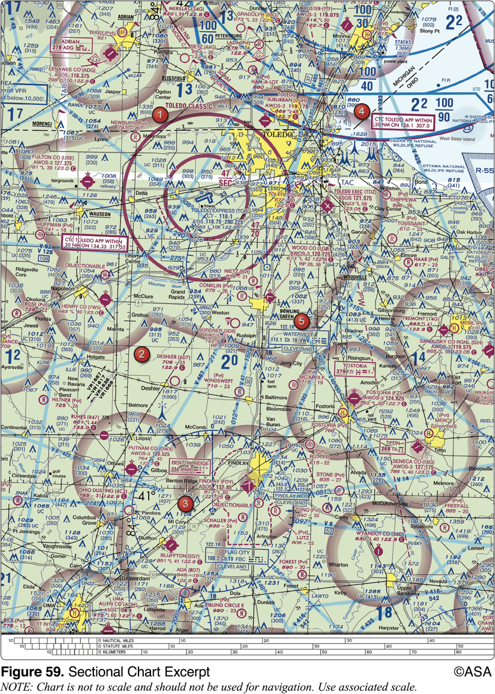
17. (3421) (Refer to Figure 59, area 3.) The airspace directly overlying the town of Findlay is
a. Class E airspace from 700 feet AGL. b. surface area Class E airspace. c. Class E airspace from 1,200 feet AGL.

Slide 34
17. (3421) (Refer to Figure 59, area 3.) The airspace directly overlying the town of Findlay is
a. Class E airspace from 700 feet AGL. *b. surface area Class E airspace. c. Class E airspace from 1,200 feet AGL.
The town of Findlay is outlined in yellow just north of Findlay (FDY) Airport. Findlay's magenta segmented line depicts surface area Class E airspace.

Slide 35
18. (3529.1) If a true heading of 135° results in a ground track of 130° and a true airspeed of 135 knots results in a groundspeed of 140 knots, the wind would be from
a. 019° and 12 knots. b. 200° and 13 knots. c. 246° and 13 knots.

Slide 36
18. (3529.1) If a true heading of 135° results in a ground track of 130° and a true airspeed of 135 knots results in a groundspeed of 140 knots, the wind would be from
a. 019° and 12 knots. b. 200° and 13 knots. *c. 246° and 13 knots.
You are heading to the southeast (135°) at 135 knots. The wind is blowing you left of course (130°) and giving you a faster ground speed which means the wind is blowing from the southwest. Use your manual or electronic flight computer to determine the wind direction and speed at 246° and 13 knots. Answer (A) is incorrect because a wind from 019° would blow you right of course (resulting in a ground track of 140°). Answer (B) is incorrect because a wind from 200° would be a right quartering headwind which wouldn't increase your ground speed.

Slide 37
19. (3529.2) When converting from true course to magnetic heading, a pilot should
a. subtract easterly variation and right wind correction angle. b. add westerly variation and subtract left wind correction angle. c. subtract westerly variation and add right wind correction angle.

Slide 38
19. (3529.2) When converting from true course to magnetic heading, a pilot should
a. subtract easterly variation and right wind correction angle. *b. add westerly variation and subtract left wind correction angle. c. subtract westerly variation and add right wind correction angle.
When converting a true course to a true heading, subtract a left wind correction angle or add a right wind correction angle. When converting from a true heading to a magnetic heading, add westerly variation or subtract easterly variation. Answer (A) is incorrect because right wind correction is added. Answer (C) is incorrect because westerly variation is added.

Slide 39
20. (3529.3) How far will an aircraft travel in 2-1/2 minutes with a groundspeed of 98 knots?
a. 2.45 NM. b. 3.35 NM. c. 4.08 NM.

Slide 40
20. (3529.3) How far will an aircraft travel in 2-1/2 minutes with a groundspeed of 98 knots?
a. 2.45 NM. b. 3.35 NM. *c. 4.08 NM.
To find the distance flown in a given time, multiply ground speed by time. The distance flown in 2-1/2 minutes (convert to hours by dividing by 60) at a ground speed of 98 knots is .04 x 98 = 4.08 NM.

Slide 41
21. (3529.4) How far will an aircraft travel in 7.5 minutes with a ground speed of 114 knots?
a. 14.25 NM. b. 15.00 NM. c. 14.50 NM.

Slide 42
21. (3529.4) How far will an aircraft travel in 7.5 minutes with a ground speed of 114 knots?
*a. 14.25 NM. b. 15.00 NM. c. 14.50 NM.
To find the distance flown in a given time, multiply ground speed by time. The distance flown in 7.5 minutes (convert to hours by dividing by 60) at a ground speed of 114 knots is .125 x 114 = 14.25 NM.

Slide 43
22. (3530) (Refer to Figure 20, area 3.) Determine the approximate latitude and longitude of Currituck County Airport.
a. 36°24'N - 76°01'W. b. 36°48'N - 76°01'W. c. 47°24'N - 75°58'W.

Slide 44
22. (3530) (Refer to Figure 20, area 3.) Determine the approximate latitude and longitude of Currituck County Airport.
*a. 36°24'N - 76°01'W. b. 36°48'N - 76°01'W. c. 47°24'N - 75°58'W.
Graticules on Sectional Aeronautical Charts are the lines dividing each 30 minutes of latitude and each 30 minutes of longitude. Each tick mark represents one minute of latitude or longitude. Latitude increases northward, west longitude increases going westward. The approximate latitude and longitude of Currituck County Airport is 36°24'N, 76°01'W.

Slide 45
23. (3530.1) Which statement about longitude and latitude is true?
a. Lines of longitude are parallel to the equator. b. Lines of longitude cross the equator at right angles. c. The 0° line of latitude passes through Greenwich, England.

Slide 46
23. (3530.1) Which statement about longitude and latitude is true?
a. Lines of longitude are parallel to the equator. *b. Lines of longitude cross the equator at right angles. c. The 0° line of latitude passes through Greenwich, England.
Meridians of longitude encircle the earth from pole to pole, and all meridians cross the equator at right angles. Answer (A) is incorrect because lines of latitude are parallel to the equator. Answer (C) is incorrect because the 0Â° line of longitude passes through Greenwich, England.

Slide 47
24. (3531) (Refer to Figure 20.) Determine the magnetic course from First Flight Airport (area 5) to Hampton Roads Airport (area 2).
a. 141°. b. 321°. c. 332°.

Slide 48
24. (3531) (Refer to Figure 20.) Determine the magnetic course from First Flight Airport (area 5) to Hampton Roads Airport (area 2).
a. 141°. b. 321°. *c. 332°.
Use the following steps: 1. Plot the course from First Flight Airport to Hampton Roads Airport. 2. Measure the true course angle at the approximate midpoint of the route. The true course is 321°. 3. Note that the variation is 11°W as shown on the isogonic line. 4. Using the formula: MC = TC ± VAR, MC = 321° + 11°W, MC = 332°

Slide 49
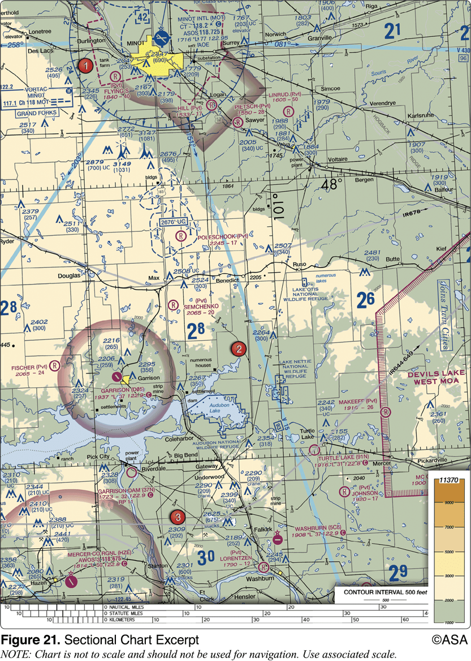
25. (3535) (Refer to Figure 21, area 2.) Which airport is located at approximately 47°35'30"N latitude and 100°43'00"W longitude?
a. Turtle Lake. b. MAKEEFF. c. Johnson.

Slide 50
25. (3535) (Refer to Figure 21, area 2.) Which airport is located at approximately 47°35'30"N latitude and 100°43'00"W longitude?
a. Turtle Lake. *b. MAKEEFF. c. Johnson.
Graticules on Sectional Aeronautical Charts are the lines dividing each 30 minutes of latitude and each 30 minutes of longitude. Each tick mark represents one minute of latitude or longitude. Latitude increases northward, west longitude increases going westward. The Makeeff (PVT) airport is located at approximately 47°35'30"N latitude and 100°43'00"W longitude.

Slide 51
26. (3536) (Refer to Figure 21, area 3.) Which airport is located at approximately 47°21'N latitude and 101°01'W longitude?
a. Lorentzen. b. Johnson. c. Washburn.

Slide 52
26. (3536) (Refer to Figure 21, area 3.) Which airport is located at approximately 47°21'N latitude and 101°01'W longitude?
a. Lorentzen. b. Johnson. *c. Washburn.
Graticules on Sectional Aeronautical Charts are the lines dividing each 30 minutes of latitude and each 30 minutes of longitude. Each tick mark represents one minute of latitude or longitude. Latitude increases northward, west longitude increases going westward. Washburn is located at approximately 47°21'N latitude and 101°01'W longitude.

Slide 53
27. (3538) (Refer to Figure 21.) Determine the magnetic heading for a flight from Mercer County Regional Airport (area 3) to Minot International (area 1). The wind is from 330° at 25 knots, the true airspeed is 100 knots, and the magnetic variation is 10° east.
a. 002°. b. 012°. c. 352°.

Slide 54
27. (3538) (Refer to Figure 21.) Determine the magnetic heading for a flight from Mercer County Regional Airport (area 3) to Minot International (area 1). The wind is from 330° at 25 knots, the true airspeed is 100 knots, and the magnetic variation is 10° east.
a. 002°. b. 012°. *c. 352°.
Use the following steps: 1. Plot the course from Mercer County Regional Airport to Minot Airport. 2. Measure the true course angle at the approximate midpoint of the route. The true course is 011°. 3. Find the true heading using a flight computer (Wind Correction on FLT menu using CX-3): Wind direction is 330° (given in question) Wind speed is 25 knots (given in question) True course is 011° (found in Step 2) True airspeed is 100 knots (given in question) Therefore, the true heading is 002°. 4. Calculate the magnetic heading by subtracting the easterly variation (10°) from the true heading (002°). MH = TH ± VAR MH = 002° - 10°E MH = 352°

Slide 55
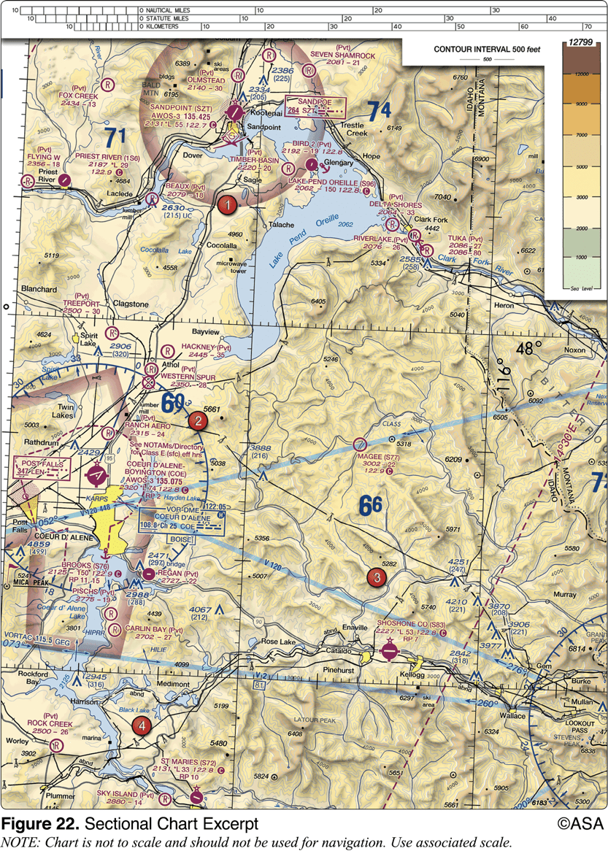
28. (3543) (Refer to Figure 22, area 3.) Determine the approximate latitude and longitude of Shoshone County Airport.
a. 47°02'N - 116°11'W. b. 47°33'N - 116°11'W. c. 47°32'N - 116°41'W.

Slide 56
28. (3543) (Refer to Figure 22, area 3.) Determine the approximate latitude and longitude of Shoshone County Airport.
a. 47°02'N - 116°11'W. *b. 47°33'N - 116°11'W. c. 47°32'N - 116°41'W.
Graticules on Sectional Aeronautical Charts are the lines dividing each 30 minutes of latitude and each 30 minutes of longitude. Each tick mark represents one minute of latitude or longitude. Latitude increases northward, west longitude increases going westward. The approximate latitude and longitude of Shoshone County Airport is 47°33'N, 116°11'W.

Slide 57
29. (3545) (Refer to Figure 22.) Determine the magnetic heading for a flight from Sandpoint Airport (area 1) to St. Maries Airport (area 4). The wind is from 215° at 25 knots and the true airspeed is 125 knots.
a. 172°. b. 349°. c. 187°.

Slide 58
29. (3545) (Refer to Figure 22.) Determine the magnetic heading for a flight from Sandpoint Airport (area 1) to St. Maries Airport (area 4). The wind is from 215° at 25 knots and the true airspeed is 125 knots.
*a. 172°. b. 349°. c. 187°.
Use the following steps: 1. Plot the course from Sandpoint Airport to St. Maries Airport. 2. Measure the true course angle at the approximate midpoint of the route (181°). 3. Find the true heading using a flight computer (Wind Correction on FLT menu using CX-3): Wind direction is 215° (given in question) Wind speed is 25 knots (given in question) True course is 181° (found in Step 2) True airspeed is 125 knots (given in question) Therefore, the true heading is 187°. 4. Calculate the magnetic heading by subtracting the easterly variation (15°) from the true heading (187°). MH = TH ± VAR MH = 187° - 15°E MH = 172°

Slide 59
30. (3546) (Refer to Figure 22.) What is the magnetic heading for a flight from Priest River Airport (area 1) to Shoshone County Airport (area 3)?The wind is from 030° at 12 knots and the true airspeed is 95 knots.
a. 121°. b. 143°. c. 136°.

Slide 60
30. (3546) (Refer to Figure 22.) What is the magnetic heading for a flight from Priest River Airport (area 1) to Shoshone County Airport (area 3)?The wind is from 030° at 12 knots and the true airspeed is 95 knots.
*a. 121°. b. 143°. c. 136°.
Use the following steps: 1. Plot the course from Priest River to Shoshone County Airport. 2. Measure the true course angle at the approximate midpoint of the route (143°). 3. Find the true heading using a flight computer (Wind Correction on FLT menu using CX-3): Wind direction is 030° (given in question) Wind speed is 12 knots (given in question) True course is 143° (found in Step 2) True airspeed is 95 knots (given in question) Therefore, the true heading is 136°. 4. Calculate the magnetic heading by subtracting the easterly variation (15°E, as shown on the dashed isogonic line) from the true heading (136°). MH = TH ± VAR MH = 136° - 15°E MH = 121°

Slide 61
31. (3547) (Refer to figure 22.) Determine the magnetic heading for a flight from St. Maries Airport (area 4) to Priest River Airport (area 1). The wind is from 340° at 10 knots, and the true airspeed is 90 knots.
a. 345°. b. 329°. c. 327°.

Slide 62
31. (3547) (Refer to figure 22.) Determine the magnetic heading for a flight from St. Maries Airport (area 4) to Priest River Airport (area 1). The wind is from 340° at 10 knots, and the true airspeed is 90 knots.
a. 345°. *b. 329°. c. 327°.
1. Plot the course from St. Maries Airport to Priest River Airport. 2. Measure the true course angle at the approximate midpoint of the route (345°). 3. Find the true heading using a flight computer (Wind Correction on FLT menu using CX-3): Wind direction is 340° (given in question) Wind speed is 10 knots (given in question) True course is 345° (found in Step 2) True airspeed is 90 knots (given in question) Therefore, the true heading is 344°. 4. Calculate the magnetic heading (MH) by subtracting the easterly variation (15°E, as shown on the dashed isogonic line) from the true heading (344°). MH = TH ± VAR MH = 344° - 15°E MH = 329°

Slide 63
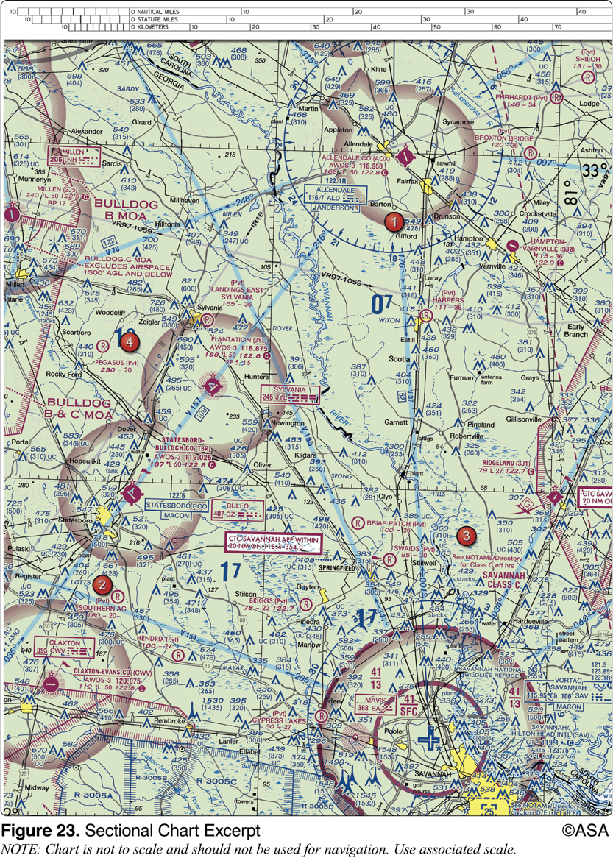
32. (3550) (Refer to Figure 23.) Determine the magnetic heading for a flight from Allendale County Airport (area 1) to Claxton-Evans County Airport (area 2). The wind is from 090° at 16 knots, the true airspeed is 90 knots, and the magnetic variation is 6 degrees West.
a. 209°. b. 230°. c. 212°.

Slide 64
32. (3550) (Refer to Figure 23.) Determine the magnetic heading for a flight from Allendale County Airport (area 1) to Claxton-Evans County Airport (area 2). The wind is from 090° at 16 knots, the true airspeed is 90 knots, and the magnetic variation is 6 degrees West.
*a. 209°. b. 230°. c. 212°.
Use the following steps: 1. Plot the course from Allendale County Airport to Claxton-Evans County Airport. 2. Measure the true course angle at the approximate midpoint of the route (212°). 3. Find the true heading using a flight computer (Wind Correction on FLT menu using CX-3): Wind direction is 090° (given in question) Wind speed is 16 knots (given in question) True course is 212° (found in Step 2) True airspeed is 90 knots (given in question) Therefore, the true heading is 203°. 4. Calculate the magnetic heading (MH) by adding the westerly variation (6°W) to the true heading (203°): MH = TH ± VAR MH = 203° + 6°W MH = 209°

Slide 65
33. (3550.1) On a cross-country flight, point A is crossed at 1500 hours and the plan is to reach point B at 1530 hours. Use the following information to determine the indicated airspeed required to reach point B on schedule. Distance between A and B 70 NM Forecast wind 310° at 15 kts Pressure altitude 8,000 ft Ambient temperature -10 °C True course 270° The required indicated airspeed would be approximately
a. 126 knots. b. 137 knots. c. 152 knots.

Slide 66
33. (3550.1) On a cross-country flight, point A is crossed at 1500 hours and the plan is to reach point B at 1530 hours. Use the following information to determine the indicated airspeed required to reach point B on schedule. Distance between A and B 70 NM Forecast wind 310° at 15 kts Pressure altitude 8,000 ft Ambient temperature -10 °C True course 270° The required indicated airspeed would be approximately
a. 126 knots. *b. 137 knots. c. 152 knots.
Use your CX-3 electronic flight computer to find the answer: 1. Find the ground speed that must be made between points A and B (Ground Speed on FLT menu). Distance 70 NM Time to travel 30 min Ground speed 140 kts 2. Find the true airspeed (Wind Correction on FLT menu). Wind direction 310° Wind speed 15 kts Course 270° Ground speed 140 kts True airspeed 151.8 kts True heading 274° 3. Find the required indicated (or calibrated) airspeed (Airspeed on FLT menu). Pressure altitude 8,000 ft Temperature -10 degrees C True airspeed 151.8 kts Indicated airspeed 137.1 kts (same as calibrated).

Slide 67
34. (3551) (Refer to Figures 23 and 58.) Determine the compass heading for a flight from Claxton-Evans County Airport (area 2) to Hampton Varnville Airport (area 1). The wind is from 280° at 08 knots, the true airspeed is 85 knots, and the magnetic variation is 5 degrees West.
a. 033°. *b. 042°. c. 038°.

Slide 68
34. (3551) (Refer to Figures 23 and 58.) Determine the compass heading for a flight from Claxton-Evans County Airport (area 2) to Hampton Varnville Airport (area 1). The wind is from 280° at 08 knots, the true airspeed is 85 knots, and the magnetic variation is 5 degrees West.
a. 033°. *b. 042°. c. 038°.
1. Plot the course from Claxton-Evans County Airport to Hampton Varnville Airport. 2. Measure the true course angle at the approximate midpoint of the route (044°). 3. Use a flight computer to find the true heading (Wind Correction on FLT menu using CX-3): Wind direction is 280° (given in question) Wind speed is 8 knots (given in question) True course is 044° (found in Step 2) True airspeed is 85 knots (given in question) Therefore, the true heading is 040°. 4. Calculate the magnetic heading by adding the westerly variation (5°W) to the true heading (040°). MH = TH ± VAR MH = 040° + 5°W MH = 045° 5. Note that the compass deviation card in Figure 58 indicates that in order to fly a magnetic course of 030°, the pilot must steer a compass heading of 027° or a 3° compass deviation. To fly a magnetic course of 060°, the pilot must steer a compass heading of 056° or a 4° compass deviation. Interpolate between these to find the compass correction for 045° (3.5°). Calculate the compass heading (CH) by subtracting the compass deviation (3.5°) from the magnetic heading (045°): CH = MH +/- DEV, CH = 045° - 3.5°, CH = 41.5°

Slide 69
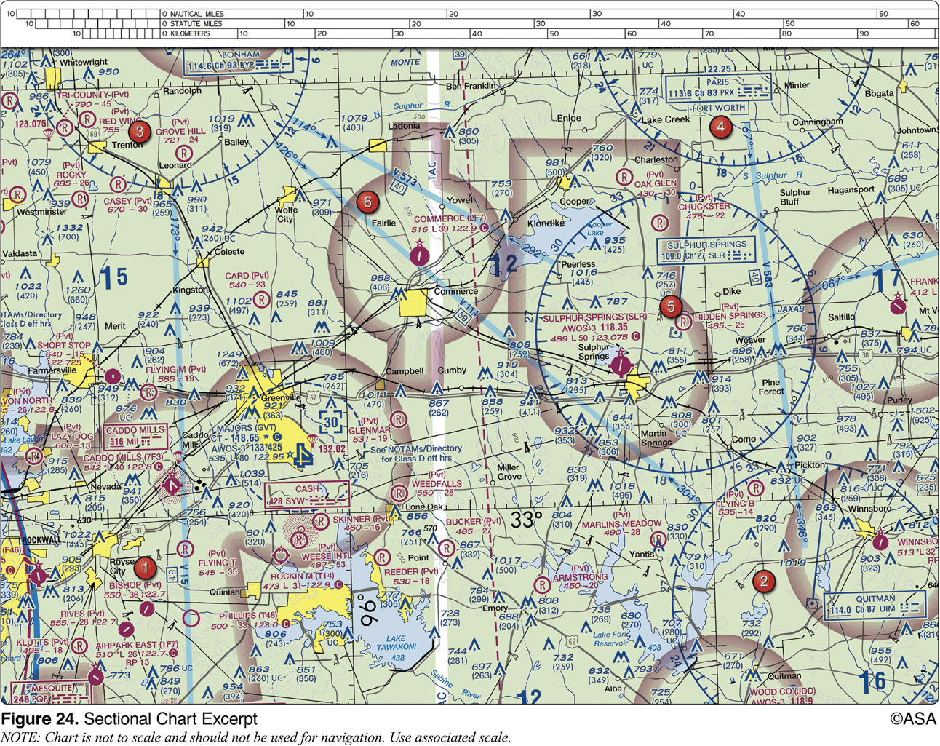
35. (3556) (Refer to Figure 24.) Determine the magnetic course from Airpark East Airport (area 1) to Winnsboro Airport (area 2). Magnetic variation is 6°30'E.
a. 075°. b. 082°. c. 091°.

Slide 70
35. (3556) (Refer to Figure 24.) Determine the magnetic course from Airpark East Airport (area 1) to Winnsboro Airport (area 2). Magnetic variation is 6°30'E.
*a. 075°. b. 082°. c. 091°.
Use the following steps: 1. Plot the course from Airpark East Airport to Winnsboro Airport. 2. Measure the true course angle at the approximate midpoint of the route (082°). 3. Calculate the magnetic course by subtracting the magnetic variation (6°30') from the true course (082°). MC = TC ± VAR MC = 082° - 6°30'E MC = 75°30' (075° is the closest answer)

Slide 71
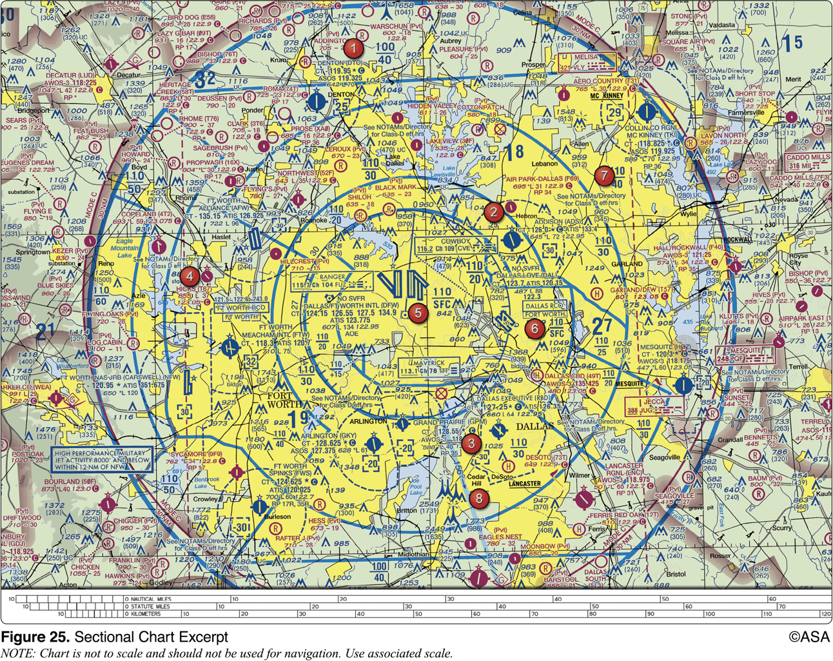
36. (3564) (Refer to Figure 25.) Determine the magnetic heading for a flight from Dallas Executive (area 3) to Fort Worth Meacham (area 4). The wind is from 030° at 10 knots, the true airspeed is 135 knots, and the magnetic variation is 7° east.
a. 266°. b. 286°. c. 312°.

Slide 72
36. (3564) (Refer to Figure 25.) Determine the magnetic heading for a flight from Dallas Executive (area 3) to Fort Worth Meacham (area 4). The wind is from 030° at 10 knots, the true airspeed is 135 knots, and the magnetic variation is 7° east.
a. 266°. *b. 286°. c. 312°.
Use the following steps: 1. Plot a course from Dallas Executive to Meacham, and measure the course (289°). 2. Using the wind obtained, calculate a correction angle. This angle will be the difference between the course bearing and the heading required to maintain that course. Wind correction angle is 4° to the right. 3. Add true course and wind correction angle to obtain true heading. 289° TC + 4° WCA = 293° TH 4. Find the magnetic heading by adding the variation to the true heading. 293° TH - 007° VAR (E) = 286° MH

Slide 73
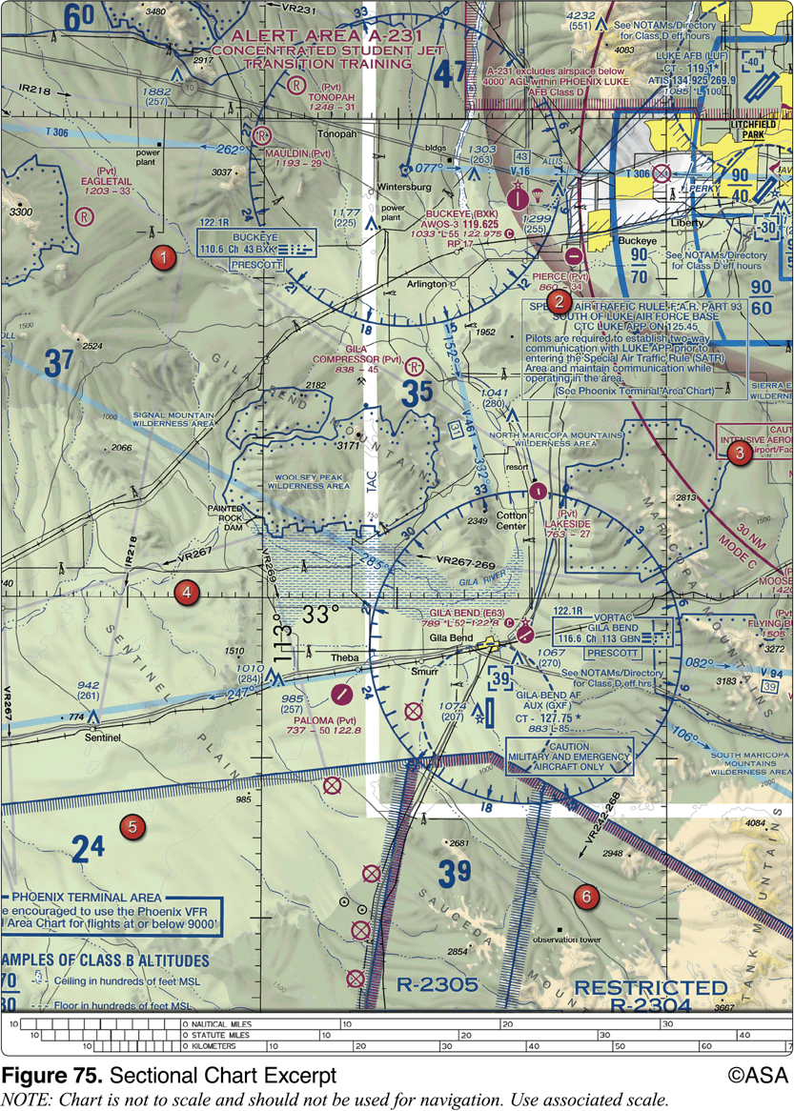
37. (3564.1) (Refer to Figure 75.) What is the time en route from the Gila Bend VORTAC to Buckeye VOR along V461 at a TAS of 125 knots and forecasted winds from 180 at 17 knots?
a. Approximately 14 minutes. b. Approximately 15 minutes. c. Approximately 13 minutes.

Slide 74
37. (3564.1) (Refer to Figure 75.) What is the time en route from the Gila Bend VORTAC to Buckeye VOR along V461 at a TAS of 125 knots and forecasted winds from 180 at 17 knots?
a. Approximately 14 minutes. b. Approximately 15 minutes. *c. Approximately 13 minutes.
Use your CX-3 electronic flight computer to find the answer: 1. Your course along V461 can be determined by using Figure 75 and identifying the 332 degrees to Buckeye. 2. Next determine your ground speed using your CX-3 and the following information: course 332 degrees, TAS 125 knots, wind direction 180, and wind speed of 17 knots. This results in a GS of 140 knots (Wind Correction on FLT menu). 3. The distance along V461 is determined by the number 31. 4. Determine your time enroute using your CX-2, 31 NM at 140 knots results in 13 minutes and 18 seconds (Ground Speed on FLT menu).

Slide 75
38. (3564.2) (Refer to Figure 21.) What is the estimated time en route from Mercer County Regional Airport (area 3) to Minot International (area 1)? The wind is from 330° at 25 knots and the true airspeed is 100 knots. Add 3-1/2 minutes for departure and climb-out.
a. 47 minutes. b. 44 minutes. c. 52 minutes.

Slide 76
38. (3564.2) (Refer to Figure 21.) What is the estimated time en route from Mercer County Regional Airport (area 3) to Minot International (area 1)? The wind is from 330° at 25 knots and the true airspeed is 100 knots. Add 3-1/2 minutes for departure and climb-out.
*a. 47 minutes. b. 44 minutes. c. 52 minutes.
Use your CX-3 electronic flight computer to find the answer: 1. Use your plotter on Figure 21 to identifying the distance (58 NM) and course (12 degrees) between Mercer and Minot airports. 2. Next determine your ground speed using your CX-3 and the following information: distance 58 NM, TAS 100 knots, course 15 degrees, wind direction 330, and wind speed 25 knots. This results in a GS of 80 knots. (Wined Correction on FLT menu) 3. Determine your time enroute using your CX-3, 43 minutes. (Ground Speed on FLT menu) 4. Add 3-1/2 minutes per the question requirements, 46-1/2 minutes.

Slide 77
39. (3565) (Refer to Figure 25.) Determine the magnetic heading for a flight from Fort Worth Meacham (area 4) to Denton Muni (area 1). The wind is from 330° at 25 knots, the true airspeed is 110 knots, and the magnetic variation is 7° east.
a. 004°. b. 017°. c. 023°.

Slide 78
39. (3565) (Refer to Figure 25.) Determine the magnetic heading for a flight from Fort Worth Meacham (area 4) to Denton Muni (area 1). The wind is from 330° at 25 knots, the true airspeed is 110 knots, and the magnetic variation is 7° east.
*a. 004°. b. 017°. c. 023°.
Use the following steps: 1. Plot a course from Meacham to Denton, and measure the course (021°). 2. Using the wind obtained, calculate a correction angle. This angle will be the difference between the course bearing and the heading required to maintain that course. Wind correction angle is 10° to the left. 3. Add course bearing and wind correction angle to obtain true heading. 021 + -010 = 011° (TH) 4. Find the magnetic heading by adding the variation to the true heading. 011 + -7 = 004° (MH)

Slide 79
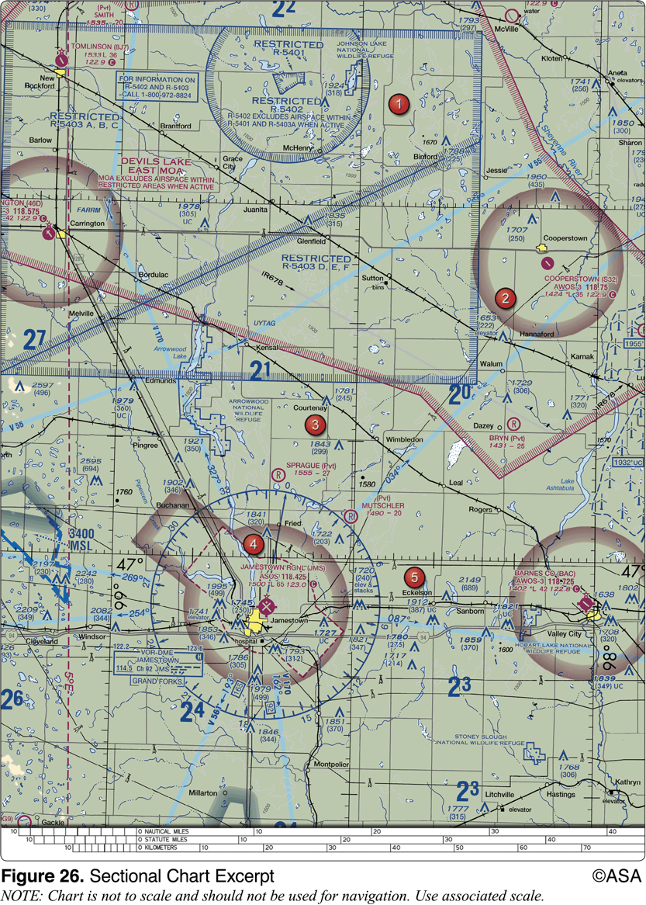
40. (3567) (Refer to Figure 26, area 2.) What is the approximate latitude and longitude of Cooperstown Airport?
a. 47°25'N - 98°06'W. b. 47°25'N - 99°54'W. c. 47°55'N - 98°06'W.

Slide 80
40. (3567) (Refer to Figure 26, area 2.) What is the approximate latitude and longitude of Cooperstown Airport?
*a. 47°25'N - 98°06'W. b. 47°25'N - 99°54'W. c. 47°55'N - 98°06'W.
Graticules on Sectional Aeronautical Charts are the lines dividing each 30 minutes of latitude and each 30 minutes of longitude. Each tick mark represents one minute of latitude or longitude. Latitude increases northward, west longitude increases going westward. Cooperstown airport is approximately at 47°25'N latitude, and 98°06'W longitude.

Slide 81
41. (3568) (Refer to Figure 26.) Determine the magnetic course from Tomlinson Airport (area 1) to Jamestown Airport (area 4).
a. 153°. b. 154°. c. 159°.

Slide 82
41. (3568) (Refer to Figure 26.) Determine the magnetic course from Tomlinson Airport (area 1) to Jamestown Airport (area 4).
*a. 153°. b. 154°. c. 159°.
Use the following steps: 1. Plot the course from Tomlinson Airport to Jamestown Airport. 2. Measure the true course angle at the approximate midpoint of the route (158°). 3. Note that the variation is 5° East as shown on the dashed isogonic line. 4. Using the formula: MC = TC ± VAR MC = 158 - 5° East MC = 153°

Slide 83
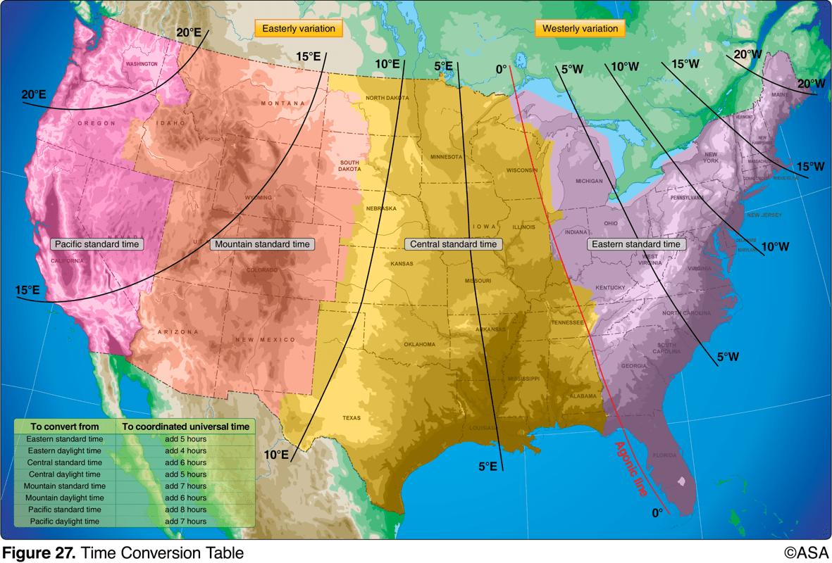
42. (3571) (Refer to Figure 27.) An aircraft departs an airport in the eastern daylight time zone at 0945 EDT for a 2-hour flight to an airport located in the central daylight time zone. The landing should be at what coordinated universal time?
a. 1345Z. b. 1445Z. c. 1545Z.

Slide 84
42. (3571) (Refer to Figure 27.) An aircraft departs an airport in the eastern daylight time zone at 0945 EDT for a 2-hour flight to an airport located in the central daylight time zone. The landing should be at what coordinated universal time?
a. 1345Z. b. 1445Z. *c. 1545Z.
Use the following steps: 1. Convert the EDT takeoff time to UTC: 0945 EDT takeoff time + 0400 conversion = 1345Z UTC (also called 'ZULU' time) 2. Add the flight time to the ZULU time of takeoff: 1345Z takeoff time + 0200 = 1545Z time of landing

Slide 85
43. (3572) (Refer to Figure 27.) An aircraft departs an airport in the central standard time zone at 0930 CST for a 2-hour flight to an airport located in the mountain standard time zone. The landing should be at what time?
a. 0930 MST. b. 1030 MST. c. 1130 MST.

Slide 86
43. (3572) (Refer to Figure 27.) An aircraft departs an airport in the central standard time zone at 0930 CST for a 2-hour flight to an airport located in the mountain standard time zone. The landing should be at what time?
a. 0930 MST. *b. 1030 MST. c. 1130 MST.
Use the following steps: 1. Change the CST takeoff time to UTC: 0930 CST takeoff time + 0600 conversion = 1530Z UTC (also called 'ZULU' time) 2. Add the flight time to the time of takeoff: 1530Z takeoff time + 0200 flight time = 1730Z time of landing 3. Convert UTC to MST: 1730Z UTC - 0700 conversion = 1030 MST time of landing

Slide 87
44. (3573) (Refer to Figure 27.) An aircraft departs an airport in the central standard time zone at 0845 CST for a 2-hour flight to an airport located in the mountain standard time zone. The landing should be at what coordinated universal time?
a. 1345Z. b. 1445Z. c. 1645Z.

Slide 88
44. (3573) (Refer to Figure 27.) An aircraft departs an airport in the central standard time zone at 0845 CST for a 2-hour flight to an airport located in the mountain standard time zone. The landing should be at what coordinated universal time?
a. 1345Z. b. 1445Z. *c. 1645Z.
Use the following steps: 1. Convert the CST takeoff time to UTC: 0845 CST takeoff time + 0600 conversion = 1445Z UTC (also called 'ZULU' time) 2. Add the flight time to the ZULU time of takeoff: 1445Z takeoff time + 0200 flight time = 1645Z the time of landing

Slide 89
45. (3574) (Refer to Figure 27.) An aircraft departs an airport in the mountain standard time zone at 1615 MST for a 2-hour 15-minute flight to an airport located in the Pacific standard time zone. The estimated time of arrival at the destination airport should be
a. 1630 PST. b. 1730 PST. c. 1830 PST.

Slide 90
45. (3574) (Refer to Figure 27.) An aircraft departs an airport in the mountain standard time zone at 1615 MST for a 2-hour 15-minute flight to an airport located in the Pacific standard time zone. The estimated time of arrival at the destination airport should be
a. 1630 PST. *b. 1730 PST. c. 1830 PST.
Use the following steps: 1. Convert the MST takeoff time to UTC: 1615 MST takeoff time + 0700 conversion = 2315Z UTC (also called 'ZULU' time) 2. Add the flight time to the ZULU time of takeoff: 2315Z takeoff time + 0215 flight time = 0130Z time of landing 3. Convert UTC to PST: 0130Z UTC - 0800 conversion = 1730 PST time of landing

Slide 91
46. (3575) (Refer to Figure 27.) An aircraft departs an airport in the Pacific standard time zone at 1030 PST for a 4-hour flight to an airport located in the central standard time zone. The landing should be at what coordinated universal time?
a. 2030Z. b. 2130Z. c. 2230Z.

Slide 92
46. (3575) (Refer to Figure 27.) An aircraft departs an airport in the Pacific standard time zone at 1030 PST for a 4-hour flight to an airport located in the central standard time zone. The landing should be at what coordinated universal time?
a. 2030Z. b. 2130Z. *c. 2230Z.
Use the following steps: 1. Convert the PST takeoff time to UTC: 1030 PST takeoff time + 0800 conversion = 1830Z UTC (also called 'ZULU' time) 2. Add the flight time to the ZULU takeoff time: 1830Z takeoff time + 0400 flight time = 2230Z time of landing

Slide 93
47. (3576) (Refer to Figure 27.) An aircraft departs an airport in the mountain standard time zone at 1515 MST for a 2-hour 30-minute flight to an airport located in the Pacific standard time zone. What is the estimated time of arrival at the destination airport?
a. 1645 PST. b. 1745 PST. c. 1845 PST.

Slide 94
47. (3576) (Refer to Figure 27.) An aircraft departs an airport in the mountain standard time zone at 1515 MST for a 2-hour 30-minute flight to an airport located in the Pacific standard time zone. What is the estimated time of arrival at the destination airport?
*a. 1645 PST. b. 1745 PST. c. 1845 PST.
Use the following steps: 1. Convert the MST takeoff time to UTC: 1515 MST takeoff time + 0700 conversion = 2215Z UTC (also called 'ZULU' time) 2. Add the flight time to the ZULU takeoff time: 2215Z takeoff time + 0230 flight time = 2445Z (0045)Z time of landing 3. Convert UTC to PST: 2445Z (0045)Z - 0800 conversion = 1645 PST time of landing

Slide 95
48. (3599) (Refer to Figure 25, area 4.) The floor of Class B airspace overlying Hicks Airport (T67) north-northwest of Fort Worth Meacham Field is
a. at the surface. b. 3,200 feet MSL. c. 4,000 feet MSL.

Slide 96
48. (3599) (Refer to Figure 25, area 4.) The floor of Class B airspace overlying Hicks Airport (T67) north-northwest of Fort Worth Meacham Field is
a. at the surface. b. 3,200 feet MSL. *c. 4,000 feet MSL.
The thick blue lines on the sectional chart indicate the boundaries of the overlying Class B airspace. Within each segment, the floor and ceiling are denoted by one number over a second number or the letters SFC. The floor of the Class B airspace is 4,000 feet MSL.

Slide 97
49. (3600) (Refer to Figure 25, area 2.) The floor of Class B airspace at Addison Airport is
a. at the surface. b. 3,000 feet MSL. c. 3,100 feet MSL.

Slide 98
49. (3600) (Refer to Figure 25, area 2.) The floor of Class B airspace at Addison Airport is
a. at the surface. *b. 3,000 feet MSL. c. 3,100 feet MSL.
The thick blue lines on the sectional chart indicate the boundaries of the overlying Class B airspace. Within each segment, the floor and ceiling are denoted by one number over a second number or the letters SFC. The floor of the Class B airspace is 3,000 feet MSL.

Slide 99
50. (3601) (Refer to Figure 20 area 4.) What hazards to aircraft may exist in restricted areas such as R-5302B?
a. Military training activities that necessitate acrobatic or abrupt flight maneuvers. b. Unusual, often invisible, hazards such as aerial gunnery or guided missiles. c. High volume of pilot training or an unusual type of aerial activity.

Slide 100
50. (3601) (Refer to Figure 20 area 4.) What hazards to aircraft may exist in restricted areas such as R-5302B?
a. Military training activities that necessitate acrobatic or abrupt flight maneuvers. *b. Unusual, often invisible, hazards such as aerial gunnery or guided missiles. c. High volume of pilot training or an unusual type of aerial activity.
Restricted Areas denote the presence of unusual, often invisible, hazards to aircraft such as artillery firing, aerial gunnery, or guided missiles. Penetration of Restricted Areas without authorization of the using or controlling agency may be extremely hazardous to the aircraft and its occupants. Answer (A) is incorrect because this defines a military operations area. Answer (C) is incorrect because this defines an alert area.

Slide 101
51. (3601.1) (Refer to Figure 75, west of Area 6.) During preflight planning, your course is plotted to fly through R-2305. Where would you find additional information regarding this airspace?
a. In the Aeronautical Information Manual. b. In the Chart Supplements U.S. c. On the Sectional Chart in the Special Use Airspace area.

Slide 102
51. (3601.1) (Refer to Figure 75, west of Area 6.) During preflight planning, your course is plotted to fly through R-2305. Where would you find additional information regarding this airspace?
a. In the Aeronautical Information Manual. b. In the Chart Supplements U.S. *c. On the Sectional Chart in the Special Use Airspace area.
West of Area 6 is within Restricted Airspace. Restricted Areas denote the presence of unusual, often invisible, hazards to aircraft such as artillery firing, aerial gunnery, or guided missiles. Penetration of Restricted Areas without authorization of the using or controlling agency may be extremely hazardous to the aircraft and its occupants. Special Use Airspace, such as Restricted Airspace, is charted on IFR or visual charts and include the hours of operation, altitudes, and the controlling agency.

Slide 103
52. (3602) (Refer to Figure 26, area 2.) What hazards to aircraft may exist in areas such as Devils Lake East MOA?
a. Unusual, often invisible, hazards to aircraft such as artillery firing, aerial gunnery, or guided missiles. b. High volume of pilot training or an unusual type of aerial activity. c. Military training activities that necessitate acrobatic or abrupt flight maneuvers.

Slide 104
52. (3602) (Refer to Figure 26, area 2.) What hazards to aircraft may exist in areas such as Devils Lake East MOA?
a. Unusual, often invisible, hazards to aircraft such as artillery firing, aerial gunnery, or guided missiles. b. High volume of pilot training or an unusual type of aerial activity. *c. Military training activities that necessitate acrobatic or abrupt flight maneuvers.
An MOA contains military training activities such as aerobatics, and calls for extreme caution.

Slide 105
53. (3603) (Refer to Figure 21, area 3.) What type military flight operations should a pilot expect along IR 644?
a. IFR training flights above 1,500 feet AGL at speeds in excess of 250 knots. b. VFR training flights above 1,500 feet AGL at speeds less than 250 knots. c. Instrument training flights below 1,500 feet AGL at speeds in excess of 150 knots

Slide 106
53. (3603) (Refer to Figure 21, area 3.) What type military flight operations should a pilot expect along IR 644?
*a. IFR training flights above 1,500 feet AGL at speeds in excess of 250 knots. b. VFR training flights above 1,500 feet AGL at speeds less than 250 knots. c. Instrument training flights below 1,500 feet AGL at speeds in excess of 150 knots.
IR644 begins at the lower left (eastbound) and turns northeast as a thin gray line. IR644 has three digits, which mean: generally above 1,500 feet AGL (but some segments below), operations under IFR, and (as with all MTRs) may be over 250 knots.

Slide 107
54. (3618) (Refer to Figure 26, area 3.) When flying over Arrowwood National Wildlife Refuge, a pilot should fly no lower than
a. 2,000 feet AGL. b. 2,500 feet AGL. c. 3,000 feet AGL.

Slide 108
54. (3618) (Refer to Figure 26, area 3.) When flying over Arrowwood National Wildlife Refuge, a pilot should fly no lower than
*a. 2,000 feet AGL. b. 2,500 feet AGL. c. 3,000 feet AGL.
All aircraft are requested to maintain a minimum altitude of 2,000 feet above the surface of National Parks, monuments, seashores, lakeshores, recreation areas, and scenic riverways administered by the National Park Service, National Wildlife Refuges, Big Game Refuges, Game Ranges and Wildlife Ranges administered by the U.S. Fish and Wildlife Service, and Wilderness and Primitive areas administered by the U.S. Forest Service.

Slide 109
55. (3622) (Refer to Figure 26, area 1.) Identify the airspace over Tomlinson Airport.
a. Class G airspace--surface up to but not including 18,000 feet MSL. b. Class G airspace--surface up to but not including 1,200 feet AGL, Class E airspace--1,200 feet AGL up to but not including 18,000 feet MSL. c. Class G airspace--surface up to but not including 700 feet MSL, Class E airspace--700 feet to 14,500 feet MSL.

Slide 110
55. (3622) (Refer to Figure 26, area 1.) Identify the airspace over Tomlinson Airport.
a. Class G airspace--surface up to but not including 18,000 feet MSL. *b. Class G airspace--surface up to but not including 1,200 feet AGL, Class E airspace--1,200 feet AGL up to but not including 18,000 feet MSL. c. Class G airspace--surface up to but not including 700 feet MSL, Class E airspace--700 feet to 14,500 feet MSL.
The blue shading in the bottom left corner of Figure 26 indicates Tomlinson Airport lies in Class G airspace from the surface to 1,200 feet AGL, and Class E airspace from 1,200 feet AGL to 18,000 feet MSL. The blue shading of the Victor airways indicates Class E airspace from 1,200 feet AGL.

Slide 111
56. (3623) (Refer to Figure 26, area 5.) The airspace overlying and within 5 miles of Barnes County Airport is
a. Class D airspace from the surface to the floor of the overlying Class E airspace. b. Class E airspace from the surface to 1,200 feet MSL. c. Class G airspace from the surface to 700 feet AGL.

Slide 112
56. (3623) (Refer to Figure 26, area 5.) The airspace overlying and within 5 miles of Barnes County Airport is
a. Class D airspace from the surface to the floor of the overlying Class E airspace. b. Class E airspace from the surface to 1,200 feet MSL. *c. Class G airspace from the surface to 700 feet AGL.
The Barnes County Airport is depicted inside the magenta shading, which is controlled airspace from 700 feet AGL up to but not including 18,000 feet. Therefore, the airspace below 700 feet AGL is Class G.

Slide 113
57. (3624) (Refer to figure 25, area 7.) The airspace overlying Collin Co RGL McKinney (TKI) is controlled from the surface to
a. 2,500 feet MSL. b. 2,900 feet MSL. c. 700 feet AGL.

Slide 114
57. (3624) (Refer to figure 25, area 7.) The airspace overlying Collin Co RGL McKinney (TKI) is controlled from the surface to
a. 2,500 feet MSL. *b. 2,900 feet MSL. c. 700 feet AGL.
The [29] indicates the Class D airspace around McKinney (TKI) goes from the surface to 2,900 feet MSL.

Slide 115
58. (3625) (Refer to Figure 25, area 4.) The airspace directly overlying Fort Worth Meacham is
a. Class B airspace to 10,000 feet MSL. b. Class C airspace to 5,000 feet MSL. c. Class D airspace to 3,200 feet MSL.

Slide 116
58. (3625) (Refer to Figure 25, area 4.) The airspace directly overlying Fort Worth Meacham is
a. Class B airspace to 10,000 feet MSL. b. Class C airspace to 5,000 feet MSL. *c. Class D airspace to 3,200 feet MSL.
A blue segmented circle depicts Class D airspace which extends from the surface to 3,200 feet MSL, in this case as shown by the blue number 32 surrounded by the blue segmented box. Answer (A) is incorrect because although Class B airspace does overlie Fort Worth Meacham to 10,000 feet MSL, its base is 4,000 feet MSL. Answer (B) is incorrect because Class C airspace does not exist around Fort Worth Meacham.

Slide 117
59. (3626) (Refer to Figure 23, area 3.) What is the floor of the Savannah Class C airspace at the shelf area (outer circle)?
a. 1,300 feet AGL. b. 1,300 feet MSL. c. 1,700 feet MSL.

Slide 118
59. (3626) (Refer to Figure 23, area 3.) What is the floor of the Savannah Class C airspace at the shelf area (outer circle)?
a. 1,300 feet AGL. *b. 1,300 feet MSL. c. 1,700 feet MSL.
Within the outer magenta circle of Savannah Class C airspace, there is a number 41 directly above the number 13. These depict the floor and ceiling of the Class C airspace; the floor being 1,300 feet MSL and the ceiling being 4,100 feet MSL.

Slide 119
60. (3627) (Refer to Figure 20, area 1.) What minimum radio equipment is required to land and take off at Norfolk International?
a. Mode C transponder and omnireceiver. b. Mode C transponder and two-way radio. c. Mode C transponder, omnireceiver, and DME.

Slide 120
60. (3627) (Refer to Figure 20, area 1.) What minimum radio equipment is required to land and take off at Norfolk International?
a. Mode C transponder and omnireceiver. *b. Mode C transponder and two-way radio. c. Mode C transponder, omnireceiver, and DME.
Norfolk International is in Class C airspace. To operate within Class C airspace, an aircraft must have two-way communications capability and a Mode C transponder.

Slide 121
61. (3628) (Refer to Figure 25.) At which airports is fixed-wing Special VFR not authorized?
a. Fort Worth Meacham and Fort Worth Spinks. b. Dallas-Fort Worth International and Dallas Love Field. c. Addison and Dallas Executive.

Slide 122
61. (3628) (Refer to Figure 25.) At which airports is fixed-wing Special VFR not authorized?
a. Fort Worth Meacham and Fort Worth Spinks. *b. Dallas-Fort Worth International and Dallas Love Field. c. Addison and Dallas Executive.
Special VFR operations by fixed-wing aircraft are prohibited in some Class B, C, and D airspaces due to the volume of IFR traffic. These airspaces are depicted by the notation 'No SVFR' over the airport information.

Slide 123
62. (3629) (Refer to Figure 22, area 3.) The vertical limits of that portion of Class E airspace designated as a Federal Airway over Magee Airport are
a. 700 feet MSL to 12,500 feet MSL. b. 7,500 feet MSL to 17,999 feet MSL. c. 1,200 feet AGL to 17,999 feet MSL.

Slide 124
62. (3629) (Refer to Figure 22, area 3.) The vertical limits of that portion of Class E airspace designated as a Federal Airway over Magee Airport are
a. 700 feet MSL to 12,500 feet MSL. b. 7,500 feet MSL to 17,999 feet MSL. *c. 1,200 feet AGL to 17,999 feet MSL.
The VOR and L/MF Airway System consists of airways designated from 1,200 feet above the surface (in some instances higher) up to, but not including, 18,000 feet MSL.

Slide 125
63. (3631) (Refer to Figure 20, area 5.) The CAUTION box denotes what hazard to aircraft?
a. Unmarked balloon on cable to 3,008 feet MSL. b. Unmarked balloon on cable to 3,008 feet AGL. c. Unmarked blimp hangers at 308 feet MSL.

Slide 126
63. (3631) (Refer to Figure 20, area 5.) The CAUTION box denotes what hazard to aircraft?
*a. Unmarked balloon on cable to 3,008 feet MSL. b. Unmarked balloon on cable to 3,008 feet AGL. c. Unmarked blimp hangers at 308 feet MSL.
Reference FAA Legend 1. The boxed caution reads, 'CAUTION: UNMARKED BALLOON ON CABLE TO 3,008 MSL.'

Slide 127
64. (3632) (Refer to Figure 20, area 2.) The flag symbol at Lake Drummond represents a
a. compulsory reporting point for Norfolk Class C airspace. b. compulsory reporting point for Hampton Roads Airport. c. visual checkpoint used to identify position for initial callup to Norfolk Approach Control.

Slide 128
64. (3632) (Refer to Figure 20, area 2.) The flag symbol at Lake Drummond represents a
a. compulsory reporting point for Norfolk Class C airspace. b. compulsory reporting point for Hampton Roads Airport. *c. visual checkpoint used to identify position for initial callup to Norfolk Approach Control.
Reference FAA Legend 1. The flag symbol represents a visual checkpoint used to identify position for initial callup to Norfolk Approach Control.

Slide 129
65. (3633) (Refer to Figure 20, area 2.) The elevation of the Chesapeake Regional Airport is
a. 19 feet. b. 55 feet. c. 230 feet.

Slide 130
65. (3633) (Refer to Figure 20, area 2.) The elevation of the Chesapeake Regional Airport is
*a. 19 feet. b. 55 feet. c. 230 feet.
Reference FAA Legend 1. The airport elevation is noted in the airport information, beneath the airport symbol. The elevation of Chesapeake Regional Airport is 19 feet.

Slide 131
66. (3634) (Refer to Figure 21.) The terrain elevation of the light tan area between Minot (area 1) and Audubon Lake (area 2) varies from
a. sea level to 2,000 feet MSL. b. 2,000 feet to 2,500 feet MSL. c. 2,000 feet to 2,700 feet MSL.

Slide 132
66. (3634) (Refer to Figure 21.) The terrain elevation of the light tan area between Minot (area 1) and Audubon Lake (area 2) varies from
a. sea level to 2,000 feet MSL. *b. 2,000 feet to 2,500 feet MSL. c. 2,000 feet to 2,700 feet MSL.
Reference FAA Legend 1. The contour line which borders the tan area is labeled 2,000 feet. There are no higher contour levels depicted inside the tan area. Answer (A) is incorrect because the light tan area indicates between 2,000-3,000 ft MSL. Answer (C) is incorrect because contour intervals are 500 ft, not 700.

Slide 133
67. (3635) (Refer to Figure 21.) Which public use airports depicted are indicated as having fuel?
a. Minot Intl. (area 1) and Garrison (area 2). b. Minot Intl. (area 1). c. Mercer County Regional Airport (area 3).

Slide 134
67. (3635) (Refer to Figure 21.) Which public use airports depicted are indicated as having fuel?
a. Minot Intl. (area 1) and Garrison (area 2). *b. Minot Intl. (area 1). c. Mercer County Regional Airport (area 3).
Reference FAA Legend 1. Minot International Airport is depicted as having fuel, as indicated by the ticks around the basic airport symbol.

Slide 135
68. (3636) (Refer to Figure 23.) The flag symbols at Statesboro Bullock County Airport, Claxton-Evans County Airport, and Ridgeland Airport are
a. outer boundaries of Savannah Class C airspace. b. airports with special traffic patterns. c. visual checkpoints to identify position for initial callup prior to entering Savannah Class C airspace.

Slide 136
68. (3636) (Refer to Figure 23.) The flag symbols at Statesboro Bullock County Airport, Claxton-Evans County Airport, and Ridgeland Airport are
a. outer boundaries of Savannah Class C airspace. b. airports with special traffic patterns. *c. visual checkpoints to identify position for initial callup prior to entering Savannah Class C airspace.
Reference FAA Legend 1. 'Visual check point' is the name for the flag symbol.

Slide 137
69. (3637) (Refer to Figure 23, area 3.) What is the height of the lighted obstacle approximately 6 nautical miles southwest of Savannah International?
a. 1,500 feet MSL. b. 1,531 feet AGL. c. 1,548 feet MSL.

Slide 138
69. (3637) (Refer to Figure 23, area 3.) What is the height of the lighted obstacle approximately 6 nautical miles southwest of Savannah International?
a. 1,500 feet MSL. b. 1,531 feet AGL. *c. 1,548 feet MSL.
Reference FAA Legend 1. The top number, printed in bold, is the height of the obstruction above mean sea level. The second number, printed in parentheses, is the height of the obstruction above ground level. The obstruction is shown as 1,548 feet MSL and 1,534 feet AGL.

Slide 139
70. (3637.1) Which is true concerning the blue and magenta colors used to depict airports on Sectional Aeronautical Charts?
a. Airports with control towers underlying Class A, B, and C airspace are shown in blue, Class D and E airspace are magenta. b. Airports with control towers underlying Class C, D, and E airspace are shown in magenta. c. Airports with control towers underlying Class B, C, D, and E airspace are shown in blue.

Slide 140
70. (3637.1) Which is true concerning the blue and magenta colors used to depict airports on Sectional Aeronautical Charts?
a. Airports with control towers underlying Class A, B, and C airspace are shown in blue, Class D and E airspace are magenta. b. Airports with control towers underlying Class C, D, and E airspace are shown in magenta. *c. Airports with control towers underlying Class B, C, D, and E airspace are shown in blue.
Reference FAA Legend 1. Airports having control towers are shown in blue, all others in magenta. Answer (A) is incorrect because Class A airspace is not depicted on a Sectional; Class C airspace is magenta; and Class E airspace is both blue and magenta depending on where the floor of the airspace starts. Answer (B) is incorrect because airports with control towers are shown in blue.

Slide 141
71. (3638) (Refer to Figure 23, area 3.) The top of the group obstruction approximately 11 nautical miles from the Savannah VORTAC on the 009° radial is
a. 400 feet AGL. b. 454 feet MSL. c. 432 feet MSL.

Slide 142
71. (3638) (Refer to Figure 23, area 3.) The top of the group obstruction approximately 11 nautical miles from the Savannah VORTAC on the 009° radial is
a. 400 feet AGL. *b. 454 feet MSL. c. 432 feet MSL.
Reference FAA Legend 1. On Figure 24, area 3, the group obstruction near the 009 deg radial has the word "stacks" below "454." The bold number (454) indicates the height of the obstruction above mean sea level.

Slide 143
72. (3639) (Refer to Figure 24, area 1.) What minimum altitude is necessary to vertically clear the obstacle on the northeast side of Airpark East Airport by 500 feet?
a. 1,010 feet MSL b. 1,273 feet MSL. c. 1,283 feet MSL.

Slide 144
72. (3639) (Refer to Figure 24, area 1.) What minimum altitude is necessary to vertically clear the obstacle on the northeast side of Airpark East Airport by 500 feet?
a. 1,010 feet MSL *b. 1,273 feet MSL. c. 1,283 feet MSL.
The elevation of the top of the obstacle is shown as 773 feet MSL. Add the 500-foot vertical clearance specified by the question to the height (MSL) of the obstacle: 773 feet MSL + 500 = 1,273 feet MSL minimum altitude

Slide 145
73. (3640) (Refer to Figure 24, area 2.) What minimum altitude is necessary to vertically clear the obstacle on the southeast side of Winnsboro Airport by 500 feet?
a. 823 feet MSL. b. 1,013 feet MSL. c. 1,403 feet MSL.

Slide 146
73. (3640) (Refer to Figure 24, area 2.) What minimum altitude is necessary to vertically clear the obstacle on the southeast side of Winnsboro Airport by 500 feet?
a. 823 feet MSL. b. 1,013 feet MSL. *c. 1,403 feet MSL.
The elevation of the top of the obstacle is shown as 903 feet MSL. Add the 500-foot vertical clearance specified by the question to the height (MSL) of the obstacle: 903 feet MSL + 500 = 1,403 feet MSL

Slide 147
74. (3642) (Refer to Figure 25, area 8.) What minimum altitude is required to fly over the Cedar Hill TV towers in the congested area south of Dallas Executive (RBD)?
a. 2,655 feet MSL. b. 3,549 feet MSL. c. 3,449 feet MSL.

Slide 148
74. (3642) (Refer to Figure 25, area 8.) What minimum altitude is required to fly over the Cedar Hill TV towers in the congested area south of Dallas Executive (RBD)?
a. 2,655 feet MSL. *b. 3,549 feet MSL. c. 3,449 feet MSL.
The height of the tower is 2,549 MSL. A 1,000-foot clearance is required between obstructions and aircraft over a congested area. 2,549 MSL + 1,000 = 3,549 MSL

Slide 149
75. (3779) The vertical limit of Class C airspace above the primary airport is normally
a. 1,200 feet AGL. b. 3,000 feet AGL. c. 4,000 feet AGL.

Slide 150
75. (3779) The vertical limit of Class C airspace above the primary airport is normally
a. 1,200 feet AGL. b. 3,000 feet AGL. *c. 4,000 feet AGL.
Class C airspace consists of two circles, both centered on the primary/Class C airspace airport. The surface area has a radius of 5 NM. The shelf area usually has a radius of 10 NM. The airspace of the surface area usually extends from the surface of the Class C airspace airport up to 4,000 feet above that airport. The airspace area between the 5 and 10 NM rings usually begins at a height of 1,200 feet AGL and extends to the same altitude cap as the inner circle. These dimensions may be varied to meet individual situations.

Slide 151
76. (3780) The radius of the procedural Outer Area of Class C airspace is normally
a. 10 NM. b. 20 NM. c. 30 NM.

Slide 152
76. (3780) The radius of the procedural Outer Area of Class C airspace is normally
a. 10 NM. *b. 20 NM. c. 30 NM.
The normal radius of the outer area will be 20 NM.

Slide 153
77. (3781) All operations within Class C airspace must be in
a. accordance with instrument flight rules. b. compliance with ATC clearances and instructions. c. an aircraft equipped with a 4096-code transponder with Mode C encoding capability.

Slide 154
77. (3781) All operations within Class C airspace must be in
a. accordance with instrument flight rules. b. compliance with ATC clearances and instructions. *c. an aircraft equipped with a 4096-code transponder with Mode C encoding capability.
Aircraft operating in Class C airspace must have a Mode C transponder. Answer (A) is incorrect because visual flight rules are also used within Class C airspace. Answer (B) is incorrect because an ATC clearance is not required to operate within Class C airspace.

Slide 155
78. (3782) Under what condition may an aircraft operate from a satellite airport within Class C airspace?
a. The pilot must file a flight plan prior to departure. b. The pilot must monitor ATC until clear of the Class C airspace. c. The pilot must contact ATC as soon as practicable after takeoff.

Slide 156
78. (3782) Under what condition may an aircraft operate from a satellite airport within Class C airspace?
a. The pilot must file a flight plan prior to departure. b. The pilot must monitor ATC until clear of the Class C airspace. *c. The pilot must contact ATC as soon as practicable after takeoff.
For aircraft departing a satellite airport, two-way radio communication must be established as soon as practicable and thereafter maintained with ATC while within the area. Answer (A) is incorrect because Class C airspace does not require flight plans, and a pilot must maintain contact with ATC in Class C airspace. Answer (B) is incorrect because Class C airspace does not require flight plans, and a pilot must maintain contact with ATC in Class C airspace.

Slide 157
79. (3783) Under what condition, if any, may pilots fly through a restricted area?
a. When flying on airways with an ATC clearance. b. With the controlling agency's authorization. c. Regulations do not allow this.

Slide 158
79. (3783) Under what condition, if any, may pilots fly through a restricted area?
a. When flying on airways with an ATC clearance. *b. With the controlling agency's authorization. c. Regulations do not allow this.
Restricted Areas can be penetrated but only with the permission of the controlling agency. No person may operate an aircraft within a restricted area contrary to the restrictions imposed unless they have the permission of the using or controlling agency as appropriate. Penetration of Restricted Areas without authorization from the using or controlling agency may be fatal to the aircraft and its occupants.

Slide 159
80. (3783.1) Flight through a restricted area should not be accomplished unless the pilot has
a. filed an IFR flight plan. b. received prior authorization from the controlling agency. c. received prior permission from the commanding officer of the nearest military base.

Slide 160
80. (3783.1) Flight through a restricted area should not be accomplished unless the pilot has
a. filed an IFR flight plan. *b. received prior authorization from the controlling agency. c. received prior permission from the commanding officer of the nearest military base.
Restricted Areas denote the existence of unusual, often invisible hazards to aircraft such as artillery firing, aerial gunnery, or guided missiles. Authorization must be received prior to entering any Restricted Areas.

Slide 161
81. (3785) What action should a pilot take when operating under VFR in a Military Operations Area (MOA)?
a. Obtain a clearance from the controlling agency prior to entering the MOA. b. Operate only on the airways that transverse the MOA. c. Exercise extreme caution when military activity is being conducted.

Slide 162
81. (3785) What action should a pilot take when operating under VFR in a Military Operations Area (MOA)?
a. Obtain a clearance from the controlling agency prior to entering the MOA. b. Operate only on the airways that transverse the MOA. *c. Exercise extreme caution when military activity is being conducted.
Pilots operating under VFR should exercise extreme caution while flying within a MOA when military activity is being conducted. No clearance is necessary to enter a MOA.

Slide 163
82. (3786) Responsibility for collision avoidance in an alert area rests with
a. the controlling agency. b. all pilots. c. Air Traffic Control.

Slide 164
82. (3786) Responsibility for collision avoidance in an alert area rests with
a. the controlling agency. *b. all pilots. c. Air Traffic Control.
All activity within an Alert Area shall be conducted in accordance with FAA regulations, without waiver, and pilots of participating aircraft, as well as pilots transiting the area, shall be equally responsible for collision avoidance.

Slide 165
83. (3787) The lateral dimensions of Class D airspace are based on
a. the number of airports that lie within the Class D airspace. b. 5 statute miles from the geographical center of the primary airport. c. the instrument procedures for which the controlled airspace is established.

Slide 166
83. (3787) The lateral dimensions of Class D airspace are based on
a. the number of airports that lie within the Class D airspace. b. 5 statute miles from the geographical center of the primary airport. *c. the instrument procedures for which the controlled airspace is established.
The dimensions of Class D airspace are as needed for each individual circumstance. The airspace may include extensions necessary for IFR arrival and departure paths.

Slide 167
84. (3787.1) When a control tower, located on an airport within Class D airspace, ceases operation for the day, what happens to the airspace designation?
a. The airspace designation normally will not change. b. The airspace remains Class D airspace as long as a weather observer or automated weather system is available. c. The airspace reverts to Class E or a combination of Class E and G airspace during the hours the tower is not in operation.

Slide 168
84. (3787.1) When a control tower, located on an airport within Class D airspace, ceases operation for the day, what happens to the airspace designation?
a. The airspace designation normally will not change. b. The airspace remains Class D airspace as long as a weather observer or automated weather system is available. *c. The airspace reverts to Class E or a combination of Class E and G airspace during the hours the tower is not in operation.
By definition, Class D airspace surrounds airports that have an operational control tower. Class D airspace reverts to Class E airspace (if the weather observer is present or the weather system is automated) or Class G airspace (at the airports where the tower controllers are also the weather observers). Answer (A) is incorrect because the tower must be operational for the airspace to be designated Class D. Answer (B) is incorrect because the airspace will revert to Class E if the tower is closed but the weather observer is present or an automated weather system is available.

Slide 169
85. (3788) A non-tower satellite airport, within the same Class D airspace as that designated for the primary airport, requires radio communications be established and maintained with the
a. satellite airport's UNICOM. b. associated Flight Service Station. c. primary airport's control tower.

Slide 170
85. (3788) A non-tower satellite airport, within the same Class D airspace as that designated for the primary airport, requires radio communications be established and maintained with the
a. satellite airport's UNICOM. b. associated Flight Service Station. *c. primary airport's control tower.
Radio communications must be established and maintained with the primary control tower even when operating to and from a non-tower airport located within the lateral limits of Class D airspace. On takeoff from a satellite airport, communication must be established as soon as practicable after takeoff.

Slide 171
86. (3799) Which initial action should a pilot take prior to entering Class C airspace?
a. Contact approach control on the appropriate frequency. b. Contact the tower and request permission to enter. c. Contact the FSS for traffic advisories..

Slide 172
86. (3799) Which initial action should a pilot take prior to entering Class C airspace?
*a. Contact approach control on the appropriate frequency. b. Contact the tower and request permission to enter. c. Contact the FSS for traffic advisories.
Radio contact is required to operate in Class C airspace, but permission is not required.

Slide 173
87. (3816) (Refer to Figure 68.) The line from point A to point B of the wind triangle represents
a. true heading and airspeed. b. true course and groundspeed. c. groundspeed and true heading.

Slide 174
87. (3816) (Refer to Figure 68.) The line from point A to point B of the wind triangle represents
*a. true heading and airspeed. b. true course and groundspeed. c. groundspeed and true heading.
The line A to B of the wind triangle represents true heading and the true airspeed. It is the vector sum of the lines C to B (the true course and ground speed) and C to A (the wind direction and speed).Answer (B) is incorrect because this is represented by the line from point C to B. Answer (C) is incorrect because these values are defined by separate lines of the wind triangle

Slide 175
88. (3817) (Refer to Figure 68.) The line from point C to point B of the wind triangle represents
a. airspeed and heading. b. groundspeed and true course. c. true heading and groundspeed.

Slide 176
88. (3817) (Refer to Figure 68.) The line from point C to point B of the wind triangle represents
a. airspeed and heading. *b. groundspeed and true course. c. true heading and groundspeed.
The line from point C to B of the wind triangle represents the ground speed and true course.Answer (A) is incorrect because this is represented by the line from point A to B. Answer (C) is incorrect because these are values are defined by separate lines of the wind triangle

Slide 177
89. (3831) Pilots flying over a national wildlife refuge are requested to fly no lower than
a. 1,000 feet AGL. b. 2,000 feet AGL. c. 3,000 feet AGL.

Slide 178
89. (3831) Pilots flying over a national wildlife refuge are requested to fly no lower than
a. 1,000 feet AGL. *b. 2,000 feet AGL. c. 3,000 feet AGL.
All aircraft are requested to maintain a minimum altitude of 2,000 feet above the surface of the following: National Parks, monuments, seashores, lakeshores, recreation areas and scenic riverways administered by the National Park Service, National Wildlife Refuges, Big Game Refuges, Game Ranges and Wildlife Ranges administered by the U.S. Fish and Wildlife Service, and Wilderness and Primitive areas administered by the U.S. Forest Service.

Slide 179
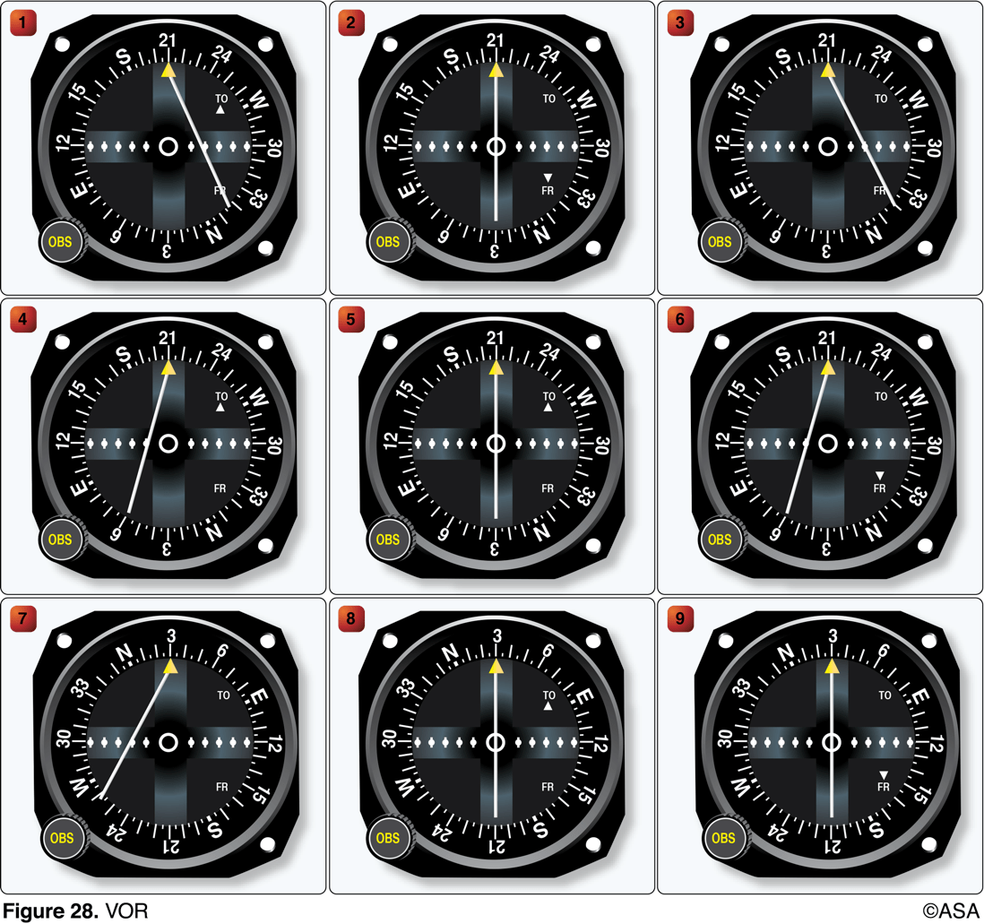
1. (3533) (Refer to Figure 20, area 3; and Figure 28.) The VOR is tuned to Elizabeth City VOR/DME, and the aircraft is positioned over Shawboro, a small town 3 NM west of Currituck County Regional (ONX). Which VOR indication is correct?
a. 2. b. 5. c. 8.

Slide 180
1. (3533) (Refer to Figure 20, area 3; and Figure 28.) The VOR is tuned to Elizabeth City VOR/DME, and the aircraft is positioned over Shawboro, a small town 3 NM west of Currituck County Regional (ONX). Which VOR indication is correct?
a. 2. *b. 5. c. 8.
1. Locate the Shawboro Airport and the Elizabeth City VOR in FAA Figure 20. Draw the radial (magnetic course FROM) of the Elizabeth City VOR on which Shawboro lies (030°). 2. When over Shawboro on the 030° radial, the CDI should be centered with a 030° FROM indication or a 210° TO indication (the reciprocal). Dials 5 and 9 satisfy these conditions.

Slide 181
2. (3539) (Refer to Figure 21.) What course should be selected on the omnibearing selector (OBS) to make a direct flight from Mercer County Regional Airport (area 3) to the Minot VORTAC (area 1) with a TO indication?
a. 001°. b. 359°. c. 179°.

Slide 182
2. (3539) (Refer to Figure 21.) What course should be selected on the omnibearing selector (OBS) to make a direct flight from Mercer County Regional Airport (area 3) to the Minot VORTAC (area 1) with a TO indication?
a. 001°. *b. 359°. c. 179°.
Use the following steps: 1. Plot a direct course from Mercer Airport to the Minot Airport VORTAC. 2. Note the radial (magnetic course FROM Minot VORTAC) on which the plotted course lies (179°). 3. Determine the course TO Minot VORTAC by finding the reciprocal: TO = FROM + 180° TO = 179° + 180° TO = 359°

Slide 183
3. (3552) (Refer to Figure 23.) What is the approximate position of the aircraft if the VOR receivers indicate the 320° radial of Savannah VORTAC (area 3) and the 184° radial of Allendale VOR (area 1)?
a. Southeast of Guyton. b. Town of Springfield. c. Over Briggs Airport.

Slide 184
3. (3552) (Refer to Figure 23.) What is the approximate position of the aircraft if the VOR receivers indicate the 320° radial of Savannah VORTAC (area 3) and the 184° radial of Allendale VOR (area 1)?
*a. Southeast of Guyton. b. Town of Springfield. c. Over Briggs Airport.
Use the following steps: 1. Plot the 320° radial (magnetic course FROM) of the Savannah VORTAC. 2. Plot the 184° radial of the Allendale VOR. 3. Note the intersection of the two plotted radials southeast of the town of Guyton.

Slide 185
4. (3553) (Refer to Figure 23.) On what course should the VOR receiver (OBS) be set to navigate direct from Hampton Varnville Airport (area 1) to Savannah VORTAC (area 3)?
a. 003°. b. 195°. c. 200°.

Slide 186
4. (3553) (Refer to Figure 23.) On what course should the VOR receiver (OBS) be set to navigate direct from Hampton Varnville Airport (area 1) to Savannah VORTAC (area 3)?
a. 003°. *b. 195°. c. 200°.
Use the following steps: 1. Plot the course direct from Hampton Varnville Airport to the Savannah VORTAC. 2. Note the radial (magnetic course from Savannah) on which the plotted course lies (015°). 3. Determine the course TO the VORTAC by finding the reciprocal: TO = FROM + 180° TO = 015° + 180° TO = 195°

Slide 187
5. (3559) (Refer to Figure 24.) What is the approximate position of the aircraft if the VOR receivers indicate the 245? radial of Sulphur Springs VOR/DME (area 5) and the 140? radial of Bonham VORTAC (area 3)?
a. Weese Intl. Airport. b. Glenmar Airport. c. Majors Airport.

Slide 188
5. (3559) (Refer to Figure 24.) What is the approximate position of the aircraft if the VOR receivers indicate the 245? radial of Sulphur Springs VOR/DME (area 5) and the 140? radial of Bonham VORTAC (area 3)?
a. Weese Intl. Airport. *b. Glenmar Airport. c. Majors Airport.
Use the following steps: 1. Plot the 245° radial (magnetic course FROM) of the Sulphur Springs VOR/DME. 2. Plot the 140° radial (magnetic course FROM) of the Bonham VORTAC. 3. Note the intersection of the two plotted radials over the Glenmar Airport (Pvt).

Slide 189
6. (3560) (Refer to Figure 24.) On what course should the VOR receiver (OBS) be set in order to navigate direct from Majors Airport (area 1) to Quitman VOR/DME (area 2)?
a. 101°. b. 108°. c. 281°.

Slide 190
6. (3560) (Refer to Figure 24.) On what course should the VOR receiver (OBS) be set in order to navigate direct from Majors Airport (area 1) to Quitman VOR/DME (area 2)?
*a. 101°. b. 108°. c. 281°.
Use the following steps: 1. Plot the course direct from Majors Airport to Quitman VOR/DME. 2. Note the radial (magnetic course FROM) of Quitman VOR/DME on which the plotted course lies (281°). 3. Determine the course TO the VOR/DME by finding the reciprocal: TO = FROM + 180° TO = 281° + 180° TO = 461° - 360° = 101°

Slide 191
7. (3561) (Refer to Figure 24, and Figure 28.) The VOR is tuned to Bonham VORTAC (area 3), and the aircraft is positioned over the town of Sulphur Springs (area 5). Which VOR indication is correct?
a. 1 b. 7 c. 8

Slide 192
7. (3561) (Refer to Figure 24, and Figure 28.) The VOR is tuned to Bonham VORTAC (area 3), and the aircraft is positioned over the town of Sulphur Springs (area 5). Which VOR indication is correct?
a. 1 *b. 7 c. 8
1. Locate and draw the magnetic course from Bonham VORTAC to Sulphur Springs (120?). 2. Notice that the OBS selections of all the dials in FAA Figure 28 are 030? or 210?, both of which are at 90? with respect to the 120? radial. Therefore, when over Sulphur Springs, the flag should indicate neither TO nor FROM and the course needle should have a full deflection either side. 3. Both dials 3 and 7 of FAA Figure 28 are at 90 degrees from the correct radial of 120 degrees. However, only dial 7 is a valid answer option.

Slide 193
8. (3566) (Refer to Figure 25, area 5.) The VOR is tuned to the VOR-DME at the Dallas-Fort Worth airport. The omnibearing selector (OBS) is set on 253°, with a TO indication, and a right course deviation indicator (CDI) deflection. What is the aircraft's position from the VOR-DME?
a. East-northeast. b. North-northeast. c. West-southwest.

Slide 194
8. (3566) (Refer to Figure 25, area 5.) The VOR is tuned to the VOR-DME at the Dallas-Fort Worth airport. The omnibearing selector (OBS) is set on 253°, with a TO indication, and a right course deviation indicator (CDI) deflection. What is the aircraft's position from the VOR-DME?
*a. East-northeast. b. North-northeast. c. West-southwest.
The course selected is 253° and the TO/FROM indicator has a TO flag, which means the aircraft is south of the course but north of the VOR. The CDI needle is deflected to the right, which means the aircraft is left (or east) of the course. Therefore, the aircraft must be to the east northeast of the station to satisfy the VOR indications.

Slide 195
9. (3570) (Refer to Figure 26, areas 4 and 2; and Figure 28.) The VOR is tuned to Jamestown VOR, and the aircraft is positioned over Cooperstown Airport. Which VOR indication is correct?
a. 2. b. 5. c. 8.

Slide 196
9. (3570) (Refer to Figure 26, areas 4 and 2; and Figure 28.) The VOR is tuned to Jamestown VOR, and the aircraft is positioned over Cooperstown Airport. Which VOR indication is correct?
a. 2. *b. 5. c. 8.
1. Locate the Cooperstown Airport and the Jamestown VOR in FAA Figure 26. Draw the radial (magnetic course FROM) of the Jamestown VOR on which Cooperstown Airport lies (030). 2. When over cooperstown Airport on the 030 radial, the CDI have a 030 FROM indication or a 210 TO indication (the reciprocal). Dial 5 satisfies these conditions.

Slide 197
10. (3577) (Refer to Figure 28, illustration 4.) The VOR receiver has the indications shown. What is the aircraft's position relative to the station?
a. North. b. East. c. South.

Slide 198
10. (3577) (Refer to Figure 28, illustration 4.) The VOR receiver has the indications shown. What is the aircraft's position relative to the station?
*a. North. b. East. c. South.
The course selected is 210° and the TO/FROM indicator is showing TO with a left deflection. This means the aircraft is right of course and north of the station.

Slide 199
11. (3578) (Refer to Figure 28, illustration 7.) The VOR receiver has the indications shown. What is the aircraft's position relative to the station?
a. East. b. Southeast. c. West.

Slide 200
11. (3578) (Refer to Figure 28, illustration 7.) The VOR receiver has the indications shown. What is the aircraft's position relative to the station?
a. East. *b. Southeast. c. West.
Observe from illustration #7 of FAA Figure 28, that there is no TO/FROM indication and the CDI is deflected left with an OBS set on 030°. The aircraft is somewhere along the perpendicular line (120/300°). The CDI left means the 030° radial is to the left, or west, of the aircraft position. "Southeast" is the only answer choice placing the aircraft on the 120° radial, or southeast of the station.

Slide 201
12. (3579) (Refer to Figure 28, illustration 5.) The VOR receiver has the indications shown. What radial is the aircraft crossing?
a. 030°. b. 210°. c. 300°.

Slide 202
12. (3579) (Refer to Figure 28, illustration 5.) The VOR receiver has the indications shown. What radial is the aircraft crossing?
*a. 030°. b. 210°. c. 300°.
The CDI is centered with the OBS set to 210° with a TO indication. Therefore, the aircraft is located on the 030° radial.

Slide 203
13. (3598.1) When the course deviation indicator (CDI) needle is centered during an omnireceiver check using a VOR test signal (VOT), the omnibearing selector (OBS) and the TO/FROM indicator should read
a. 180° FROM, only if the pilot is due north of the VOT. b. 0° TO or 180° FROM, regardless of the pilot's position from the VOT. c. 0° FROM or 180° TO, regardless of the pilot's position from the VOT.

Slide 204
13. (3598.1) When the course deviation indicator (CDI) needle is centered during an omnireceiver check using a VOR test signal (VOT), the omnibearing selector (OBS) and the TO/FROM indicator should read
a. 180° FROM, only if the pilot is due north of the VOT. b. 0° TO or 180° FROM, regardless of the pilot's position from the VOT. *c. 0° FROM or 180° TO, regardless of the pilot's position from the VOT.
To use the VOT service, tune in the VOT frequency on the VOR receiver. With the CDI centered, the OBS should read 0° with the TO/FROM indication showing 'FROM' or the OBS should read 180° with the TO/FROM indication showing 'TO.'

Slide 205
14. (3598.3) If receiver autonomous integrity monitoring (RAIM) capability is lost in flight,
a. the pilot may still rely on GPS derived altitude for vertical information. b. the pilot has no assurance of the accuracy of the GPS position. c. GPS position is reliable provided at least 3 GPS satellites are available.

Slide 206
14. (3598.3) If receiver autonomous integrity monitoring (RAIM) capability is lost in flight,
a. the pilot may still rely on GPS derived altitude for vertical information. *b. the pilot has no assurance of the accuracy of the GPS position. c. GPS position is reliable provided at least 3 GPS satellites are available.
The GPS receiver verifies the integrity (usability) of the signals received from the GPS constellation through receiver autonomous integrity monitoring (RAIM) to determine if a satellite is providing corrupted information. At least one satellite, in addition to those required for navigation, must be in view for the receiver to perform the RAIM function; thus, RAIM needs a minimum of 5 satellites in view, or 4 satellites and a barometric altimeter (baro-aiding) to detect an integrity anomaly. For receivers capable of doing so, RAIM needs 6 satellites in view (or 5 satellites with baro-aiding) to isolate the corrupt satellite signal and remove it from the navigation solution. GPS derived altitude should not be relied upon to determine aircraft altitude since the vertical error can be quite large and no integrity is provided.

Slide 207
15. (3598.4) How many Global Positioning System (GPS) satellites are required to yield a three dimensional position (latitude, longitude, and altitude) and time solution?
a. 5 b. 6 c. 4

Slide 208
15. (3598.4) How many Global Positioning System (GPS) satellites are required to yield a three dimensional position (latitude, longitude, and altitude) and time solution?
a. 5 b. 6 *c. 4
The GPS receiver uses data from a minimum of four satellites to yield a three dimensional position (latitude, longitude, and altitude) and time solution.

Slide 209
16. (3643) (Refer to Figure 25, area 5.) The navigation facility at Dallas-Ft. Worth International (DFW) is a
a. VOR. b. VORTAC. c. VOR/DME.

Slide 210
16. (3643) (Refer to Figure 25, area 5.) The navigation facility at Dallas-Ft. Worth International (DFW) is a
a. VOR. b. VORTAC. *c. VOR/DME.
Reference FAA Legend 1. There is a VOR/DME at DFW.

Slide 211
17. (3814) What procedure is recommended when climbing or descending VFR on an airway?
a. Execute gentle banks, left and right for continuous visual scanning of the airspace. b. Advise the nearest FSS of the altitude changes. c. Fly away from the centerline of the airway before changing altitude.

Slide 212
17. (3814) What procedure is recommended when climbing or descending VFR on an airway?
*a. Execute gentle banks, left and right for continuous visual scanning of the airspace. b. Advise the nearest FSS of the altitude changes. c. Fly away from the centerline of the airway before changing altitude.
During climbs and descents in flight conditions which permit visual detection of other traffic, pilots should execute gentle banks, left and right, at a frequency which permits continuous visual scanning of the airspace about them.

Slide 213
1. (3111) A steady green light signal directed from the control tower to an aircraft in flight is a signal that the pilot
a. is cleared to land. b. should give way to other aircraft and continue circling. c. should return for landing.

Slide 214
1. (3111) A steady green light signal directed from the control tower to an aircraft in flight is a signal that the pilot
*a. is cleared to land. b. should give way to other aircraft and continue circling. c. should return for landing.
A steady green light signal directed to an aircraft in flight means that the pilot is cleared to land. Answer (B) is incorrect because this would be a steady red signal. Answer (C) is incorrect because this would be a flashing green signal.

Slide 215
2. (3112) Which light signal from the control tower clears a pilot to taxi?
a. Flashing green. b. Steady green. c. Flashing white.

Slide 216
2. (3112) Which light signal from the control tower clears a pilot to taxi?
*a. Flashing green. b. Steady green. c. Flashing white.
A flashing green light signal clears a pilot to taxi. Answer (B) is incorrect because this means cleared to takeoff/land. Answer (C) is incorrect because this means return to starting point on airport.

Slide 217
3. (3113) If the control tower uses a light signal to direct a pilot to give way to other aircraft and continue circling, the light will be
a. flashing red. b. steady red. c. alternating red and green.

Slide 218
3. (3113) If the control tower uses a light signal to direct a pilot to give way to other aircraft and continue circling, the light will be
a. flashing red. *b. steady red. c. alternating red and green.
A steady red signal directed to an aircraft in flight indicates the pilot should give way to other aircraft and continue circling. Answer (A) is incorrect because this means the airport is unsafe. Answer (C) is incorrect because this means the pilot should exercise extreme caution.

Slide 219
4. (3114) A flashing white light signal from the control tower to a taxiing aircraft is an indication to
a. taxi at a faster speed. b. taxi only on taxiways and not cross runways. c. return to the starting point on the airport.

Slide 220
4. (3114) A flashing white light signal from the control tower to a taxiing aircraft is an indication to
a. taxi at a faster speed. b. taxi only on taxiways and not cross runways. *c. return to the starting point on the airport.
A flashing white light signal to a taxiing aircraft is an indication to return to the starting point on the airport. Answer (A) is incorrect because there are no light signals for these instructions. Answer (B) is incorrect because there are no light signals for these instructions.

Slide 221
5. (3115) An alternating red and green light signal directed from the control tower to an aircraft in flight is a signal to
a. hold position. b. exercise extreme caution. c. not land; the airport is unsafe.

Slide 222
5. (3115) An alternating red and green light signal directed from the control tower to an aircraft in flight is a signal to
a. hold position. *b. exercise extreme caution. c. not land; the airport is unsafe.
An alternating red and green light signal means to exercise extreme caution. Answer (A) is incorrect because you can't hold position in flight. Answer (C) is incorrect because this would be a flashing red signal.

Slide 223
6. (3116) While on final approach for landing, an alternating green and red light followed by a flashing red light is received from the control tower. Under these circumstances, the pilot should
a. discontinue the approach, fly the same traffic pattern and approach again, and land. b. exercise extreme caution and abandon the approach, realizing the airport is unsafe for landing. c. abandon the approach, circle the airport to the right, and expect a flashing white light when the airport is safe for landing.

Slide 224
6. (3116) While on final approach for landing, an alternating green and red light followed by a flashing red light is received from the control tower. Under these circumstances, the pilot should
a. discontinue the approach, fly the same traffic pattern and approach again, and land. *b. exercise extreme caution and abandon the approach, realizing the airport is unsafe for landing. c. abandon the approach, circle the airport to the right, and expect a flashing white light when the airport is safe for landing.
An alternating red and green light means to exercise extreme caution. A flashing red light means the airport is unsafe, do not land. Answer (A) is incorrect because the flashing red light indicates the airport is unsafe for landing. Answer (C) is incorrect because a flashing white is not applicable in flight.

Slide 225
7. (3129) An operable 4096-code transponder and Mode C encoding altimeter are required in
a. Class B airspace and within 30 miles of the Class B primary airport. b. Class D airspace. c. Class E airspace below 10,000 feet MSL.

Slide 226
7. (3129) An operable 4096-code transponder and Mode C encoding altimeter are required in
*a. Class B airspace and within 30 miles of the Class B primary airport. b. Class D airspace. c. Class E airspace below 10,000 feet MSL.
Encoding transponders are required within all Class B airspace and within 30 miles of the primary airport even if you are below a Class B airspace layer. Answer (B) is incorrect because transponders are not required in Class D airspace, or below 10,000 feet unless in Class B or C airspace. Answer (C) is incorrect because transponders are not required in Class D airspace, or below 10,000 feet unless in Class B or C airspace.

Slide 227
8. (3160) When must batteries in an emergency locator transmitter (ELT) be replaced or recharged, if re-chargeable?
a. After any inadvertent activation of the ELT. b. When the ELT has been in use for more than 1 cumulative hour. c. When the ELT can no longer be heard over the airplane's communication radio receiver.

Slide 228
8. (3160) When must batteries in an emergency locator transmitter (ELT) be replaced or recharged, if re-chargeable?
a. After any inadvertent activation of the ELT. *b. When the ELT has been in use for more than 1 cumulative hour. c. When the ELT can no longer be heard over the airplane's communication radio receiver.
ELT batteries must be replaced after 1 hour of cumulative use or when 50 percent of their useful life has expired, whichever comes first.

Slide 229
9. (3161) When are non-rechargeable batteries of an emergency locator transmitter (ELT) required to be replaced?
a. Every 24 months. b. When 50 percent of their useful life expires. c. At the time of each 100-hour or annual inspection.

Slide 230
9. (3161) When are non-rechargeable batteries of an emergency locator transmitter (ELT) required to be replaced?
a. Every 24 months. *b. When 50 percent of their useful life expires. c. At the time of each 100-hour or annual inspection.
ELT batteries must be replaced after 1 hour of cumulative use or when 50 percent of their useful life has expired, whichever comes first.

Slide 231
10. (3165) An operable 4096-code transponder with an encoding altimeter is required in which airspace?
a. Class A, Class B (and within 30 miles of the Class B primary airport), and Class C. b. Class D and Class E (below 10,000 feet MSL). c. Class D and Class G (below 10,000 feet MSL).

Slide 232
10. (3165) An operable 4096-code transponder with an encoding altimeter is required in which airspace?
*a. Class A, Class B (and within 30 miles of the Class B primary airport), and Class C. b. Class D and Class E (below 10,000 feet MSL). c. Class D and Class G (below 10,000 feet MSL).
Class A, B (and within 30 miles of the Class B primary airport), and C airspace require a Mode C transponder.

Slide 233
11. (3166) With certain exceptions, all aircraft within 30 miles of a Class B primary airport from the surface upward to 10,000 feet MSL must be equipped with
a. an operable VOR or TACAN receiver and an ADF receiver. b. instruments and equipment required for IFR operations. c. ADS-B Out Equipment.

Slide 234
11. (3166) With certain exceptions, all aircraft within 30 miles of a Class B primary airport from the surface upward to 10,000 feet MSL must be equipped with
a. an operable VOR or TACAN receiver and an ADF receiver. b. instruments and equipment required for IFR operations. *c. ADS-B Out Equipment.
With certain exceptions, all aircraft operating within 30 miles of Class B airspace will require ADS-B equipment to be installed and in transmit mode.Answer (A) is incorrect because they apply to IFR flight. Answer (B) is incorrect because they apply to IFR flight.

Slide 235
12. (3604) (Refer to Figure 20, area 3.) What is the recommended communications procedure for a landing at Currituck County Airport?
a. Transmit intentions on 122.9 MHz when 10 miles out and give position reports in the traffic pattern. b. Contact Elizabeth City FSS for airport advisory service. c. Contact New Bern FSS for area traffic information.

Slide 236
12. (3604) (Refer to Figure 20, area 3.) What is the recommended communications procedure for a landing at Currituck County Airport?
*a. Transmit intentions on 122.9 MHz when 10 miles out and give position reports in the traffic pattern. b. Contact Elizabeth City FSS for airport advisory service. c. Contact New Bern FSS for area traffic information.
Where there is no tower, flight service, or UNICOM station on the airport, use MULTICOM frequency 122.9 for self-announce procedures. Such airports will be identified in the appropriate aeronautical information publications.

Slide 237
13. (3605) (Refer to Figure 21, area 2.) The CTAF/MULTICOM frequency for Garrison Airport is
a. 122.8 MHz. b. 122.9 MHz. c. 123.0 MHz.

Slide 238
13. (3605) (Refer to Figure 21, area 2.) The CTAF/MULTICOM frequency for Garrison Airport is
a. 122.8 MHz. *b. 122.9 MHz. c. 123.0 MHz.
Where there is no tower, flight service, or UNICOM station on the airport, use MULTICOM frequency 122.9 for self-announce procedures. Such airports will be identified in the appropriate aeronautical information publications.

Slide 239
14. (3605.1) As standard operating practice, all inbound traffic to an airport without a control tower should continuously monitor the appropriate facility from a distance of
a. 25 miles. b. 20 miles. c. 10 miles.

Slide 240
14. (3605.1) As standard operating practice, all inbound traffic to an airport without a control tower should continuously monitor the appropriate facility from a distance of
a. 25 miles. b. 20 miles. *c. 10 miles.
Pilots of inbound traffic should monitor and communicate as appropriate on the designated CTAF from 10 miles to landing. Pilots of departing aircraft should monitor/communicate on the appropriate frequency from start-up, during taxi, and until 10 miles from the airport unless the CFRs or local procedures require otherwise.

Slide 241
15. (3605.2) Absence of the sky condition and visibility on an ATIS broadcast indicates that
a. weather conditions are at or above VFR minimums. b. the sky condition is clear and visibility is unrestricted. c. the ceiling is at least 5,000 feet and visibility is 5 miles or more.

Slide 242
15. (3605.2) Absence of the sky condition and visibility on an ATIS broadcast indicates that
a. weather conditions are at or above VFR minimums. b. the sky condition is clear and visibility is unrestricted. *c. the ceiling is at least 5,000 feet and visibility is 5 miles or more.
The absence of a sky condition or ceiling and/or visibility on ATIS indicates a ceiling of 5,000 feet or above and visibility of 5 miles or more.

Slide 243
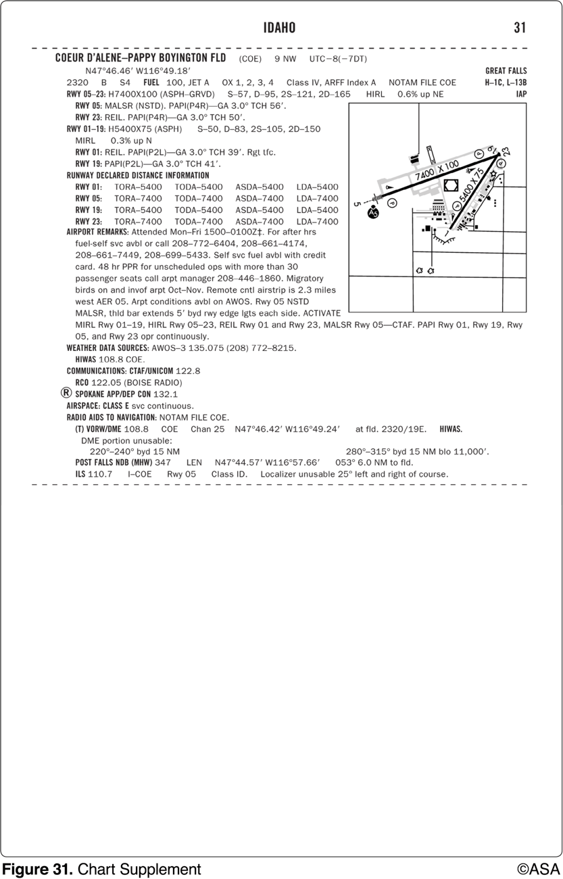
16. (3606) (Refer to Figure 22, area 2; and Figure 31.) At Coeur D'Alene, which frequency should be used as a Common Traffic Advisory Frequency (CTAF) to self-announce position and intentions?
a. 122.05 MHz. b. 122.1/108.8 MHz. c. 122.8 MHz.

Slide 244
16. (3606) (Refer to Figure 22, area 2; and Figure 31.) At Coeur D'Alene, which frequency should be used as a Common Traffic Advisory Frequency (CTAF) to self-announce position and intentions?
a. 122.05 MHz. b. 122.1/108.8 MHz. *c. 122.8 MHz.
CTAF is a frequency designed for the purpose of carrying out airport advisory practices and/or position reporting at an uncontrolled airport (which may also occur during hours when a tower is closed). The CTAF may be a UNICOM, MULTICOM, FSS, or tower frequency and is identified in the appropriate aeronautical publications. A solid dot with the letter 'C' inside indicates the CTAF. When the control tower operates part time and a UNICOM frequency is provided, use the UNICOM frequency.

Slide 245
17. (3607) (Refer to Figure 22, area 2; and Figure 31). At Coeur D'Alene, which frequency should be used as a Common Traffic Advisory Frequency (CTAF) to monitor airport traffic?
a. 122.05 MHz. b. 135.075 MHz. c. 122.8 MHz.

Slide 246
17. (3607) (Refer to Figure 22, area 2; and Figure 31). At Coeur D'Alene, which frequency should be used as a Common Traffic Advisory Frequency (CTAF) to monitor airport traffic?
a. 122.05 MHz. b. 135.075 MHz. *c. 122.8 MHz.
CTAF is a frequency designed for the purpose of carrying out airport advisory practices and/or position reporting at an uncontrolled airport (which may also occur during hours when a tower is closed). The CTAF may be a UNICOM, MULTICOM, FSS, or tower frequency and is identified in the appropriate aeronautical publications. A solid dot with the letter 'C' inside indicates the CTAF. When the control tower operates part time and a UNICOM frequency is provided, use the UNICOM frequency.

Slide 247
18. (3608) (Refer to Figure 22, area 2; and Figure 31.) What is the correct UNICOM frequency to be used at Coeur D'Alene to request fuel?
a. 135.075 MHz. b. 122.1/108.8 MHz. c. 122.8 MHz.

Slide 248
18. (3608) (Refer to Figure 22, area 2; and Figure 31.) What is the correct UNICOM frequency to be used at Coeur D'Alene to request fuel?
a. 135.075 MHz. b. 122.1/108.8 MHz. *c. 122.8 MHz.
The sectional chart and Chart Supplements U.S. both list the UNICOM frequency as 122.8. This is the appropriate frequency to use to contact UNICOM. The UNICOM frequency is depicted in the airport information in the lower right-hand corner.

Slide 249
19. (3609) (Refer to Figure 25, area 3.) If Dallas Executive (RBD) tower is not in operation, which frequency should be used as a Common Traffic Advisory Frequency (CTAF) to monitor airport traffic?
a. 127.25 MHz. b. 122.95 MHz. c. 126.35 MHz.

Slide 250
19. (3609) (Refer to Figure 25, area 3.) If Dallas Executive (RBD) tower is not in operation, which frequency should be used as a Common Traffic Advisory Frequency (CTAF) to monitor airport traffic?
*a. 127.25 MHz. b. 122.95 MHz. c. 126.35 MHz.
A solid dot with the letter 'C' inside indicates the CTAF.

Slide 251
20. (3610) (Refer to Figure 26, area 2.) What is the recommended communication procedure when inbound to land at Cooperstown Airport?
a. Broadcast intentions when 10 miles out on the CTAF/MULTICOM frequency, 122.9 MHz. b. Contact UNICOM when 10 miles out on 122.8 MHz. c. Circle the airport in a left turn prior to entering traffic.

Slide 252
20. (3610) (Refer to Figure 26, area 2.) What is the recommended communication procedure when inbound to land at Cooperstown Airport?
*a. Broadcast intentions when 10 miles out on the CTAF/MULTICOM frequency, 122.9 MHz. b. Contact UNICOM when 10 miles out on 122.8 MHz. c. Circle the airport in a left turn prior to entering traffic.
MULTICOM frequency is always 122.9 MHz, and the correct procedure is to broadcast intentions when 10 miles from the airport.

Slide 253
21. (3611) (Refer to Figure 26, area 4.) The CTAF/UNICOM frequency at Jamestown Airport is
a. 122.0 MHz. b. 123.0 MHz. c. 123.6 MHz.

Slide 254
21. (3611) (Refer to Figure 26, area 4.) The CTAF/UNICOM frequency at Jamestown Airport is
a. 122.0 MHz. *b. 123.0 MHz. c. 123.6 MHz.
CTAF is a frequency designed for the purpose of carrying out airport advisory practices and/or position reporting at an uncontrolled airport (which may also occur during hours when a tower is closed). The CTAF may be a UNICOM, MULTICOM, FSS, or tower frequency and is identified in the appropriate aeronautical publications. A solid dot with the letter 'C' inside indicates the CTAF; it may be a UNICOM, MULTICOM, FSS, or tower frequency.

Slide 255
22. (3612) (Refer to Figure 26, area 5.) What is the CTAF/UNICOM frequency at Barnes County Airport?
a. 122.0 MHz.
b. 122.8 MHz.
c. 123.6 MHz.

Slide 256
22. (3612) (Refer to Figure 26, area 5.) What is the CTAF/UNICOM frequency at Barnes County Airport?
a. 122.0 MHz.
*b. 122.8 MHz.
c. 123.6 MHz.
CTAF is a frequency designed for the purpose of carrying out airport advisory practices and/or position reporting at an uncontrolled airport (which may also occur during hours when a tower is closed). The CTAF may be a UNICOM, MULTICOM, FSS, or tower frequency and is identified in the appropriate aeronautical publications. A solid dot with the letter 'C' inside indicates the CTAF.

Slide 257
23. (3613) When flying HAWK N666CB, the proper phraseology for initial contact with McAlester Flight Service is
a. 'MC ALESTER RADIO, HAWK SIX SIX SIX CHARLIE BRAVO, RECEIVING ARDMORE VORTAC, OVER.' b. 'MC ALESTER STATION, HAWK SIX SIX SIX CEE BEE, RECEIVING ARDMORE VORTAC, OVER.' c. 'MC ALESTER FLIGHT SERVICE STATION, HAWK NOVEMBER SIX CHARLIE BRAVO, RECEIVING ARDMORE VORTAC, OVER.'

Slide 258
23. (3613) When flying HAWK N666CB, the proper phraseology for initial contact with McAlester Flight Service is
*a. 'MC ALESTER RADIO, HAWK SIX SIX SIX CHARLIE BRAVO, RECEIVING ARDMORE VORTAC, OVER.' b. 'MC ALESTER STATION, HAWK SIX SIX SIX CEE BEE, RECEIVING ARDMORE VORTAC, OVER.' c. 'MC ALESTER FLIGHT SERVICE STATION, HAWK NOVEMBER SIX CHARLIE BRAVO, RECEIVING ARDMORE VORTAC, OVER.'
The term 'initial radio contact,' or 'initial callup,' means the first radio call you make to a given facility, or the first call to a different controller or Flight Service specialist within a facility. Use the following format: 1. Name of facility being called; 2. Your full aircraft identification as filed in the flight plan; 3. Type of message to follow or your request if it is short, and 4. The word 'over,' if required. Example: 'New York Radio, Mooney Three One One Echo.' When the aircraft manufacturer's name or model is stated, the prefix 'N' is dropped. The first two characters of the call sign may be dropped only after ATC calls you by your last three letters/numbers.

Slide 259
24. (3614) The correct method of stating 4,500 feet MSL to ATC is
a. 'FOUR THOUSAND FIVE HUNDRED.' b. 'FOUR POINT FIVE.' c. 'FORTY-FIVE HUNDRED FEET MSL.'

Slide 260
24. (3614) The correct method of stating 4,500 feet MSL to ATC is
*a. 'FOUR THOUSAND FIVE HUNDRED.' b. 'FOUR POINT FIVE.' c. 'FORTY-FIVE HUNDRED FEET MSL.'
Up to but not including 18,000 feet MSL, state the separate digits of the thousands, plus the hundreds, if appropriate. Example: '4,500 -- four thousand, five hundred.'

Slide 261
25. (3615) The correct method of stating 10,500 feet MSL to ATC is
a. 'TEN THOUSAND, FIVE HUNDRED FEET.' b. 'TEN POINT FIVE.' c. 'ONE ZERO THOUSAND, FIVE HUNDRED.'

Slide 262
25. (3615) The correct method of stating 10,500 feet MSL to ATC is
a. 'TEN THOUSAND, FIVE HUNDRED FEET.' b. 'TEN POINT FIVE.' *c. 'ONE ZERO THOUSAND, FIVE HUNDRED.'
Up to but not including 18,000 feet MSL, state the separate digits of the thousands, plus the hundreds, if appropriate. Example: '10,500 -- one zero thousand, five hundred.'

Slide 263
26. (3630) (Refer to Figure 21.) On what frequency can a pilot receive Hazardous Inflight Weather Advisory Service (HIWAS) in the vicinity of area 1?
a. 117.1 MHz. b. 118.0 MHz. c. 122.0 MHz.

Slide 264
26. (3630) (Refer to Figure 21.) On what frequency can a pilot receive Hazardous Inflight Weather Advisory Service (HIWAS) in the vicinity of area 1?
*a. 117.1 MHz. b. 118.0 MHz. c. 122.0 MHz.
The reversed-out H in the upper right corner indicates HIWAS on the VOR frequency.

Slide 265
27. (3641) (Refer to Figure 25, area 2.) The control tower frequency for Addison Airport is
a. 122.95 MHz. b. 126.0 MHz. c. 133.4 MHz.

Slide 266
27. (3641) (Refer to Figure 25, area 2.) The control tower frequency for Addison Airport is
a. 122.95 MHz. *b. 126.0 MHz. c. 133.4 MHz.
The correct answer is found in the explanatory box for Addison airport in area 2: 126.0 MHz.

Slide 267
28. (3790) Select the UNICOM frequencies normally assigned to stations at landing areas used exclusively as heliports.
a. 122.75 and 123.65 MHz. b. 123.0 and 122.95 MHz. c. 123.05 and 123.075 MHz.

Slide 268
28. (3790) Select the UNICOM frequencies normally assigned to stations at landing areas used exclusively as heliports.
a. 122.75 and 123.65 MHz. b. 123.0 and 122.95 MHz. *c. 123.05 and 123.075 MHz.
Frequencies used solely for heliports are 123.050 and 123.075.

Slide 269
29. (3791) Automatic Terminal Information Service (ATIS) is the continuous broadcast of recorded information concerning
a. pilots of radar-identified aircraft whose aircraft is in dangerous proximity to terrain or to an obstruction. b. nonessential information to reduce frequency congestion. c. noncontrol information in selected high-activity terminal areas.

Slide 270
29. (3791) Automatic Terminal Information Service (ATIS) is the continuous broadcast of recorded information concerning
a. pilots of radar-identified aircraft whose aircraft is in dangerous proximity to terrain or to an obstruction. b. nonessential information to reduce frequency congestion. *c. noncontrol information in selected high-activity terminal areas.
ATIS is the continuous broadcast of recorded noncontrol information in selected high-activity terminal areas.

Slide 271
30. (3792) An ATC radar facility issues the following advisory to a pilot flying on a heading of 090°: 'TRAFFIC THREE O'CLOCK, 2 MILES, WESTBOUND...' Where should the pilot look for this traffic?
a. East. b. South. c. West.

Slide 272
30. (3792) An ATC radar facility issues the following advisory to a pilot flying on a heading of 090°: 'TRAFFIC THREE O'CLOCK, 2 MILES, WESTBOUND...' Where should the pilot look for this traffic?
a. East. *b. South. c. West.
Traffic information will be given in azimuth from the aircraft in terms of the 12-hour clock. Thus, each hour would constitute an angle of 30°. Picture a clock in your lap; three o'clock is to your right, nine o'clock is to your left, twelve o'clock is straight ahead, and six o'clock is behind you. If an aircraft is proceeding on a heading of 090° (east), traffic located at the three o'clock position would be 90° right of the nose, south of the aircraft.

Slide 273
31. (3792.1) When an air traffic controller issues radar traffic information in relation to the 12-hour clock, the reference the controller uses is the aircraft`s
a. true course. b. ground track. c. magnetic heading.

Slide 274
31. (3792.1) When an air traffic controller issues radar traffic information in relation to the 12-hour clock, the reference the controller uses is the aircraft`s
a. true course. *b. ground track. c. magnetic heading.
Azimuth information given by ATC is based on the ground track of an aircraft as it is observed. The pilot must apply a correction to the reported azimuth using a drift-correction angle in order to maintain the track.

Slide 275
32. (3793) An ATC radar facility issues the following advisory to a pilot flying on a heading of 360°: 'TRAFFIC TEN O'CLOCK, 2 MILES, SOUTHBOUND...' Where should the pilot look for this traffic?
a. Northwest. b. Northeast. c. Southwest.

Slide 276
32. (3793) An ATC radar facility issues the following advisory to a pilot flying on a heading of 360°: 'TRAFFIC TEN O'CLOCK, 2 MILES, SOUTHBOUND...' Where should the pilot look for this traffic?
*a. Northwest. b. Northeast. c. Southwest.
If an aircraft is proceeding on a heading of 360° (north), traffic located at the ten o'clock position would be 60° (left) of the nose, or to the northwest.

Slide 277
33. (3794) An ATC radar facility issues the following advisory to a pilot during a local flight: 'TRAFFIC TWO O'CLOCK, 5 MILES, NORTHBOUND...' Where should the pilot look for this traffic?
a. Between directly ahead and 90° to the left. b. Between directly behind and 90° to the right. c. Between directly ahead and 90° to the right.

Slide 278
33. (3794) An ATC radar facility issues the following advisory to a pilot during a local flight: 'TRAFFIC TWO O'CLOCK, 5 MILES, NORTHBOUND...' Where should the pilot look for this traffic?
a. Between directly ahead and 90° to the left. b. Between directly behind and 90° to the right. *c. Between directly ahead and 90° to the right.
Traffic information issued to the pilot as 'two o'clock' would mean approximately 60° right.

Slide 279
34. (3795) An ATC radar facility issues the following advisory to a pilot flying north in a calm wind: 'TRAFFIC NINE O'CLOCK, 2 MILES, SOUTHBOUND...' Where should the pilot look for this traffic?
a. South. b. North. c. West.

Slide 280
34. (3795) An ATC radar facility issues the following advisory to a pilot flying north in a calm wind: 'TRAFFIC NINE O'CLOCK, 2 MILES, SOUTHBOUND...' Where should the pilot look for this traffic?
a. South. b. North. *c. West.
An aircraft flying north in calm wind would be heading 360°. When advised of traffic at the nine o'clock position, the pilot should look 90° left of the nose, to the west.

Slide 281
35. (3796) Basic radar service in the terminal radar program is best described as
a. safety alerts, traffic advisories and limited vectoring to VFR aircraft. b. mandatory radar service provided by the Automated Radar Terminal System (ARTS) program. c. wind shear warning at participating airports.

Slide 282
35. (3796) Basic radar service in the terminal radar program is best described as
*a. safety alerts, traffic advisories and limited vectoring to VFR aircraft. b. mandatory radar service provided by the Automated Radar Terminal System (ARTS) program. c. wind shear warning at participating airports.
In addition to the use of radar for the control of IFR aircraft, all commissioned radar facilities provide traffic advisories and limited vectoring (on a workload-permitting basis) to VFR aircraft. Radar facilities are not responsible for weather information and the service is not mandatory.

Slide 283
36. (3797) From whom should a departing VFR aircraft request radar traffic information during ground operations?
a. Clearance delivery. b. Tower, just before takeoff. c. Ground control, on initial contact.

Slide 284
36. (3797) From whom should a departing VFR aircraft request radar traffic information during ground operations?
a. Clearance delivery. b. Tower, just before takeoff. *c. Ground control, on initial contact.
Pilots of departing VFR aircraft are encouraged to request radar traffic information by notifying ground control on initial contact with their request and proposed direction of flight.

Slide 285
37. (3798) TRSA Service in the terminal radar program provides
a. IFR separation (1,000 feet vertical and 3 miles lateral) between all aircraft. b. warning to pilots when their aircraft are in unsafe proximity to terrain, obstructions, or other aircraft. c. sequencing and separation for participating VFR aircraft.

Slide 286
37. (3798) TRSA Service in the terminal radar program provides
a. IFR separation (1,000 feet vertical and 3 miles lateral) between all aircraft. b. warning to pilots when their aircraft are in unsafe proximity to terrain, obstructions, or other aircraft. *c. sequencing and separation for participating VFR aircraft.
TRSA Service provides separation of participating VFR aircraft and all IFR aircraft operating within the airspace.

Slide 287
38. (3800) When making routine transponder code changes, pilots should avoid inadvertent selection of which codes?
a. 0700, 1700, 7000. b. 1200, 1500, 7000. c. 7500, 7600, 7700.

Slide 288
38. (3800) When making routine transponder code changes, pilots should avoid inadvertent selection of which codes?
a. 0700, 1700, 7000. b. 1200, 1500, 7000. *c. 7500, 7600, 7700.
When making routine code changes, pilots should avoid selecting codes 7500, 7600 or 7700, thereby preventing false alarms at automated ground facilities.

Slide 289
39. (3800.1) When making routine transponder code changes, pilots should avoid inadvertent selection of which code?
a. 7200. b. 7400. c. 7500.

Slide 290
39. (3800.1) When making routine transponder code changes, pilots should avoid inadvertent selection of which code?
a. 7200. b. 7400. *c. 7500.
When making routine code changes, pilots should avoid selecting codes 7500, 7600 or 7700, thereby preventing false alarms at automated ground facilities.

Slide 291
40. (3801) When operating under VFR below 18,000 feet MSL, unless otherwise authorized, what transponder code should be selected?
a. 1200 b. 7600 c. 7700

Slide 292
40. (3801) When operating under VFR below 18,000 feet MSL, unless otherwise authorized, what transponder code should be selected?
*a. 1200 b. 7600 c. 7700
Unless otherwise instructed by an ATC facility, adjust the transponder to reply on Mode 3/A, code 1200, regardless of altitude.

Slide 293
41. (3802) Unless otherwise authorized, if flying a transponder equipped aircraft, a pilot should squawk which VFR code?
a. 1200. b. 7600. c. 7700.

Slide 294
41. (3802) Unless otherwise authorized, if flying a transponder equipped aircraft, a pilot should squawk which VFR code?
*a. 1200. b. 7600. c. 7700.
It is important for pilots to operate the transponder and encoder so radar controllers will know the aircraft's position and altitude - even if not in communications with ATC.

Slide 295
42. (3803) If Air Traffic Control advises that radar service is terminated when the pilot is departing Class C airspace, the transponder should be set to code
a. 0000. b. 1200. c. 4096.

Slide 296
42. (3803) If Air Traffic Control advises that radar service is terminated when the pilot is departing Class C airspace, the transponder should be set to code
a. 0000. *b. 1200. c. 4096.
When VFR, unless otherwise instructed by an ATC facility, adjust transponder to reply code 1200 regardless of altitude.

Slide 297
43. (3804) If the aircraft's radio fails, what is the recommended procedure when landing at a controlled airport?
a. Observe the traffic flow, enter the pattern, and look for a light signal from the tower. b. Enter a crosswind leg and rock the wings. c. Flash the landing lights and cycle the landing gear while circling the airport.

Slide 298
43. (3804) If the aircraft's radio fails, what is the recommended procedure when landing at a controlled airport?
*a. Observe the traffic flow, enter the pattern, and look for a light signal from the tower. b. Enter a crosswind leg and rock the wings. c. Flash the landing lights and cycle the landing gear while circling the airport.
When a transmitter, receiver, or both have become inoperative, an aircraft should observe the traffic flow, enter the pattern, and look for a light signal from the tower, when landing at a controlled airport. Answer (B) is incorrect because entering on the crosswind is not required and rocking the wings is used to acknowledge light signals during the day. Flashing the lights is used to acknowledge light signals during night, and a fixed gear airplane would not be able to cycle the gear. Answer (C) is incorrect because entering on the crosswind is not required and rocking the wings is used to acknowledge light signals during the day. Flashing the lights is used to acknowledge light signals during night, and a fixed gear airplane would not be able to cycle the gear.

Slide 299
44. (3811) After landing at a tower-controlled airport, when should the pilot contact ground control?
a. When advised by the tower to do so. b. Prior to turning off the runway. c. After reaching a taxiway that leads directly to the parking area.

Slide 300
44. (3811) After landing at a tower-controlled airport, when should the pilot contact ground control?
*a. When advised by the tower to do so. b. Prior to turning off the runway. c. After reaching a taxiway that leads directly to the parking area.
A pilot who has just landed should not change from tower to ground frequency until advised to do so by the controller.

Slide 301
45. (3812) If instructed by ground control to taxi to Runway 9, the pilot may proceed
a. via taxiways and across runways to, but not onto, Runway 9. b. to the next intersecting runway where further clearance is required. c. via taxiways and across runways to Runway 9, where an immediate takeoff may be made

Slide 302
45. (3812) If instructed by ground control to taxi to Runway 9, the pilot may proceed
a. via taxiways and across runways to, but not onto, Runway 9. *b. to the next intersecting runway where further clearance is required. c. via taxiways and across runways to Runway 9, where an immediate takeoff may be made.
When ATC clears an aircraft to 'taxi to' an assigned takeoff runway, the absence of holding instructions does not authorize the aircraft to 'cross' all runways which the taxi route intersects except the assigned takeoff runway. A clearance must be obtained prior to crossing any runway. It does not include authorization to 'Taxi on to' or 'cross' the assigned takeoff runway at any point.

Slide 303
46. (3819) When activated, an emergency locator transmitter (ELT) transmits on
a. 118.0 MHz. b. 406 MHz. c. 123.0 MHz.

Slide 304
46. (3819) When activated, an emergency locator transmitter (ELT) transmits on
a. 118.0 MHz. *b. 406 MHz. c. 123.0 MHz.
ELTs transmit an audio tone on 406 MHz.

Slide 305
47. (3819.1) When activated, an emergency locator transmitter (ELT) transmits on
a. 118.0 and 118.8 MHz. b. 121.5 and 243.0 MHz. c. 123.0 and 119.0 MHz.

Slide 306
47. (3819.1) When activated, an emergency locator transmitter (ELT) transmits on
a. 118.0 and 118.8 MHz. *b. 121.5 and 243.0 MHz. c. 123.0 and 119.0 MHz.
ELTs transmit an audio tone on 121.5, 243.0, and 406 MHz. ELTs operating on 121.5 and 243.0 MHz are analog devices. The newer 406 MHz ELT is a digital transmitter that can be encoded with the owner's contact information or aircraft data.

Slide 307
48. (3820) When must the battery in an emergency locator transmitter (ELT) be replaced (or recharged if the battery is rechargeable)?
a. After one-half the battery's useful life. b. During each annual and 100-hour inspection. c. Every 24 calendar months.

Slide 308
48. (3820) When must the battery in an emergency locator transmitter (ELT) be replaced (or recharged if the battery is rechargeable)?
*a. After one-half the battery's useful life. b. During each annual and 100-hour inspection. c. Every 24 calendar months.
ELT batteries must be replaced after 1 hour of cumulative use or when 50 percent of their useful life has expired, whichever comes first.

Slide 309
49. (3821) When may an emergency locator transmitter (ELT) be tested?
a. Anytime. b. At 15 and 45 minutes past the hour. c. During the first 5 minutes after the hour.

Slide 310
49. (3821) When may an emergency locator transmitter (ELT) be tested?
a. Anytime. b. At 15 and 45 minutes past the hour. *c. During the first 5 minutes after the hour.
An ELT test should be conducted only during the first 5 minutes after any hour and then only for three audible sweeps.

Slide 311
50. (3822) Which procedure is recommended to ensure that the emergency locator transmitter (ELT) has not been activated?
a. Turn off the aircraft ELT after landing. b. Ask the airport tower if they are receiving an ELT signal. c. Monitor 121.5 before engine shutdown..

Slide 312
50. (3822) Which procedure is recommended to ensure that the emergency locator transmitter (ELT) has not been activated?
a. Turn off the aircraft ELT after landing. b. Ask the airport tower if they are receiving an ELT signal. *c. Monitor 121.5 before engine shutdown.
Immediately after hard landings and before parking, check radio frequency 121.5 MHz.

Slide 313
51. (3996) When operating the transponder on the VFR code (1200), what is the minimum mode the transponder must be in?
a. Mode A. b. Mode C. c. Mode F.

Slide 314
51. (3996) When operating the transponder on the VFR code (1200), what is the minimum mode the transponder must be in?
*a. Mode A. b. Mode C. c. Mode F.
When operating on the VFR code 1200, adjust the transponder to reply on Mode A unless otherwise instructed by an ATC facility.Answer (B) is incorrect because while altitude-reporting Mode C should be used if it is installed, it is not required to squawk 1200. Answer (C) is incorrect because F is not a transponder mode.

Slide 315
52. (3998) When should pilots state their position on the airport when calling the tower for takeoff?
a. When visibility is less than 1 mile. b. When parallel runways are in use. c. When departing from a runway intersection.

Slide 316
52. (3998) When should pilots state their position on the airport when calling the tower for takeoff?
a. When visibility is less than 1 mile. b. When parallel runways are in use. *c. When departing from a runway intersection.
Pilots should state their position on the airport when calling the tower for takeoff from a runway intersection.

