Slide 1
1. (2004) While on a VFR cross-country and not in contact with ATC, what frequency would you use in the event of an emergency?
a. 121.5 MHz. b. 122.5 MHz. c. 128.725 MHz.

Slide 2
1. (2004) While on a VFR cross-country and not in contact with ATC, what frequency would you use in the event of an emergency?
*a. 121.5 MHz. b. 122.5 MHz. c. 128.725 MHz.
Although the frequency in use or other frequencies assigned by ATC are preferable, the following emergency frequencies can be used for distress or urgency communications: 121.5 MHz, 243.0 MHz, or 406 mHz.

Slide 3
2. (3001) With respect to the certification of airmen, which are categories of aircraft?
a. Gyroplane, helicopter, airship, free balloon. b. Airplane, rotorcraft, glider, lighter-than-air. c. Single-engine land and sea, multiengine land and sea.

Slide 4
2. (3001) With respect to the certification of airmen, which are categories of aircraft?
a. Gyroplane, helicopter, airship, free balloon. *b. Airplane, rotorcraft, glider, lighter-than-air. c. Single-engine land and sea, multiengine land and sea.
With respect to the certification of airmen, category means a broad classification of aircraft such as airplane, rotorcraft, glider, and lighter-than-air, weight shift control, and powered parachute. Answer (A) is incorrect because it refers to classes of rotorcraft and lighter-than-air craft. Answer (C) is incorrect because it refers to classes of airplanes.

Slide 5
3. (3002) With respect to the certification of airmen, which are classes of aircraft?
a. Airplane, rotorcraft, glider, lighter-than-air. b. Single-engine land and sea, multiengine land and sea. c. Lighter-than-air, airship, hot air balloon, gas balloon.

Slide 6
3. (3002) With respect to the certification of airmen, which are classes of aircraft?
a. Airplane, rotorcraft, glider, lighter-than-air. *b. Single-engine land and sea, multiengine land and sea. c. Lighter-than-air, airship, hot air balloon, gas balloon.
With respect to the certification of airmen, a class refers to aircraft with similar operating characteristics such as single-engine land/sea and multiengine land/sea, gyroplane, helicopter, airship, and free balloon. Answer (A) is incorrect because it refers to categories of aircraft. Answer (C) is incorrect because it refers to lighter-than-air category. Airship and free balloon are lighter-than-air class ratings, but hot air balloon and gas balloon are not.

Slide 7
4. (3003) With respect to the certification of aircraft, which is a category of aircraft?
a. Normal, utility, acrobatic. b. Airplane, rotorcraft, glider. c. Landplane, seaplane.

Slide 8
4. (3003) With respect to the certification of aircraft, which is a category of aircraft?
*a. Normal, utility, acrobatic. b. Airplane, rotorcraft, glider. c. Landplane, seaplane.
With respect to the certification of aircraft, a category of aircraft means a grouping of aircraft based upon intended use or operating limitations. Examples include normal, utility, acrobatic, transport, limited, restricted, and provisional. Answer (B) is incorrect because it refers to the certification of airmen, not aircraft. Answer (C) is incorrect because it is not any kind of category.

Slide 9
5. (3004) With respect to the certification of aircraft, which is a class of aircraft?
a. Airplane, rotorcraft, glider, balloon. b. Normal, utility, acrobatic, limited. c. Transport, restricted, provisional.

Slide 10
5. (3004) With respect to the certification of aircraft, which is a class of aircraft?
*a. Airplane, rotorcraft, glider, balloon. b. Normal, utility, acrobatic, limited. c. Transport, restricted, provisional.
With respect to the certification of aircraft, class is a broad grouping of aircraft having similar means of propulsion, flight, or landing. Examples include airplane, rotorcraft, glider, balloon, landplane, and seaplane. Answer (B) is incorrect because they refer to category of aircraft rather than class. Answer (C) is incorrect because they refer to category of aircraft rather than class.

Slide 11
6. (3005) The definition of nighttime is
a. sunset to sunrise. b. 1 hour after sunset to 1 hour before sunrise. c. the time between the end of evening civil twilight and the beginning of morning civil twilight.

Slide 12
6. (3005) The definition of nighttime is
a. sunset to sunrise. b. 1 hour after sunset to 1 hour before sunrise. *c. the time between the end of evening civil twilight and the beginning of morning civil twilight.
Night is the time between the end of evening civil twilight and the beginning of morning civil twilight converted to local time, as published in the American Air Almanac. Answer (A) is incorrect because it refers to the time when lighted position lights are required. Answer (B) is incorrect because it refers to the currency requirement to carry passengers.

Slide 13
7. (3012.2) What should an owner or operator know about Airworthiness Directives (ADs)?
a. For Informational purposes only. b. They are mandatory. c. They are voluntary.

Slide 14
7. (3012.2) What should an owner or operator know about Airworthiness Directives (ADs)?
a. For Informational purposes only. *b. They are mandatory. c. They are voluntary.
ADs are mandatory. No person may operate a product to which an airworthiness directive applies except in accordance with the requirements of that airworthiness directive.

Slide 15
8. (3012.3) May a pilot operate an aircraft that is not in compliance with an Airworthiness Directive (AD)?
a. Yes, under VFR conditions only. b. Yes, ADs are only voluntary. c. Yes, if allowed by the AD.

Slide 16
8. (3012.3) May a pilot operate an aircraft that is not in compliance with an Airworthiness Directive (AD)?
a. Yes, under VFR conditions only. b. Yes, ADs are only voluntary. *c. Yes, if allowed by the AD.
No person may operate a product to which an airworthiness directive applies except in accordance with the requirements of that airworthiness directive.

Slide 17
9. (3013.1) Preventive maintenance has been performed on an aircraft. What paperwork is required?
a. A full, detailed description of the work done must be entered in the airframe logbook. b. The date the work was completed, and the name of the person who did the work must be entered in the airframe and engine logbook. c. The signature, certificate number, and kind of certificate held by the person approving the work and a description of the work must be entered in the aircraft maintenance records.

Slide 18
9. (3013.1) Preventive maintenance has been performed on an aircraft. What paperwork is required?
a. A full, detailed description of the work done must be entered in the airframe logbook. b. The date the work was completed, and the name of the person who did the work must be entered in the airframe and engine logbook. *c. The signature, certificate number, and kind of certificate held by the person approving the work and a description of the work must be entered in the aircraft maintenance records.
Each registered owner or operator shall keep records of preventative maintenance. The records must include: 1. A description of the work performed; 2. The date of completion of the work performed; and 3. The signature and certificate number of the person approving the aircraft for return to service (could be pilot certificate number for Part 43 when you are doing your own preventative maintenance). Answer (A) is incorrect because it is incomplete. Answer (B) is incorrect because it refers to who performed the work rather than who approved it.

Slide 19
10. (3013.2) What regulation allows a private pilot to perform preventive maintenance?
a. 14 CFR _sect_91.403. b. 14 CFR _sect_43.7. c. 14 CFR _sect_61.113..

Slide 20
10. (3013.2) What regulation allows a private pilot to perform preventive maintenance?
a. 14 CFR _sect_91.403. *b. 14 CFR _sect_43.7. c. 14 CFR _sect_61.113.
14 CFR_sect_43.7 Persons authorized to approve aircraft, airframes, aircraft engines, propellers, appliances, or component parts for return to service after maintenance, preventive maintenance, rebuilding, or alteration says a person holding at least a private pilot certificate may approve an aircraft for return to service after performing preventive maintenance under the provisions of _sect_43.3(g). Answer (A) is incorrect because 14 CFR _sect_91.403 explains that the owner or operator must maintain the aircraft in airworthy condition. Answer (C) is incorrect because 14 CFR _sect_61.113 details the private pilot privileges and limitations while operating as pilot-in-command.

Slide 21
11. (3013.3) Who may perform preventive maintenance on an aircraft and approve it for return to service?
a. Student or recreational pilot. b. Private or commercial pilot. c. None of the above.

Slide 22
11. (3013.3) Who may perform preventive maintenance on an aircraft and approve it for return to service?
a. Student or recreational pilot. *b. Private or commercial pilot. c. None of the above.
A person holding at least a Private Pilot Certificate may approve an aircraft for return to service after performing preventive maintenance.

Slide 23
12. (3014) Which operation would be described as preventive maintenance?
a. Replenishing hydraulic fluid. b. Repair of portions of skin sheets by making additional seams. c. Repair of landing gear brace struts.

Slide 24
12. (3014) Which operation would be described as preventive maintenance?
*a. Replenishing hydraulic fluid. b. Repair of portions of skin sheets by making additional seams. c. Repair of landing gear brace struts.
Preventative maintenance items which can be performed by the pilot are listed in Part 43 and include such basic items as oil changes, wheel bearing lubrication, and hydraulic fluid (brakes, landing gear system) refills. Answer (B) is incorrect because they both list major maintenance. Answer (C) is incorrect because they both list major maintenance.

Slide 25
13. (3016) What document(s) must be in your personal possession or readily accessible in the aircraft while operating as pilot-in-command of an aircraft?
a. Certificates showing accomplishment of a checkout in the aircraft and a current flight review. b. A pilot certificate with an endorsement showing accomplishment of an annual flight review and a pilot logbook showing recency of experience. c. An appropriate pilot certificate and an appropriate current medical certificate if required.

Slide 26
13. (3016) What document(s) must be in your personal possession or readily accessible in the aircraft while operating as pilot-in-command of an aircraft?
a. Certificates showing accomplishment of a checkout in the aircraft and a current flight review. b. A pilot certificate with an endorsement showing accomplishment of an annual flight review and a pilot logbook showing recency of experience. *c. An appropriate pilot certificate and an appropriate current medical certificate if required.
No person may act as PIC, or in any other capacity as a required pilot flight crewmember, of a civil aircraft of U.S. registry unless they have in possession or readily accessible in the aircraft a current pilot certificate and a photo ID. Except for free balloon pilots piloting balloons and glider pilots piloting gliders, no person may act as PIC or in any other capacity as a required pilot flight crewmember of an aircraft unless they have in possession or readily accessible in the aircraft an appropriate current medical certificate or other documentation acceptable to the FAA. Answer (A) is incorrect because aircraft checkouts don't need to be recorded, and a flight review record and currency proof don't need to be in your possession. Answer (B) is incorrect because aircraft checkouts don't need to be recorded, and a flight review record and currency proof don't need to be in your possession.

Slide 27
14. (3017) When must a current pilot certificate be in the pilot's personal possession or readily accessible in the aircraft?
a. When acting as a crew chief during launch and recovery. b. Only when passengers are carried. c. Anytime when acting as pilot-in-command or as a required crewmember.

Slide 28
14. (3017) When must a current pilot certificate be in the pilot's personal possession or readily accessible in the aircraft?
a. When acting as a crew chief during launch and recovery. b. Only when passengers are carried. *c. Anytime when acting as pilot-in-command or as a required crewmember.
No person may act as PIC, or in any other capacity as a required pilot flight crewmember, of a civil aircraft of U.S. registry unless they have in possession or readily accessible in the aircraft a current pilot certificate and a photo ID. Answer (A) is incorrect because a crew chief does not require a pilot certificate, and pilots must have certificates, regardless of whether carrying passengers or not. Answer (B) is incorrect because a crew chief does not require a pilot certificate, and pilots must have certificates, regardless of whether carrying passengers or not.

Slide 29
15. (3018) A recreational or private pilot acting as pilot in command, or in any other capacity as a required pilot flight crewmember, must have in their personal possession or readily accessible in the aircraft a current
a. logbook endorsement to show that a flight review has been satisfactorily accomplished.. b. medical certificate if required and an appropriate pilot certificate. c. endorsement on the pilot certificate to show that a flight review has been satisfactorily accomplished.

Slide 30
15. (3018) A recreational or private pilot acting as pilot in command, or in any other capacity as a required pilot flight crewmember, must have in their personal possession or readily accessible in the aircraft a current
a. logbook endorsement to show that a flight review has been satisfactorily accomplished.. *b. medical certificate if required and an appropriate pilot certificate. c. endorsement on the pilot certificate to show that a flight review has been satisfactorily accomplished.
No person may act as PIC, or in any other capacity as a required pilot flight crewmember, of a civil aircraft of U.S. registry unless they have in possession or readily accessible in the aircraft a current pilot certificate and a photo ID. Except for free balloon pilots piloting balloons and glider pilots piloting gliders, no person may act as PIC or in any other capacity as a required pilot flight crewmember of an aircraft unless they have in possession or readily accessible in the aircraft an appropriate current medical certificate or other documentation acceptable to the FAA. Answer (A) is incorrect because proof of a flight review does not need to be in your possession while acting as PIC. Answer (C) is incorrect because proof of a flight review does not need to be in your possession while acting as PIC.

Slide 31
16. (3019) Each person who holds a pilot certificate or a medical certificate shall present it for inspection upon the request of any
a. authorized representative of the Department of Transportation. b. person in a position of authority. c. local law enforcement officer.

Slide 32
16. (3019) Each person who holds a pilot certificate or a medical certificate shall present it for inspection upon the request of any
a. authorized representative of the Department of Transportation. b. person in a position of authority. *c. local law enforcement officer.
Each person who holds a pilot or medical certificate shall present it for inspection upon the request of the FAA Administrator, an NTSB representative, or any Federal, State, or local law enforcement officer.

Slide 33
17. (3020) A Third Class Medical Certificate is issued to a 36-year-old pilot on August 10, this year. To exercise the privileges of a Private Pilot Certificate, the medical certificate will be valid until midnight on
a. August 10, 3 years later. b. August 31, 5 years later. c. August 31, 3 years later.

Slide 34
17. (3020) A Third Class Medical Certificate is issued to a 36-year-old pilot on August 10, this year. To exercise the privileges of a Private Pilot Certificate, the medical certificate will be valid until midnight on
a. August 10, 3 years later. *b. August 31, 5 years later. c. August 31, 3 years later.
A Third Class Medical Certificate expires at the end of the last day of the 60th month after the month of the date of the examination shown on the certificate if the person has not reached his or her 40th birthday on or before the date of examination, for operations requiring a Private Pilot Certificate.

Slide 35
18. (3021) A Third Class Medical Certificate is issued to a 51-year-old pilot on May 3, this year. To exercise the privileges of a Private Pilot Certificate, the medical certificate will be valid until midnight on
a. May 3, 1 year later. b. May 31, 1 year later. c. May 31, 2 years later.

Slide 36
18. (3021) A Third Class Medical Certificate is issued to a 51-year-old pilot on May 3, this year. To exercise the privileges of a Private Pilot Certificate, the medical certificate will be valid until midnight on
a. May 3, 1 year later. b. May 31, 1 year later. *c. May 31, 2 years later.
A Third Class Medical Certificate expires at the end of the last day of the 24th month after the month of the date of the examination shown on the certificate if the person has reached his or her 40th birthday on or before the date of examination, for operations requiring a Private Pilot Certificate.

Slide 37
19. (3022) For private pilot operations, a Second-Class Medical Certificate issued to a 42-year-old pilot on July 15, this year, will expire at midnight on
a. July 15, 2 years later. b. July 31, 1 year later. c. July 31, 2 years later.

Slide 38
19. (3022) For private pilot operations, a Second-Class Medical Certificate issued to a 42-year-old pilot on July 15, this year, will expire at midnight on
a. July 15, 2 years later. b. July 31, 1 year later. *c. July 31, 2 years later.
A Second-Class Medical Certificate expires at the end of the last day of the 24th month after the month of the date of the examination shown on the certificate if the person has reached his or her 40th birthday on or before the date of examination, for operations requiring a Private Pilot Certificate.

Slide 39
20. (3023) For private pilot operations, a First Class Medical Certificate issued to a 23-year-old pilot on October 21, this year, will expire at midnight on
a. October 21, 2 years later. b. October 31, next year. c. October 31, 5 years later.

Slide 40
20. (3023) For private pilot operations, a First Class Medical Certificate issued to a 23-year-old pilot on October 21, this year, will expire at midnight on
a. October 21, 2 years later. b. October 31, next year. *c. October 31, 5 years later.
A First Class Medical Certificate expires at the end of the last day of the 60th month after the month of the date of the examination shown on the certificate if the person has not reached his or her 40th birthday on or before the date of examination, for operations requiring a Private Pilot Certificate.

Slide 41
21. (3023.1) To operate under BasicMed the pilot-in-command must have completed a physical examination by a state-licensed physician within the preceding
a. 48 months. b. 24 months. c. 12 months.

Slide 42
21. (3023.1) To operate under BasicMed the pilot-in-command must have completed a physical examination by a state-licensed physician within the preceding
*a. 48 months. b. 24 months. c. 12 months.
BasicMed regulations require you to complete the CMEC every 24 months while a physical examination by a state-licensed physician must be completed every 48 months.

Slide 43
22. (3023.2) For private pilot operations under BasicMed, the pilot-in-command is allowed to fly with no more than
a. six passengers. b. five passengers. c. five occupants.

Slide 44
22. (3023.2) For private pilot operations under BasicMed, the pilot-in-command is allowed to fly with no more than
a. six passengers. *b. five passengers. c. five occupants.
As PIC during private pilot operations under BasicMed, the aircraft is restricted to fly with no more than five passengers and authorized to carry no more than six total occupants. Answer (A) is incorrect because six passengers plus the PIC would equal seven total occupants. Answer (C) is incorrect because BasicMed allows for aircraft authorized to carry no more than six total occupants.

Slide 45
23. (3023.3) To maintain BasicMed privileges you are required to complete the comprehensive medical examination checklist (CMEC) every
a. 48 months. b. 24 months. c. 12 months.

Slide 46
23. (3023.3) To maintain BasicMed privileges you are required to complete the comprehensive medical examination checklist (CMEC) every
*a. 48 months. b. 24 months. c. 12 months.
BasicMed regulations require you to complete a medical education course every 24 months and a medical examination checklist and physical examination with a state-licensed physician every 48 months.

Slide 47
24. (3024) The pilot-in-command is required to hold a type rating in which aircraft?
a. Aircraft operated under an authorization issued by the Administrator. b. Aircraft having a gross weight of more than 12,500 pounds. c. Aircraft involved in ferry flights, training flights, or test flights.

Slide 48
24. (3024) The pilot-in-command is required to hold a type rating in which aircraft?
a. Aircraft operated under an authorization issued by the Administrator. *b. Aircraft having a gross weight of more than 12,500 pounds. c. Aircraft involved in ferry flights, training flights, or test flights.
A type rating is required in order for a pilot to act as PIC of a large aircraft (except lighter-than-air) which is further defined as more than 12,500 pounds maximum certificated takeoff weight or a turbojet-powered aircraft. Answer (A) is incorrect because they don't address the weight or type of propulsion. Answer (C) is incorrect because they don't address the weight or type of propulsion.

Slide 49
25. (3025) What is the definition of a high-performance airplane?
a. An airplane with an engine of more than 200 horsepower. b. An airplane with 180 horsepower, or retractable landing gear, flaps, and a fixed-pitch propeller. c. An airplane with a normal cruise speed in excess of 200 knots.

Slide 50
25. (3025) What is the definition of a high-performance airplane?
*a. An airplane with an engine of more than 200 horsepower. b. An airplane with 180 horsepower, or retractable landing gear, flaps, and a fixed-pitch propeller. c. An airplane with a normal cruise speed in excess of 200 knots.
A high-performance airplane is one with an engine of more than 200 horsepower.

Slide 51
26. (3026) Before a person holding a Private Pilot Certificate may act as pilot-in-command of a high-performance airplane, that person must have
a. passed a flight test in that airplane from an FAA inspector. b. an endorsement in that person's logbook that he or she is competent to act as pilot-in-command. c. received ground and flight instruction from an authorized flight instructor who then endorses that person's logbook.

Slide 52
26. (3026) Before a person holding a Private Pilot Certificate may act as pilot-in-command of a high-performance airplane, that person must have
a. passed a flight test in that airplane from an FAA inspector. b. an endorsement in that person's logbook that he or she is competent to act as pilot-in-command. *c. received ground and flight instruction from an authorized flight instructor who then endorses that person's logbook.
No person holding a Private or Commercial Pilot Certificate may pilot a high-performance aircraft unless they have received instruction and has been certified competent in their logbook. Answer (A) is incorrect because a flight test is not required. Answer (B) is incorrect because instruction is required.

Slide 53
27. (3027) In order to act as pilot-in-command of a high-performance airplane, a pilot must have
a. made and logged three solo takeoffs and landings in a high-performance airplane. b. passed a flight test in a high-performance airplane. c. received and logged ground and flight instruction in an airplane that has more than 200 horsepower.

Slide 54
27. (3027) In order to act as pilot-in-command of a high-performance airplane, a pilot must have
a. made and logged three solo takeoffs and landings in a high-performance airplane. b. passed a flight test in a high-performance airplane. *c. received and logged ground and flight instruction in an airplane that has more than 200 horsepower.
A high-performance airplane is one with more than 200 horsepower. No person holding a Private or Commercial Pilot Certificate may pilot a high-performance aircraft unless they have received ground and flight instruction and has been certified proficient in their logbook.Answer (A) is incorrect because landings are only required in order to carry passengers, and they don't need to be solo. Answer (B) is incorrect because a flight test is not required.

Slide 55
28. (3028) To act as pilot-in-command of an aircraft carrying passengers, a pilot must show by logbook endorsement the satisfactory completion of a flight review or completion of a pilot proficiency check within the preceding
a. 6 calendar months. b. 12 calendar months. c. 24 calendar months.

Slide 56
28. (3028) To act as pilot-in-command of an aircraft carrying passengers, a pilot must show by logbook endorsement the satisfactory completion of a flight review or completion of a pilot proficiency check within the preceding
a. 6 calendar months. b. 12 calendar months. *c. 24 calendar months.
Each pilot must complete a flight review every 24 calendar months.

Slide 57
9. (3029) If recency of experience requirements for night flight are not met and official sunset is 1830, the latest time passengers may be carried is
a. 1829 b. 1859 c. 1929

Slide 58
9. (3029) If recency of experience requirements for night flight are not met and official sunset is 1830, the latest time passengers may be carried is
a. 1829 b. 1859 *c. 1929
No person may act as PIC of an aircraft carrying passengers during the period beginning one hour after sunset and ending one hour before sunrise (as published in the American Air Almanac) unless, within the preceding 90 days, they have made at least three takeoffs and three landings to a full stop during that period in the category and class of aircraft to be used. 1830 + 59 minutes = 1929

Slide 59
30. (3030) To act as pilot-in-command of an aircraft carrying passengers, the pilot must have made at least three takeoffs and three landings in an aircraft of the same category, class, and if a type rating is required, of the same type, within the preceding
a. 90 days. b. 12 calendar months. c. 24 calendar months.

Slide 60
30. (3030) To act as pilot-in-command of an aircraft carrying passengers, the pilot must have made at least three takeoffs and three landings in an aircraft of the same category, class, and if a type rating is required, of the same type, within the preceding
*a. 90 days. b. 12 calendar months. c. 24 calendar months.
No person may act as PIC of an aircraft carrying passengers, unless, within the preceding 90 days, they have made three takeoffs and three landings as the sole manipulator of the flight controls in an aircraft of the same category and class and, if a type rating is required, of the same type. If the aircraft is a tailwheel airplane, the landings must have been made to a full stop.

Slide 61
31. (3030.1) Your cousin wants you to take him flying. You must have made at least three takeoffs and three landings in your aircraft within the preceding
a. 90 days. b. 60 days. c. 30 days.

Slide 62
31. (3030.1) Your cousin wants you to take him flying. You must have made at least three takeoffs and three landings in your aircraft within the preceding
*a. 90 days. b. 60 days. c. 30 days.
No person may act as PIC of an aircraft carrying passengers, unless, within the preceding 90 days, they have made three takeoffs and three landings as the sole manipulator of the flight controls in an aircraft of the same category and class and, if a type rating is required, of the same type. If the aircraft is a tailwheel airplane, the landings must have been made to a full stop.

Slide 63
32. (3031) To act as pilot-in-command of an aircraft carrying passengers, the pilot must have made three takeoffs and three landings within the preceding 90 days in an aircraft of the same
a. make and model. b. category and class, but not type. c. category, class, and type, if a type rating is required.

Slide 64
32. (3031) To act as pilot-in-command of an aircraft carrying passengers, the pilot must have made three takeoffs and three landings within the preceding 90 days in an aircraft of the same
a. make and model. b. category and class, but not type. *c. category, class, and type, if a type rating is required.
No person may act as PIC of an aircraft carrying passengers, unless, within the preceding 90 days, they have made three takeoffs and three landings as the sole manipulator of the flight controls in an aircraft of the same category and class and, if a type rating is required, of the same type. If the aircraft is a tailwheel airplane, the landings must have been made to a full stop.

Slide 65
33. (3032) The takeoffs and landings required to meet the recency of experience requirements for carrying passengers in a tailwheel airplane
a. may be touch and go or full stop. b. must be touch and go. c. must be to a full stop.

Slide 66
33. (3032) The takeoffs and landings required to meet the recency of experience requirements for carrying passengers in a tailwheel airplane
a. may be touch and go or full stop. b. must be touch and go. *c. must be to a full stop.
No person may act as PIC of an aircraft carrying passengers, unless, within the preceding 90 days, they have made three takeoffs and three landings as the sole manipulator of the flight controls in an aircraft of the same category and class and, if a type rating is required, of the same type. If the aircraft is a tailwheel airplane, the landings must have been made to a full stop.

Slide 67
34. (3033) The three takeoffs and landings that are required to act as pilot-in-command at night must be done during the time period from
a. sunset to sunrise. b. 1 hour after sunset to 1 hour before sunrise. c. the end of evening civil twilight to the beginning of morning civil twilight.

Slide 68
34. (3033) The three takeoffs and landings that are required to act as pilot-in-command at night must be done during the time period from
a. sunset to sunrise. *b. 1 hour after sunset to 1 hour before sunrise. c. the end of evening civil twilight to the beginning of morning civil twilight.
No person may act as PIC of an aircraft carrying passengers during the period beginning one hour after sunset and ending one hour before sunrise (as published in the American Air Almanac) unless, within the preceding 90 days, they have made at least three takeoffs and three landings to a full stop during that period in the category and class of aircraft to be used. Answer (A) is incorrect because this is the requirement for position lights. Answer (C) is incorrect because it refers to the time which may be logged as night flight.

Slide 69
35. (3034) To meet the recency of experience requirements to act as pilot-in-command carrying passengers at night, a pilot must have made at least three takeoffs and three landings to a full stop within the preceding 90 days in
a. the same category and class of aircraft to be used. b. the same type of aircraft to be used. c. any aircraft.

Slide 70
35. (3034) To meet the recency of experience requirements to act as pilot-in-command carrying passengers at night, a pilot must have made at least three takeoffs and three landings to a full stop within the preceding 90 days in
*a. the same category and class of aircraft to be used. b. the same type of aircraft to be used. c. any aircraft.
No person may act as PIC of an aircraft carrying passengers during the period beginning one hour after sunset and ending one hour before sunrise (as published in the American Air Almanac) unless, within the preceding 90 days, they have made at least three takeoffs and three landings to a full stop during that period in the category and class of aircraft to be used.

Slide 71
36. (3035) If a certificated pilot changes permanent mailing address and fails to notify the FAA Airmen Certification Branch of the new address, the pilot is entitled to exercise the privileges of the pilot certificate for a period of only
a. 30 days after the date of the move. b. 60 days after the date of the move. c. 90 days after the date of the move.

Slide 72
36. (3035) If a certificated pilot changes permanent mailing address and fails to notify the FAA Airmen Certification Branch of the new address, the pilot is entitled to exercise the privileges of the pilot certificate for a period of only
*a. 30 days after the date of the move. b. 60 days after the date of the move. c. 90 days after the date of the move.
The holder of a Pilot or Flight Instructor Certificate who has made a change in their permanent mailing address may not, after 30 days from the date moved, exercise the privileges of their certificate unless they have notified the FAA in writing.

Slide 73
37. (3036) A certificated private pilot may not act as pilot-in-command of an aircraft towing a glider unless there is entered in the pilot's logbook a minimum of
a. 100 hours of pilot flight time in any aircraft, that the pilot is using to tow a glider. b. 100 hours of pilot-in-command time in the aircraft category, class, and type, if required, that the pilot is using to tow a glider. c. 200 hours of pilot-in-command time in the aircraft category, class, and type, if required, that the pilot is using to tow a glider.

Slide 74
37. (3036) A certificated private pilot may not act as pilot-in-command of an aircraft towing a glider unless there is entered in the pilot's logbook a minimum of
a. 100 hours of pilot flight time in any aircraft, that the pilot is using to tow a glider. *b. 100 hours of pilot-in-command time in the aircraft category, class, and type, if required, that the pilot is using to tow a glider. c. 200 hours of pilot-in-command time in the aircraft category, class, and type, if required, that the pilot is using to tow a glider.
With a Private Pilot Certificate, no person may act as PIC of an aircraft towing a glider unless they have had, and entered in their logbook, at least: 1. 100 hours of PIC time in the aircraft category, class, and type (if required), or 2. 200 hours of PIC time in powered or other aircraft.Answer (A) is incorrect because the 100 hours must be as PIC and in the proper category, class and type, if required. Answer (C) is incorrect because the 200 hours of flight time can be in a combination of powered and other-than-powered.

Slide 75
38. (3037) To act as pilot-in-command of an aircraft towing a glider, a pilot is required to have made within the preceding 24 months
a. at least three flights as observer in a glider being towed by an aircraft. b. at least three flights in a powered glider. c. at least three actual or simulated glider tows while accompanied by a qualified pilot.

Slide 76
38. (3037) To act as pilot-in-command of an aircraft towing a glider, a pilot is required to have made within the preceding 24 months
a. at least three flights as observer in a glider being towed by an aircraft. b. at least three flights in a powered glider. *c. at least three actual or simulated glider tows while accompanied by a qualified pilot.
No person may act as PIC of an aircraft towing a glider unless within the preceding 24 months they have: 1. Made at least three actual or simulated glider tows while accompanied by a qualified pilot who meets the requirements of 14 CFR 61.69; or 2. Made at least three flights as PIC of a glider towed by an aircraft.

Slide 77
39. (3039) A Third Class Medical Certificate was issued to a 19-year-old pilot on August 10, this year. To exercise the privileges of a Recreational or Private Pilot Certificate, the medical certificate will expire at midnight on
a. August 10, 2 years later b. August 31, 5 years later. c. August 31, 2 years later.

Slide 78
39. (3039) A Third Class Medical Certificate was issued to a 19-year-old pilot on August 10, this year. To exercise the privileges of a Recreational or Private Pilot Certificate, the medical certificate will expire at midnight on
a. August 10, 2 years later *b. August 31, 5 years later. c. August 31, 2 years later.
A Third Class Medical Certificate expires at the end of the last day of the 60th month after the month of the date of the examination shown on the certificate if the person has not reached his or her 40th birthday on or before the date of examination, for operations requiring a Recreational or Private Pilot Certificate.

Slide 79
40. (3040) If a recreational or private pilot had a flight review on August 8, this year, when is the next flight review required?
a. August 8, 2 years later. b. August 31, next year. c. August 31, 2 years later.

Slide 80
40. (3040) If a recreational or private pilot had a flight review on August 8, this year, when is the next flight review required?
a. August 8, 2 years later. b. August 31, next year. *c. August 31, 2 years later.
Each pilot must have completed a biennial flight review since the beginning of the 24th calendar month before the month in which that pilot acts as PIC. A calendar month always ends at midnight of the last day of the month. If a pilot had a flight review on August 8, the next flight review would be due on August 31, two years later.

Slide 81
41. (3041) Each recreational or private pilot is required to have
a. a biennial flight review. b. an annual flight review. c. a semiannual flight review.

Slide 82
41. (3041) Each recreational or private pilot is required to have
*a. a biennial flight review. b. an annual flight review. c. a semiannual flight review.
Each pilot must have completed a biennial flight review since the beginning of the 24th calendar month before the month in which that pilot acts as PIC.

Slide 83
42. (3064) In regard to privileges and limitations, a private pilot may
a. not pay less than the pro rata share of the operating expenses of a flight with passengers provided the expenses involve only fuel, oil, airport expenditures, or rental fees. b. act as pilot-in-command of an aircraft carrying a passenger for compensation if the flight is in connection with a business or employment. c. not be paid in any manner for the operating expenses of a flight.

Slide 84
42. (3064) In regard to privileges and limitations, a private pilot may
*a. not pay less than the pro rata share of the operating expenses of a flight with passengers provided the expenses involve only fuel, oil, airport expenditures, or rental fees. b. act as pilot-in-command of an aircraft carrying a passenger for compensation if the flight is in connection with a business or employment. c. not be paid in any manner for the operating expenses of a flight.
A private pilot may not pay less than the pro rata share of the operating expenses of a flight with passengers, provided the expenses involve only fuel, oil, airport expenditures, or rental fees.

Slide 85
43. (3065) According to regulations pertaining to privileges and limitations, a private pilot may
a. be paid for the operating expenses of a flight if at least three takeoffs and three landings were made by the pilot within the preceding 90 days. b. not be paid in any manner for the operating expenses of a flight. c. not pay less than the pro rata share of the operating expenses of a flight with passengers provided the expenses involve only fuel, oil, airport expenditures, or rental fees.

Slide 86
43. (3065) According to regulations pertaining to privileges and limitations, a private pilot may
a. be paid for the operating expenses of a flight if at least three takeoffs and three landings were made by the pilot within the preceding 90 days. b. not be paid in any manner for the operating expenses of a flight. *c. not pay less than the pro rata share of the operating expenses of a flight with passengers provided the expenses involve only fuel, oil, airport expenditures, or rental fees.
A private pilot may not pay less than the pro rata share of the operating expenses of a flight with passengers, provided the expenses involve only fuel, oil, airport expenditures, or rental fees.

Slide 87
44. (3066) What exception, if any, permits a private pilot to act as pilot-in-command of an aircraft carrying passengers who pay for the flight?
a. If the passengers pay all the operating expenses. b. If a donation is made to a charitable organization for the flight. c. There is no exception.

Slide 88
44. (3066) What exception, if any, permits a private pilot to act as pilot-in-command of an aircraft carrying passengers who pay for the flight?
a. If the passengers pay all the operating expenses. *b. If a donation is made to a charitable organization for the flight. c. There is no exception.
A private pilot may act as PIC of an aircraft used in a passenger-carrying airlift sponsored by a charitable organization, and for which the passengers make a donation to the organization. This can be done if the sponsor of the airlift notifies the FSDO having jurisdiction over the area concerned, at least 7 days before the flight, and furnishes any essential information that the office requests.

Slide 89
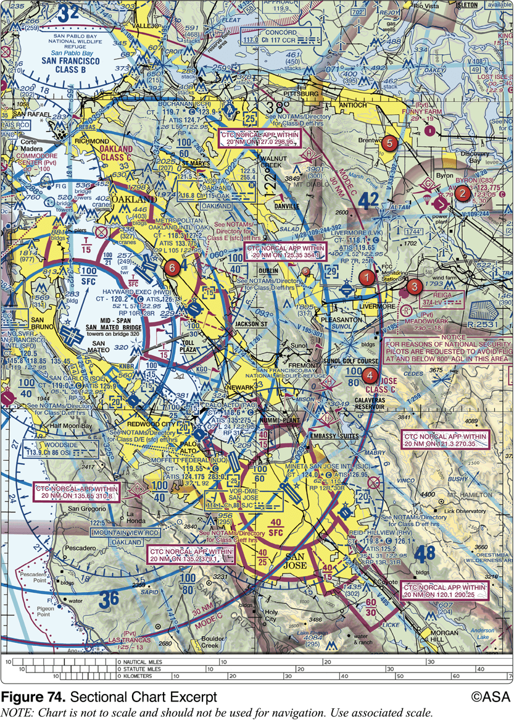
45. (3067) (Refer to Figure 74.) What minimum pilot certificate is required for a flight departing out of Hayward Executive (area 6)?
a. Student Pilot Certificate. b. Private Pilot Certificate c. Sport Pilot Certificate.

Slide 90
45. (3067) (Refer to Figure 74.) What minimum pilot certificate is required for a flight departing out of Hayward Executive (area 6)?
*a. Student Pilot Certificate. b. Private Pilot Certificate c. Sport Pilot Certificate.
Hayward Executive is located in Class D airspace up to but not including 1,500 feet MSL as depicted by the blue segmented line surrounding it. No specific pilot certification is required for flight within Class D airspace. A student pilot may operate within Class D airspace with appropriate solo endorsements.Answer (B) is incorrect because no minimum pilot certificate is specified for operations in Class D airspace. Answer (C) is incorrect because no minimum pilot certificate is specified for operations in Class D airspace.

Slide 91
46. (3070) The final authority as to the operation of an aircraft is the
a. Federal Aviation Administration. b. pilot-in-command. c. aircraft manufacturer.

Slide 92
46. (3070) The final authority as to the operation of an aircraft is the
a. Federal Aviation Administration. *b. pilot-in-command. c. aircraft manufacturer.
The PIC of an aircraft is directly responsible for and is the final authority as to the operation of that aircraft.

Slide 93
47. (3072) If an in-flight emergency requires immediate action, the pilot-in-command may
a. deviate from any rule of 14 CFR Part 91 to the extent required to meet the emergency, but must submit a written report to the Administrator within 24 hours. b. deviate from any rule of 14 CFR Part 91 to the extent required to meet that emergency. c. not deviate from any rule of 14 CFR Part 91 unless prior to the deviation approval is granted by the Administrator.

Slide 94
47. (3072) If an in-flight emergency requires immediate action, the pilot-in-command may
a. deviate from any rule of 14 CFR Part 91 to the extent required to meet the emergency, but must submit a written report to the Administrator within 24 hours. *b. deviate from any rule of 14 CFR Part 91 to the extent required to meet that emergency. c. not deviate from any rule of 14 CFR Part 91 unless prior to the deviation approval is granted by the Administrator.
If an emergency requires immediate action, the PIC may deviate from the operating rules of Part 91 to the extent necessary to meet that emergency. No report of such deviation is required unless the FAA requests one.

Slide 95
48. (3073) When must a pilot who deviates from a regulation during an emergency send a written report of that deviation to the Administrator?
a. Within 7 days. b. Within 10 days. c. Upon request.

Slide 96
48. (3073) When must a pilot who deviates from a regulation during an emergency send a written report of that deviation to the Administrator?
a. Within 7 days. b. Within 10 days. *c. Upon request.
Each PIC who deviates from a rule in an emergency shall, upon request, send a written report of that deviation to the Administrator.

Slide 97
49. (3074) Who is responsible for determining if an aircraft is in condition for safe flight?
a. A certificated aircraft mechanic. b. The pilot-in-command. c. The owner or operator.

Slide 98
49. (3074) Who is responsible for determining if an aircraft is in condition for safe flight?
a. A certificated aircraft mechanic. *b. The pilot-in-command. c. The owner or operator.
The PIC of an aircraft is responsible for determining whether that aircraft is in condition for safe flight. The pilot shall discontinue the flight when unairworthy mechanical, electrical, or structural conditions occur.

Slide 99
50. (3075) Where may an aircraft's operating limitations be found?
a. On the airworthiness certificate. b. In the current, FAA-approved flight manual, approved manual material, markings, and placards, or any combination thereof. c. In the aircraft airframe and engine logbooks.

Slide 100
50. (3075) Where may an aircraft's operating limitations be found?
a. On the airworthiness certificate. *b. In the current, FAA-approved flight manual, approved manual material, markings, and placards, or any combination thereof. c. In the aircraft airframe and engine logbooks.
No person may operate a civil aircraft without complying with the limitations found in the approved flight manual, markings, and placards.

Slide 101
51. (3075.1) Where may an aircraft`s operating limitations be found if the aircraft has an experimental or special light-sport airworthiness certificate?
a. Attached to the Airworthiness Certificate. b. In the current, FAA-approved flight manual. c. In the aircraft airframe and engine logbooks.

Slide 102
51. (3075.1) Where may an aircraft`s operating limitations be found if the aircraft has an experimental or special light-sport airworthiness certificate?
*a. Attached to the Airworthiness Certificate. b. In the current, FAA-approved flight manual. c. In the aircraft airframe and engine logbooks.
Operating limitations for experimental and special light-sport aircraft are attached to the airworthiness certificate; 14 CFR 21.190 and 91.319 describe the qualification for issuance and operating limitations. FAA order 8130.2G specifically states that the operating limitations will be attached to FAA Form 8130-7.

Slide 103
52. (3076) Under what conditions may objects be dropped from an aircraft?
a. Only in an emergency. b. If precautions are taken to avoid injury or damage to persons or property on the surface. c. If prior permission is received from the FAA.

Slide 104
52. (3076) Under what conditions may objects be dropped from an aircraft?
a. Only in an emergency. *b. If precautions are taken to avoid injury or damage to persons or property on the surface. c. If prior permission is received from the FAA.
No PIC of a civil aircraft may allow any object to be dropped from an aircraft in flight that creates a hazard to persons or property. However, this does not prohibit the dropping of any object if reasonable precautions are taken to avoid injury or damage to persons or property.

Slide 105
53. (3077) A person may not act as a crewmember of a civil aircraft if alcoholic beverages have been consumed by that person within the preceding
a. 8 hours. b. 12 hours. c. 24 hours.

Slide 106
53. (3077) A person may not act as a crewmember of a civil aircraft if alcoholic beverages have been consumed by that person within the preceding
*a. 8 hours. b. 12 hours. c. 24 hours.
No person may act or attempt to act as a crewmember of a civil aircraft within 8 hours after the consumption of any alcoholic beverage. Remember: '8 hours bottle to throttle.'

Slide 107
54. (3078) Under what condition, if any, may a pilot allow a person who is obviously under the influence of drugs to be carried aboard an aircraft?
a. In an emergency or if the person is a medical patient under proper care. b. Only if the person does not have access to the cockpit or pilot's compartment. c. Under no condition.

Slide 108
54. (3078) Under what condition, if any, may a pilot allow a person who is obviously under the influence of drugs to be carried aboard an aircraft?
*a. In an emergency or if the person is a medical patient under proper care. b. Only if the person does not have access to the cockpit or pilot's compartment. c. Under no condition.
Except in an emergency, or a medical patient under proper care, no pilot of a civil aircraft may allow a person who appears to be intoxicated, or who demonstrates by manner or physical indications that the individual is under the influence of drugs, to be carried in that aircraft.

Slide 109
55. (3079) No person may attempt to act as a crewmember of a civil aircraft with
a. .008 percent by weight or more alcohol in the blood. b. .004 percent by weight or more alcohol in the blood. c. .04 percent by weight or more alcohol in the blood.

Slide 110
55. (3079) No person may attempt to act as a crewmember of a civil aircraft with
a. .008 percent by weight or more alcohol in the blood. b. .004 percent by weight or more alcohol in the blood. *c. .04 percent by weight or more alcohol in the blood.
No person may act, or attempt to act, as a crewmember of a civil aircraft while having .04 percent or more, by weight, alcohol in the blood.

Slide 111
56. (3079.1) How soon after the conviction for driving while intoxicated by alcohol or drugs shall it be reported to the FAA Civil Aviation Security Division?
a. No later than 60 days after the motor vehicle action. b. No later than 30 working days after the motor vehicle action. c. Required to be reported upon renewal of medical certificate.

Slide 112
56. (3079.1) How soon after the conviction for driving while intoxicated by alcohol or drugs shall it be reported to the FAA Civil Aviation Security Division?
*a. No later than 60 days after the motor vehicle action. b. No later than 30 working days after the motor vehicle action. c. Required to be reported upon renewal of medical certificate.
Each person holding a pilot certificate shall provide a written report of each drug or alcohol-related motor vehicle action to the AMC-700 not later than 60 days after the motor vehicle action.

Slide 113
57. (3080) Which preflight action is specifically required of the pilot prior to each flight?
a. Check the aircraft logbooks for appropriate entries. b. Become familiar with all available information concerning the flight. c. Review wake turbulence avoidance procedures.

Slide 114
57. (3080) Which preflight action is specifically required of the pilot prior to each flight?
a. Check the aircraft logbooks for appropriate entries. *b. Become familiar with all available information concerning the flight. c. Review wake turbulence avoidance procedures.
Each PIC shall, before each flight, become familiar with all available information concerning that flight. This information must include: (a) For a flight under IFR or a flight not in the vicinity of an airport, weather reports and forecasts, fuel requirements, alternatives available if the planned flight cannot be completed, and any known traffic delays of which the pilot has been advised by ATC; (b) For any flight, runway lengths of airports of intended use, and the following takeoff and landing distance information: 1. For civil aircraft for which an approved airplane or rotorcraft flight manual containing takeoff and landing distance data is required, the takeoff and landing distance data contained therein; and 2. For civil aircraft other than those specified in paragraph (b)(1) of this section, other reliable information appropriate to the aircraft, relating to aircraft performance under expected values of airport elevation and runway slope, aircraft gross weight, and wind and temperature.

Slide 115
58. (3081) Preflight action, as required for all flights away from the vicinity of an airport, shall include
a. the designation of an alternate airport. b. a study of arrival procedures at airports/ heliports of intended use. c. an alternate course of action if the flight cannot be completed as planned.

Slide 116
58. (3081) Preflight action, as required for all flights away from the vicinity of an airport, shall include
a. the designation of an alternate airport. b. a study of arrival procedures at airports/ heliports of intended use. *c. an alternate course of action if the flight cannot be completed as planned.
Each PIC shall, before each flight, become familiar with all available information concerning that flight. This information must include: (a) For a flight under IFR or a flight not in the vicinity of an airport, weather reports and forecasts, fuel requirements, alternatives available if the planned flight cannot be completed, and any known traffic delays of which the pilot has been advised by ATC; (b) For any flight, runway lengths of airports of intended use, and the following takeoff and landing distance information: 1. For civil aircraft for which an approved airplane or rotorcraft flight manual containing takeoff and landing distance data is required, the takeoff and landing distance data contained therein; and 2. For civil aircraft other than those specified in paragraph (b)(1) of this section, other reliable information appropriate to the aircraft, relating to aircraft performance under expected values of airport elevation and runway slope, aircraft gross weight, and wind and temperature.

Slide 117
59. (3082) In addition to other preflight actions for a VFR flight away from the vicinity of the departure airport, regulations specifically require the pilot-in-command to
a. review traffic control light signal procedures. b. check the accuracy of the navigation equipment and the emergency locator transmitter (ELT). c. determine runway lengths at airports of intended use and the aircraft's takeoff and landing distance data.

Slide 118
59. (3082) In addition to other preflight actions for a VFR flight away from the vicinity of the departure airport, regulations specifically require the pilot-in-command to
a. review traffic control light signal procedures. b. check the accuracy of the navigation equipment and the emergency locator transmitter (ELT). *c. determine runway lengths at airports of intended use and the aircraft's takeoff and landing distance data.
Each PIC shall, before each flight, become familiar with all available information concerning that flight. This information must include: (a) For a flight under IFR or a flight not in the vicinity of an airport, weather reports and forecasts, fuel requirements, alternatives available if the planned flight cannot be completed, and any known traffic delays of which the pilot has been advised by ATC; (b) For any flight, runway lengths of airports of intended use, and the following takeoff and landing distance information: 1. For civil aircraft for which an approved airplane or rotorcraft flight manual containing takeoff and landing distance data is required, the takeoff and landing distance data contained therein; and 2. For civil aircraft other than those specified in paragraph (b)(1) of this section, other reliable information appropriate to the aircraft, relating to aircraft performance under expected values of airport elevation and runway slope, aircraft gross weight, and wind and temperature.

Slide 119
60. (3083) Flight crewmembers are required to keep their safety belts and shoulder harnesses fastened during
a. takeoffs and landings. b. all flight conditions. c. flight in turbulent air.

Slide 120
60. (3083) Flight crewmembers are required to keep their safety belts and shoulder harnesses fastened during
*a. takeoffs and landings. b. all flight conditions. c. flight in turbulent air.
During takeoff, landing, and while en route, each required flight crewmember shall keep theirir seatbelt fastened while at the station. During takeoff and landing, this includes wearing a shoulder harness (if installed) unless it interferes with required duties.

Slide 121
61. (3084) Which best describes the flight conditions under which flight crewmembers are specifically required to keep their safety belts and shoulder harnesses fastened?
a. Safety belts during takeoff and landing; shoulder harnesses during takeoff and landing. b. Safety belts during takeoff and landing; shoulder harnesses during takeoff and landing and while en route. c. Safety belts during takeoff and landing and while en route; shoulder harnesses during takeoff and landing.

Slide 122
61. (3084) Which best describes the flight conditions under which flight crewmembers are specifically required to keep their safety belts and shoulder harnesses fastened?
a. Safety belts during takeoff and landing; shoulder harnesses during takeoff and landing. b. Safety belts during takeoff and landing; shoulder harnesses during takeoff and landing and while en route. *c. Safety belts during takeoff and landing and while en route; shoulder harnesses during takeoff and landing.
During takeoff, landing, and while en route, each required flight crewmember shall keep their seatbelt fastened while at their station. During takeoff and landing, this includes wearing a shoulder harness (if installed) unless it interferes with required duties.

Slide 123
62. (3085) With respect to passengers, what obligation, if any, does a pilot-in-command have concerning the use of safety belts?
a. The pilot-in-command must instruct the passengers to keep their safety belts fastened for the entire flight. b. The pilot-in-command must brief the passengers on the use of safety belts and notify them to fasten their safety belts during taxi, takeoff, and landing. c. The pilot-in-command has no obligation in regard to passengers' use of safety belts.

Slide 124
62. (3085) With respect to passengers, what obligation, if any, does a pilot-in-command have concerning the use of safety belts?
a. The pilot-in-command must instruct the passengers to keep their safety belts fastened for the entire flight. *b. The pilot-in-command must brief the passengers on the use of safety belts and notify them to fasten their safety belts during taxi, takeoff, and landing. c. The pilot-in-command has no obligation in regard to passengers' use of safety belts.
Unless otherwise authorized by the Administrator, no pilot may takeoff in a civil aircraft unless the PIC of that aircraft ensures that each person on board is briefed on how to fasten and unfasten their seatbelt, and that each person has been notified to fasten the seatbelt during taxi, takeoff, and landing.

Slide 125
63. (3085.1) Pre-takeoff briefing of passengers about the use of seat belts for a flight is the responsibility of
a. all passengers. b. the pilot-in-command. c. the right seat pilot.

Slide 126
63. (3085.1) Pre-takeoff briefing of passengers about the use of seat belts for a flight is the responsibility of
a. all passengers. *b. the pilot-in-command. c. the right seat pilot.
Unless otherwise authorized by the Administrator, no pilot may takeoff in a civil aircraft unless the PIC of that aircraft ensures that each person on board is briefed on how to fasten and unfasten their seatbelt, and that each person has been notified to fasten the seatbelt during taxi, takeoff, and landing.

Slide 127
64. (3086) With certain exceptions, safety belts are required to be secured about passengers during
a. taxi, takeoffs, and landings. b. all flight conditions. c. flight in turbulent air.

Slide 128
64. (3086) With certain exceptions, safety belts are required to be secured about passengers during
*a. taxi, takeoffs, and landings. b. all flight conditions. c. flight in turbulent air.
During taxi, takeoff, and landing, each person on board the aircraft must occupy a seat or berth with a seatbelt and shoulder harness, properly secured if installed.

Slide 129
65. (3087) Safety belts are required to be properly secured about which persons in an aircraft and when?
a. Pilots only, during takeoffs and landings. b. Passengers, during taxi, takeoffs, and landings only. c. Each person on board the aircraft during the entire flight.

Slide 130
65. (3087) Safety belts are required to be properly secured about which persons in an aircraft and when?
a. Pilots only, during takeoffs and landings. *b. Passengers, during taxi, takeoffs, and landings only. c. Each person on board the aircraft during the entire flight.
During taxi, takeoff, and landing, each person on board the aircraft must occupy a seat or berth with a safety belt and shoulder harness, properly secured if installed. However, a child under two years of age may be held by an adult who is occupying a seat or a berth, and a person on board for the purpose of engaging in sport parachuting may use the floor of the aircraft as a seat.

Slide 131
66. (3088) No person may operate an aircraft in formation flight
a. over a densely populated area. b. in Class D airspace. c. except by prior arrangement with the pilot in command of each aircraft.

Slide 132
66. (3088) No person may operate an aircraft in formation flight
a. over a densely populated area. b. in Class D airspace. *c. except by prior arrangement with the pilot in command of each aircraft.
No person may operate an aircraft in formation flight except by arrangement with the PIC of each aircraft in the formation. The only restriction to formation flight is when carrying passengers for hire.

Slide 133
67. (3089) Which aircraft has the right-of-way over all other air traffic?
a. A balloon. b. An aircraft in distress. c. An aircraft on final approach to land.

Slide 134
67. (3089) Which aircraft has the right-of-way over all other air traffic?
a. A balloon. *b. An aircraft in distress. c. An aircraft on final approach to land.
An aircraft in distress has the right-of-way over all other air traffic.

Slide 135
68. (3090) What action is required when two aircraft of the same category converge, but not head-on?
a. The faster aircraft shall give way. b. The aircraft on the left shall give way. c. Each aircraft shall give way to the right.

Slide 136
68. (3090) What action is required when two aircraft of the same category converge, but not head-on?
a. The faster aircraft shall give way. *b. The aircraft on the left shall give way. c. Each aircraft shall give way to the right.
When two aircraft of the same 'right-of-way' category converge at approximately the same altitude, the aircraft to the other's right has the right-of-way. Answer (A) is incorrect because speed has nothing to do with right-of-way. Answer (C) is incorrect because 'each aircraft giving way to the right' is the rule when approaching head-on.

Slide 137
69. (3091) Which aircraft has the right-of-way over the other aircraft listed?
a. Gyroplane. b. Airship. c. Aircraft towing other aircraft.

Slide 138
69. (3091) Which aircraft has the right-of-way over the other aircraft listed?
a. Gyroplane. b. Airship. *c. Aircraft towing other aircraft.
An aircraft towing or refueling other aircraft has the right-of-way over all other engine-driven aircraft.

Slide 139
70. (3092) An airplane and an airship are converging. If the airship is left of the airplane's position, which aircraft has the right-of-way?
a. The airship. b. The airplane. c. Each pilot should alter course to the right.

Slide 140
70. (3092) An airplane and an airship are converging. If the airship is left of the airplane's position, which aircraft has the right-of-way?
*a. The airship. b. The airplane. c. Each pilot should alter course to the right.
An airship has the right-of-way over an airplane or rotorcraft.

Slide 141
71. (3093) Which aircraft has the right-of-way over the other aircraft listed?
a. Glider. b. Airship. c. Aircraft refueling other aircraft.

Slide 142
71. (3093) Which aircraft has the right-of-way over the other aircraft listed?
*a. Glider. b. Airship. c. Aircraft refueling other aircraft.
A glider has the right-of-way over an airship, airplane, or rotorcraft. Answer (B) is incorrect because a glider has the right-of-way over powered aircraft. Answer (C) is incorrect because an aircraft refueling other aircraft only has right-of-way over other engine-driven aircraft.

Slide 143
72. (3094) What action should the pilots of a glider and an airplane take if on a head-on collision course?
a. The airplane pilot should give way to the left. b. The glider pilot should give way to the right. c. Both pilots should give way to the right.

Slide 144
72. (3094) What action should the pilots of a glider and an airplane take if on a head-on collision course?
a. The airplane pilot should give way to the left. b. The glider pilot should give way to the right. *c. Both pilots should give way to the right.
When two aircraft are approaching each other from head-on, or nearly so, each pilot must alter course to the right. This rule does not give right-of-way by categories.

Slide 145
73. (3095) When two or more aircraft are approaching an airport for the purpose of landing, the right-of-way belongs to the aircraft
a. that has the other to its right. b. that is the least maneuverable. c. at the lower altitude, but it shall not take advantage of this rule to cut in front of or to overtake another.

Slide 146
73. (3095) When two or more aircraft are approaching an airport for the purpose of landing, the right-of-way belongs to the aircraft
a. that has the other to its right. b. that is the least maneuverable. *c. at the lower altitude, but it shall not take advantage of this rule to cut in front of or to overtake another.
When two aircraft are approaching an airport for landing, the lower aircraft has the right-of-way. A pilot shall not take advantage of that rule to overtake or cut in front of another aircraft.

Slide 147
74. (3096) A seaplane and a motorboat are on crossing courses. If the motorboat is to the left of the seaplane, which has the right-of-way?
a. The motorboat. b. The seaplane. c. Both should alter course to the right.

Slide 148
74. (3096) A seaplane and a motorboat are on crossing courses. If the motorboat is to the left of the seaplane, which has the right-of-way?
a. The motorboat. *b. The seaplane. c. Both should alter course to the right.
For water operation, when aircraft, or an aircraft and a vessel, are on crossing courses, the aircraft or vessel to the other's right has the right-of-way.

Slide 149
75. (3097) Unless otherwise authorized, what is the maximum indicated airspeed at which a person may operate an aircraft below 10,000 feet MSL?
a. 200 knots. b. 250 knots. c. 288 knots.

Slide 150
75. (3097) Unless otherwise authorized, what is the maximum indicated airspeed at which a person may operate an aircraft below 10,000 feet MSL?
a. 200 knots. *b. 250 knots. c. 288 knots.
Maximum speed below 10,000 feet MSL is 250 knots.

Slide 151
76. (3098) Unless otherwise authorized, the maximum indicated airspeed at which aircraft may be flown when at or below 2,500 feet AGL and within 4 nautical miles of the primary airport of Class C airspace is
a. 200 knots. b. 230 knots. c. 250 knots.

Slide 152
76. (3098) Unless otherwise authorized, the maximum indicated airspeed at which aircraft may be flown when at or below 2,500 feet AGL and within 4 nautical miles of the primary airport of Class C airspace is
*a. 200 knots. b. 230 knots. c. 250 knots.
Unless otherwise authorized or required by ATC, no person may operate an aircraft at or below 2,500 feet AGL within 4 NM of the primary airport of a Class C or Class D airspace area at an indicated airspeed of more than 200 knots.

Slide 153
77. (3099) When flying in the airspace underlying Class B airspace, the maximum speed authorized is
a. 200 knots. b. 230 knots. c. 250 knots.

Slide 154
77. (3099) When flying in the airspace underlying Class B airspace, the maximum speed authorized is
*a. 200 knots. b. 230 knots. c. 250 knots.
No person may operate an aircraft in the airspace underlying Class B airspace at a speed of more than 200 knots.

Slide 155
78. (3100) When flying in a VFR corridor designated through Class B airspace, the maximum speed authorized is
a. 180 knots. b. 200 knots. c. 250 knots.

Slide 156
78. (3100) When flying in a VFR corridor designated through Class B airspace, the maximum speed authorized is
a. 180 knots. *b. 200 knots. c. 250 knots.
Maximum speed in a VFR corridor through Class B airspace is 200 KIAS.

Slide 157
79. (3101) Except when necessary for takeoff or landing, what is the minimum safe altitude for a pilot to operate an aircraft anywhere?
a. An altitude allowing, if a power unit fails, an emergency landing without undue hazard to persons or property on the surface. b. An altitude of 500 feet above the surface and no closer than 500 feet to any person, vessel, vehicle, or structure. c. An altitude of 500 feet above the highest obstacle within a horizontal radius of 1,000 feet.

Slide 158
79. (3101) Except when necessary for takeoff or landing, what is the minimum safe altitude for a pilot to operate an aircraft anywhere?
*a. An altitude allowing, if a power unit fails, an emergency landing without undue hazard to persons or property on the surface. b. An altitude of 500 feet above the surface and no closer than 500 feet to any person, vessel, vehicle, or structure. c. An altitude of 500 feet above the highest obstacle within a horizontal radius of 1,000 feet.
Except when necessary for takeoff or landing, no person may operate an aircraft anywhere below an altitude allowing, if a power unit fails, an emergency landing without undue hazard to persons or property on the surface.

Slide 159
80. (3102) Except when necessary for takeoff or landing, what is the minimum safe altitude required for a pilot to operate an aircraft over congested areas?
a. An altitude of 1,000 feet above any person, vessel, vehicle, or structure. b. An altitude of 500 feet above the highest obstacle within a horizontal radius of 1,000 feet of the aircraft. c. An altitude of 1,000 feet above the highest obstacle within a horizontal radius of 2,000 feet of the aircraft.

Slide 160
80. (3102) Except when necessary for takeoff or landing, what is the minimum safe altitude required for a pilot to operate an aircraft over congested areas?
a. An altitude of 1,000 feet above any person, vessel, vehicle, or structure. b. An altitude of 500 feet above the highest obstacle within a horizontal radius of 1,000 feet of the aircraft. *c. An altitude of 1,000 feet above the highest obstacle within a horizontal radius of 2,000 feet of the aircraft.
Except when necessary for takeoff or landing, no person may operate an aircraft over any congested area of a city, town, or settlement, or over any open air assembly of persons, below an altitude of 1,000 feet above the highest obstacle within a horizontal radius of 2,000 feet of the aircraft.

Slide 161
81. (3103) Except when necessary for takeoff or landing, what is the minimum safe altitude required for a pilot to operate an aircraft over other than a congested area?
a. An altitude allowing, if a power unit fails, an emergency landing without undue hazard to persons or property on the surface. b. An altitude of 500 feet AGL, except over open water or a sparsely populated area, which requires 500 feet from any person, vessel, vehicle, or structure. c. An altitude of 500 feet above the highest obstacle within a horizontal radius of 1,000 feet.

Slide 162
81. (3103) Except when necessary for takeoff or landing, what is the minimum safe altitude required for a pilot to operate an aircraft over other than a congested area?
a. An altitude allowing, if a power unit fails, an emergency landing without undue hazard to persons or property on the surface. *b. An altitude of 500 feet AGL, except over open water or a sparsely populated area, which requires 500 feet from any person, vessel, vehicle, or structure. c. An altitude of 500 feet above the highest obstacle within a horizontal radius of 1,000 feet.
Except when necessary for takeoff or landing, no person may operate an aircraft over other than congested areas below an altitude of 500 feet above the surface except over open water or sparsely populated areas. In that case, the aircraft may not be operated closer than 500 feet to any person, vessel, vehicle, or structure.

Slide 163
82. (3104) Except when necessary for takeoff or landing, an aircraft may not be operated closer than what distance from any person, vessel, vehicle, or structure?
a. 500 feet. b. 700 feet. c. 1,000 feet.

Slide 164
82. (3104) Except when necessary for takeoff or landing, an aircraft may not be operated closer than what distance from any person, vessel, vehicle, or structure?
*a. 500 feet. b. 700 feet. c. 1,000 feet.
Except when necessary for takeoff or landing, no person may operate an aircraft closer than 500 feet to any person, vessel, vehicle, or structure.

Slide 165
83. (3108) When an ATC clearance has been obtained, no pilot-in-command may deviate from that clearance, unless that pilot obtains an amended clearance. The one exception to this regulation is
a. when the clearance states 'at pilot's discretion.' b. an emergency. c. if the clearance contains a restriction.

Slide 166
83. (3108) When an ATC clearance has been obtained, no pilot-in-command may deviate from that clearance, unless that pilot obtains an amended clearance. The one exception to this regulation is
a. when the clearance states 'at pilot's discretion.' *b. an emergency. c. if the clearance contains a restriction.
Except in an emergency, no person may operate an aircraft contrary to an ATC clearance or instruction.

Slide 167
84. (3108.1) As pilot-in-command of an aircraft, under which situation can you deviate from an ATC clearance?
a. When operating in Class A airspace at night. b. If an ATC clearance is not understood and in VFR conditions. c. In response to a traffic alert and collision avoidance system resolution advisory.

Slide 168
84. (3108.1) As pilot-in-command of an aircraft, under which situation can you deviate from an ATC clearance?
a. When operating in Class A airspace at night. b. If an ATC clearance is not understood and in VFR conditions. *c. In response to a traffic alert and collision avoidance system resolution advisory.
The regulations authorize deviations from a clearance in response to a traffic alert and collision avoidance system resolution advisory. You must notify ATC as soon as possible following the deviation. Answer (A) is incorrect because neither of these are acceptable reasons to deviate from an ATC clearance. Answer (B) is incorrect because neither of these are acceptable reasons to deviate from an ATC clearance.

Slide 169
85. (3109) When would a pilot be required to submit a detailed report of an emergency which caused the pilot to deviate from an ATC clearance?
a. Within 48 hours if requested by ATC. b. Immediately. c. Within 7 days.

Slide 170
85. (3109) When would a pilot be required to submit a detailed report of an emergency which caused the pilot to deviate from an ATC clearance?
*a. Within 48 hours if requested by ATC. b. Immediately. c. Within 7 days.
Each PIC who deviated from an ATC clearance during an emergency must submit a detailed report within 48 hours if requested by ATC.

Slide 171
86. (3110) What action, if any, is appropriate if the pilot deviates from an ATC instruction during an emergency and is given priority?
a. Take no special action since you are pilot in command. b. File a detailed report within 48 hours to the chief of the appropriate ATC facility, if requested. c. File a report to the FAA Administrator, as soon as possible.

Slide 172
86. (3110) What action, if any, is appropriate if the pilot deviates from an ATC instruction during an emergency and is given priority?
a. Take no special action since you are pilot in command. *b. File a detailed report within 48 hours to the chief of the appropriate ATC facility, if requested. c. File a report to the FAA Administrator, as soon as possible.
Each PIC who (though not deviating from a rule of 14 CFR Part 91) is given priority by ATC in an emergency shall, if requested by ATC, submit a detailed report of that emergency within 48 hours to the chief of that ATC facility.

Slide 173
87. (3131) What is the specific fuel requirement for flight under VFR during daylight hours in an airplane?
a. Enough to complete the flight at normal cruising speed with adverse wind conditions. b. Enough to fly to the first point of intended landing and to fly after that for 30 minutes at normal cruising speed. c. Enough to fly to the first point of intended landing and to fly after that for 45 minutes at normal cruising speed.

Slide 174
87. (3131) What is the specific fuel requirement for flight under VFR during daylight hours in an airplane?
a. Enough to complete the flight at normal cruising speed with adverse wind conditions. *b. Enough to fly to the first point of intended landing and to fly after that for 30 minutes at normal cruising speed. c. Enough to fly to the first point of intended landing and to fly after that for 45 minutes at normal cruising speed.
No person may begin a flight in an airplane under VFR unless (considering wind and forecast weather conditions) there is enough fuel to fly to the first point of intended landing and, assuming normal cruising speed, and day operations, to fly after that for at least 30 minutes.

Slide 175
88. (3132) What is the specific fuel requirement for flight under VFR at night in an airplane?
a. Enough to complete the flight at normal cruising speed with adverse wind conditions. b. Enough to fly to the first point of intended landing and to fly after that for 30 minutes at normal cruising speed. c. Enough to fly to the first point of intended landing and to fly after that for 45 minutes at normal cruising speed.

Slide 176
88. (3132) What is the specific fuel requirement for flight under VFR at night in an airplane?
a. Enough to complete the flight at normal cruising speed with adverse wind conditions. b. Enough to fly to the first point of intended landing and to fly after that for 30 minutes at normal cruising speed. *c. Enough to fly to the first point of intended landing and to fly after that for 45 minutes at normal cruising speed.
No person may begin a flight in an airplane under VFR unless (considering wind and forecast weather conditions) there is enough fuel to fly to the first point of intended landing and, assuming normal cruising speed, and night operations, to fly after that for at least 45 minutes.

Slide 177
89. (3136) During operations within controlled airspace at altitudes of less than 1,200 feet AGL, the minimum horizontal distance from clouds requirement for VFR flight is
a. 1,000 feet. b. 1,500 feet. c. 2,000 feet.

Slide 178
89. (3136) During operations within controlled airspace at altitudes of less than 1,200 feet AGL, the minimum horizontal distance from clouds requirement for VFR flight is
a. 1,000 feet. b. 1,500 feet. *c. 2,000 feet.
Minimum horizontal distance from clouds within Class C, D, or E airspace below 10,000 feet MSL is 2,000 feet.

Slide 179
90. (3137) What minimum visibility and clearance from clouds are required for VFR operations in Class G airspace at 700 feet AGL or below during daylight hours?
a. 1 mile visibility and clear of clouds. b. 1 mile visibility, 500 feet below, 1,000 feet above, and 2,000 feet horizontal clearance from clouds. c. 3 miles visibility and clear of clouds.

Slide 180
90. (3137) What minimum visibility and clearance from clouds are required for VFR operations in Class G airspace at 700 feet AGL or below during daylight hours?
*a. 1 mile visibility and clear of clouds. b. 1 mile visibility, 500 feet below, 1,000 feet above, and 2,000 feet horizontal clearance from clouds. c. 3 miles visibility and clear of clouds.
Minimum visibility and cloud clearance for Class G airspace at 700 feet AGL or below during daylight hours is 1 mile visibility and clear of clouds. Answer (B) is incorrect because this is for Class C, D, or E airspace. Answer (C) is incorrect because this is for Class B airspace.

Slide 181
91. (3138) What minimum flight visibility is required for VFR flight operations on an airway below 10,000 feet MSL?
a. 1 mile. b. 3 miles. c. 4 miles.

Slide 182
91. (3138) What minimum flight visibility is required for VFR flight operations on an airway below 10,000 feet MSL?
a. 1 mile. *b. 3 miles. c. 4 miles.
An airway below 10,000 feet MSL is in either Class B, C, or D, or E airspace, and requires 3 miles flight visibility.

Slide 183
92. (3139) The minimum distance from clouds required for VFR operations on an airway below 10,000 feet MSL is
a. remain clear of clouds. b. 500 feet below, 1,000 feet above, and 2,000 feet horizontally. c. 500 feet above, 1,000 feet below, and 2,000 feet horizontally.

Slide 184
92. (3139) The minimum distance from clouds required for VFR operations on an airway below 10,000 feet MSL is
a. remain clear of clouds. *b. 500 feet below, 1,000 feet above, and 2,000 feet horizontally. c. 500 feet above, 1,000 feet below, and 2,000 feet horizontally.
An airway below 10,000 feet MSL is in either Class B, C, or D, or E airspace, and requires a cloud clearance of 500 feet below, 1,000 feet above, and 2,000 feet horizontally.

Slide 185
93. (3140) During operations within controlled airspace at altitudes of more than 1,200 feet AGL, but less than 10,000 feet MSL, the minimum distance above clouds requirement for VFR flight is
a. 500 feet. b. 1,000 feet. c. 1,500 feet.

Slide 186
93. (3140) During operations within controlled airspace at altitudes of more than 1,200 feet AGL, but less than 10,000 feet MSL, the minimum distance above clouds requirement for VFR flight is
a. 500 feet. *b. 1,000 feet. c. 1,500 feet.
Class B, C, D, and E airspace are all controlled airspace in which VFR flight is allowed, and requires a cloud clearance of 1,000 feet above at altitudes of more than 1,200 feet AGL, but less than 10,000 feet MSL.

Slide 187
94. (3141) VFR flight in controlled airspace above 1,200 feet AGL and below 10,000 feet MSL requires a minimum visibility and vertical cloud clearance of
a. 3 miles, and 500 feet below or 1,000 feet above the clouds in controlled airspace. b. 5 miles, and 1,000 feet below or 1,000 feet above the clouds at all altitudes. c. 5 miles, and 1,000 feet below or 1,000 feet above the clouds only in Class A airspace.

Slide 188
94. (3141) VFR flight in controlled airspace above 1,200 feet AGL and below 10,000 feet MSL requires a minimum visibility and vertical cloud clearance of
*a. 3 miles, and 500 feet below or 1,000 feet above the clouds in controlled airspace. b. 5 miles, and 1,000 feet below or 1,000 feet above the clouds at all altitudes. c. 5 miles, and 1,000 feet below or 1,000 feet above the clouds only in Class A airspace.
With the exception of Class B airspace, VFR flight into controlled airspace requires 3 statute miles visibility and cloud clearance of 500 feet below and 1,000 feet above when operating above 1,200 feet AGL and below 10,000 feet MSL.

Slide 189
95. (3142) During operations outside controlled airspace at altitudes of more than 1,200 feet AGL, but less than 10,000 feet MSL, the minimum flight visibility for VFR flight at night is
a. 1 mile. b. 3 miles. c. 5 miles.

Slide 190
95. (3142) During operations outside controlled airspace at altitudes of more than 1,200 feet AGL, but less than 10,000 feet MSL, the minimum flight visibility for VFR flight at night is
a. 1 mile. *b. 3 miles. c. 5 miles.
At altitudes of more than 1,200 feet AGL but less than 10,000 feet MSL, Class G airspace requires 3 miles visibility at night.

Slide 191
96. (3143) During operations outside controlled airspace at altitudes of more than 1,200 feet AGL, but less than 10,000 feet MSL, the minimum flight visibility for day VFR flight is
a. 1 mile. b. 3 miles. c. 5 miles.

Slide 192
96. (3143) During operations outside controlled airspace at altitudes of more than 1,200 feet AGL, but less than 10,000 feet MSL, the minimum flight visibility for day VFR flight is
*a. 1 mile. b. 3 miles. c. 5 miles.
At altitudes of more than 1,200 feet AGL but less than 10,000 feet MSL, Class G airspace requires 1 mile visibility during the day.

Slide 193
97. (3144) During operations outside controlled airspace at altitudes of more than 1,200 feet AGL, but less than 10,000 feet MSL, the minimum distance below clouds requirement for VFR flight at night is
a. 500 feet. b. 1,000 feet. c. 1,500 feet.

Slide 194
97. (3144) During operations outside controlled airspace at altitudes of more than 1,200 feet AGL, but less than 10,000 feet MSL, the minimum distance below clouds requirement for VFR flight at night is
*a. 500 feet. b. 1,000 feet. c. 1,500 feet.
At altitudes of more than 1,200 feet AGL but less than 10,000 feet MSL, Class G airspace requires a cloud clearance of 500 feet below, 1,000 feet above, and 2,000 feet horizontal, during both day and night flights.

Slide 195
98. (3145) The minimum flight visibility required for VFR flights above 10,000 feet MSL and more than 1,200 feet AGL in controlled airspace is
a. 1 mile. b. 3 miles. *c. 5 miles.

Slide 196
98. (3145) The minimum flight visibility required for VFR flights above 10,000 feet MSL and more than 1,200 feet AGL in controlled airspace is
a. 1 mile. b. 3 miles. *c. 5 miles.

Slide 197
99. (3146) For VFR flight operations above 10,000 feet MSL and more than 1,200 feet AGL, the minimum horizontal distance from clouds required is
a. 1,000 feet. b. 2,000 feet. c. 1 mile.

Slide 198
99. (3146) For VFR flight operations above 10,000 feet MSL and more than 1,200 feet AGL, the minimum horizontal distance from clouds required is
a. 1,000 feet. b. 2,000 feet. *c. 1 mile.
Controlled airspace above 10,000 feet which allows VFR is Class E airspace, and requires cloud clearance of 1,000 feet below, 1,000 feet above, and 1 SM horizontal during operations above 10,000 feet MSL and more than 1,200 feet AGL.

Slide 199
100. (3147) During operations at altitudes of more than 1,200 feet AGL and at or above 10,000 feet MSL, the minimum distance above clouds requirement for VFR flight is
a. 500 feet. b. 1,000 feet. c. 1,500 feet.

Slide 200
100. (3147) During operations at altitudes of more than 1,200 feet AGL and at or above 10,000 feet MSL, the minimum distance above clouds requirement for VFR flight is
a. 500 feet. *b. 1,000 feet. c. 1,500 feet.
Controlled airspace above 10,000 feet which allows VFR is Class E airspace, and requires cloud clearance of 1,000 feet below, 1,000 feet above, and 1 SM horizontal during operations above 10,000 feet MSL and more than 1,200 feet AGL.

Slide 201
101. (3148) No person may take off or land an aircraft under basic VFR at an airport that lies within Class D airspace unless the
a. flight visibility at that airport is at least 1 mile. b. ground visibility at that airport is at least 1 mile. c. ground visibility at that airport is at least 3 miles.

Slide 202
101. (3148) No person may take off or land an aircraft under basic VFR at an airport that lies within Class D airspace unless the
a. flight visibility at that airport is at least 1 mile. b. ground visibility at that airport is at least 1 mile. *c. ground visibility at that airport is at least 3 miles.
Except for Special VFR procedures, no person may operate an aircraft under VFR within Class D airspace, beneath the ceiling when the ceiling is less than 1,000 feet. No person may takeoff or land an aircraft, or enter the traffic pattern of an airport under VFR, within Class D airspace unless ground visibility at that airport is at least 3 statute miles.

Slide 203
102. (3149) The basic VFR weather minimums for operating an aircraft within Class D airspace are
a. 500-foot ceiling and 1 mile visibility. b. 1,000-foot ceiling and 3 miles visibility. c. clear of clouds and 2 miles visibility.

Slide 204
102. (3149) The basic VFR weather minimums for operating an aircraft within Class D airspace are
a. 500-foot ceiling and 1 mile visibility. *b. 1,000-foot ceiling and 3 miles visibility. c. clear of clouds and 2 miles visibility.
Except for Special VFR procedures, no person may operate an aircraft under VFR within Class D airspace, beneath the ceiling when the ceiling is less than 1,000 feet. No person may takeoff or land an aircraft, or enter the traffic pattern of an airport under VFR, within Class D airspace unless ground visibility at that airport is at least 3 statute miles.

Slide 205
103. (3150) A Special VFR clearance authorizes the pilot of an aircraft to operate VFR while within Class D airspace when the visibility is
a. less than 1 mile and the ceiling is less than 1,000 feet. b. at least 1 mile and the aircraft can remain clear of clouds. c. at least 3 miles and the aircraft can remain clear of clouds.

Slide 206
103. (3150) A Special VFR clearance authorizes the pilot of an aircraft to operate VFR while within Class D airspace when the visibility is
a. less than 1 mile and the ceiling is less than 1,000 feet. *b. at least 1 mile and the aircraft can remain clear of clouds. c. at least 3 miles and the aircraft can remain clear of clouds.
No person may operate an aircraft (other than a helicopter) in a Class D airspace under Special VFR unless clear of clouds and flight visibility is at least 1 statute mile.

Slide 207
104. (3151) What is the minimum weather condition required for airplanes operating under Special VFR in Class D airspace?
a. 1 mile flight visibility. b. 1 mile flight visibility and 1,000-foot ceiling. c. 3 miles flight visibility and 1,000-foot ceiling.

Slide 208
104. (3151) What is the minimum weather condition required for airplanes operating under Special VFR in Class D airspace?
*a. 1 mile flight visibility. b. 1 mile flight visibility and 1,000-foot ceiling. c. 3 miles flight visibility and 1,000-foot ceiling.
No person may operate an aircraft (other than a helicopter) in a Class D airspace under special VFR unless clear of clouds and flight visibility is at least 1 statute mile.

Slide 209
105. (3153) What are the minimum requirements for airplane operations under Special VFR in Class D airspace at night?
a. The airplane must be under radar surveillance at all times while in Class D airspace. b. The airplane must be equipped for IFR with an altitude reporting transponder. c. The pilot must be instrument rated, and the airplane must be IFR equipped.

Slide 210
105. (3153) What are the minimum requirements for airplane operations under Special VFR in Class D airspace at night?
a. The airplane must be under radar surveillance at all times while in Class D airspace. b. The airplane must be equipped for IFR with an altitude reporting transponder. *c. The pilot must be instrument rated, and the airplane must be IFR equipped.
No person may operate an aircraft (other than a helicopter) in a Class D airspace under special weather minimums between sunset and sunrise unless the pilot and airplane are certified for instrument flight. Answer (A) is incorrect because radar and transponder are not required in Class D airspace. Answer (B) is incorrect because radar and transponder are not required in Class D airspace.

Slide 211
106. (3154) No person may operate an airplane within Class D airspace at night under Special VFR unless the
a. flight can be conducted 500 feet below the clouds. b. airplane is equipped for instrument flight. c. flight visibility is at least 3 miles.

Slide 212
106. (3154) No person may operate an airplane within Class D airspace at night under Special VFR unless the
a. flight can be conducted 500 feet below the clouds. *b. airplane is equipped for instrument flight. c. flight visibility is at least 3 miles.
No person may operate an aircraft (other than a helicopter) in a Class D airspace under special weather minimums between sunset and sunrise unless the airplane and pilot are certified for instrument flight.

Slide 213
107. (3155) Which cruising altitude is appropriate for a VFR flight on a magnetic course of 135°?
a. Even thousandths. b. Even thousandths plus 500 feet. c. Odd thousandths plus 500 feet.

Slide 214
107. (3155) Which cruising altitude is appropriate for a VFR flight on a magnetic course of 135°?
a. Even thousandths. b. Even thousandths plus 500 feet. *c. Odd thousandths plus 500 feet.
When operating below 18,000 feet MSL in VFR cruising flight more than 3,000 feet above the surface and on a magnetic course of 0° through 179°, any odd thousand-foot MSL altitude plus 500 feet (i.e., 3,500, 5,500, etc.) is appropriate. On a course of 180° through 359°, even thousands plus 500 feet (4,500, 6,500, etc.) is appropriate.

Slide 215
108. (3156) Which VFR cruising altitude is acceptable for a flight on a victor airway with a magnetic course of 175°? The terrain is less than 1,000 feet.
a. 4,500 feet. b. 5,000 feet. c. 5,500 feet.

Slide 216
108. (3156) Which VFR cruising altitude is acceptable for a flight on a victor airway with a magnetic course of 175°? The terrain is less than 1,000 feet.
a. 4,500 feet. b. 5,000 feet. *c. 5,500 feet.
When operating below 18,000 feet MSL in VFR cruising flight more than 3,000 feet above the surface and on a magnetic course of 0° through 179°, any odd thousand-foot MSL altitude plus 500 feet (i.e., 3,500, 5,500, etc.) is appropriate. On a course of 180° through 359°, even thousands plus 500 feet (4,500, 6,500, etc.) is appropriate.

Slide 217
109. (3157) Which VFR cruising altitude is appropriate when flying above 3,000 feet AGL on a magnetic course of 185°?
a. 4,000 feet. b. 4,500 feet. c. 5,000 feet.

Slide 218
109. (3157) Which VFR cruising altitude is appropriate when flying above 3,000 feet AGL on a magnetic course of 185°?
a. 4,000 feet. *b. 4,500 feet. c. 5,000 feet.
When operating below 18,000 feet MSL in VFR cruising flight more than 3,000 feet above the surface and on a magnetic course of 0° through 179°, any odd thousand-foot MSL altitude plus 500 feet (i.e., 3,500, 5,500, etc.) is appropriate. On a course of 180° through 359°, even thousands plus 500 feet (4,500, 6,500, etc.) is appropriate.

Slide 219
110. (3158) Each person operating an aircraft at a VFR cruising altitude shall maintain an odd-thousand plus 500-foot altitude while on a
a. magnetic heading of 0° through 179°. b. magnetic course of 0° through 179°. c. true course of 0° through 179°.

Slide 220
110. (3158) Each person operating an aircraft at a VFR cruising altitude shall maintain an odd-thousand plus 500-foot altitude while on a
a. magnetic heading of 0° through 179°. *b. magnetic course of 0° through 179°. c. true course of 0° through 179°.
When operating below 18,000 feet MSL in VFR cruising flight more than 3,000 feet above the surface and on a magnetic course of 0° through 179°, any odd thousand-foot MSL altitude plus 500 feet (i.e., 3,500, 5,500, etc.) is appropriate. On a course of 180° through 359°, even thousands plus 500 feet (4,500, 6,500, etc.) is appropriate. Answer (A) is incorrect because VFR altitudes are based on a magnetic course. Answer (C) is incorrect because VFR altitudes are based on a magnetic course.

Slide 221
111. (3159) In addition to a valid airworthiness certificate, what documents or records must be aboard an aircraft during flight?
a. Aircraft engine and airframe logbooks, and owner's manual. b. Radio operator's permit, and repair and alteration forms. c. Operating limitations and registration certificate.

Slide 222
111. (3159) In addition to a valid airworthiness certificate, what documents or records must be aboard an aircraft during flight?
a. Aircraft engine and airframe logbooks, and owner's manual. b. Radio operator's permit, and repair and alteration forms. *c. Operating limitations and registration certificate.
No person may operate an aircraft unless it has within it: 1. An appropriate and current airworthiness certificate, displayed at the cabin or cockpit entrance so that it is legible to passengers or crew. 2. A registration certificate issued to its owner. 3. An approved flight manual, manual material, markings and placards or any combination thereof, which show the operating limitations of the aircraft.

Slide 223
112. (3172) An approved chair-type parachute may be carried in an aircraft for emergency use if it has been packed by an appropriately rated parachute rigger within the preceding
a. 120 days. b. 180 days. c. 365 days.

Slide 224
112. (3172) An approved chair-type parachute may be carried in an aircraft for emergency use if it has been packed by an appropriately rated parachute rigger within the preceding
a. 120 days. *b. 180 days. c. 365 days.
No pilot of a civil aircraft may allow a parachute that is available for emergency use to be carried in that aircraft unless, if a chair type, it has been packed by a certificated and appropriately-rated parachute rigger within the preceding 180 days.

Slide 225
113. (3173) With certain exceptions, when must each occupant of an aircraft wear an approved parachute?
a. When a door is removed from the aircraft to facilitate parachute jumpers. b. When intentionally pitching the nose of the aircraft up or down 30° or more. c. When intentionally banking in excess of 30°.

Slide 226
113. (3173) With certain exceptions, when must each occupant of an aircraft wear an approved parachute?
a. When a door is removed from the aircraft to facilitate parachute jumpers. *b. When intentionally pitching the nose of the aircraft up or down 30° or more. c. When intentionally banking in excess of 30°.
Unless each occupant of the aircraft is wearing an approved parachute, no pilot of a civil aircraft, carrying any person (other than a crewmember) may execute an intentional maneuver that exceeds 60° bank or 30° nose up or down, relative to the horizon.

Slide 227
114. (3178) Which is normally prohibited when operating a restricted category civil aircraft?
a. Flight under instrument flight rules. b. Flight over a densely populated area. c. Flight within Class D airspace.

Slide 228
114. (3178) Which is normally prohibited when operating a restricted category civil aircraft?
a. Flight under instrument flight rules. *b. Flight over a densely populated area. c. Flight within Class D airspace.
No person may operate a restricted category civil aircraft within the United States: 1. Over a densely populated area. 2. In a congested airway. 3. Near a busy airport where passenger transport operations are conducted.

Slide 229
115. (3179) Unless otherwise specifically authorized, no person may operate an aircraft that has an experimental certificate
a. beneath the floor of Class B airspace. b. over a densely populated area or in a congested airway. c. from the primary airport within Class D airspace.

Slide 230
115. (3179) Unless otherwise specifically authorized, no person may operate an aircraft that has an experimental certificate
a. beneath the floor of Class B airspace. *b. over a densely populated area or in a congested airway. c. from the primary airport within Class D airspace.
Unless otherwise authorized by the Administrator in special operating limitations, no person may operate an aircraft that has an experimental certificate over a densely populated area or in a congested airway.

Slide 231
116. (3180.1) The responsibility for ensuring that an aircraft is maintained in an airworthy condition is primarily that of the
a. pilot-in-command. b. owner or operator. c. mechanic who performs the work.

Slide 232
116. (3180.1) The responsibility for ensuring that an aircraft is maintained in an airworthy condition is primarily that of the
a. pilot-in-command. *b. owner or operator. c. mechanic who performs the work.
The owner or operator of an aircraft is primarily responsible for maintaining the aircraft in an airworthy condition. The PIC of a civil aircraft is responsible for determining whether that aircraft is in condition for safe flight.

Slide 233
117. (3180.2) The airworthiness of an aircraft can be determined by a preflight inspection and a
a. statement from the owner or operator that the aircraft is airworthy. b. log book endorsement from a flight instructor. c. review of the maintenance records.

Slide 234
117. (3180.2) The airworthiness of an aircraft can be determined by a preflight inspection and a
a. statement from the owner or operator that the aircraft is airworthy. b. log book endorsement from a flight instructor. *c. review of the maintenance records.
The airworthiness of an aircraft can be determined by a preflight inspection and a review of the maintenance records. Each owner or operator shall ensure that maintenance personnel make appropriate entries in the aircraft maintenance records indicating maintenance done and the aircraft has been approved for return to service.

Slide 235
118. (3181.1) The responsibility for ensuring that maintenance personnel make the appropriate entries in the aircraft maintenance records indicating the aircraft has been approved for return to service lies with the
a. owner or operator. b. pilot-in-command. c. mechanic who performed the work.

Slide 236
118. (3181.1) The responsibility for ensuring that maintenance personnel make the appropriate entries in the aircraft maintenance records indicating the aircraft has been approved for return to service lies with the
*a. owner or operator. b. pilot-in-command. c. mechanic who performed the work.
The registered owner or operator shall ensure that the aircraft maintenance records include the signature and the certificate number of the person approving the aircraft for return to service.

Slide 237
119. (3181.2) Who is responsible for ensuring appropriate entries are made in maintenance records indicating the aircraft has been approved for return to service?
a. Owner or operator. b. Certified mechanic. c. Repair station.

Slide 238
119. (3181.2) Who is responsible for ensuring appropriate entries are made in maintenance records indicating the aircraft has been approved for return to service?
*a. Owner or operator. b. Certified mechanic. c. Repair station.
Each owner or operator shall ensure that maintenance personnel make appropriate entries in the aircraft maintenance records indicating maintenance done and the aircraft has been approved for return to service.

Slide 239
120. (3181.3) Who is responsible for ensuring Airworthiness Directives (ADs) are complied with?
a. Owner or operator. b. Repair station. c. Mechanic with inspection authorization (IA).

Slide 240
120. (3181.3) Who is responsible for ensuring Airworthiness Directives (ADs) are complied with?
*a. Owner or operator. b. Repair station. c. Mechanic with inspection authorization (IA).
The owner or operator of an aircraft is primarily responsible for maintaining that aircraft in an airworthy condition, including compliance with the ADs found in 14 CFR Part 39.

Slide 241
121. (3182) Completion of an annual condition inspection and the return of the aircraft to service should always be indicated by
a. the relicensing date on the registration certificate. b. an appropriate notation in the aircraft maintenance records. c. an inspection sticker placed on the instrument panel that lists the annual inspection completion date.

Slide 242
121. (3182) Completion of an annual condition inspection and the return of the aircraft to service should always be indicated by
a. the relicensing date on the registration certificate. *b. an appropriate notation in the aircraft maintenance records. c. an inspection sticker placed on the instrument panel that lists the annual inspection completion date.
Each registered owner or operator shall keep records of the maintenance and alteration, and records of the 100-hour, annual, progressive, and other required or approved inspections, as appropriate, for each aircraft (including the airframe) and each engine, propeller, rotor, and appliance of an aircraft. The records must include: 1. A description (or reference to data acceptable to the Administrator) of the work performed; 2. The date of completion of the work performed; and 3. The signature and certificate number of the person approving the aircraft for return to service.

Slide 243
122. (3183) If an alteration or repair substantially affects an aircraft's operation in flight, that aircraft must be test flown by an appropriately rated pilot and approved for return to service prior to being operated
a. by any private pilot. b. with passengers aboard. c. for compensation or hire.

Slide 244
122. (3183) If an alteration or repair substantially affects an aircraft's operation in flight, that aircraft must be test flown by an appropriately rated pilot and approved for return to service prior to being operated
a. by any private pilot. *b. with passengers aboard. c. for compensation or hire.
No person may carry any person (other than crewmembers) in an aircraft that has been maintained, rebuilt, or altered in a manner that may have appreciably changed its flight characteristics or substantially affected its operation in flight until an appropriately-rated pilot with at least a Private Pilot Certificate flies the aircraft, makes an operational check of the maintenance performed or alteration made, and logs the flight in the aircraft records.

Slide 245
123. (3184) Before passengers can be carried in an aircraft that has been altered in a manner that may have appreciably changed its flight characteristics, it must be flight tested by an appropriately-rated pilot who holds at least a
a. Commercial Pilot Certificate with an Instrument Rating. b. Private Pilot Certificate. c. Commercial Pilot Certificate and a mechanic's certificate.

Slide 246
123. (3184) Before passengers can be carried in an aircraft that has been altered in a manner that may have appreciably changed its flight characteristics, it must be flight tested by an appropriately-rated pilot who holds at least a
a. Commercial Pilot Certificate with an Instrument Rating. *b. Private Pilot Certificate. c. Commercial Pilot Certificate and a mechanic's certificate.
No person may carry any person (other than crewmembers) in an aircraft that has been maintained, rebuilt, or altered in a manner that may have appreciably changed its flight characteristics or substantially affected its operation in flight until an appropriately rated pilot with at least a Private Pilot Certificate flies the aircraft, makes an operational check of the maintenance performed or alteration made, and logs the flight in the aircraft records.

Slide 247
124. (3185) An aircraft's annual condition inspection was performed on July 12, this year. The next annual inspection will be due no later than
a. July 1, next year. b. July 13, next year. c. July 31, next year.

Slide 248
124. (3185) An aircraft's annual condition inspection was performed on July 12, this year. The next annual inspection will be due no later than
a. July 1, next year. b. July 13, next year. *c. July 31, next year.
No person may operate an aircraft unless, within the preceding 12 calendar months, it has had an annual inspection in accordance with Part 43 and has been approved for return to service by an authorized person.

Slide 249
125. (3186) To determine the expiration date of the last annual aircraft inspection, a person should refer to the
a. airworthiness certificate. b. registration certificate. c. aircraft maintenance records.

Slide 250
125. (3186) To determine the expiration date of the last annual aircraft inspection, a person should refer to the
a. airworthiness certificate. b. registration certificate. *c. aircraft maintenance records.
Each registered owner or operator shall keep records of the maintenance and alteration, and records of the 100-hour, annual, progressive, and other required or approved inspections, as appropriate, for each aircraft (including the airframe) and each engine, propeller, rotor, and appliance of an aircraft.

Slide 251
126. (3187) How long does the airworthiness certificate of an aircraft remain valid?
a. As long as the aircraft has a current registration certificate. b. Indefinitely, unless the aircraft suffers major damage. c. As long as the aircraft is maintained and operated as required by Federal Aviation Regulations.

Slide 252
126. (3187) How long does the airworthiness certificate of an aircraft remain valid?
a. As long as the aircraft has a current registration certificate. b. Indefinitely, unless the aircraft suffers major damage. *c. As long as the aircraft is maintained and operated as required by Federal Aviation Regulations.
Unless sooner surrendered, suspended, revoked, or a termination date is otherwise established by the Administrator, standard airworthiness certificates and airworthiness certificates issued for restricted or limited category aircraft are effective as long as the maintenance, preventive maintenance, and alterations are performed in accordance with Parts 43 and 91 and the aircraft are registered in the United States.

Slide 253
127. (3188) What aircraft inspections are required for rental aircraft that are also used for flight instruction?
a. Annual condition and 100-hour inspections. b. Biannual condition and 100-hour inspections. c. Annual condition and 50-hour inspections.

Slide 254
127. (3188) What aircraft inspections are required for rental aircraft that are also used for flight instruction?
*a. Annual condition and 100-hour inspections. b. Biannual condition and 100-hour inspections. c. Annual condition and 50-hour inspections.
No person may operate an aircraft carrying any person for hire, and no person may give flight instruction for hire in an aircraft which that person provides, unless within the preceding 100 hours of time in service it has received an annual or 100-hour inspection and been approved for return to service.

Slide 255
128. (3189) An aircraft had a 100-hour inspection when the tachometer read 1259.6. When is the next 100-hour inspection due?
a. 1349.6 hours. b. 1359.6 hours. c. 1369.6 hours.

Slide 256
128. (3189) An aircraft had a 100-hour inspection when the tachometer read 1259.6. When is the next 100-hour inspection due?
a. 1349.6 hours. *b. 1359.6 hours. c. 1369.6 hours.
The 100-hour limitation may be exceeded by not more than 10 hours if necessary to reach a place at which the inspection can be done. The excess time, however, is included in computing the next 100 hours in service. 1259.6 time at 100-hour inspection + 100.0 time in service = 1359.6 time next inspection due

Slide 257
129. (3190) A 100-hour inspection was due at 3302.5 hours. The 100-hour inspection was actually done at 3309.5 hours. When is the next 100-hour inspection due?
a. 3312.5 hours. b. 3402.5 hours. c. 3395.5 hours.

Slide 258
129. (3190) A 100-hour inspection was due at 3302.5 hours. The 100-hour inspection was actually done at 3309.5 hours. When is the next 100-hour inspection due?
a. 3312.5 hours. *b. 3402.5 hours. c. 3395.5 hours.
The 100-hour limitation may be exceeded by not more than 10 hours if necessary to reach a place at which the inspection can be done. The excess time, however, is included in computing the next 100 hours in service. 3302.5 time inspection was due + 100.0 time in service = 3402.5 time next inspection due

Slide 259
130. (3191) No person may use an ATC transponder unless it has been tested and inspected within at least the preceding
a. 6 calendar months. b. 12 calendar months. c. 24 calendar months.

Slide 260
130. (3191) No person may use an ATC transponder unless it has been tested and inspected within at least the preceding
a. 6 calendar months. b. 12 calendar months. *c. 24 calendar months.
No person may use an ATC transponder unless within the preceding 24 calendar months, the ATC transponder has been tested and inspected and found to comply with Appendix F of Part 43.

Slide 261
131. (3192) Maintenance records show the last transponder inspection was performed on September 1, 2014. The next inspection will be due no later than
a. September 30, 2015. b. September 1, 2016. c. September 30, 2016.

Slide 262
131. (3192) Maintenance records show the last transponder inspection was performed on September 1, 2014. The next inspection will be due no later than
a. September 30, 2015. b. September 1, 2016. *c. September 30, 2016.
No person may use an ATC transponder unless within the preceding 24 calendar months, the ATC transponder has been tested and inspected and found to comply with Appendix F of Part 43.

Slide 263
132. (3193) Which records or documents shall the owner or operator of an aircraft keep to show compliance with an applicable Airworthiness Directive?
a. Aircraft maintenance records. b. Airworthiness Certificate and Pilot's Operating Handbook. c. Airworthiness and Registration Certificates.

Slide 264
132. (3193) Which records or documents shall the owner or operator of an aircraft keep to show compliance with an applicable Airworthiness Directive?
*a. Aircraft maintenance records. b. Airworthiness Certificate and Pilot's Operating Handbook. c. Airworthiness and Registration Certificates.
Each registered owner or operator shall keep records of the maintenance and alteration, and records of the 100-hour, annual, progressive, and other required or approved inspections, as appropriate, for each aircraft (including the airframe) and each engine, propeller, rotor, and appliance of an aircraft.

Slide 265
133. (3194) If an aircraft is involved in an accident which results in substantial damage to the aircraft, the nearest NTSB field office should be notified
a. immediately. b. within 48 hours. c. within 7 days.

Slide 266
133. (3194) If an aircraft is involved in an accident which results in substantial damage to the aircraft, the nearest NTSB field office should be notified
*a. immediately. b. within 48 hours. c. within 7 days.
The operator of an aircraft shall immediately, and by the most expeditious means available, notify the nearest NTSB field office when an aircraft accident occurs.

Slide 267
134. (3195) Which incident requires an immediate notification to the nearest NTSB field office?
a. A forced landing due to engine failure. b. Landing gear damage due to a hard landing. c. Flight control system malfunction or failure.

Slide 268
134. (3195) Which incident requires an immediate notification to the nearest NTSB field office?
a. A forced landing due to engine failure. b. Landing gear damage due to a hard landing. *c. Flight control system malfunction or failure.
Immediate notification to the nearest NTSB is necessary if there is malfunction or failure of the flight control system.

Slide 269
135. (3196) Which incident would necessitate an immediate notification to the nearest NTSB field office?
a. An inflight generator/alternator failure. b. An inflight fire. c. An inflight loss of VOR receiver capability.

Slide 270
135. (3196) Which incident would necessitate an immediate notification to the nearest NTSB field office?
a. An inflight generator/alternator failure. *b. An inflight fire. c. An inflight loss of VOR receiver capability.
Immediate notification of the NTSB is necessary if an inflight fire occurs.

Slide 271
136. (3197) Which incident requires an immediate notification be made to the nearest NTSB field office?
a. An overdue aircraft that is believed to be involved in an accident. b. An inflight radio communications failure. c. An inflight generator or alternator failure.

Slide 272
136. (3197) Which incident requires an immediate notification be made to the nearest NTSB field office?
*a. An overdue aircraft that is believed to be involved in an accident. b. An inflight radio communications failure. c. An inflight generator or alternator failure.
When an aircraft is overdue and believed to have been involved in an accident, the NTSB must be notified immediately.

Slide 273
137. (3198) May aircraft wreckage be moved prior to the time the NTSB takes custody?
a. Yes, but only if moved by a federal, state, or local law enforcement officer. b. Yes, but only to protect the wreckage from further damage. c. No, it may not be moved under any circumstances.

Slide 274
137. (3198) May aircraft wreckage be moved prior to the time the NTSB takes custody?
a. Yes, but only if moved by a federal, state, or local law enforcement officer. *b. Yes, but only to protect the wreckage from further damage. c. No, it may not be moved under any circumstances.
Prior to the time the Board and its authorized representative takes custody of aircraft wreckage, it may not be disturbed or moved except to remove persons injured or trapped, to protect the wreckage from further damage, or to protect the public from injury.

Slide 275
138. (3199) The pilot of an aircraft that has been involved in an accident is required to file an NTSB accident report within how many days?
a. 5 b. 7 c. 10

Slide 276
138. (3199) The pilot of an aircraft that has been involved in an accident is required to file an NTSB accident report within how many days?
a. 5 b. 7 *c. 10
The operator of an aircraft shall file a report on Board Form 6120.1 or 6120.2 within 10 days of an accident.

Slide 277
139. (3200) The operator of an aircraft that has been involved in an incident is required to submit a report to the nearest field office of the NTSB
a. within 7 days. b. within 10 days. c. when requested.

Slide 278
139. (3200) The operator of an aircraft that has been involved in an incident is required to submit a report to the nearest field office of the NTSB
a. within 7 days. b. within 10 days. *c. when requested.
A report on an incident for which notification is required shall be filed only as requested by an authorized representative of the Board.

Slide 279
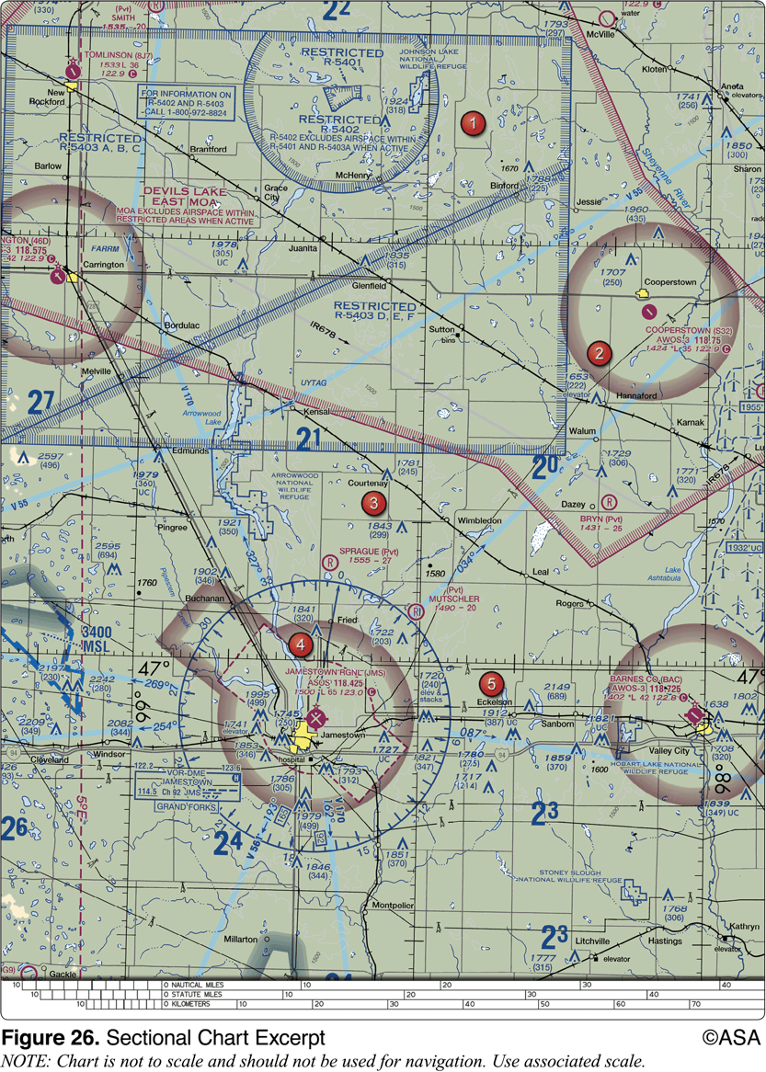
140. (3520) (Refer to Figure 26, area 2.) In flight and approaching the Bryn (Pvt) Airstrip the weather minimums are
*a. 1 statute mile visibility. b. 3 statute miles in all airspace. c. no visibility, remain clear of clouds.

Slide 280
140. (3520) (Refer to Figure 26, area 2.) In flight and approaching the Bryn (Pvt) Airstrip the weather minimums are
*a. 1 statute mile visibility. b. 3 statute miles in all airspace. c. no visibility, remain clear of clouds.
Bryn (Pvt) Airstrip is located in Class G airspace. Therefore, the visibility and cloud clear requirements are 1 SM and clear of clouds.

Slide 281
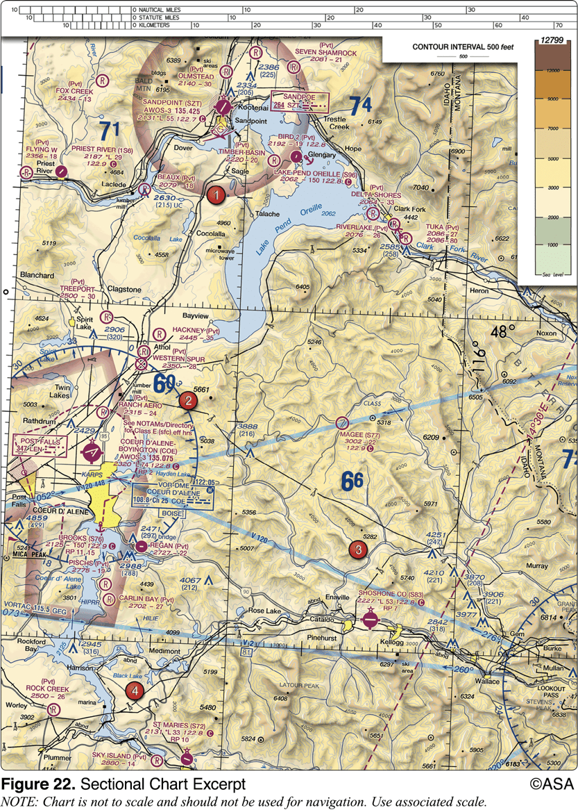
141. (3620.1) (Refer to Figure 22, area 1.) The visibility and cloud clearance requirements to operate VFR during daylight hours over Sandpoint Airport at 1,200 feet AGL are
a. 1 mile and 1,000 feet above, 500 feet below, and 2,000 feet horizontally from each cloud. b. 1 mile and clear of clouds. c. 3 miles and 1,000 feet above, 500 feet below, and 2,000 feet horizontally from each cloud.

Slide 282
141. (3620.1) (Refer to Figure 22, area 1.) The visibility and cloud clearance requirements to operate VFR during daylight hours over Sandpoint Airport at 1,200 feet AGL are
a. 1 mile and 1,000 feet above, 500 feet below, and 2,000 feet horizontally from each cloud. b. 1 mile and clear of clouds. *c. 3 miles and 1,000 feet above, 500 feet below, and 2,000 feet horizontally from each cloud.
The Sandpoint Airport Class E airspace starts at 700 feet AGL. The visibility and cloud clearance requirements to operate VFR during daylight hours over Sandpoint Airport at 1,200 feet AGL are 3 SM, 500 feet below, 1,000 feet above, and 2,000 feet horizontal.

Slide 283
142. (3620.2) (Refer to Figure 22, area 1.) The visibility and cloud clearance requirements to operate at night over Sandpoint Airport at less than 700 feet AGL are
a. 3 miles and 1,000 feet above, 500 feet below, and 2,000 feet horizontally from each cloud. b. 3 miles and clear of clouds. c. 1 mile and 1,000 feet above, 500 feet below, and 2,000 feet horizontally from each cloud.

Slide 284
142. (3620.2) (Refer to Figure 22, area 1.) The visibility and cloud clearance requirements to operate at night over Sandpoint Airport at less than 700 feet AGL are
*a. 3 miles and 1,000 feet above, 500 feet below, and 2,000 feet horizontally from each cloud. b. 3 miles and clear of clouds. c. 1 mile and 1,000 feet above, 500 feet below, and 2,000 feet horizontally from each cloud.
The Sandpoint Airport Class E airspace starts at 700 feet AGL. Below 700 feet AGL, the visibility and cloud clearance requirements to operate VFR during daylight hours is 1 mile visibility and clear of clouds. At night, the requirements are 3 SM, 500 feet below, 1,000 feet above, and 2,000 feet horizontal.

Slide 285
143. (3621.1) (Refer to Figure 26, area 2.) The visibility and cloud clearance requirements to operate VFR during daylight hours over the town of Cooperstown between 1,200 feet AGL and 10,000 feet MSL are
a. 1 mile and clear of clouds. b. 1 mile and 1,000 feet above, 500 feet below, and 2,000 feet horizontally from clouds. c. 3 miles and 1,000 feet above, 500 feet below, and 2,000 feet horizontally from clouds.

Slide 286
143. (3621.1) (Refer to Figure 26, area 2.) The visibility and cloud clearance requirements to operate VFR during daylight hours over the town of Cooperstown between 1,200 feet AGL and 10,000 feet MSL are
a. 1 mile and clear of clouds. b. 1 mile and 1,000 feet above, 500 feet below, and 2,000 feet horizontally from clouds. *c. 3 miles and 1,000 feet above, 500 feet below, and 2,000 feet horizontally from clouds.
For VFR flight during daylight hours, between 1,200 feet AGL and 10,000 feet MSL, in Class E airspace, visibility and cloud clearances require 3 miles and 1,000 feet above, 500 feet below, and 2,000 feet horizontally.

Slide 287
144. (3621.2) (Refer to Figure 26, area 2.) The day VFR visibility and cloud clearance requirements to operate over the town of Cooperstown, after departing and climbing out of the Cooperstown Airport at or below 700 feet AGL are
a. 3 miles and clear of clouds. b. 1 mile and 1,000 feet above, 500 feet below, and 2,000 feet horizontally from clouds. c. 1 mile and clear of clouds.

Slide 288
144. (3621.2) (Refer to Figure 26, area 2.) The day VFR visibility and cloud clearance requirements to operate over the town of Cooperstown, after departing and climbing out of the Cooperstown Airport at or below 700 feet AGL are
a. 3 miles and clear of clouds. b. 1 mile and 1,000 feet above, 500 feet below, and 2,000 feet horizontally from clouds. *c. 1 mile and clear of clouds.
Cooperstown is in Class G airspace from the surface to 700 feet AGL. Therefore, the visibility and cloud clearance requirements are 1 mile and clear of clouds.

Slide 289
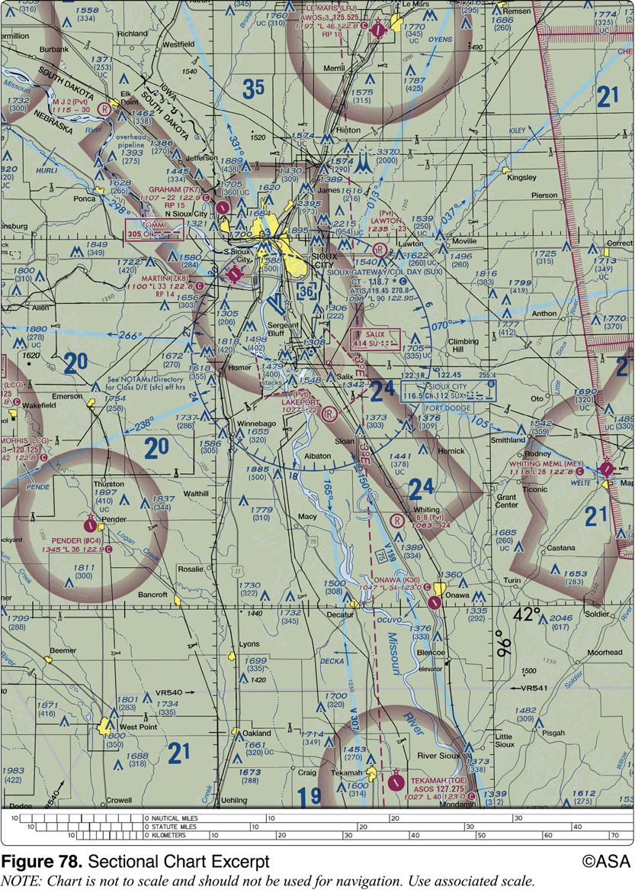
145. (3621.3) (Refer to Figure 78.) What are the basic VFR weather minima required to takeoff from the Onawa (K36) airport during the day?
a. 3 statute miles visibility, 500 feet below the clouds, 1,000 feet above the clouds and 2,000 feet horizontally from the clouds. b. 0 statute miles, clear of clouds. c. 1 statute mile, clear of clouds.

Slide 290
145. (3621.3) (Refer to Figure 78.) What are the basic VFR weather minima required to takeoff from the Onawa (K36) airport during the day?
a. 3 statute miles visibility, 500 feet below the clouds, 1,000 feet above the clouds and 2,000 feet horizontally from the clouds. b. 0 statute miles, clear of clouds. *c. 1 statute mile, clear of clouds.
Onawa (K36) is in the bottom right quadrant of the sectional excerpt. It is outside any shading or lines, indicating the airport is in Class G airspace. The basic VFR weather minima for a daytime departure from a Class G airport is 1 statute mile and clear of clouds.

Slide 291
146. (3709) FAA Advisory Circulars (some free, others at cost) are available to all pilots and are obtained by
a. distribution from the nearest FAA district office. b. ordering those desired from the Government Printing Office. c. subscribing to the Federal Register.

Slide 292
146. (3709) FAA Advisory Circulars (some free, others at cost) are available to all pilots and are obtained by
a. distribution from the nearest FAA district office. *b. ordering those desired from the Government Printing Office. c. subscribing to the Federal Register.
Advisory circulars which are offered for sale or free may be ordered from the Superintendent of Documents, U.S. Government Printing Office.

Slide 293
147. (3813) What ATC facility should the pilot contact to receive a special VFR departure clearance in Class D airspace?
a. Automated Flight Service Station. b. Air traffic control tower. c. Air Route Traffic Control Center.

Slide 294
147. (3813) What ATC facility should the pilot contact to receive a special VFR departure clearance in Class D airspace?
a. Automated Flight Service Station. *b. Air traffic control tower. c. Air Route Traffic Control Center.
When a control tower is in operation, requests for Special VFR clearances should be to the tower.

Slide 295
148. (3818) How should a VFR flight plan be closed at the completion of the flight at a controlled airport?
a. The tower will automatically close the flight plan when the aircraft turns off the runway. b. The pilot must close the flight plan with the FAA upon landing. c. The tower will relay the instructions to the nearest FSS when the aircraft contacts the tower for landing.

Slide 296
148. (3818) How should a VFR flight plan be closed at the completion of the flight at a controlled airport?
a. The tower will automatically close the flight plan when the aircraft turns off the runway. *b. The pilot must close the flight plan with the FAA upon landing. c. The tower will relay the instructions to the nearest FSS when the aircraft contacts the tower for landing.
The PIC, upon canceling or completing the flight under the flight plan, shall notify an FAA Flight Service Station or ATC facility.

Slide 297
149. (3837) An ATC clearance provides
a. priority over all other traffic. b. adequate separation from all traffic. c. authorization to proceed under specified traffic conditions in controlled airspace.

Slide 298
149. (3837) An ATC clearance provides
a. priority over all other traffic. b. adequate separation from all traffic. *c. authorization to proceed under specified traffic conditions in controlled airspace.
An ATC clearance is an authorization by air traffic control, for the purpose of preventing collisions between known aircraft, for an aircraft to proceed under specified traffic conditions within controlled airspace. Answer (A) is incorrect because a clearance does not provide priority. Answer (B) is incorrect because a clearance does not relieve the pilot of the responsibility for collision avoidance with aircraft not in instrument meteorological conditions (IMC).

Slide 299
150. (3854) FAA Advisory Circulars containing subject matter specifically related to Airmen are issued under which subject number?
a. 60 b. 70 c. 90

Slide 300
150. (3854) FAA Advisory Circulars containing subject matter specifically related to Airmen are issued under which subject number?
*a. 60 b. 70 c. 90
Appendix II of the Advisory Circular Checklist contains the Circular Numbering System wherein advisory circular numbers relate to Federal Aviation Regulations subchapter titles and correspond to the parts and/or sections of the regulations. The four to remember are: 20 - Aircraft; 60 - Airmen; 70 - Airspace; and 90 - Air Traffic and General Operating Rules

Slide 301
151. (3855) FAA Advisory Circulars containing subject matter specifically related to Airspace are issued under which subject number?
a. 60 b. 70 c. 90

Slide 302
151. (3855) FAA Advisory Circulars containing subject matter specifically related to Airspace are issued under which subject number?
a. 60 *b. 70 c. 90
Appendix II of the Advisory Circular Checklist contains the Circular Numbering System wherein advisory circular numbers relate to Federal Aviation Regulations subchapter titles and correspond to the parts and/or sections of the regulations. The four to remember are: 20 - Aircraft; 60 - Airmen; 70 - Airspace; and 90 - Air Traffic and General Operating Rules

Slide 303
152. (3856) FAA Advisory Circulars containing subject matter specifically related to Air Traffic Control and General Operations are issued under which subject number?
a. 60 b. 70 c. 90

Slide 304
152. (3856) FAA Advisory Circulars containing subject matter specifically related to Air Traffic Control and General Operations are issued under which subject number?
a. 60 b. 70 *c. 90
Appendix II of the Advisory Circular Checklist contains the Circular Numbering System wherein advisory circular numbers relate to Federal Aviation Regulations subchapter titles and correspond to the parts and/or sections of the regulations. The four to remember are: 20 - Aircraft; 60 - Airmen; 70 - Airspace; and 90 - Air Traffic and General Operating Rules

Slide 305
1. (3120) While operating in Class D airspace, each pilot of an aircraft approaching to land on a runway served by a visual approach slope indicator (VASI) shall
a. maintain a 3° glide until approximately 1/2 mile to the runway before going below the VASI. b. maintain an altitude at or above the glide slope until a lower altitude is necessary for a safe landing. c. stay high until the runway can be reached in a power-off landing.

Slide 306
1. (3120) While operating in Class D airspace, each pilot of an aircraft approaching to land on a runway served by a visual approach slope indicator (VASI) shall
a. maintain a 3° glide until approximately 1/2 mile to the runway before going below the VASI. *b. maintain an altitude at or above the glide slope until a lower altitude is necessary for a safe landing. c. stay high until the runway can be reached in a power-off landing.
An airplane approaching to land on a runway served by a VASI shall maintain an altitude at or above the glide slope until a lower altitude is necessary for a safe landing.

Slide 307
2. (3121) When approaching to land on a runway served by a visual approach slope indicator (VASI), the pilot shall
a. maintain an altitude that captures the glide slope at least 2 miles downwind from the runway threshold. b. maintain an altitude at or above the glide slope. c. remain on the glide slope and land between the two-light bar.

Slide 308
2. (3121) When approaching to land on a runway served by a visual approach slope indicator (VASI), the pilot shall
a. maintain an altitude that captures the glide slope at least 2 miles downwind from the runway threshold. *b. maintain an altitude at or above the glide slope. c. remain on the glide slope and land between the two-light bar.
An airplane approaching to land on a runway served by a VASI shall maintain an altitude at or above the glide slope until a lower altitude is necessary for a safe landing.

Slide 309
3. (3123) Which is the correct traffic pattern departure procedure to use at a noncontrolled airport?
a. Depart in any direction consistent with safety, after crossing the airport boundary. b. Make all turns to the left. c. Comply with any FAA traffic pattern established for the airport.

Slide 310
3. (3123) Which is the correct traffic pattern departure procedure to use at a noncontrolled airport?
a. Depart in any direction consistent with safety, after crossing the airport boundary. b. Make all turns to the left. *c. Comply with any FAA traffic pattern established for the airport.
In the case of an aircraft departing an airport without an operating control tower, comply with any FAA traffic pattern for that airport.

Slide 311
4. (3123.1) The recommended entry position to an airport traffic pattern is
a. 45° to the base leg just below traffic pattern altitude. b. to enter 45° at the midpoint of the downwind leg at traffic pattern altitude. c. to cross directly over the airport at traffic pattern altitude and join the downwind leg.

Slide 312
4. (3123.1) The recommended entry position to an airport traffic pattern is
a. 45° to the base leg just below traffic pattern altitude. *b. to enter 45° at the midpoint of the downwind leg at traffic pattern altitude. c. to cross directly over the airport at traffic pattern altitude and join the downwind leg.
The recommended entry position for an airport traffic pattern is 45° to the midpoint of the downwind leg at traffic pattern altitude.

Slide 313
5. (3162) Except in Alaska, during what time period should lighted position lights be displayed on an aircraft?
a. End of evening civil twilight to the beginning of morning civil twilight. b. 1 hour after sunset to 1 hour before sunrise. c. Sunset to sunrise.

Slide 314
5. (3162) Except in Alaska, during what time period should lighted position lights be displayed on an aircraft?
a. End of evening civil twilight to the beginning of morning civil twilight. b. 1 hour after sunset to 1 hour before sunrise. *c. Sunset to sunrise.
An aircraft must display lighted position lights from sunset to sunrise. Answer (A) is incorrect because it applies to logging of night time. Answer (B) is incorrect because it applies to the night landing requirement.

Slide 315
6. (3163) When operating an aircraft at cabin pressure altitudes above 12,500 feet MSL up to and including 14,000 feet MSL, supplemental oxygen shall be used during
a. the entire flight time at those altitudes. b. that flight time in excess of 10 minutes at those altitudes. c. that flight time in excess of 30 minutes at those altitudes.

Slide 316
6. (3163) When operating an aircraft at cabin pressure altitudes above 12,500 feet MSL up to and including 14,000 feet MSL, supplemental oxygen shall be used during
a. the entire flight time at those altitudes. b. that flight time in excess of 10 minutes at those altitudes. *c. that flight time in excess of 30 minutes at those altitudes.
No person may operate civil aircraft at cabin pressure altitudes above 12,500 feet MSL up to and including 14,000 feet MSL, unless the required minimum flight crew uses supplemental oxygen for that part of the flight at those altitudes that is more than 30 minutes duration.

Slide 317
7. (3164) Unless each occupant is provided with supplemental oxygen, no person may operate a civil aircraft of U.S. registry above a maximum cabin pressure altitude of
a. 12,500 feet MSL. b. 14,000 feet MSL. c. 15,000 feet MSL.

Slide 318
7. (3164) Unless each occupant is provided with supplemental oxygen, no person may operate a civil aircraft of U.S. registry above a maximum cabin pressure altitude of
a. 12,500 feet MSL. b. 14,000 feet MSL. *c. 15,000 feet MSL.
No person may operate a civil aircraft at cabin pressure altitudes above 15,000 feet MSL unless each occupant is provided with supplemental oxygen.

Slide 319
8. (3302) When taxiing with strong quartering tailwinds, which aileron positions should be used?
a. Aileron down on the downwind side. b. Ailerons neutral. c. Aileron down on the side from which the wind is blowing.

Slide 320
8. (3302) When taxiing with strong quartering tailwinds, which aileron positions should be used?
a. Aileron down on the downwind side. b. Ailerons neutral. *c. Aileron down on the side from which the wind is blowing.
Taxiing with a quartering tailwind provides the most hazardous conditions. In this case, the elevator should be in the down position and the aileron on the upwind side should also be in the down position to keep the wing from lifting.

Slide 321
9. (3303) Which aileron positions should a pilot generally use when taxiing in strong quartering headwinds?
a. Aileron up on the side from which the wind is blowing. b. Aileron down on the side from which the wind is blowing. c. Ailerons neutral.

Slide 322
9. (3303) Which aileron positions should a pilot generally use when taxiing in strong quartering headwinds?
*a. Aileron up on the side from which the wind is blowing. b. Aileron down on the side from which the wind is blowing. c. Ailerons neutral.
When taxiing a nosewheel aircraft in the presence of moderate to strong winds, extra caution should be taken. For a quartering headwind, the elevator should be held in the neutral position, and the aileron on the upwind side should be in the up position.

Slide 323
10. (3304) Which wind condition would be most critical when taxiing a nosewheel equipped high-wing airplane?
a. Quartering tailwind. b. Direct crosswind. c. Quartering headwind.

Slide 324
10. (3304) Which wind condition would be most critical when taxiing a nosewheel equipped high-wing airplane?
*a. Quartering tailwind. b. Direct crosswind. c. Quartering headwind.
When taxiing a nosewheel aircraft in the presence of moderate to strong winds, extra caution should be taken. Taxiing with a quartering tailwind produces the most hazardous conditions.

Slide 325
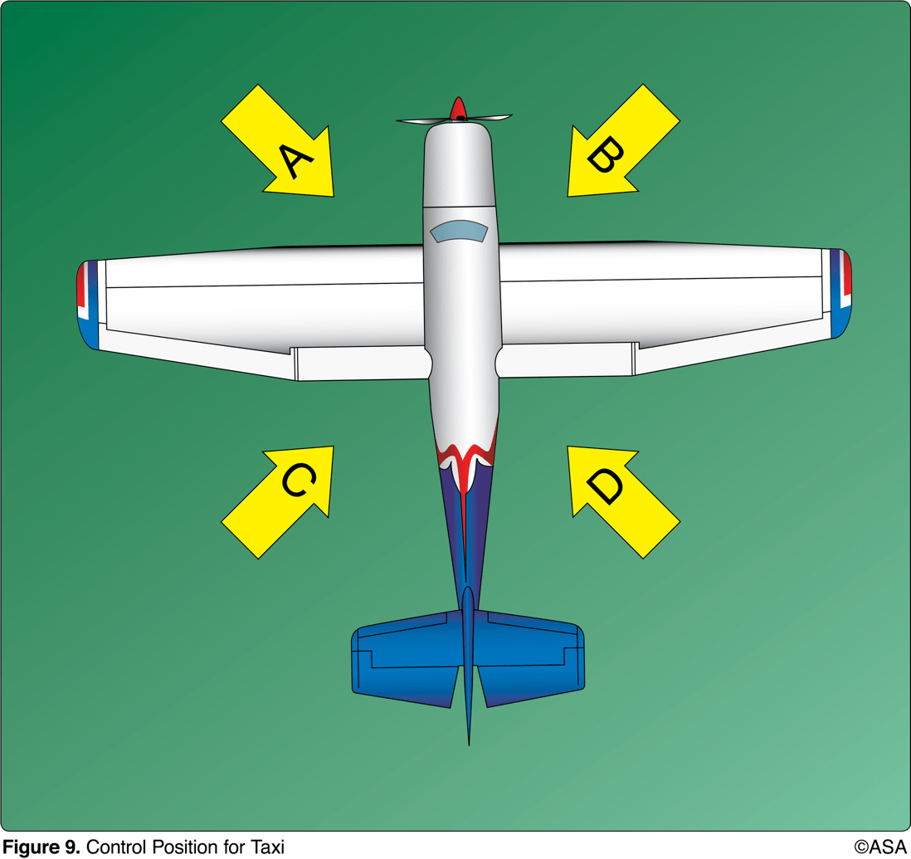
11. (3305) (Refer to Figure 9, area A.) How should the flight controls be held while taxiing a tricycle-gear equipped airplane into a left quartering headwind?
a. Left aileron up, elevator neutral. b. Left aileron down, elevator neutral. c. Left aileron up, elevator down.

Slide 326
11. (3305) (Refer to Figure 9, area A.) How should the flight controls be held while taxiing a tricycle-gear equipped airplane into a left quartering headwind?
*a. Left aileron up, elevator neutral. b. Left aileron down, elevator neutral. c. Left aileron up, elevator down.
When taxiing a nosewheel aircraft in the presence of moderate to strong winds, extra caution should be taken. For a quartering headwind, the elevator should be held in the neutral position, and the aileron on the upwind side should be in the up position.

Slide 327
12. (3306) (Refer to Figure 9, area B.) How should the flight controls be held while taxiing a tailwheel airplane into a right quartering headwind?
a. Right aileron up, elevator up. b. Right aileron down, elevator neutral. c. Right aileron up, elevator down.

Slide 328
12. (3306) (Refer to Figure 9, area B.) How should the flight controls be held while taxiing a tailwheel airplane into a right quartering headwind?
*a. Right aileron up, elevator up. b. Right aileron down, elevator neutral. c. Right aileron up, elevator down.
When taxiing a tailwheel airplane with a quartering headwind, the aileron on the upwind side should be up, and the elevator held in the up position to hold the tail down.

Slide 329
13. (3307) (Refer to Figure 9, area C.) How should the flight controls be held while taxiing a tailwheel airplane with a left quartering tailwind?
a. Left aileron up, elevator neutral. b. Left aileron down, elevator neutral. c. Left aileron down, elevator down.

Slide 330
13. (3307) (Refer to Figure 9, area C.) How should the flight controls be held while taxiing a tailwheel airplane with a left quartering tailwind?
a. Left aileron up, elevator neutral. b. Left aileron down, elevator neutral. *c. Left aileron down, elevator down.
When taxiing a tailwheel aircraft with a quartering tailwind, the upwind aileron should be down to keep that wing from lifting, and the elevator should also be down.

Slide 331
14. (3308) (Refer to Figure 9, area C.) How should the flight controls be held while taxiing a tricycle-gear equipped airplane with a left quartering tailwind?
a. Left aileron up, elevator neutral. b. Left aileron down, elevator down. c. Left aileron up, elevator down.

Slide 332
14. (3308) (Refer to Figure 9, area C.) How should the flight controls be held while taxiing a tricycle-gear equipped airplane with a left quartering tailwind?
a. Left aileron up, elevator neutral. *b. Left aileron down, elevator down. c. Left aileron up, elevator down.
Taxiing with a quartering tailwind produces the most hazardous conditions. In this case, the elevator should be in the down position, and the aileron on the upwind side should also be in the down position to keep the wing from lifting.

Slide 333
15. (3308.1) To minimize the side loads placed on the landing gear during touchdown, the pilot should keep the
a. direction of motion of the aircraft parallel to the runway. b. longitudinal axis of the aircraft parallel to the direction of its motion. c. downwind wing lowered sufficiently to eliminate the tendency for the aircraft to drift.

Slide 334
15. (3308.1) To minimize the side loads placed on the landing gear during touchdown, the pilot should keep the
a. direction of motion of the aircraft parallel to the runway. *b. longitudinal axis of the aircraft parallel to the direction of its motion. c. downwind wing lowered sufficiently to eliminate the tendency for the aircraft to drift.
It is extremely important that the touchdown occur with the airplane's longitudinal axis exactly parallel to the direction in which the airplane is moving along the runway. Failure to accomplish this imposes severe side loads on the landing gear. To avoid these side stresses, the pilot should not allow the airplane to touch down while turned into the wind or drifting. Answer (A) is incorrect because moving alongside the runway is not sufficient to reduce or eliminate side loads on the landing gear; the aircraft must be heading straight down the runway. Answer (C) is incorrect because this describes what happens on final approach, but the aircraft must be heading straight before it touches down.

Slide 335
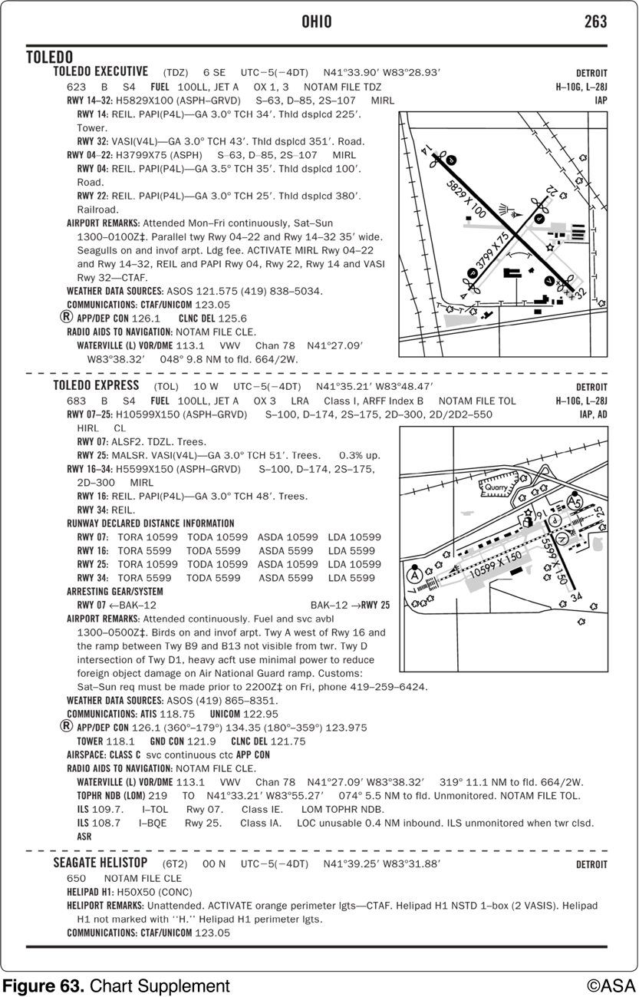
16. (3513) (Refer to Figure 63.) What is the length of the displaced threshold for runway 22 at Toledo (TDZ)?
a. 25 feet. b. 100 feet. c. 380 feet.

Slide 336
16. (3513) (Refer to Figure 63.) What is the length of the displaced threshold for runway 22 at Toledo (TDZ)?
a. 25 feet. b. 100 feet. *c. 380 feet.
The Chart Supplements U.S. for Toledo Executive (TDZ) shows a displaced threshold (Thld dsplcd) of 380 feet for Runway 22.Answer (A) is incorrect because 25 feet is the touchdown zone height for runway 22 Answer (B) is incorrect because 100 feet is the displaced threshold for runway 4.

Slide 337
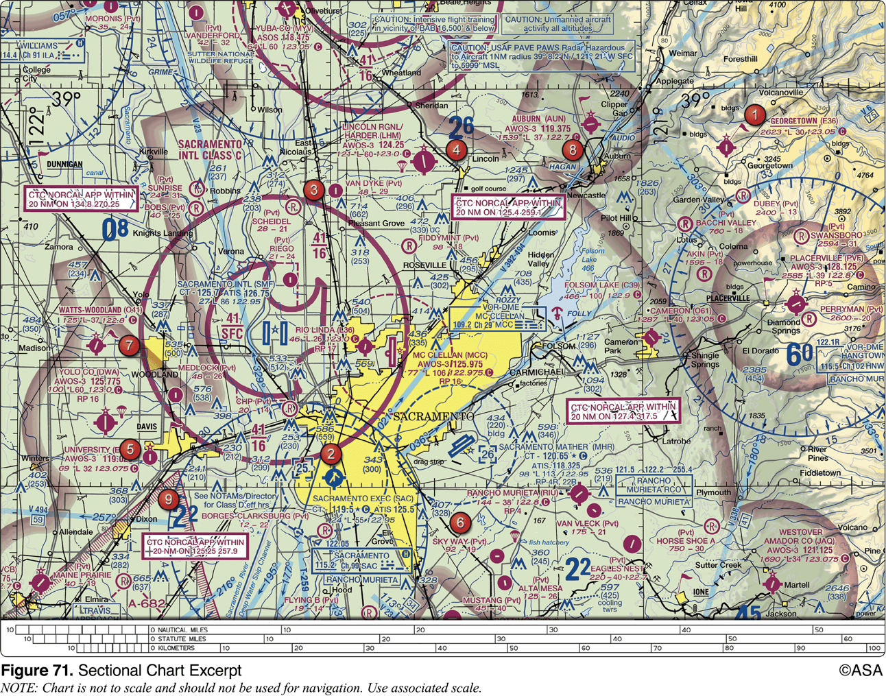
17. (3619) (Refer to Figure 71, area 4 and Legend 1.) For information about the parachute jumping operations at Lincoln Regional/ Harder (LHM) Airport, refer to
a. notes on the border of the chart. b. the Chart Supplements U.S. c. the Notices to Airmen (NOTAM) publication..

Slide 338
17. (3619) (Refer to Figure 71, area 4 and Legend 1.) For information about the parachute jumping operations at Lincoln Regional/ Harder (LHM) Airport, refer to
a. notes on the border of the chart. *b. the Chart Supplements U.S. c. the Notices to Airmen (NOTAM) publication.
Tabulations of parachute jump areas in the U.S. are contained in the Chart Supplements U.S.

Slide 339
18. (3619.1) Information concerning parachute jumping sites may be found in the
a. NOTAMs. b. Chart Supplements U.S. c. Graphic Notices and Supplemental Data.

Slide 340
18. (3619.1) Information concerning parachute jumping sites may be found in the
a. NOTAMs. *b. Chart Supplements U.S. c. Graphic Notices and Supplemental Data.
Tabulations of parachute jump areas in the U.S. are contained in the Chart Supplements U.S.

Slide 341
19. (3710) Prior to starting each maneuver, pilots should
a. check altitude, airspeed, and heading indications. b. visually scan the entire area for collision avoidance. c. announce their intentions on the nearest CTAF.

Slide 342
19. (3710) Prior to starting each maneuver, pilots should
a. check altitude, airspeed, and heading indications. *b. visually scan the entire area for collision avoidance. c. announce their intentions on the nearest CTAF.
Scanning the sky for other aircraft is a key factor in collision avoidance. Answer (A) is incorrect because checking your instruments is important but secondary to collision avoidance. Answer (C) is incorrect because announcing your intentions on the nearest CTAF does not guarantee that anyone is listening.

Slide 343
20. (3710.1) Most midair collision accidents occur during
a. hazy days. b. clear days. c. cloudy nights.

Slide 344
20. (3710.1) Most midair collision accidents occur during
a. hazy days. *b. clear days. c. cloudy nights.
The FAA Near Mid-Air Collision Report indicates that 81% of the incidents occurred in clear skies and unrestricted visibility conditions.

Slide 345
21. (3712) What is the most effective way to use the eyes during night flight?
a. Look only at far away, dim lights. b. Scan slowly to permit off center viewing. c. Concentrate directly on each object for a few seconds.

Slide 346
21. (3712) What is the most effective way to use the eyes during night flight?
a. Look only at far away, dim lights. *b. Scan slowly to permit off center viewing. c. Concentrate directly on each object for a few seconds.
During daylight, an object can be seen best by looking directly at it, but at night, a scanning procedure to permit off-center viewing of the object is more effective. In addition, the pilot should consciously practice moving the eyes more slowly than in daylight to optimize night vision. Off-center viewing must be utilized during night flying because of the distribution of rods and cones in the eye.

Slide 347
22. (3713) The best method to use when looking for other traffic at night is to
a. look to the side of the object and scan slowly. b. scan the visual field very rapidly. c. look to the side of the object and scan rapidly.

Slide 348
22. (3713) The best method to use when looking for other traffic at night is to
*a. look to the side of the object and scan slowly. b. scan the visual field very rapidly. c. look to the side of the object and scan rapidly.
During daylight, an object can be seen best by looking directly at it, but at night, a scanning procedure to permit off-center viewing of the object is more effective. In addition, the pilot should consciously practice moving the eyes more slowly than in daylight to optimize night vision. Off-center viewing must be utilized during night flying because of the distribution of rods and cones in the eye.

Slide 349
23. (3714) The most effective method of scanning for other aircraft for collision avoidance during nighttime hours is to use
a. regularly spaced concentration on the three, nine, and twelve o'clock positions. b. a series of short, regularly spaced eye movements to search each 30° sector. c. peripheral vision by scanning small sectors and utilizing off center viewing.

Slide 350
23. (3714) The most effective method of scanning for other aircraft for collision avoidance during nighttime hours is to use
a. regularly spaced concentration on the three, nine, and twelve o'clock positions. b. a series of short, regularly spaced eye movements to search each 30° sector. *c. peripheral vision by scanning small sectors and utilizing off center viewing.
During daylight, an object can be seen best by looking directly at it, but at night, a scanning procedure to permit off-center viewing of the object is more effective. In addition, the pilot should consciously practice moving the eyes more slowly than in daylight to optimize night vision. Off-center viewing must be utilized during night flying because of the distribution of rods and cones in the eye.

Slide 351
24. (3715) During a night flight, you observe a steady red light and a flashing red light ahead and at the same altitude. What is the general direction of movement of the other aircraft?
a. The other aircraft is crossing to the left. b. The other aircraft is crossing to the right. c. The other aircraft is approaching head-on.

Slide 352
24. (3715) During a night flight, you observe a steady red light and a flashing red light ahead and at the same altitude. What is the general direction of movement of the other aircraft?
*a. The other aircraft is crossing to the left. b. The other aircraft is crossing to the right. c. The other aircraft is approaching head-on.
Airplanes have a red light on the left wing tip, a green light on the right wing tip and a white light on the tail. The flashing red light is the rotating beacon which can be seen from all directions around the aircraft. If the only steady light seen is red, then the airplane is crossing from right to left in relation to the observing pilot.

Slide 353
25. (3716) During a night flight, you observe a steady white light and a flashing red light ahead and at the same altitude. What is the general direction of movement of the other aircraft?
a. The other aircraft is flying away from you. b. The other aircraft is crossing to the left. c. The other aircraft is crossing to the right.

Slide 354
25. (3716) During a night flight, you observe a steady white light and a flashing red light ahead and at the same altitude. What is the general direction of movement of the other aircraft?
*a. The other aircraft is flying away from you. b. The other aircraft is crossing to the left. c. The other aircraft is crossing to the right.
Airplanes have a red light on the left wing tip, a green light on the right wing tip and a white light on the tail. The flashing red light is the rotating beacon which can be seen from all directions around the aircraft. When the only steady light seen is white, then the airplane is headed away from the observing pilot.

Slide 355
26. (3717) During a night flight, you observe steady red and green lights ahead and at the same altitude. What is the general direction of movement of the other aircraft?
a. The other aircraft is crossing to the left. |b. The other aircraft is flying away from you. c. The other aircraft is approaching head-on.

Slide 356
26. (3717) During a night flight, you observe steady red and green lights ahead and at the same altitude. What is the general direction of movement of the other aircraft?
a. The other aircraft is crossing to the left. |b. The other aircraft is flying away from you. *c. The other aircraft is approaching head-on.
When both a red and green light of another airplane are observed, the airplane would be flying in a general direction toward you. Airplanes have a red light on the left wing tip, a green light on the right wing tip and a white light on the tail.

Slide 357
27. (3718) Airport taxiway edge lights are identified at night by
a. white directional lights. b. blue omnidirectional lights. c. alternate red and green lights.

Slide 358
27. (3718) Airport taxiway edge lights are identified at night by
a. white directional lights. *b. blue omnidirectional lights. c. alternate red and green lights.
A taxiway edge lighting system consists of omnidirectional blue lights which outline the usable limits of taxi paths.

Slide 359
28. (3719) VFR approaches to land at night should be accomplished
a. at a higher airspeed. b. with a steeper descent. c. the same as during daytime..

Slide 360
28. (3719) VFR approaches to land at night should be accomplished
a. at a higher airspeed. b. with a steeper descent. *c. the same as during daytime.
Inexperienced pilots often have a tendency to make approaches and landings at night with excessive airspeed. Every effort should be made to execute the approach and landing in the same manner as during the day.

Slide 361
29. (3760) A slightly high glide slope indication from a precision approach path indicator is
a. four white lights. b. three white lights and one red light. c. two white lights and two red lights.

Slide 362
29. (3760) A slightly high glide slope indication from a precision approach path indicator is
a. four white lights. *b. three white lights and one red light. c. two white lights and two red lights.
The PAPI uses light units similar to the VASI but are installed in a single row of either two or four light units. Four white lights means you are above the glide slope, three white lights and one red light means you are slightly high, two red and two white lights means you are on the glide slope, three reds and one white light means you are slightly low and four red lights means you are below the glide slope.

Slide 363
30. (3762.1) Which approach and landing objective is assured when the pilot remains on the proper glidepath of the VASI?
a. Runway identification and course guidance. b. Safe obstruction clearance in the approach area. c. Lateral course guidance to the runway.

Slide 364
30. (3762.1) Which approach and landing objective is assured when the pilot remains on the proper glidepath of the VASI?
a. Runway identification and course guidance. *b. Safe obstruction clearance in the approach area. c. Lateral course guidance to the runway.
The VASI is a system of lights arranged to provide visual descent guidance information during the approach to a runway. These lights are visible from 3 to 5 miles during the day, and up to 20 miles or more at night. The visual glidepath of the VASI provides safe obstruction clearance within 10° of the extended runway centerline, and to 4 NM from the runway threshold.

Slide 365
31. (3764) A below glide slope indication from a pulsating approach slope indicator is a
a. pulsating white light. b. steady white light. c. pulsating red light.

Slide 366
31. (3764) A below glide slope indication from a pulsating approach slope indicator is a
a. pulsating white light. b. steady white light. *c. pulsating red light.
Pulsating visual approach slope indicators normally consist of a single light unit projecting a two-color visual approach path. The below-glide-path indication is red or pulsating red. The on-glide-path indication is a steady white light for one type of system, while for another system it is an alternating red and white light.

Slide 367
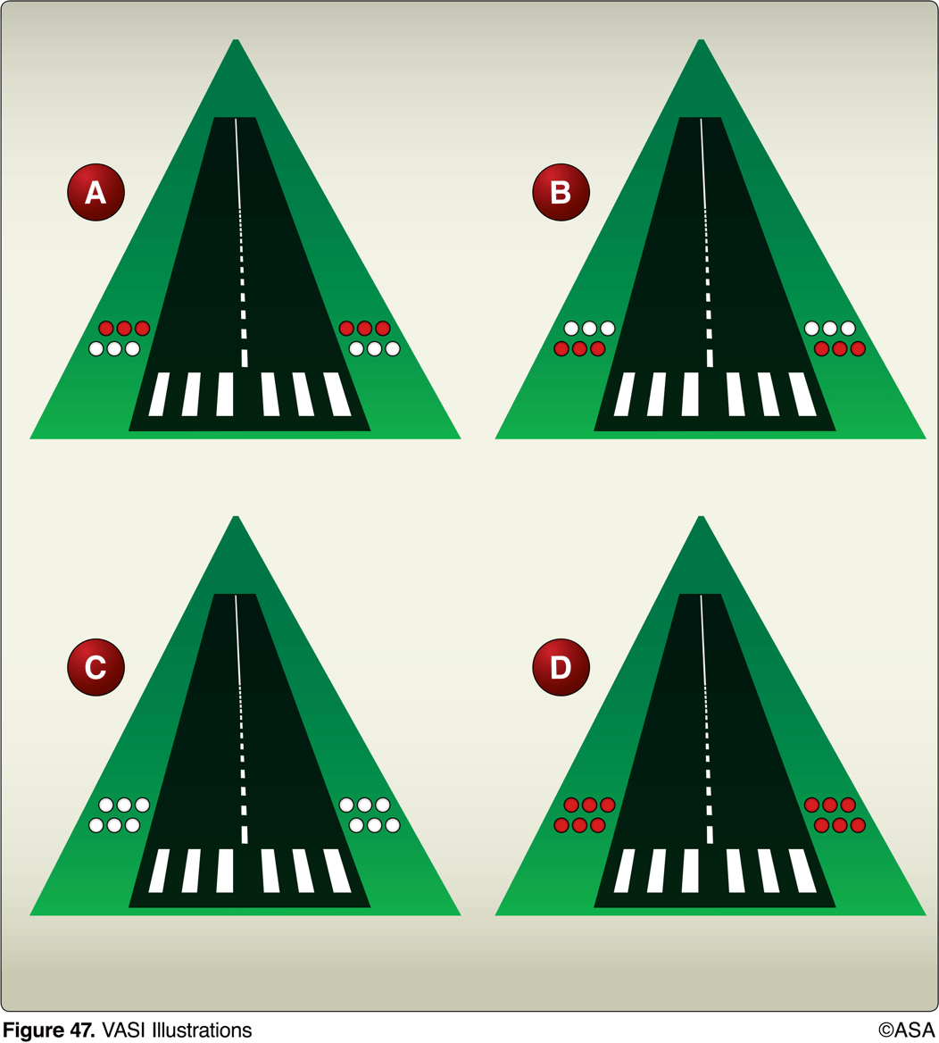
32. (3765) (Refer to Figure 47.) Illustration A indicates that the aircraft is
a. below the glide slope. b. on the glide slope. c. above the glide slope..

Slide 368
32. (3765) (Refer to Figure 47.) Illustration A indicates that the aircraft is
a. below the glide slope. *b. on the glide slope. c. above the glide slope.
The two-bar VASI on-glide-slope indication is red over white lights.

Slide 369
33. (3766) (Refer to Figure 47.) VASI lights as shown by illustration C indicate that the airplane is
a. off course to the left. b. above the glide slope. c. below the glide slope.

Slide 370
33. (3766) (Refer to Figure 47.) VASI lights as shown by illustration C indicate that the airplane is
a. off course to the left. *b. above the glide slope. c. below the glide slope.
The two-bar VASI above-glide-slope indication is white over white lights. VASI lights do not give horizontal direction.

Slide 371
34. (3767) (Refer to Figure 47.) While on final approach to a runway equipped with a standard 2-bar VASI, the lights appear as shown by illustration D. This means that the aircraft is
a. above the glide path. b. below the glide path. c. on the glide path.

Slide 372
34. (3767) (Refer to Figure 47.) While on final approach to a runway equipped with a standard 2-bar VASI, the lights appear as shown by illustration D. This means that the aircraft is
a. above the glide path. *b. below the glide path. c. on the glide path.
The below-glide-path indication from a two-bar VASI is red over red lights.

Slide 373
35. (3768) To set the high intensity runway lights on medium intensity, the pilot should click the microphone seven times, and then click it
a. one time within four seconds. b. three times within three seconds. c. five times within five seconds.

Slide 374
35. (3768) To set the high intensity runway lights on medium intensity, the pilot should click the microphone seven times, and then click it
a. one time within four seconds. b. three times within three seconds. *c. five times within five seconds.
To save money at low-usage airports, pilot-controlled lighting is installed. Key the mic seven times to set the highest level, then adjust to medium with five clicks.

Slide 375
36. (3769) An airport's rotating beacon operated during daylight hours indicates
a. there are obstructions on the airport. b. that weather at the airport located in Class D airspace is below basic VFR weather minimums. c. the Air Traffic Control tower is not in operation.

Slide 376
36. (3769) An airport's rotating beacon operated during daylight hours indicates
a. there are obstructions on the airport. *b. that weather at the airport located in Class D airspace is below basic VFR weather minimums. c. the Air Traffic Control tower is not in operation.
In Class B, C, D or E airspace, operation of the airport beacon during the hours of daylight often indicates that the weather in the airspace is below basic VFR weather minimums (ground visibility is less than 3 miles and/or the ceiling is less than 1,000 feet).

Slide 377
37. (3770) A lighted heliport may be identified by a
a. green, yellow, and white rotating beacon. b. flashing yellow light. c. blue lighted square landing area.

Slide 378
37. (3770) A lighted heliport may be identified by a
*a. green, yellow, and white rotating beacon. b. flashing yellow light. c. blue lighted square landing area.
A lighted heliport has a green, yellow, and white beacon flashing 30 to 60 times per minute. A flashing yellow light identifies a lighted water port.

Slide 379
38. (3771) A military air station can be identified by a rotating beacon that emits
a. white and green alternating flashes. b. two quick white flashes between green flashes. c. green, yellow, and white flashes.

Slide 380
38. (3771) A military air station can be identified by a rotating beacon that emits
a. white and green alternating flashes. *b. two quick white flashes between green flashes. c. green, yellow, and white flashes.
Military airport beacons flash alternately white and green, but are differentiated from civil beacons by dual-peaked (two quick) white flashes between the green flashes.

Slide 381
39. (3772) How can a military airport be identified at night?
a. Alternate white and green light flashes. b. Dual peaked (two quick) white flashes between green flashes. c. White flashing lights with steady green at the same location.

Slide 382
39. (3772) How can a military airport be identified at night?
a. Alternate white and green light flashes. *b. Dual peaked (two quick) white flashes between green flashes. c. White flashing lights with steady green at the same location.
Military airport beacons flash alternately white and green, but are differentiated from civil beacons by dual-peaked (two quick) white flashes between the green flashes.

Slide 383
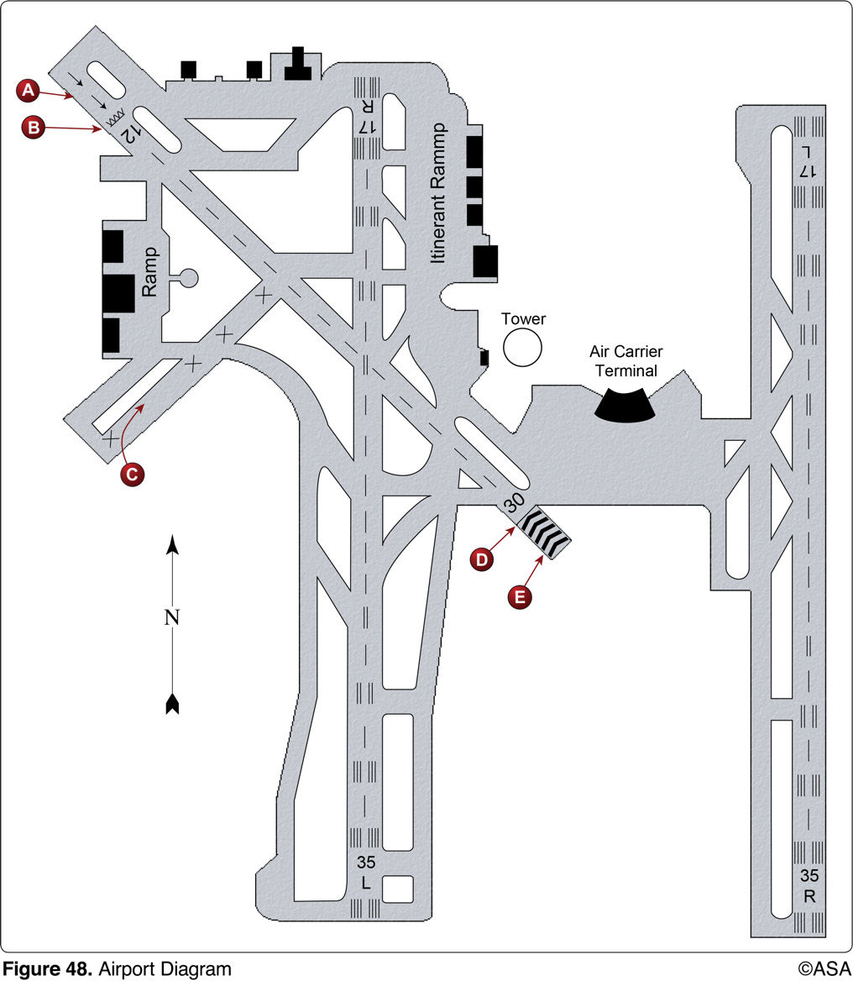
40. (3773) (Refer to Figure 48.) The portion of the runway identified by the letter A may be used for
a. landing. b. taxiing and takeoff. c. taxiing and landing.

Slide 384
40. (3773) (Refer to Figure 48.) The portion of the runway identified by the letter A may be used for
a. landing. *b. taxiing and takeoff. c. taxiing and landing.
Thresholds are marked at the beginning of a full-strength runway surface able to endure landing impacts or at a point on the runway which will encourage pilots to avoid short approaches due to hidden noise or obstacle problems. Area A of Figure 48 is marked with arrows which point towards a displaced threshold. Thus, the paved surface prior to the threshold is available for taxi, takeoff and landing rollout, but not for touchdown.

Slide 385
41. (3774) (Refer to Figure 48.) According to the airport diagram, which statement is true?
a. Runway 30 is equipped at position E with emergency arresting gear to provide a means of stopping military aircraft. b. Takeoffs may be started at position A on Runway 12, and the landing portion of this runway begins at position B. c. The takeoff and landing portion of Runway 30 begins at position E.

Slide 386
41. (3774) (Refer to Figure 48.) According to the airport diagram, which statement is true?
a. Runway 30 is equipped at position E with emergency arresting gear to provide a means of stopping military aircraft. *b. Takeoffs may be started at position A on Runway 12, and the landing portion of this runway begins at position B. c. The takeoff and landing portion of Runway 30 begins at position E.
Thresholds are marked at the beginning of a full-strength runway surface able to endure landing impacts or at a point on the runway which will encourage pilots to avoid short approaches due to hidden noise or obstacle problems. Area A of Figure 48 is marked with ovals which signify a displaced threshold. Thus, the paved surface prior to the threshold is available for taxi, takeoff, and landing rollout, but not for touchdown.

Slide 387
42. (3776) (Refer to Figure 48.) Area C on the airport depicted is classified as a
a. stabilized area. b. multiple heliport. c. closed runway.

Slide 388
42. (3776) (Refer to Figure 48.) Area C on the airport depicted is classified as a
a. stabilized area. b. multiple heliport. *c. closed runway.
An 'X' painted on the end of runway means it is closed.

Slide 389
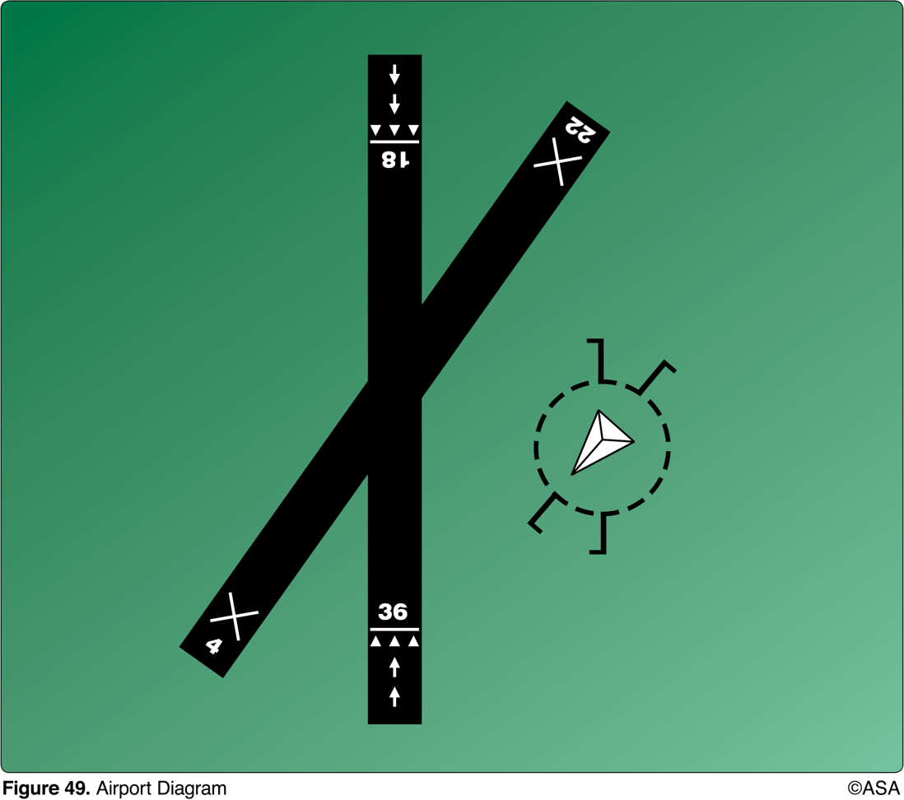
43. (3777) (Refer to Figure 49.) The arrows that appear on the end of the north/south runway indicate that the area
a. may be used only for taxiing. b. is usable for taxiing, takeoff, and landing. c. cannot be used for landing, but may be used for taxiing and takeoff.

Slide 390
43. (3777) (Refer to Figure 49.) The arrows that appear on the end of the north/south runway indicate that the area
a. may be used only for taxiing. b. is usable for taxiing, takeoff, and landing. *c. cannot be used for landing, but may be used for taxiing and takeoff.
The paved area behind the displaced runway threshold is available for taxiing, landing rollout, and the takeoff of aircraft.

Slide 391
44. (3778) The numbers 9 and 27 on a runway indicate that the runway is oriented approximately
a. 009° and 027° true.
b. 090° and 270° true.
c. 090° and 270° magnetic.
The runway number is the whole number nearest one-tenth the magnetic azimuth of the centerline of the runway, measured clockwise from magnetic north. For example: 272° = Runway 27; 087° = Runway 9.

Slide 392
44. (3778) The numbers 9 and 27 on a runway indicate that the runway is oriented approximately
a. 009° and 027° true.
b. 090° and 270° true.
*c. 090° and 270° magnetic.
The runway number is the whole number nearest one-tenth the magnetic azimuth of the centerline of the runway, measured clockwise from magnetic north. For example: 272° = Runway 27; 087° = Runway 9.

Slide 393
45. (3778.1) The numbers 8 and 26 on the approach ends of the runway indicate that the runway is orientated approximately
a. 008° and 026° true. b. 080° and 260° true. c. 080° and 260° magnetic.

Slide 394
45. (3778.1) The numbers 8 and 26 on the approach ends of the runway indicate that the runway is orientated approximately
a. 008° and 026° true. b. 080° and 260° true. *c. 080° and 260° magnetic.
The runway number is the whole number nearest one-tenth the magnetic azimuth of the centerline of the runway, measured clockwise from magnetic north.

Slide 395
46. (3778.2) When turning onto a taxiway from another taxiway, what is the purpose of the taxiway directional sign?
a. Indicates direction to take-off runway. b. Indicates designation and direction of exit taxiway from runway. c. Indicates designation and direction of taxiway leading out of an intersection.

Slide 396
46. (3778.2) When turning onto a taxiway from another taxiway, what is the purpose of the taxiway directional sign?
a. Indicates direction to take-off runway. b. Indicates designation and direction of exit taxiway from runway. *c. Indicates designation and direction of taxiway leading out of an intersection.
The taxiway directional sign identifies the designation(s) of the intersecting taxiway(s) leading out of the intersection that a pilot would normally be expected to turn onto or hold short of. Answer (A) is incorrect because this is the purpose of the runway location sign. Answer (B) is incorrect because this is the purpose of the destination sign.

Slide 397
47. (3778.3) (Refer to Figure 64.) Which symbol indicates a taxiway/taxiway intersection hold position marking?
a. B b. D c. E

Slide 398
47. (3778.3) (Refer to Figure 64.) Which symbol indicates a taxiway/taxiway intersection hold position marking?
a. B b. D *c. E
Symbol 'E' indicates a taxiway/taxiway hold marking. Answer (A) is incorrect because B is a stop bar/ILS hold marking. Answer (B) is incorrect because D is a hold marking for land and hold short operations.

Slide 399
48. (3778.4) (Refer to Figure 64.) Which marking indicates a vehicle lane?
a. A. b. C. c. E.

Slide 400
48. (3778.4) (Refer to Figure 64.) Which marking indicates a vehicle lane?
a. A. *b. C. c. E.
The vehicle roadway markings are used when necessary to define a pathway for vehicle operations on or crossing areas that are also intended for aircraft. These markings consist of a white solid line to delineate each edge of the roadway and a dashed line to separate lanes within the edges of the roadway. In lieu of the solid lines, zipper markings may be used to delineate the edges of the vehicle roadway.

Slide 401
49. (3778.5) The yellow demarcation bar marking indicates
a. a runway with a displaced threshold that precedes the runway. b. a hold line from a taxiway to a runway. c. the beginning of available runway for landing on the approach side.

Slide 402
49. (3778.5) The yellow demarcation bar marking indicates
*a. a runway with a displaced threshold that precedes the runway. b. a hold line from a taxiway to a runway. c. the beginning of available runway for landing on the approach side.
A demarcation bar delineates a runway with a displaced threshold from a blast pad, stopway or taxiway that precedes the runway. A demarcation bar is 3 feet (1 m) wide and yellow, since it is not located on the runway.

Slide 403
50. (3805) (Refer to Figure 49.) Select the proper traffic pattern and runway for landing.
a. Left-hand traffic and Runway 18. b. Right-hand traffic and Runway 18. c. Left-hand traffic and Runway 22.

Slide 404
50. (3805) (Refer to Figure 49.) Select the proper traffic pattern and runway for landing.
a. Left-hand traffic and Runway 18. *b. Right-hand traffic and Runway 18. c. Left-hand traffic and Runway 22.
The small end of the tetrahedron points into the wind, indicating the direction of landing. The wind is coming from the southwest. However, the runway most nearly aligned into the wind is closed (X), leaving Runway 18 as the most suitable runway. The traffic pattern indicators on a segmented circle are used to indicate the direction of turns. The traffic pattern indicators, shown as extensions from the segmented circle, represent the base and final approach legs. The traffic pattern indicator shows right traffic for Runway 18.

Slide 405
51. (3806) (Refer to Figure 49.) If the wind is as shown by the landing direction indicator, the pilot should land on
a. Runway 18 and expect a crosswind from the right. b. Runway 22 directly into the wind. c. Runway 36 and expect a crosswind from the right.

Slide 406
51. (3806) (Refer to Figure 49.) If the wind is as shown by the landing direction indicator, the pilot should land on
*a. Runway 18 and expect a crosswind from the right. b. Runway 22 directly into the wind. c. Runway 36 and expect a crosswind from the right.
The small end of the tetrahedron points into the wind indicating the direction of landing. Landing to the south on Runway 18, the pilot could expect a right crosswind.

Slide 407
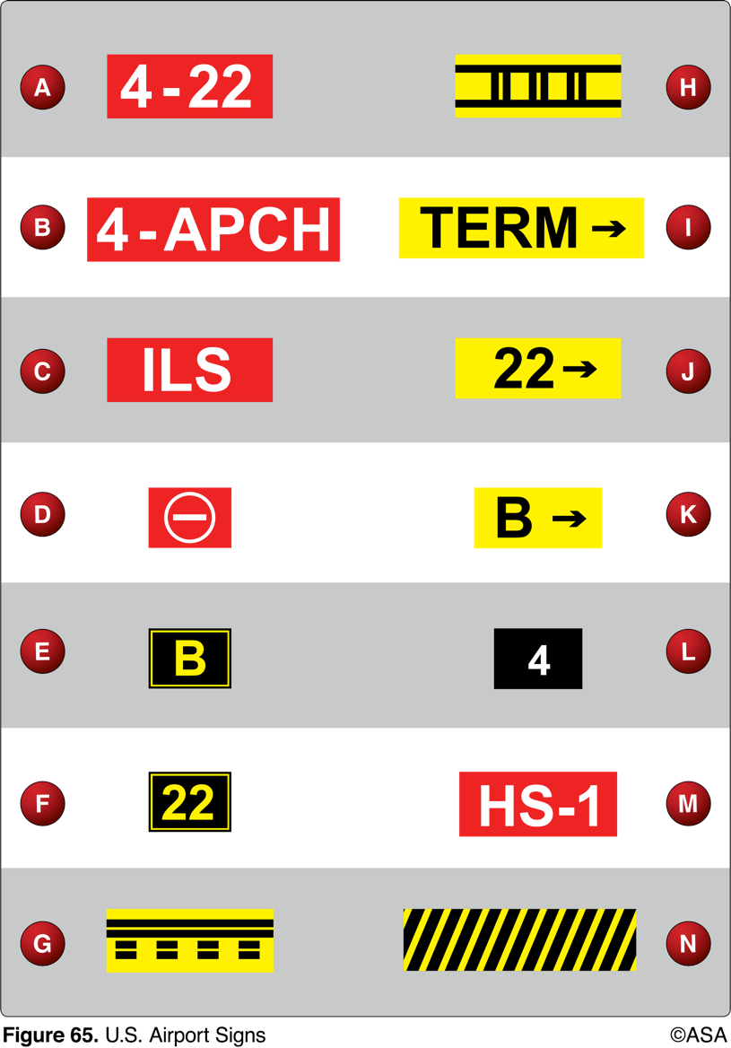
52. (3806.1) (Refer to Figure 65.) Sign F confirms your position on
a. Runway 22. b. routing to Runway 22. c. taxiway 22.

Slide 408
52. (3806.1) (Refer to Figure 65.) Sign F confirms your position on
*a. Runway 22. b. routing to Runway 22. c. taxiway 22.
F is a runway location sign, which identifies the runway on which the aircraft is located.

Slide 409
53. (3806.2) (Refer to Figure 65.) Sign E is a visual clue that
a. confirms the aircraft's location to be on taxiway B. b. warns the pilot of approaching taxiway B. c. indicates "B" holding area is ahead.

Slide 410
53. (3806.2) (Refer to Figure 65.) Sign E is a visual clue that
*a. confirms the aircraft's location to be on taxiway B. b. warns the pilot of approaching taxiway B. c. indicates "B" holding area is ahead
E is a taxiway location sign, which identifies the taxiway upon which the aircraft is located.

Slide 411
54. (3806.3) (Refer to Figure 65.) A left turn at the intersection depicting sign A would place the aircraft
a. ready for a Runway 4 intersection takeoff. b. on the taxiway leading to Runway 4. c. ready for a Runway 22 intersection takeoff.

Slide 412
54. (3806.3) (Refer to Figure 65.) A left turn at the intersection depicting sign A would place the aircraft
a. ready for a Runway 4 intersection takeoff. b. on the taxiway leading to Runway 4. *c. ready for a Runway 22 intersection takeoff.
Sign A is a runway holding position sign. The inscription on the sign contains the designation of the intersecting runway. The runway numbers on the sign are arranged to correspond to the respective runway threshold. "4-22" indicates that the threshold for Runway 4 is to the left and the threshold for Runway 22 is to the right. Making a left turn at the sign would put you ready for a Runway 22 intersection takeoff.

Slide 413
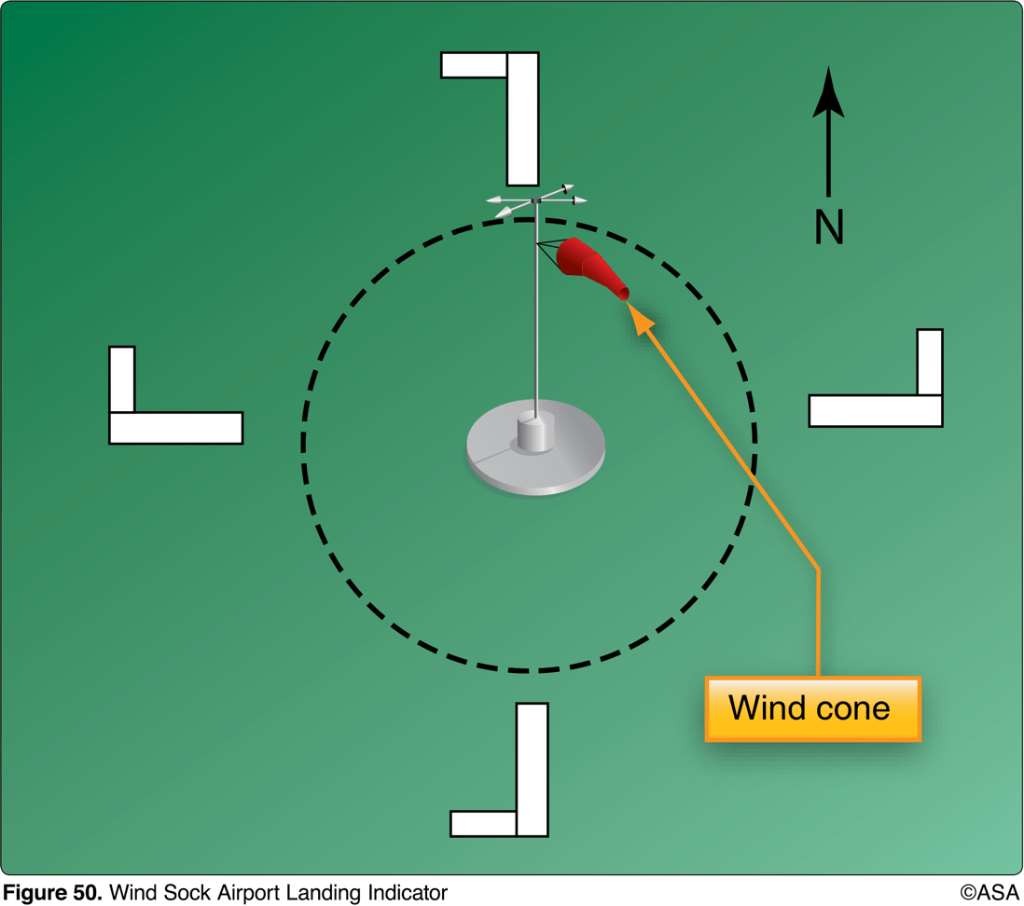
55. (3807) (Refer to Figure 50.) The segmented circle indicates that the airport traffic is
a. left-hand for Runway 36 and right-hand for Runway 18. b. left-hand for Runway 18 and right-hand for Runway 36. c. right-hand for Runway 9 and left-hand for Runway 27.

Slide 414
55. (3807) (Refer to Figure 50.) The segmented circle indicates that the airport traffic is
*a. left-hand for Runway 36 and right-hand for Runway 18. b. left-hand for Runway 18 and right-hand for Runway 36. c. right-hand for Runway 9 and left-hand for Runway 27.
The traffic pattern indicators on a segmented circle are used to indicate the direction of turns. The traffic pattern indicators, shown as extensions from the segmented circle, represent the base and final approach legs.

Slide 415
56. (3808) (Refer to Figure 50.) The traffic patterns indicated in the segmented circle have been arranged to avoid flights over an area to the
a. south of the airport. b. north of the airport. c. southeast of the airport.

Slide 416
56. (3808) (Refer to Figure 50.) The traffic patterns indicated in the segmented circle have been arranged to avoid flights over an area to the
a. south of the airport. b. north of the airport. *c. southeast of the airport.
The segmented circle depicts the direction of landing for each airport; the long part of the "L" depicts the runway, and the short part depicts the airport traffic pattern for that runway. This figure indicates there are no flights that cross the southeast area of the airport.

Slide 417
57. (3809) (Refer to Figure 50.) The segmented circle indicates that a landing on Runway 26 will be with a
a. right-quartering headwind. b. left-quartering headwind. c. right-quartering tailwind.

Slide 418
57. (3809) (Refer to Figure 50.) The segmented circle indicates that a landing on Runway 26 will be with a
*a. right-quartering headwind. b. left-quartering headwind. c. right-quartering tailwind.
The large end of the wind cone (wind sock) points into the wind. The wind cone in FAA Figure 50 indicates a wind from the northwest. When landing on Runway 26, this would be a right quartering headwind.

Slide 419
58. (3810) (Refer to Figure 50.) Which runway and traffic pattern should be used as indicated by the wind cone in the segmented circle?
a. Right-hand traffic on Runway 9. b. Right-hand traffic on Runway 18. c. Left-hand traffic on Runway 36.

Slide 420
58. (3810) (Refer to Figure 50.) Which runway and traffic pattern should be used as indicated by the wind cone in the segmented circle?
a. Right-hand traffic on Runway 9. b. Right-hand traffic on Runway 18. *c. Left-hand traffic on Runway 36.
The large end of the wind cone (wind sock) points into the wind. The wind cone in FAA Figure 50 indicates a wind from the northwest. Landing into the wind can be accomplished on either Runway 27 or Runway 36. The traffic pattern indicators require right traffic to Runway 27 and left traffic to Runway 36.

Slide 421
59. (3832) Large accumulations of carbon monoxide in the human body result in
a. tightness across the forehead. b. loss of muscular power. c. an increased sense of well-being.

Slide 422
59. (3832) Large accumulations of carbon monoxide in the human body result in
a. tightness across the forehead. *b. loss of muscular power. c. an increased sense of well-being.
A large accumulation of carbon monoxide in the body results in loss of muscular power, vomiting, convulsions, and coma. Answer (A) is incorrect because hypoxia gives you an increased sense of well-being and stress could result in tightness across the forehead. Answer (C) is incorrect because hypoxia gives you an increased sense of well-being and stress could result in tightness across the forehead.

Slide 423
60. (3833) What effect does haze have on the ability to see traffic or terrain features during flight?
a. Haze causes the eyes to focus at infinity. b. The eyes tend to overwork in haze and do not detect relative movement easily. c. All traffic or terrain features appear to be farther away than their actual distance.

Slide 424
60. (3833) What effect does haze have on the ability to see traffic or terrain features during flight?
a. Haze causes the eyes to focus at infinity. b. The eyes tend to overwork in haze and do not detect relative movement easily. *c. All traffic or terrain features appear to be farther away than their actual distance.
Atmospheric haze can create the illusion of being at a greater distance from objects on the ground and in the air.

Slide 425
61. (3834) Eye movements during daytime collision avoidance scanning should
a. not exceed 10 degrees and view each sector at least 1 second. b. be 30 degrees and view each sector at least 3 seconds. c. use peripheral vision by scanning small sectors and utilizing off-center viewing.

Slide 426
61. (3834) Eye movements during daytime collision avoidance scanning should
*a. not exceed 10 degrees and view each sector at least 1 second. b. be 30 degrees and view each sector at least 3 seconds. c. use peripheral vision by scanning small sectors and utilizing off-center viewing.
Effective scanning is accomplished with a series of short, regularly spaced eye movements that bring successive areas of the sky into the central visual field. Each movement should not exceed 10 degrees, and each area should be observed for at least one second to enable detection.

Slide 427
62. (3835) Which technique should a pilot use to scan for traffic to the right and left during straight-and-level flight?
a. Systematically focus on different segments of the sky for short intervals. b. Concentrate on relative movement detected in the peripheral vision area. c. Continuous sweeping of the windshield from right to left.

Slide 428
62. (3835) Which technique should a pilot use to scan for traffic to the right and left during straight-and-level flight?
*a. Systematically focus on different segments of the sky for short intervals. b. Concentrate on relative movement detected in the peripheral vision area. c. Continuous sweeping of the windshield from right to left.
Effective scanning is accomplished with a series of short, regularly spaced eye movements that bring successive areas of the sky into the central visual field. Each movement should not exceed 10 degrees, and each area should be observed for at least one second to enable detection.

Slide 429
63. (3836) How can you determine if another aircraft is on a collision course with your aircraft?
a. The other aircraft will always appear to get larger and closer at a rapid rate. b. The nose of each aircraft is pointed at the same point in space. c. There will be no apparent relative motion between your aircraft and the other aircraft.

Slide 430
63. (3836) How can you determine if another aircraft is on a collision course with your aircraft?
a. The other aircraft will always appear to get larger and closer at a rapid rate. b. The nose of each aircraft is pointed at the same point in space. *c. There will be no apparent relative motion between your aircraft and the other aircraft.
Any aircraft that appears to have no relative motion and stays in one scan quadrant is likely to be on a collision course.

Slide 431
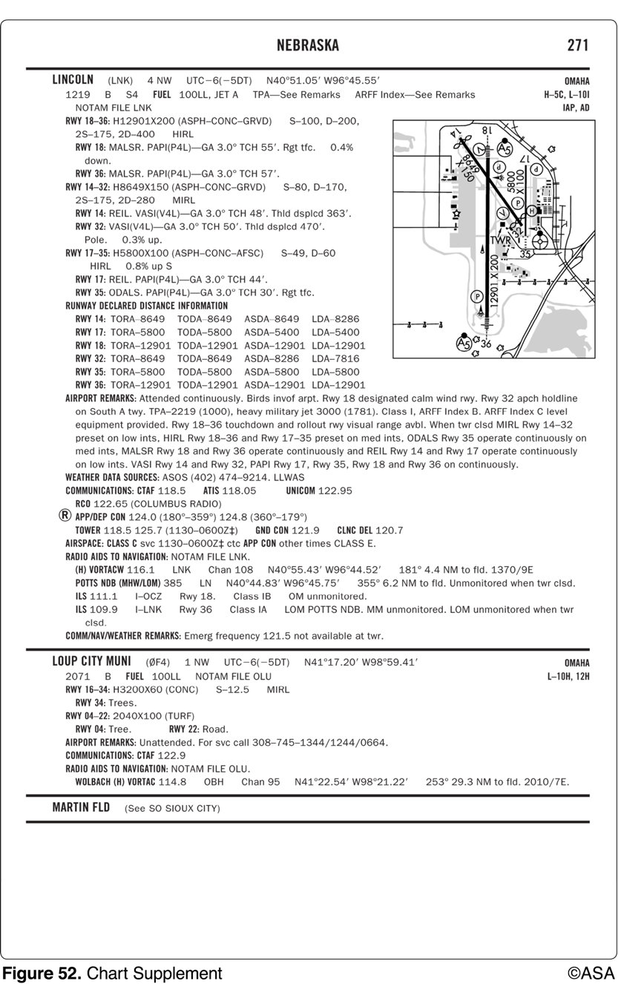
64. (3838) (Refer to Figure 52.) When approaching Lincoln Municipal from the west at noon for the purpose of landing, initial communications should be with
a. Lincoln Approach Control on 124.0 MHz. b. Minneapolis Center on 128.75 MHz. c. Lincoln Tower on 118.5 MHz.

Slide 432
64. (3838) (Refer to Figure 52.) When approaching Lincoln Municipal from the west at noon for the purpose of landing, initial communications should be with
*a. Lincoln Approach Control on 124.0 MHz. b. Minneapolis Center on 128.75 MHz. c. Lincoln Tower on 118.5 MHz.
Arriving aircraft landing at airports within Class C airspace should contact approach control from outside the Class C airspace on the specified frequency. 1. Figure 52 shows UTC -6 (-5DT). This means that local time is 6 hours behind UTC time, and 5 hours behind during daylight savings time. In order to convert local time to UTC time, add this difference to local time. 1200 local + 0600 UTC conversion = 1800Z. Lincoln Municipal approach should be contacted since its hours of operations are 1130-0630Z. 2. Identify the appropriate frequency for the aircraft's arrival from the west, 270°. Two frequencies are available. Aircraft approaching from any direction between 170° and 349° should make contact on 124.0 MHz.

Slide 433
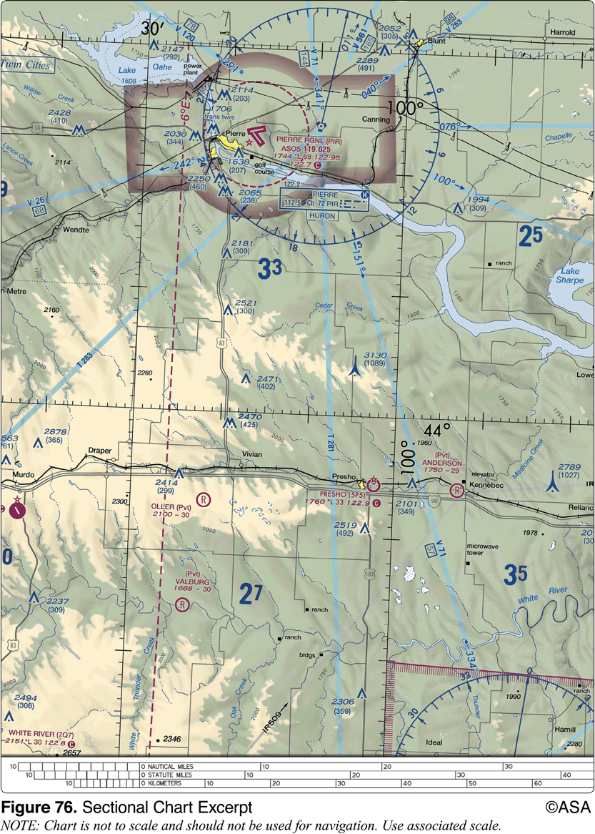
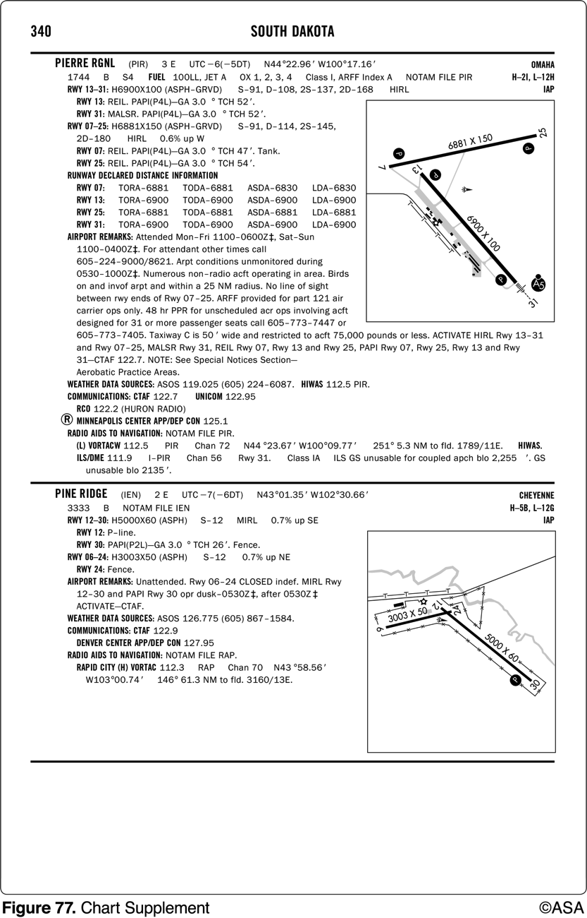
65. (3838.1) (Refer to Figures 76 and 77.) Inbound to Pierre Regional (PIR) from the southwest wind 240 at 12 knots expect to make
a. left traffic for Runway 25. b. right traffic for Runway 25. c. left traffic for Runway 07.

Slide 434
65. (3838.1) (Refer to Figures 76 and 77.) Inbound to Pierre Regional (PIR) from the southwest wind 240 at 12 knots expect to make
*a. left traffic for Runway 25. b. right traffic for Runway 25. c. left traffic for Runway 07.
Unless otherwise noted in the Chart Supplements U.S. airport traffic patterns are left traffic for stated runway. Wind is 240 at 12 knots resulting in a landing into the wind on Runway 25. Answer (B) is incorrect because the Chart Supplements U.S. does not list or specify right traffic for Runway 25. Answer (C) is incorrect because landing on Runway 07 would result in a significant tailwind landing.

Slide 435
66. (3839) (Refer to Figure 52.) Which type radar service is provided to VFR aircraft at Lincoln Municipal?
a. Sequencing to the primary Class C airport and standard separation. b. Sequencing to the primary Class C airport and conflict resolution so that radar targets do not touch, or 1,000 feet vertical separation. *c. Sequencing to the primary Class C airport, traffic advisories, conflict resolution, and safety alerts..

Slide 436
66. (3839) (Refer to Figure 52.) Which type radar service is provided to VFR aircraft at Lincoln Municipal?
a. Sequencing to the primary Class C airport and standard separation. b. Sequencing to the primary Class C airport and conflict resolution so that radar targets do not touch, or 1,000 feet vertical separation. *c. Sequencing to the primary Class C airport, traffic advisories, conflict resolution, and safety alerts.
Radar service in Class C airspace consists of sequencing to the primary airport, standard IFR/IFR separation, IFR/VFR separation (so that targets do not touch or have less than 500-foot separation), and providing traffic advisories and safety alerts.

Slide 437
67. (3840) (Refer to Figure 52.) What is the recommended communications procedure for landing at Lincoln Municipal during the hours when the tower is not in operation?
a. Monitor airport traffic and announce your position and intentions on 118.5 MHz. b. Contact UNICOM on 122.95 MHz for traffic advisories. c. Monitor ATIS for airport conditions, then announce your position on 122.95 MHz.

Slide 438
67. (3840) (Refer to Figure 52.) What is the recommended communications procedure for landing at Lincoln Municipal during the hours when the tower is not in operation?
*a. Monitor airport traffic and announce your position and intentions on 118.5 MHz. b. Contact UNICOM on 122.95 MHz for traffic advisories. c. Monitor ATIS for airport conditions, then announce your position on 122.95 MHz.
At an airport where the tower is operated on a part-time basis, a pilot should self-announce on the CTAF.

Slide 439
68. (3841) (Refer to Figure 52.) Where is Loup City Municipal located in relation to the city?
a. Northeast approximately 3 miles. b. Northwest approximately 1 mile. c. East approximately 7 miles.

Slide 440
68. (3841) (Refer to Figure 52.) Where is Loup City Municipal located in relation to the city?
a. Northeast approximately 3 miles. *b. Northwest approximately 1 mile. c. East approximately 7 miles.
Airport location is expressed as distance and direction from the center of the associated city in NM and cardinal points. The first item in parentheses is the airport identifier and the second item is the relation from the city. In this case, '1 NW.'

Slide 441
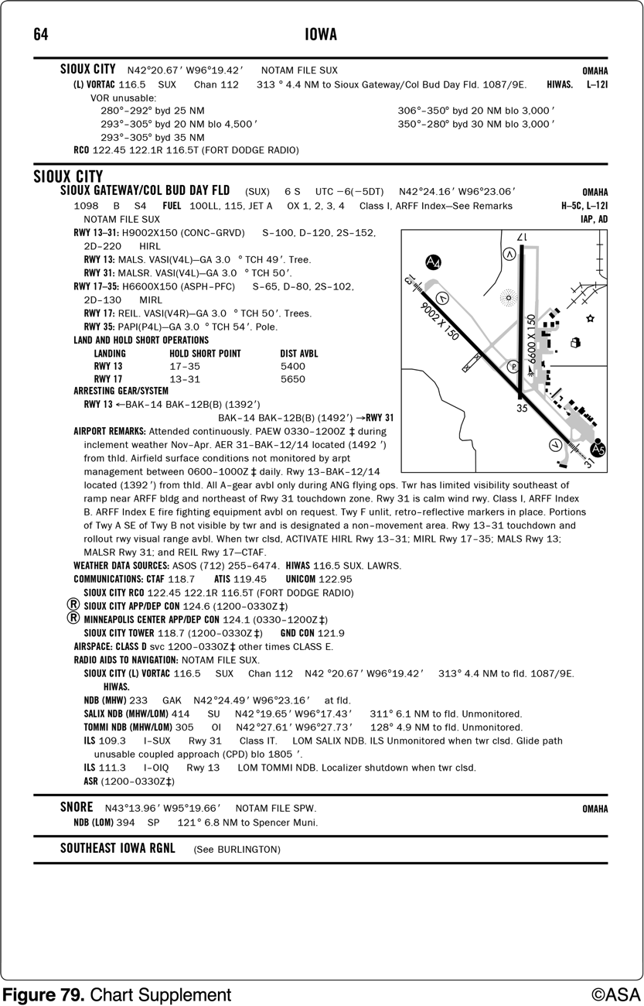
69. (3841.1) (Refer to Figure 78, 79 and Legend 3.) Where in relation to the airfield is the airport beacon located for Sioux City (SUX) airport?
a. West of runway 17-35. b. East of runway 17-35. c. Approach end of runway 31.

Slide 442
69. (3841.1) (Refer to Figure 78, 79 and Legend 3.) Where in relation to the airfield is the airport beacon located for Sioux City (SUX) airport?
a. West of runway 17-35. *b. East of runway 17-35. c. Approach end of runway 31.
Using Legend 3 you can determine that an airport beacon is depicted by a star feature. In both Figure 78 and on the airport diagram of Figure 79, locate the star feature on the east side of the airport or east of runway 17-35.

Slide 443
70. (3842) (Refer to Figure 52.) Traffic patterns in effect at Lincoln Municipal are
a. to the right on Runway 18 and Runway 36. b. to the right on Runway 18 and Runway 35; to the left on Runway 36. c. to the right on Runways 14 - 32.

Slide 444
70. (3842) (Refer to Figure 52.) Traffic patterns in effect at Lincoln Municipal are
a. to the right on Runway 18 and Runway 36. *b. to the right on Runway 18 and Runway 35; to the left on Runway 36. c. to the right on Runways 14 - 32.
Traffic is to the left unless otherwise stated in the Chart Supplements U.S. as 'Rgt tfc.'

Slide 445
71. (3844) Which statement best defines hypoxia?
a. A state of oxygen deficiency in the body. b. An abnormal increase in the volume of air breathed. c. A condition of gas bubble formation around the joints or muscles.

Slide 446
71. (3844) Which statement best defines hypoxia?
*a. A state of oxygen deficiency in the body. b. An abnormal increase in the volume of air breathed. c. A condition of gas bubble formation around the joints or muscles.
Hypoxia is an oxygen deficiency in the body usually caused by flight at higher altitudes. For optimum protection from hypoxia, pilots are encouraged to use supplemental oxygen above 10,000 feet during the day, and above 5,000 feet at night. Answer (B) is incorrect because it describes hyperventilation. Answer (C) is incorrect because it describes the bends.

Slide 447
72. (3845) When a stressful situation is encountered in flight, an abnormal increase in the volume of air breathed in and out can cause a condition known as
a. hyperventilation. b. aerosinusitis. c. aerotitis.

Slide 448
72. (3845) When a stressful situation is encountered in flight, an abnormal increase in the volume of air breathed in and out can cause a condition known as
*a. hyperventilation. b. aerosinusitis. c. aerotitis.
An abnormal increase in the volume of air breathed in and out of the lungs flushes an excessive amount of carbon dioxide from the lungs and blood, causing hyperventilation.

Slide 449
73. (3846) Which would most likely result in hyperventilation?
a. Emotional tension, anxiety, or fear. b. The excessive consumption of alcohol. c. An extremely slow rate of breathing and insufficient oxygen.

Slide 450
73. (3846) Which would most likely result in hyperventilation?
*a. Emotional tension, anxiety, or fear. b. The excessive consumption of alcohol. c. An extremely slow rate of breathing and insufficient oxygen.
Hyperventilation is most likely to occur during periods of stress or anxiety.

Slide 451
74. (3847) A pilot experiencing the effects of hyperventilation should be able to restore the proper carbon dioxide level in the body by
a. slowing the breathing rate, breathing into a paper bag, or talking aloud. b. breathing spontaneously and deeply or gaining mental control of the situation. c. increasing the breathing rate in order to increase lung ventilation.

Slide 452
74. (3847) A pilot experiencing the effects of hyperventilation should be able to restore the proper carbon dioxide level in the body by
*a. slowing the breathing rate, breathing into a paper bag, or talking aloud. b. breathing spontaneously and deeply or gaining mental control of the situation. c. increasing the breathing rate in order to increase lung ventilation.
The symptoms of hyperventilation subside within a few minutes after the rate and depth of breathing are consciously brought back under control. The buildup of carbon dioxide in the body can be hastened by controlled breathing in and out of a paper bag held over the nose and mouth. Talking aloud often helps, while normally-paced breathing at all times prevents hyperventilation.

Slide 453
75. (3848) Susceptibility to carbon monoxide poisoning increases as
a. altitude increases. b. altitude decreases. c. air pressure increases.

Slide 454
75. (3848) Susceptibility to carbon monoxide poisoning increases as
*a. altitude increases. b. altitude decreases. c. air pressure increases.
Susceptibility to carbon monoxide poisoning increases with altitude. As altitude increases, air pressure decreases and the body has difficulty getting oxygen. Add carbon monoxide, which further deprives the body of oxygen, and the situation can become critical.

Slide 455
76. (3849) What preparation should a pilot make to adapt the eyes for night flying?
a. Wear sunglasses after sunset until ready for flight. b. Avoid red lights at least 30 minutes before the flight. c. Avoid bright white lights at least 30 minutes before the flight.

Slide 456
76. (3849) What preparation should a pilot make to adapt the eyes for night flying?
a. Wear sunglasses after sunset until ready for flight. b. Avoid red lights at least 30 minutes before the flight. *c. Avoid bright white lights at least 30 minutes before the flight.
Exposure to total darkness for at least 30 minutes is required for complete dark adaptation. Any degree of dark adaptation is lost within a few seconds of viewing a bright light. Red lights do not affect night vision.

Slide 457
77. (3850) The danger of spatial disorientation during flight in poor visual conditions may be reduced by
a. shifting the eyes quickly between the exterior visual field and the instrument panel. b. having faith in the instruments rather than taking a chance on the sensory organs. c. leaning the body in the opposite direction of the motion of the aircraft.

Slide 458
77. (3850) The danger of spatial disorientation during flight in poor visual conditions may be reduced by
a. shifting the eyes quickly between the exterior visual field and the instrument panel. *b. having faith in the instruments rather than taking a chance on the sensory organs. c. leaning the body in the opposite direction of the motion of the aircraft.
Even if the natural horizon or surface reference is clearly visible, rely on instrument indications to overcome the effects of spatial disorientation. Shifting the eyes quickly from outside to inside, and leaning, will only compound the problem.

Slide 459
78. (3851) A lack of orientation with regard to the position, attitude, or movement of the aircraft in space is defined as
a. spatial disorientation. b. hyperventilation. c. hypoxia.

Slide 460
78. (3851) A lack of orientation with regard to the position, attitude, or movement of the aircraft in space is defined as
*a. spatial disorientation. b. hyperventilation. c. hypoxia.
Spatial disorientation is the state of confusion due to misleading information being sent to the brain from various sensory organs, resulting in a lack of awareness of the aircraft position in relation to a specific reference point.

Slide 461
79. (3852) Pilots are more subject to spatial disorientation if
a. they ignore the sensations of muscles and inner ear. b. visual cues are taken away, as they are in instrument meteorological conditions (IMC). c. eyes are moved often in the process of cross-checking the flight instruments.

Slide 462
79. (3852) Pilots are more subject to spatial disorientation if
a. they ignore the sensations of muscles and inner ear. *b. visual cues are taken away, as they are in instrument meteorological conditions (IMC). c. eyes are moved often in the process of cross-checking the flight instruments.
Sight, supported by other senses, allows the pilot to maintain orientation. However, during periods of low visibility, the supporting senses sometimes conflict with what is seen. When this happens, a pilot is particularly vulnerable to disorientation and must rely more on flight instruments.

Slide 463
80. (3853) If a pilot experiences spatial disorientation during flight in a restricted visibility condition, the best way to overcome the effect is to
a. rely upon the aircraft instrument indications. b. concentrate on yaw, pitch, and roll sensations. c. consciously slow the breathing rate until symptoms clear and then resume normal breathing rate.

Slide 464
80. (3853) If a pilot experiences spatial disorientation during flight in a restricted visibility condition, the best way to overcome the effect is to
*a. rely upon the aircraft instrument indications. b. concentrate on yaw, pitch, and roll sensations. c. consciously slow the breathing rate until symptoms clear and then resume normal breathing rate.
Even if the natural horizon or surface reference is clearly visible, rely on instrument indications to overcome the effects of spatial disorientation. Shifting the eyes quickly from outside to inside and leaning will only compound the problem.

Slide 465
81. (3916) Pilots are encouraged to turn on their landing lights when operating below 10,000 feet, day or night, and when operating within
a. Class B airspace. b. 10 miles of any airport. c. within 15 miles of a towered airport.

Slide 466
81. (3916) Pilots are encouraged to turn on their landing lights when operating below 10,000 feet, day or night, and when operating within
a. Class B airspace. *b. 10 miles of any airport. c. within 15 miles of a towered airport.
Pilots are encouraged to turn on their landing lights when operating below 10,000 feet, day or night, especially when operating within 10 miles of any airport or in conditions of reduced visibility and in areas where flocks of birds may be expected.

Slide 467
82. (3916.1) The Aeronautical Information Manual (AIM) specifically encourages pilots to turn on their landing lights when operating below 10,000 feet, day or night, and especially when operating
a. in Class B airspace. b. in conditions of reduced visibility. c. within 15 miles of a towered airport.

Slide 468
82. (3916.1) The Aeronautical Information Manual (AIM) specifically encourages pilots to turn on their landing lights when operating below 10,000 feet, day or night, and especially when operating
a. in Class B airspace. *b. in conditions of reduced visibility. c. within 15 miles of a towered airport.
Pilots are encouraged to turn on their landing lights when operating below 10,000 feet, day or night, especially when operating within 10 miles of any airport or in conditions of reduced visibility and in areas where flocks of birds may be expected.

Slide 469
83. (3931) What is it often called when a pilot pushes his or her capabilities and the aircraft's limits by trying to maintain visual contact with the terrain in low visibility and ceiling?
a. Scud running. b. Mind set. c. Peer pressure.

Slide 470
83. (3931) What is it often called when a pilot pushes his or her capabilities and the aircraft's limits by trying to maintain visual contact with the terrain in low visibility and ceiling?
*a. Scud running. b. Mind set. c. Peer pressure.
Scud running is pushing the capabilities of the pilot and the aircraft to the limits by trying to maintain visual contact with the terrain while trying to avoid physical contact with it.

Slide 471
84. (3931.1) Hazardous attitudes occur to every pilot to some degree at some time. What are some of these hazardous attitudes?
a. Poor risk management and lack of stress management. b. Anti-authority, impulsivity, macho, resignation, and invulnerability. c. Poor situational awareness, snap judgments, and lack of a decision making process.

Slide 472
84. (3931.1) Hazardous attitudes occur to every pilot to some degree at some time. What are some of these hazardous attitudes?
a. Poor risk management and lack of stress management. *b. Anti-authority, impulsivity, macho, resignation, and invulnerability. c. Poor situational awareness, snap judgments, and lack of a decision making process.
ADM addresses the following five hazardous attitudes: anti-authority (don't tell me!), impulsivity (do something quickly!), invulnerability (it won't happen to me!), macho (I can do it!), resignation (what's the use?).

Slide 473
85. (3931.2) In the aeronautical decision making (ADM) process, what is the first step in neutralizing a hazardous attitude?
a. Making a rational judgement. b. Recognizing hazardous thoughts. c. Recognizing the invulnerability of the situation.

Slide 474
85. (3931.2) In the aeronautical decision making (ADM) process, what is the first step in neutralizing a hazardous attitude?
a. Making a rational judgement. *b. Recognizing hazardous thoughts. c. Recognizing the invulnerability of the situation.
Hazardous attitudes which contribute to poor pilot judgment can be effectively counteracted by redirecting that hazardous attitude so that appropriate action can be taken. Recognition of hazardous thoughts is the first step in neutralizing them in the ADM process.

Slide 475
86. (3931.3) Risk management, as part of the aeronautical decision making (ADM) process, relies on which features to reduce the risks associated with each flight?
a. Application of stress management and risk element procedures. b. Situational awareness, problem recognition, and good judgment. c. The mental process of analyzing all information in a particular situation and making a timely decision on what action to take.

Slide 476
86. (3931.3) Risk management, as part of the aeronautical decision making (ADM) process, relies on which features to reduce the risks associated with each flight?
a. Application of stress management and risk element procedures. *b. Situational awareness, problem recognition, and good judgment. c. The mental process of analyzing all information in a particular situation and making a timely decision on what action to take.
Risk management is the part of the ADM which relies on situational awareness, problem recognition, and good judgment to reduce risks associated with each flight.

Slide 477
87. (3932) What antidotal phrase can help reverse the hazardous attitude of anti-authority?
a. Rules do not apply in this situation. b. I know what I am doing. c. Follow the rules.

Slide 478
87. (3932) What antidotal phrase can help reverse the hazardous attitude of anti-authority?
a. Rules do not apply in this situation. b. I know what I am doing. *c. Follow the rules.
The anti-authority (don't tell me!) attitude is found in people who do not like anyone telling them what to do. The antidote for this attitude is: follow the rules, they are usually right.

Slide 479
88. (3933) What antidotal phrase can help reverse the hazardous attitude of impulsivity?
a. It could happen to me. b. Do it quickly to get it over with. c. Not so fast, think first.

Slide 480
88. (3933) What antidotal phrase can help reverse the hazardous attitude of impulsivity?
a. It could happen to me. b. Do it quickly to get it over with. *c. Not so fast, think first.
Impulsivity (do something quickly!) is the attitude of people who frequently feel the need to do something, anything, immediately. They do not stop to think about what they are about to do, they do not select the best alternative, and they do the first thing that comes to mind. The antidote for this attitude is: Not so fast. Think first.

Slide 481
89. (3934) What antidotal phrase can help reverse the hazardous attitude of invulnerability?
a. It will not happen to me. b. It can not be that bad. c. It could happen to me.

Slide 482
89. (3934) What antidotal phrase can help reverse the hazardous attitude of invulnerability?
a. It will not happen to me. b. It can not be that bad. *c. It could happen to me.
Invulnerability (it won't happen to me) is found in people who think accidents happen to others, but never to them. Pilots who think this way are more likely to take chances and increase risk. The antidote for this attitude is: It could happen to me.

Slide 483
90. (3935) What antidotal phrase can help reverse the hazardous attitude of macho?
a. I can do it. b. Taking chances is foolish. c. Nothing will happen.

Slide 484
90. (3935) What antidotal phrase can help reverse the hazardous attitude of macho?
a. I can do it. *b. Taking chances is foolish. c. Nothing will happen.
Macho (I can do it) is the attitude found in pilots who are always trying to prove they are better than anyone else. Pilots with this type of attitude will try to prove themselves by taking risks in order to impress others. The antidote for this attitude is: Taking chances is foolish.

Slide 485
91. (3936) What antidotal phrase can help reverse the hazardous attitude of resignation?
a. What is the use. b. Someone else is responsible. c. I am not helpless.

Slide 486
91. (3936) What antidotal phrase can help reverse the hazardous attitude of resignation?
a. What is the use. b. Someone else is responsible. *c. I am not helpless.
Resignation (what's the use) is the attitude in pilots who do not see themselves as being able to make a great deal of difference in what happens to them. When things go well, the pilot is apt to think it's due to good luck. When things go badly, the pilot may feel that 'someone is out to get me,' or attribute it to bad luck. The antidote for this attitude is: I'm not helpless. I can make a difference.

Slide 487
92. (3937) Who is responsible for determining whether a pilot is fit to fly for a particular flight, even though he or she holds a current medical certificate?
a. The FAA. b. The medical examiner. c. The pilot.

Slide 488
92. (3937) Who is responsible for determining whether a pilot is fit to fly for a particular flight, even though he or she holds a current medical certificate?
a. The FAA. b. The medical examiner. *c. The pilot.
The pilot is responsible for determining if they are fit to fly for a particular flight.

Slide 489
93. (3938) What is the one common factor which affects most preventable accidents?
a. Structural failure. b. Mechanical malfunction. c. Human error.

Slide 490
93. (3938) What is the one common factor which affects most preventable accidents?
a. Structural failure. b. Mechanical malfunction. *c. Human error.
Most preventable accidents have one common factor: human error, rather than a mechanical malfunction.

Slide 491
94. (3939) What often leads to spatial disorientation or collision with ground/obstacles when flying under Visual Flight Rules (VFR)?
a. Continual flight into instrument conditions. b. Getting behind the aircraft. c. Duck-under syndrome.

Slide 492
94. (3939) What often leads to spatial disorientation or collision with ground/obstacles when flying under Visual Flight Rules (VFR)?
*a. Continual flight into instrument conditions. b. Getting behind the aircraft. c. Duck-under syndrome.
Continuing VFR flight into IMC often leads to spatial disorientation or collision with ground/obstacles. It is even more dangerous if the pilot is not instrument qualified or current.

Slide 493
95. (3940) What is one of the neglected items when a pilot relies on short and long term memory for repetitive tasks?
a. Checklists. b. Situation awareness. c. Flying outside the envelope.

Slide 494
95. (3940) What is one of the neglected items when a pilot relies on short and long term memory for repetitive tasks?
*a. Checklists. b. Situation awareness. c. Flying outside the envelope.
Unjustified reliance on the pilot's short and long term memory, regular flying skills, repetitive and familiar routes usually results in neglect of flight planning, preflight inspections, and checklists.

Slide 495
96. (3940.1) A pilot and two passengers landed on a 2,100 foot east-west gravel strip with an elevation of 1,800 feet. The temperature is warmer than expected and after computing the density altitude it is determined the takeoff distance over a 50 foot obstacle is 1,980 feet. The airplane is 75 pounds under gross weight. What would be the best choice?
a. Taking off into the headwind will give the extra climb-out time needed. b. Try a takeoff without the passengers to make sure the climb is adequate. c. Wait until the temperature decreases, and recalculate the takeoff performance.

Slide 496
96. (3940.1) A pilot and two passengers landed on a 2,100 foot east-west gravel strip with an elevation of 1,800 feet. The temperature is warmer than expected and after computing the density altitude it is determined the takeoff distance over a 50 foot obstacle is 1,980 feet. The airplane is 75 pounds under gross weight. What would be the best choice?
a. Taking off into the headwind will give the extra climb-out time needed. b. Try a takeoff without the passengers to make sure the climb is adequate. *c. Wait until the temperature decreases, and recalculate the takeoff performance.
The conditions described provide only 120 feet for a margin of error between required takeoff distance and available runway. This is too risky; the pilot should wait until conditions improve and there is a larger margin of safety between available and needed runway distance.

Slide 497
97. (3951) Who should not participate in the Land and Hold Short Operations (LAHSO) program?
a. Recreational pilots only. b. Military pilots. c. Student pilots.

Slide 498
97. (3951) Who should not participate in the Land and Hold Short Operations (LAHSO) program?
a. Recreational pilots only. b. Military pilots. *c. Student pilots.
Student pilots or pilots not familiar with LAHSO should not participate in the program.

Slide 499
98. (3952) Who has final authority to accept or decline any land and hold short (LAHSO) clearance?
a. Pilot-in-command. b. Air traffic controller. c. Second-in-command.

Slide 500
98. (3952) Who has final authority to accept or decline any land and hold short (LAHSO) clearance?
*a. Pilot-in-command. b. Air traffic controller. c. Second-in-command.
The PIC has the final authority to accept or decline any land and hold short clearance. The safety and operation of the aircraft remain the responsibility of the pilot.

Slide 501
99. (3953) When should pilots decline a land and hold short (LAHSO) clearance?
a. When it will compromise safety. b. Only when the tower operator concurs. c. Pilots can not decline clearance.

Slide 502
99. (3953) When should pilots decline a land and hold short (LAHSO) clearance?
*a. When it will compromise safety. b. Only when the tower operator concurs. c. Pilots can not decline clearance.
Pilots are expected to decline a LAHSO clearance if they determine it will compromise safety.

Slide 503
100. (3954) Where is the Available Landing Distance (ALD) data published for an airport that utilizes Land and Hold Short Operations (LAHSO)?
a. Special Notices section of the Chart Supplements U.S. b. 14 CFR Part 91, General Operating and Flight Rules. c. Aeronautical Information Manual (AIM).

Slide 504
100. (3954) Where is the Available Landing Distance (ALD) data published for an airport that utilizes Land and Hold Short Operations (LAHSO)?
*a. Special Notices section of the Chart Supplements U.S. b. 14 CFR Part 91, General Operating and Flight Rules. c. Aeronautical Information Manual (AIM).
ALD data is published in the special notices section of the Chart Supplements U.S. and in the U.S. Terminal Procedures Publications.

Slide 505
101. (3955) What is the minimum visibility for a pilot to receive a land and hold short (LAHSO) clearance?
a. 3 nautical miles. b. 3 statute miles. c. 1 statute mile.

Slide 506
101. (3955) What is the minimum visibility for a pilot to receive a land and hold short (LAHSO) clearance?
a. 3 nautical miles. *b. 3 statute miles. c. 1 statute mile.
Pilots should only receive a LAHSO clearance when there is a minimum ceiling of 1,000 feet and 3 statute miles visibility. The intent of having basic VFR weather conditions is to allow pilots to maintain visual contact with other aircraft and ground vehicle operations.

Slide 507
102. (3955.1) When approaching taxiway holding lines from the side with the continuous lines, the pilot
a. may continue taxiing. b. should not cross the lines without ATC clearance. c. should continue taxiing until all parts of the aircraft have crossed the lines.

Slide 508
102. (3955.1) When approaching taxiway holding lines from the side with the continuous lines, the pilot
a. may continue taxiing. *b. should not cross the lines without ATC clearance. c. should continue taxiing until all parts of the aircraft have crossed the lines.
When approaching the holding line from the side with the continuous lines, a pilot should not cross the holding line without ATC clearance at a controlled airport, or without making sure of adequate separation from other aircraft at uncontrolled airports. Answer (A) is incorrect because no part of the aircraft may cross the hold line without ATC clearance. Answer (C) is incorrect because no part of the aircraft may cross the hold line without ATC clearance.

Slide 509
103. (3955.2) What is the purpose of the runway/runway hold position sign?
a. Denotes entrance to runway from a taxiway. b. Denotes area protected for an aircraft approaching or departing a runway. c. Denotes intersecting runways.

Slide 510
103. (3955.2) What is the purpose of the runway/runway hold position sign?
a. Denotes entrance to runway from a taxiway. b. Denotes area protected for an aircraft approaching or departing a runway. *c. Denotes intersecting runways.
Mandatory instruction signs are used to denote an entrance to a runway or critical area and areas where an aircraft is prohibited from entering. The runway holding position sign is located at the holding position on taxiways that intersect a runway or on runways that intersect other runways.

Slide 511
104. (3955.3) What does the outbound destination sign identify?
a. Identifies entrance to the runway from a taxiway. b. Identifies direction to take-off runways. c. Identifies runway on which an aircraft is located.

Slide 512
104. (3955.3) What does the outbound destination sign identify?
a. Identifies entrance to the runway from a taxiway. *b. Identifies direction to take-off runways. c. Identifies runway on which an aircraft is located.
Outbound destination signs provide information for locating the departure runway. Answer (A) is incorrect because this is a runway marking. Answer (C) is incorrect because this is a runway location sign.

Slide 513
105. (3955.4) What is the purpose of the no entry sign?
a. Identifies a paved area where aircraft are prohibited from entering. b. Identifies area that does not continue beyond intersection. c. Identifies the exit boundary for the runway protected area.

Slide 514
105. (3955.4) What is the purpose of the no entry sign?
*a. Identifies a paved area where aircraft are prohibited from entering. b. Identifies area that does not continue beyond intersection. c. Identifies the exit boundary for the runway protected area.
The no entry sign prohibits an aircraft from entering an area. Typically, this sign would be located on a taxiway intended to be used in only one direction or at the intersection of vehicle roadways with runways, taxiways or aprons where the roadway may be mistaken as a taxiway or other aircraft movement surface.Answer (B) is incorrect because this is the purpose of a hold position sign. Answer (C) is incorrect because this is the purpose of the runway boundary sign.

Slide 515
106. (3955.5) (Refer to Figure 65.) Which airport marking is a runway safety area/obstacle free zone boundary?
a. G. b. H. c. N.

Slide 516
106. (3955.5) (Refer to Figure 65.) Which airport marking is a runway safety area/obstacle free zone boundary?
*a. G. b. H. c. N.
The runway boundary sign has a yellow background and a black inscription, with a graphic that depicts the pavement holding position marking. This sign, which faces the runway and is visible to the pilot exiting the runway, is located adjacent to the holding-position marking on the pavement. The sign is intended to provide pilots with another visual cue they can use as a guide in deciding when they are clear of the runway. Answer (B) is incorrect because this is an ILS critical area boundary sign. Answer (C) is incorrect because this is a taxiway-ending marker.

Slide 517
107. (3955.6) (Refer to Figure 65.) From the cockpit, marking G confirms the aircraft to be
a. on a taxiway, about to enter runway zone. b. on a runway, about to clear. c. near an instrument approach clearance zone.

Slide 518
107. (3955.6) (Refer to Figure 65.) From the cockpit, marking G confirms the aircraft to be
a. on a taxiway, about to enter runway zone. *b. on a runway, about to clear. c. near an instrument approach clearance zone.
Illustration G is a runway boundary sign, which has a yellow background and a black inscription with a graphic that depicts the pavement holding position marking. This sign, which faces the runway and is visible to the pilot exiting the runway, is located adjacent to the holding position marking on the pavement. It is intended to provide pilots with another visual cue they can use in deciding if they are clear of the runway.

Slide 519
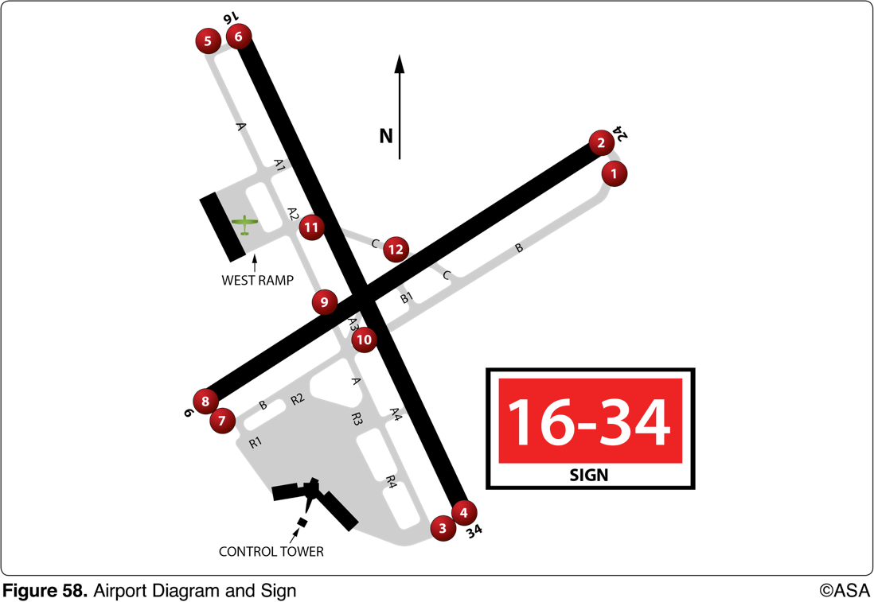
108. (3957) (Refer to Figure Commercial 58.) You have requested taxi instructions for takeoff using Runway 16. The controller issues the following taxi instructions: "N123, Taxi to Runway 16." Where are you required to stop in order to be in compliance with the controller's instructions
a. 5 (Five). b. 6 (Six). c. 9 (Nine).

Slide 520
108. (3957) (Refer to Figure Commercial 58.) You have requested taxi instructions for takeoff using Runway 16. The controller issues the following taxi instructions: "N123, Taxi to Runway 16." Where are you required to stop in order to be in compliance with the controller's instructions
*a. 5 (Five). b. 6 (Six). c. 9 (Nine).
When ATC clears an aircraft to "taxi to" an assigned takeoff runway, the absence of holding instructions does not authorize the aircraft to "cross" all runways which the taxi route intersects except the assigned takeoff runway. A clearance must be obtained prior to crossing any runway. It does not include authorization to "taxi onto" or "cross" the assigned takeoff runway at any point. You should taxi and hold short of Runway 16, which is position 5. Answer (B) is incorrect because "taxi to" does not authorize the aircraft to "taxi onto" the assigned takeoff runway. Answer (C) is incorrect because the airplane should taxi the most direct route to the assigned runway unless instructed otherwise; position 9 would not be encountered for the airplane at the west ramp to taxi to Runway 16.

