Slide 1
1. (3006) Which V-speed represents maneuvering speed?
a. V(A).
b. V(LO).
c. V(NE).

Slide 2
1. (3006) Which V-speed represents maneuvering speed?
*a. V(A).
b. V(LO).
c. V(NE).
V(A) is design maneuvering speed. Answer (B) is incorrect because this is the maximum landing gear operating speed. Answer (C) is incorrect because this is the never-exceed speed.

Slide 3
2. (3007) Which V-speed represents maximum flap extended speed?
a. V(FE). b. V(LOF). c. V(FC).

Slide 4
2. (3007) Which V-speed represents maximum flap extended speed?
*a. V(FE). b. V(LOF). c. V(FC).
V(FE) is the highest calibrated airspeed permissible with the wing flaps in a prescribed extended position. Answer (B) is incorrect because this is the liftoff speed. Answer (C) is incorrect because this is the maximum speed for stability characteristics.

Slide 5
3. (3008) Which V-speed represents maximum landing gear extended speed?
a. V(LE). b. V(LO). c. V(FE).

Slide 6
3. (3008) Which V-speed represents maximum landing gear extended speed?
*a. V(LE). b. V(LO). c. V(FE).
V(LE) is the maximum calibrated airspeed at which the airplane can be safely flown with the landing gear extended. Answer (B) is incorrect because V(LO) is maximum landing gear operating speed. Answer (C) is incorrect because V(FE) is maximum flap extended speed.

Slide 7
4. (3009) V(NO) is defined as the
a. normal operating range. b. never-exceed speed. c. maximum structural cruising speed.

Slide 8
4. (3009) V(NO) is defined as the
a. normal operating range. b. never-exceed speed. *c. maximum structural cruising speed.
V(NO) is the maximum calibrated airspeed for normal operation, or the maximum structural cruising speed. Answer (A) is incorrect because this is not designated a V-speed, but rather it is the green arc on the airspeed indicator. Answer (B) is incorrect because this is V(NE).

Slide 9
5. (3010) V(SO) is defined as the
a. stalling speed or minimum steady flight speed in the landing configuration. b. stalling speed or minimum steady flight speed in a specified configuration. c. stalling speed or minimum takeoff safety speed.

Slide 10
5. (3010) V(SO) is defined as the
*a. stalling speed or minimum steady flight speed in the landing configuration. b. stalling speed or minimum steady flight speed in a specified configuration. c. stalling speed or minimum takeoff safety speed.
V(SO) is the calibrated power-off stalling speed or the minimum steady-flight speed at which the aircraft is controllable in the landing configuration. Answer (B) is incorrect because this is V(S1). Answer (C) is incorrect because V(S) is stalling speed, and V(2) is the minimum takeoff safety speed.

Slide 11
6. (3011) Which would provide the greatest gain in altitude in the shortest distance during climb after takeoff?
a. V(Y). b. V(A). c. V(X).

Slide 12
6. (3011) Which would provide the greatest gain in altitude in the shortest distance during climb after takeoff?
a. V(Y). b. V(A). *c. V(X).
V(X) (best angle-of-climb speed) is the calibrated airspeed at which the aircraft will attain the highest altitude in a given horizontal distance. Answer (A) is incorrect because V(Y) is best rate-of-climb speed. Answer (B) is incorrect because V(A) is design maneuvering speed.

Slide 13
7. (3012.1) After takeoff, which airspeed would the pilot use to gain the most altitude in a given period of time?
a. V(Y). b. V(X). c. V(A).

Slide 14
7. (3012.1) After takeoff, which airspeed would the pilot use to gain the most altitude in a given period of time?
*a. V(Y). b. V(X). c. V(A).
V(Y) (best rate-of-climb speed) is the calibrated airspeed at which the airplane will obtain the maximum increase in altitude per unit of time (feet per minute) after takeoff. Answer (B) is incorrect because V(X) is the best angle-of-climb speed. Answer (C) is incorrect because V(A) is the design maneuvering speed.

Slide 15
8. (3105) If an altimeter setting is not available before flight, to which altitude should the pilot adjust the altimeter?
a. The elevation of the nearest airport corrected to mean sea level. b. The elevation of the departure area. c. Pressure altitude corrected for nonstandard temperature.

Slide 16
8. (3105) If an altimeter setting is not available before flight, to which altitude should the pilot adjust the altimeter?
a. The elevation of the nearest airport corrected to mean sea level. *b. The elevation of the departure area. c. Pressure altitude corrected for nonstandard temperature.
The altimeter should be set to the elevation of the departure airport for airplanes, and the departure area for other aircraft. Answer (A) is incorrect because airport elevation is always expressed in feet above MSL. Answer (C) is incorrect because pressure altitude adjusted for nonstandard temperature is not true altitude, but density altitude.

Slide 17
9. (3106) Prior to takeoff, the altimeter should be set to which altitude or altimeter setting?
a. The current local altimeter setting, if available, or the departure airport elevation. b. The corrected density altitude of the departure airport. c. The corrected pressure altitude for the departure airport.

Slide 18
9. (3106) Prior to takeoff, the altimeter should be set to which altitude or altimeter setting?
*a. The current local altimeter setting, if available, or the departure airport elevation. b. The corrected density altitude of the departure airport. c. The corrected pressure altitude for the departure airport.
The altimeter should be set to the elevation of the departure airport for airplanes, and the departure area for other aircraft. Answer (B) is incorrect because density altitude is pressure altitude corrected for nonstandard temperature variations and only concerns the performance of the aircraft. Answer (C) is incorrect because pressure altitude is the altitude indicated on the altimeter when the altimeter is set to 29.92.

Slide 19
10. (3107) At what altitude shall the altimeter be set to 29.92, when climbing to cruising flight level?
a. 14,500 feet MSL. b. 18,000 feet MSL. c. 24,000 feet MSL.

Slide 20
10. (3107) At what altitude shall the altimeter be set to 29.92, when climbing to cruising flight level?
a. 14,500 feet MSL. *b. 18,000 feet MSL. c. 24,000 feet MSL.
The altimeter should be set to 29.92 "Hg at 18,000 feet MSL and above. Note: 18,000 feet is Class A airspace, which requires an instrument rating to operate in. Answer (A) is incorrect because 14,500 feet is the base of Class E airspace, when not designated lower. Answer (C) is incorrect because 24,000 feet MSL is the altitude at which DME is required.

Slide 21
11. (3247) If the pitot tube and outside static vents become clogged, which instruments would be affected?
a. The altimeter, airspeed indicator, and turn-and-slip indicator. b. The altimeter, airspeed indicator, and vertical speed indicator. c. The altimeter, attitude indicator, and turn-and-slip indicator.

Slide 22
11. (3247) If the pitot tube and outside static vents become clogged, which instruments would be affected?
a. The altimeter, airspeed indicator, and turn-and-slip indicator. *b. The altimeter, airspeed indicator, and vertical speed indicator. c. The altimeter, attitude indicator, and turn-and-slip indicator.
Airspeed, altimeter, and vertical speed all receive static input and would indicate inaccurately if the static sources became plugged. Answer (A) is incorrect because the turn-and-slip indicator and attitude indicator are gyroscopic instruments, and are not part of the pitot-static system. Answer (C) is incorrect because the turn-and-slip indicator and attitude indicator are gyroscopic instruments, and are not part of the pitot-static system.

Slide 23
12. (3248) Which instrument will become inoperative if the pitot tube becomes clogged?
a. Altimeter. b. Vertical speed. c. Airspeed.

Slide 24
12. (3248) Which instrument will become inoperative if the pitot tube becomes clogged?
a. Altimeter. b. Vertical speed. *c. Airspeed.
The pitot tube provides input for the airspeed indicator only. Answer (A) is incorrect because the altimeter and vertical speed indicator operate off the static system and are not affected by a clogged pitot tube. Answer (B) is incorrect because the altimeter and vertical speed indicator operate off the static system and are not affected by a clogged pitot tube.

Slide 25
13. (3249) Which instrument(s) will become inoperative if the static vents become clogged?
a. Airspeed only. b. Altimeter only. c. Airspeed, altimeter, and vertical speed.

Slide 26
13. (3249) Which instrument(s) will become inoperative if the static vents become clogged?
a. Airspeed only. b. Altimeter only. *c. Airspeed, altimeter, and vertical speed.
Airspeed, altimeter, and vertical speed all receive static input and would indicate inaccurately if the static sources became plugged.

Slide 27
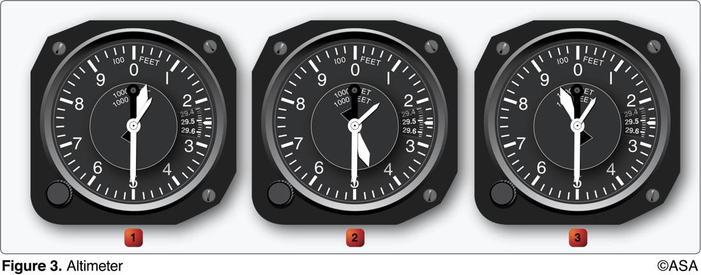
14. (3250) (Refer to Figure 3.) Altimeter 1 indicates
a. 500 feet. b. 1,500 feet. c. 10,500 feet.

Slide 28
14. (3250) (Refer to Figure 3.) Altimeter 1 indicates
a. 500 feet. b. 1,500 feet. *c. 10,500 feet.
On altimeter #1 the 10,000-foot pointer (shortest hand) is just above 10,000 feet, the 1,000-foot pointer (fat hand) is between 0 and 1,000 feet, and the 100-foot pointer is on 500 feet.

Slide 29
15. (3251) (Refer to Figure 3.) Altimeter 2 indicates
a. 1,500 feet. b. 4,500 feet. c. 14,500 feet.

Slide 30
15. (3251) (Refer to Figure 3.) Altimeter 2 indicates
a. 1,500 feet. b. 4,500 feet. *c. 14,500 feet.
On altimeter #2 the 10,000-foot pointer is between 10,000 feet and 20,000 feet. The 1,000-foot pointer is between 4,000 feet and 5,000 feet, and the 100-foot pointer is on 500 feet.

Slide 31
16. (3252) (Refer to Figure 3.) Altimeter 3 indicates
a. 9,500 feet. b. 10,950 feet. c. 15,940 feet.

Slide 32
16. (3252) (Refer to Figure 3.) Altimeter 3 indicates
*a. 9,500 feet. b. 10,950 feet. c. 15,940 feet.
On altimeter #3 the 10,000-foot pointer is not quite to 10,000 feet. The 1,000-foot pointer is halfway between 9,000 and 10,000 feet, and the 100-foot pointer is on 500 feet.

Slide 33
17. (3253) (Refer to Figure 3.) Which altimeter(s) indicate(s) more than 10,000 feet?
a. 1, 2, and 3. b. 1 and 2 only. c. 1 only.

Slide 34
17. (3253) (Refer to Figure 3.) Which altimeter(s) indicate(s) more than 10,000 feet?
a. 1, 2, and 3. *b. 1 and 2 only. c. 1 only.
The shortest hand (10,000 foot) in #1 is between 1 and 2, indicating 10,000 feet plus. The shortest hand in #2 also indicates 10,000 feet plus. The shortest hand in #3 indicates less than 10,000 feet.

Slide 35
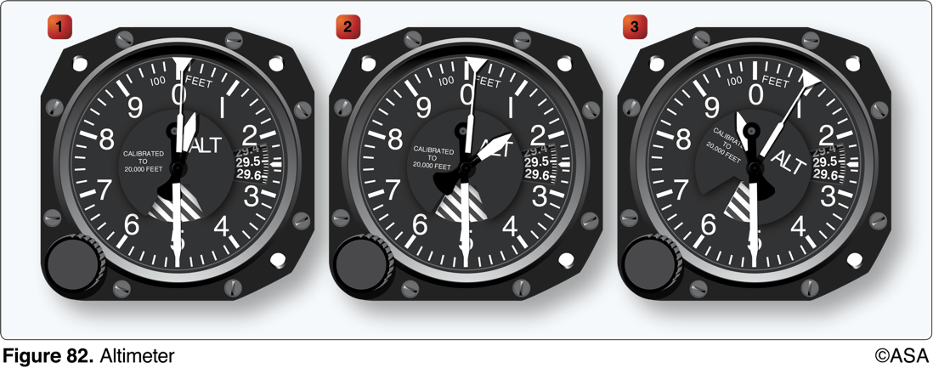
18. (3253.1) (Refer to Figure 82.) Altimeter 3 is indicating a VFR cruising altitude for which direction?
a. 180-359 degrees magnetic. b. 179 degrees true. c. 080 degrees magnetic.

Slide 36
18. (3253.1) (Refer to Figure 82.) Altimeter 3 is indicating a VFR cruising altitude for which direction?
a. 180-359 degrees magnetic. b. 179 degrees true. *c. 080 degrees magnetic.
On altimeter #3, the 10,000-foot pointer is just before 10,000 feet. The 1,000-foot pointer is between 9,000 feet and 10,000 feet, and the 100-foot pointer is on 500 feet. The aircraft is at an altitude of 9,500 feet. A magnetic course of 0° to 179° should be flown at a VFR cruising altitude of odd-thousands plus 500 feet.Answer (A) is incorrect because a VFR cruising altitude in a direction of 180-359° should be flown at an even flight altitude plus 500 feet altitude. Answer (B) is incorrect because VFR cruising altitudes should be determined by magnetic direction, not true.

Slide 37
19. (3254) Altimeter setting is the value to which the barometric pressure scale of the altimeter is set so the altimeter indicates
a. calibrated altitude at field elevation. b. absolute altitude at field elevation. c. true altitude at field elevation.

Slide 38
19. (3254) Altimeter setting is the value to which the barometric pressure scale of the altimeter is set so the altimeter indicates
a. calibrated altitude at field elevation. b. absolute altitude at field elevation. *c. true altitude at field elevation.
The local altimeter setting corrects for the difference between existing pressure and standard atmospheric pressure. Whether local pressure is higher or lower than standard, it will indicate true altitude (MSL) at ground level, when the aircraft altimeter is set to the local altimeter setting (assuming no setting scale error). Answer (A) is incorrect because 'calibrated' does not apply to altitudes; it only applies to airspeeds. Answer (B) is incorrect because absolute altitude is the height above the ground.

Slide 39
20. (3255) How do variations in temperature affect the altimeter?
a. Pressure levels are raised on warm days and the indicated altitude is lower than true altitude. b. Higher temperatures expand the pressure levels and the indicated altitude is higher than true altitude. c. Lower temperatures lower the pressure levels and the indicated altitude is lower than true altitude.

Slide 40
20. (3255) How do variations in temperature affect the altimeter?
*a. Pressure levels are raised on warm days and the indicated altitude is lower than true altitude. b. Higher temperatures expand the pressure levels and the indicated altitude is higher than true altitude. c. Lower temperatures lower the pressure levels and the indicated altitude is lower than true altitude.
On a warm day, the expanded air is lighter than on a cold day, and consequently the pressure levels are raised. For example, the pressure level where the altimeter indicates 10,000 feet will be higher on a warm day than under standard conditions. On a cold day the reverse is true. Answer (B) is incorrect because raising the pressure levels would not cause the indicated altitude to be higher than the true altitude. Answer (C) is incorrect because lowering the pressure levels would not cause the indicated altitude to be lower than the true altitude.

Slide 41
21. (3256) What is true altitude?
a. The vertical distance of the aircraft above sea level. b. The vertical distance of the aircraft above the surface. c. The height above the standard datum plane.

Slide 42
21. (3256) What is true altitude?
*a. The vertical distance of the aircraft above sea level. b. The vertical distance of the aircraft above the surface. c. The height above the standard datum plane.
True altitude is height above sea level. Airport terrain and obstacle elevations found on aeronautical charts are true altitudes. Answer (B) is incorrect because the vertical distance above the surface is absolute altitude. Answer (C) is incorrect because the height above the standard datum plane is pressure altitude.

Slide 43
22. (3257) What is absolute altitude?
a. The altitude read directly from the altimeter. b. The vertical distance of the aircraft above the surface. c. The height above the standard datum plane.

Slide 44
22. (3257) What is absolute altitude?
a. The altitude read directly from the altimeter. *b. The vertical distance of the aircraft above the surface. c. The height above the standard datum plane.
Absolute altitude is height above the surface. This height may be indicated directly on a radar altimeter. Absolute altitude may be approximately computed from indicated altitude and chart elevation data. Answer (A) is incorrect because the altitude read from the altimeter is indicated altitude. Answer (C) is incorrect because the height above the standard datum plane is pressure altitude.

Slide 45
23. (3258) What is density altitude?
a. The height above the standard datum plane. b. The pressure altitude corrected for nonstandard temperature. c. The altitude read directly from the altimeter.

Slide 46
23. (3258) What is density altitude?
a. The height above the standard datum plane. *b. The pressure altitude corrected for nonstandard temperature. c. The altitude read directly from the altimeter.
Under standard atmospheric conditions, each level of air in the atmosphere has a specific density, and under standard conditions, pressure altitude and density altitude identify the same level. At temperatures higher or lower than standard, density altitude cannot be determined directly from the altimeter. Answer (A) is incorrect because the height above the standard datum plane is pressure altitude. Answer (C) is incorrect because the altitude read from the altimeter is indicated altitude.

Slide 47
24. (3259) What is pressure altitude?
a. The indicated altitude corrected for position and installation error. b. The altitude indicated when the barometric pressure scale is set to 29.92. c. The indicated altitude corrected for non standard temperature and pressure.

Slide 48
24. (3259) What is pressure altitude?
a. The indicated altitude corrected for position and installation error. *b. The altitude indicated when the barometric pressure scale is set to 29.92. c. The indicated altitude corrected for non standard temperature and pressure.
The pressure altitude can be determined by either of two methods: 1. Setting the barometric scale of the altimeter to 29.92 and reading the indicated altitude, or 2. Applying a correction factor to the elevation (true altitude) according to the reported altimeter setting. Answer (A) is incorrect because the altimeter is not corrected for position and installation error. Answer (C) is incorrect because indicated altitude corrected for nonstandard temperature and pressure defines density altitude.

Slide 49
25. (3260) Under what condition is indicated altitude the same as true altitude?
a. If the altimeter has no mechanical error. b. When at sea level under standard conditions. c. When at 18,000 feet MSL with the altimeter set at 29.92.

Slide 50
25. (3260) Under what condition is indicated altitude the same as true altitude?
a. If the altimeter has no mechanical error. *b. When at sea level under standard conditions. c. When at 18,000 feet MSL with the altimeter set at 29.92.
On a standard day (29.92 "Hg and +15°C) at sea level, pressure altitude, indicated altitude, and density altitude are all equal. Any variation from standard temperature or pressure will have an effect on the altimeter. Answer (A) is incorrect because mechanical error does not apply to true altitude. Answer (C) is incorrect because when the altimeter is set to 29.92, it indicates pressure altitude.

Slide 51
26. (3261) If it is necessary to set the altimeter from 29.15 to 29.85, what change occurs?
a. 70-foot increase in indicated altitude. b. 70-foot increase in density altitude. c. 700-foot increase in indicated altitude.

Slide 52
26. (3261) If it is necessary to set the altimeter from 29.15 to 29.85, what change occurs?
a. 70-foot increase in indicated altitude. b. 70-foot increase in density altitude. *c. 700-foot increase in indicated altitude.
When the knob on the altimeter is rotated, the pressure scale moves simultaneously with the altimeter pointers. The numerical values of pressure indicated in the window increase while the altimeter indicates an increase in altitude; or decrease while the altimeter indicates a decrease in altitude. This is contrary to the reaction on the pointers when air pressure changes, and is based solely on the mechanical makeup of the altimeter. The difference between the two settings is equal to 0.70 "Hg (29.85 - 29.15). At the standard pressure lapse rate of 1 "Hg = 1,000 feet in altitude, the amount of change equals 700 feet.

Slide 53
27. (3262) The pitot system provides impact pressure for which instrument?
a. Altimeter. b. Vertical speed indicator. c. Airspeed indicator.

Slide 54
27. (3262) The pitot system provides impact pressure for which instrument?
a. Altimeter. b. Vertical speed indicator. *c. Airspeed indicator.
The pitot tube provides input for the airspeed indicator only. Answer (A) is incorrect because the altimeter and vertical speed indicator operate off the static system. Answer (B) is incorrect because the altimeter and vertical speed indicator operate off the static system.

Slide 55
28. (3264) What does the red line on an airspeed indicator represent?
a. Maneuvering speed. b. Turbulent or rough-air speed. c. Never-exceed speed.

Slide 56
28. (3264) What does the red line on an airspeed indicator represent?
a. Maneuvering speed. b. Turbulent or rough-air speed. *c. Never-exceed speed.
The upper end of the arc is marked by a red radial line which is the never-exceed speed (V(NE)). Answer (A) is incorrect because the maneuvering speed and turbulent or rough-air speed is not indicated on the airspeed indicator. Answer (B) is incorrect because the maneuvering speed and turbulent or rough-air speed is not indicated on the airspeed indicator.

Slide 57
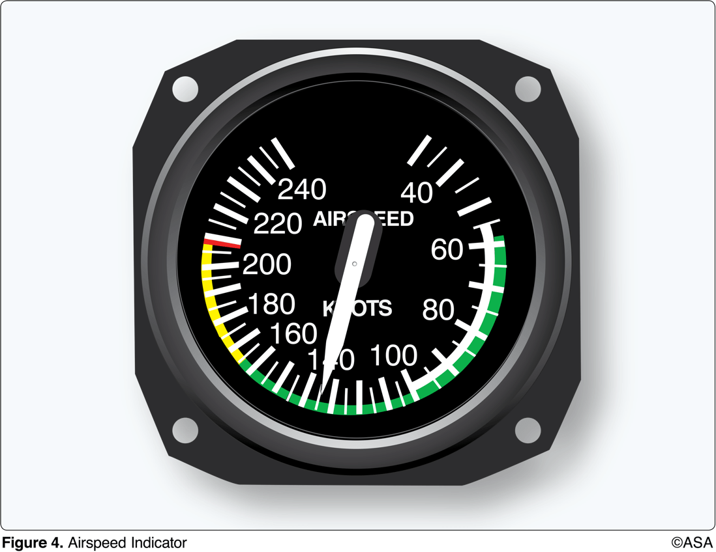
29. (3265) (Refer to Figure 4.) What is the full flap operating range for the airplane?
a. 55 to 100 knots. b. 55 to 208 knots. c. 55 to 165 knots.

Slide 58
29. (3265) (Refer to Figure 4.) What is the full flap operating range for the airplane?
*a. 55 to 100 knots. b. 55 to 208 knots. c. 55 to 165 knots.
The flap operating range is marked by the white arc. The low end is V(SO) (stall speed in a landing configuration), and the high end is V(FE) (maximum flap extended speed). Answer (B) is incorrect because 55 to 208 knots is the entire operating range of this airplane, from the stall speed to the never-exceed speed. Answer (C) is incorrect because 55 to 165 knots is the normal operating range for this airplane (green arc).

Slide 59
30. (3266) (Refer to Figure 4.) What is the caution range of the airplane?
a. 0 to 60 knots. b. 100 to 165 knots. c. 165 to 208 knots.

Slide 60
30. (3266) (Refer to Figure 4.) What is the caution range of the airplane?
a. 0 to 60 knots. b. 100 to 165 knots. *c. 165 to 208 knots.
The caution range (yellow arc) includes speeds which should only be flown in smooth air, and is 165 to 208 knots for this airplane. Answer (A) is incorrect because 0 to 60 knots is less than stall speed. Answer (B) is incorrect because 100 to 165 knots is the normal operating airspeed range from maximum flap extension speed to maximum structural cruising speed, the upper limit of the green arc and lower limit of the yellow arc.

Slide 61
31. (3267) (Refer to Figure 4.) The maximum speed at which the airplane can be operated in smooth air is
a. 100 knots. b. 165 knots. c. 208 knots.

Slide 62
31. (3267) (Refer to Figure 4.) The maximum speed at which the airplane can be operated in smooth air is
a. 100 knots. b. 165 knots. *c. 208 knots.
The caution range (yellow arc) includes speeds which should only be flown in smooth air; the maximum speed in the caution range is 208 knots for this airplane. Answer (A) is incorrect because 100 knots is the upper limit of the white arc, which is the maximum flap extended speed. Answer (B) is incorrect because 165 knots is the upper limit of the green arc, which is the maximum structural cruising speed.

Slide 63
32. (3268) (Refer to Figure 4.) Which marking identifies the never-exceed speed?
a. Upper limit of the green arc. b. Upper limit of the white arc c. The red radial line.

Slide 64
32. (3268) (Refer to Figure 4.) Which marking identifies the never-exceed speed?
a. Upper limit of the green arc. b. Upper limit of the white arc *c. The red radial line.
The upper end of the arc is marked by a red radial line which is the never-exceed speed (V(NE)). Answer (A) is incorrect because the upper limit of the green arc is the beginning of the caution range. Answer (B) is incorrect because the upper limit of the white arc is the maximum speed at which flaps may be extended.

Slide 65
33. (3269) (Refer to Figure 4.) Which color identifies the power-off stalling speed in a specified configuration?
a. Upper limit of the green arc. b. Upper limit of the white arc. c. Lower limit of the green arc.

Slide 66
33. (3269) (Refer to Figure 4.) Which color identifies the power-off stalling speed in a specified configuration?
a. Upper limit of the green arc. b. Upper limit of the white arc. *c. Lower limit of the green arc.
The green arc is the normal operating range. The lower end of the arc (V(S1)) is the stalling speed in a specified configuration. Answer (A) is incorrect because the upper limit of the green arc indicates the maximum structural cruising speed. Answer (B) is incorrect because the upper limit of the white arc is the maximum flap extended speed.

Slide 67
34. (3270) (Refer to Figure 4.) What is the maximum flaps-extended speed?
a. 65 knots. b. 100 knots. c. 165 knots.

Slide 68
34. (3270) (Refer to Figure 4.) What is the maximum flaps-extended speed?
a. 65 knots. *b. 100 knots. c. 165 knots.
The flap operating range is marked by the white arc. The high end is V(FE) (maximum flap extended speed), which is 100 knots for this airplane. Answer (A) is incorrect because 65 knots is the lower limit of the green arc, which is the power-off stall speed, V(S1). Answer (C) is incorrect because 165 knots is the upper limit of the green arc, which is V(NO).

Slide 69
35. (3271) (Refer to Figure 4.) Which color identifies the normal flap operating range?
a. The yellow arc. b. The green arc. c. The white arc.

Slide 70
35. (3271) (Refer to Figure 4.) Which color identifies the normal flap operating range?
a. The yellow arc. b. The green arc. *c. The white arc.
The flap operating range is marked by the white arc. The low end is V(SO) (stall speed in a landing configuration), and the high end is V(FE) (maximum flap extended speed). Answer (A) is incorrect because the yellow arc is the caution range. Answer (B) is incorrect because the green arc indicates the normal operating range.

Slide 71
36. (3272) (Refer to Figure 4.) Which color identifies the power-off stalling speed with wing flaps and landing gear in the landing configuration?
a. Upper limit of the green arc. b. Upper limit of the white arc. c. Lower limit of the white arc.

Slide 72
36. (3272) (Refer to Figure 4.) Which color identifies the power-off stalling speed with wing flaps and landing gear in the landing configuration?
a. Upper limit of the green arc. b. Upper limit of the white arc. *c. Lower limit of the white arc.
The flap operating range is marked by the white arc. The low end is V(SO) (stall speed in a landing configuration). Answer (A) is incorrect because the upper limit of the green arc is V(NO). Answer (B) is incorrect because the upper limit of the white arc is V(FE).

Slide 73
37. (3273) (Refer to Figure 4.) What is the maximum structural cruising speed?
a. 100 knots. b. 165 knots. c. 208 knots.

Slide 74
37. (3273) (Refer to Figure 4.) What is the maximum structural cruising speed?
a. 100 knots. *b. 165 knots. c. 208 knots.
The green arc is the normal operating range. The upper end of the arc (V(NO)) is the maximum structural cruising speed. Answer (A) is incorrect because 100 knots is the upper limit of the white arc, which is the maximum flap extended speed. Answer (C) is incorrect because 208 knots is the never-exceed speed.

Slide 75
38. (3274) What is an important airspeed limitation that is not color coded on airspeed indicators?
a. Never-exceed speed. b. Maximum structural cruising speed. c. Maneuvering speed.

Slide 76
38. (3274) What is an important airspeed limitation that is not color coded on airspeed indicators?
a. Never-exceed speed. b. Maximum structural cruising speed. *c. Maneuvering speed.
Maneuvering speed (V(A)) is not displayed on the airspeed indicator. Answer (A) is incorrect because the never-exceed speed is indicated by a red line on the airspeed indicator. Answer (B) is incorrect because the maximum structural cruising speed can be found on the airspeed indicator by the upper limit of the green arc.

Slide 77
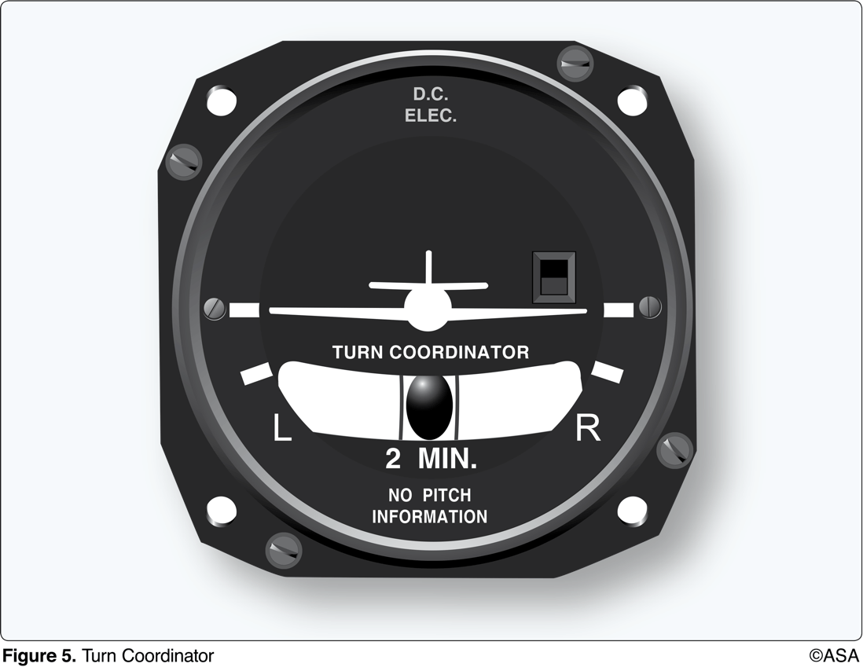
39. (3275) (Refer to Figure 5.) A turn coordinator provides an indication of the
a. movement of the aircraft about the yaw and roll axis. b. angle of bank up to but not exceeding 30°. c. attitude of the aircraft with reference to the longitudinal axis.

Slide 78
39. (3275) (Refer to Figure 5.) A turn coordinator provides an indication of the
*a. movement of the aircraft about the yaw and roll axis. b. angle of bank up to but not exceeding 30°. c. attitude of the aircraft with reference to the longitudinal axis.
The movement of the miniature airplane on the instrument is proportional to the roll rate of the airplane. When the roll rate is reduced to zero, i.e., the bank is held constant, the instrument provides an indication of the rate of turn. This design features a realignment of the gyro in such a manner that it senses airplane movement about the yaw and roll axis. Answer (B) is incorrect because the miniature aircraft indicates rate of turn, not angle of bank or attitude. Answer (C) is incorrect because the miniature aircraft indicates rate of turn, not angle of bank or attitude.

Slide 79
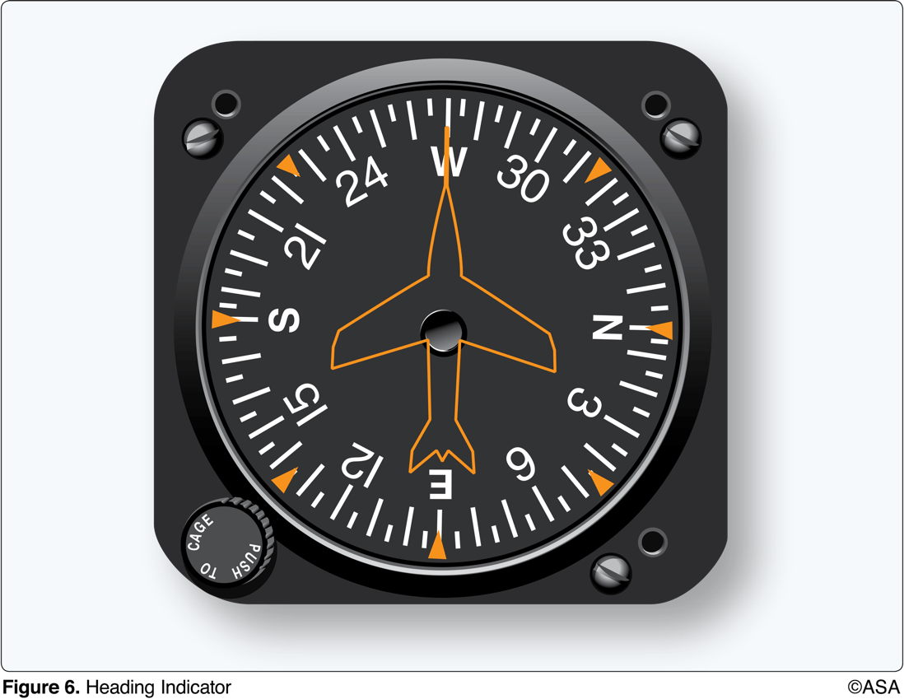
40. (3276) (Refer to Figure 6.) To receive accurate indications during flight from a heading indicator, the instrument must be
a. set prior to flight on a known heading. b. calibrated on a compass rose at regular intervals. c. periodically realigned with the magnetic compass as the gyro precesses.

Slide 80
40. (3276) (Refer to Figure 6.) To receive accurate indications during flight from a heading indicator, the instrument must be
a. set prior to flight on a known heading. b. calibrated on a compass rose at regular intervals. *c. periodically realigned with the magnetic compass as the gyro precesses.
Because the heading indicator is run by a gyroscope instead of a magnetic source, precession will cause creep or drift from a heading to which it is set. It is important to check the indications frequently and reset the heading indicator to align it with the magnetic compass when required. Answer (A) is incorrect because they don't do anything to correct for precession in flight. Answer (B) is incorrect because they don't do anything to correct for precession in flight.

Slide 81
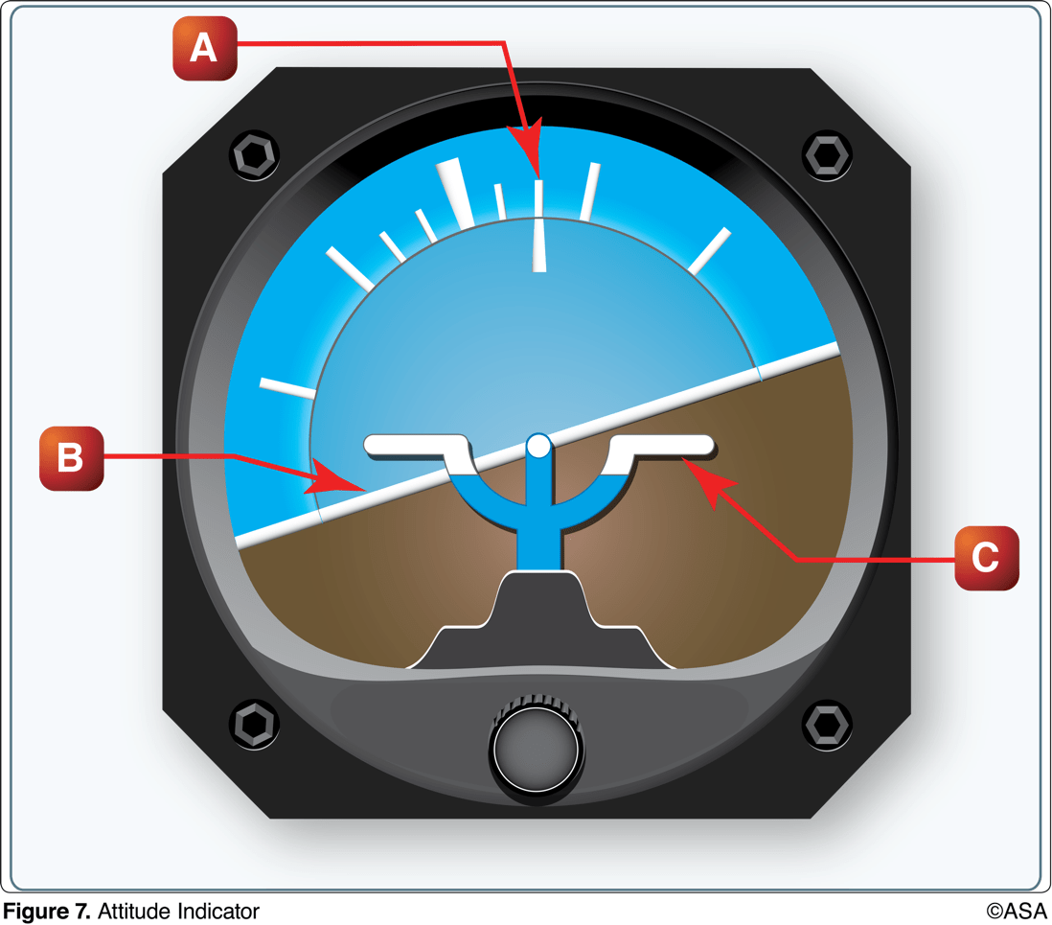
41. (3277) (Refer to Figure 7.) The proper adjustment to make on the attitude indicator during level flight is to align the
a. horizon bar to the level-flight indication. b. horizon bar to the miniature airplane. c. miniature airplane to the horizon bar.

Slide 82
41. (3277) (Refer to Figure 7.) The proper adjustment to make on the attitude indicator during level flight is to align the
a. horizon bar to the level-flight indication. b. horizon bar to the miniature airplane. *c. miniature airplane to the horizon bar.
The miniature airplane C is adjusted so that the wings overlap the horizon bar B when the airplane is in straight-and-level cruising flight. Answer (A) is incorrect because adjustment is only made to the miniature airplane. Answer (B) is incorrect because adjustment is only made to the miniature airplane.

Slide 83
42. (3278) (Refer to Figure 7.) How should a pilot determine the direction of bank from an attitude indicator such as the one illustrated?
a. By the direction of deflection of the banking scale (A). b. By the direction of deflection of the horizon bar (B). c. By the relationship of the miniature airplane (C) to the deflected horizon bar (B).

Slide 84
42. (3278) (Refer to Figure 7.) How should a pilot determine the direction of bank from an attitude indicator such as the one illustrated?
a. By the direction of deflection of the banking scale (A). b. By the direction of deflection of the horizon bar (B). *c. By the relationship of the miniature airplane (C) to the deflected horizon bar (B).
The relationship of the miniature aircraft C to the horizon bar B is the same as the relationship of the real aircraft to the actual horizon. Answer (A) is incorrect because the bank scale shows degrees, and not direction of bank. Answer (B) is incorrect because the horizon line deflects opposite the direction of turn, in order to correct horizon representation.

Slide 85
43. (3279) Deviation in a magnetic compass is caused by the
a. presence of flaws in the permanent magnets of the compass. b. difference in the location between true north and magnetic north. c. magnetic fields within the aircraft distorting the lines of magnetic force.

Slide 86
43. (3279) Deviation in a magnetic compass is caused by the
a. presence of flaws in the permanent magnets of the compass. b. difference in the location between true north and magnetic north. *c. magnetic fields within the aircraft distorting the lines of magnetic force.
Magnetic disturbances from magnetic fields produced by metals and electrical accessories in an aircraft disturb the compass card and produce an additional error which is referred to as deviation. Answer (A) is incorrect because deviation is not caused by magnet flaws. Answer (B) is incorrect because the difference between magnetic north and true north is called variation.

Slide 87
44. (3279.1) The angular difference between true north and magnetic north is
a. magnetic deviation. b. magnetic variation. c. compass acceleration error.

Slide 88
44. (3279.1) The angular difference between true north and magnetic north is
a. magnetic deviation. *b. magnetic variation. c. compass acceleration error.
The angular difference between magnetic north, the reference for the magnetic compass, and true north is variation. Answer (A) is incorrect because deviation is the error caused by magnetic fields produced by metal and electrical accessories within the airplane. Answer (C) is incorrect because compass acceleration errors are fluctuations in the compass during changes in speed.

Slide 89
45. (3279.2) Deviation error of the magnetic compass is caused by
a. a northerly turning error. b. certain metals and electrical systems within the aircraft. c. the difference in location of true north and magnetic north.

Slide 90
45. (3279.2) Deviation error of the magnetic compass is caused by
a. a northerly turning error. *b. certain metals and electrical systems within the aircraft. c. the difference in location of true north and magnetic north.
Magnetic disturbances from magnetic fields produced by metals and electrical accessories in an aircraft disturb the compass card and produce an additional error which is referred to as deviation.Answer (A) is incorrect because this describes acceleration error. Answer (C) is incorrect because the difference between magnetic north and true north is called variation.

Slide 91
46. (3280) In the Northern Hemisphere, a magnetic compass will normally indicate initially a turn toward the west if
a. a left turn is entered from a north heading. b. a right turn is entered from a north heading. c. an aircraft is accelerated while on a north heading.

Slide 92
46. (3280) In the Northern Hemisphere, a magnetic compass will normally indicate initially a turn toward the west if
a. a left turn is entered from a north heading. *b. a right turn is entered from a north heading. c. an aircraft is accelerated while on a north heading.
If on a northerly heading and a turn is made toward east or west, the initial indication of the compass lags, or indicates a turn in the opposite direction. Answer (A) is incorrect because a left turn would indicate a turn toward the east, while turning west. Answer (C) is incorrect because acceleration error does not occur on a north or south heading.

Slide 93
47. (3281) In the Northern Hemisphere, a magnetic compass will normally indicate initially a turn toward the east if
a. an aircraft is decelerated while on a south heading. b. an aircraft is accelerated while on a north heading. c. a left turn is entered from a north heading.

Slide 94
47. (3281) In the Northern Hemisphere, a magnetic compass will normally indicate initially a turn toward the east if
a. an aircraft is decelerated while on a south heading. b. an aircraft is accelerated while on a north heading. *c. a left turn is entered from a north heading.
If on a northerly heading and a turn is made toward east or west, the initial indication of the compass lags, or indicates a turn in the opposite direction. Answer (A) is incorrect because acceleration error does not occur on north or south headings. Answer (B) is incorrect because acceleration error does not occur on north or south headings.

Slide 95
48. (3282) In the Northern Hemisphere, a magnetic compass will normally indicate a turn toward the north if
a. an aircraft is decelerated while on an east or west heading. b. a left turn is entered from a west heading. c. an aircraft is accelerated while on an east or west heading.

Slide 96
48. (3282) In the Northern Hemisphere, a magnetic compass will normally indicate a turn toward the north if
a. an aircraft is decelerated while on an east or west heading. b. a left turn is entered from a west heading. *c. an aircraft is accelerated while on an east or west heading.
While on an east or west heading, an increase in airspeed or acceleration will cause the compass to indicate a turn toward the north and a deceleration will cause the compass to indicate a turn to the south. If on a north or south heading, no error will be apparent because of acceleration or deceleration. (Remember ANDS = Accelerate North Decelerate South).

Slide 97
49. (3283) In the Northern Hemisphere, the magnetic compass will normally indicate a turn toward the south when
a. a left turn is entered from an east heading. b. a right turn is entered from a west heading. c. the aircraft is decelerated while on a west heading.

Slide 98
49. (3283) In the Northern Hemisphere, the magnetic compass will normally indicate a turn toward the south when
a. a left turn is entered from an east heading. b. a right turn is entered from a west heading. *c. the aircraft is decelerated while on a west heading.
While on an east or west heading, an increase in airspeed or acceleration will cause the compass to indicate a turn toward the north and a deceleration will cause the compass to indicate a turn to the south. If on a north or south heading, no error will be apparent because of acceleration or deceleration. (Remember ANDS = Accelerate North Decelerate South). Answer (A) is incorrect because on east and west heading, turning error is negligible. Answer (B) is incorrect because on east and west heading, turning error is negligible.

Slide 99
50. (3283.1) What should be the indication on the magnetic compass as you roll into a standard rate turn to the right from a south heading in the Northern Hemisphere?
a. The compass will initially indicate a turn to the left. b. The compass will indicate a turn to the right, but at a faster rate than is actually occurring. c. The compass will remain on south for a short time, then gradually catch up to the magnetic heading of the airplane.

Slide 100
50. (3283.1) What should be the indication on the magnetic compass as you roll into a standard rate turn to the right from a south heading in the Northern Hemisphere?
a. The compass will initially indicate a turn to the left. *b. The compass will indicate a turn to the right, but at a faster rate than is actually occurring. c. The compass will remain on south for a short time, then gradually catch up to the magnetic heading of the airplane.
If you are on a southerly heading and roll into a standard-rate turn to the right, the compass will immediately indicate a turn toward the west (to the right) because of the northerly turning error. During the first part of the turn, it will show a faster rate of turn than you are actually making. Answer (A) is incorrect because the compass will initially indicate a turn to the left when rolling into a standard rate turn from a north heading in the Northern Hemisphere. Answer (C) is incorrect because the compass indication will lead the turn when rolling into a standard rate turn from a south heading in the Northern Hemisphere.

Slide 101
51. (3284) In the Northern Hemisphere, if an aircraft is accelerated or decelerated, the magnetic compass will normally indicate
a. a turn momentarily. b. correctly when on a north or south heading. c. a turn toward the south.

Slide 102
51. (3284) In the Northern Hemisphere, if an aircraft is accelerated or decelerated, the magnetic compass will normally indicate
a. a turn momentarily. *b. correctly when on a north or south heading. c. a turn toward the south.
While on an east or west heading, an increase in airspeed or acceleration will cause the compass to indicate a turn toward the north and a deceleration will cause the compass to indicate a turn to the south. If on a north or south heading, no error will be apparent because of acceleration or deceleration. (Remember ANDS = Accelerate North Decelerate South). Answer (A) is incorrect because acceleration error only occurs on an easterly/westerly heading; if accelerating, indicates a turn to the north and if decelerating, to the south. Answer (C) is incorrect because acceleration error only occurs on an easterly/westerly heading; if accelerating, indicates a turn to the north and if decelerating, to the south.

Slide 103
52. (3286) During flight, when are the indications of a magnetic compass accurate?
a. Only in straight-and-level unaccelerated flight. b. As long as the airspeed is constant. c. During turns if the bank does not exceed 18°.

Slide 104
52. (3286) During flight, when are the indications of a magnetic compass accurate?
*a. Only in straight-and-level unaccelerated flight. b. As long as the airspeed is constant. c. During turns if the bank does not exceed 18°.
The magnetic compass should be read only when the aircraft is flying straight-and-level at a constant speed. This will help reduce errors to the minimum. Answer (B) is incorrect because airspeed can remain constant in a turn, and the compass is subject to turning errors. Answer (C) is incorrect because no matter how steep the turn, the compass is still susceptible to turning errors.

Slide 105
53. (3387) If a pilot changes the altimeter setting from 30.11 to 29.96, what is the approximate change in indication?
a. Altimeter will indicate .15 "Hg higher. b. Altimeter will indicate 150 feet higher. c. Altimeter will indicate 150 feet lower.

Slide 106
53. (3387) If a pilot changes the altimeter setting from 30.11 to 29.96, what is the approximate change in indication?
a. Altimeter will indicate .15 "Hg higher. b. Altimeter will indicate 150 feet higher. *c. Altimeter will indicate 150 feet lower.
When the knob on the altimeter is rotated, the altimeter setting pressure scale moves simultaneously with the altimeter pointers. The numerical values of pressure indicated in the window increase while the altimeter indicates an increase in altitude, or decrease while the altimeter indicates a decrease in altitude. This is contrary to the reaction on the pointers when air pressure changes and is based solely on the mechanical makeup of the altimeter. The difference between the two settings is equal to .15 "Hg (30.11 - 29.96 = 0.15). At the standard pressure lapse rate of 1 "Hg = 1,000 feet in altitude, the amount of change equals 150 feet.

Slide 107
54. (3388) Under which condition will pressure altitude be equal to true altitude?
a. When the atmospheric pressure is 29.92 "Hg. b. When standard atmospheric conditions exist. c. When indicated altitude is equal to the pressure altitude.

Slide 108
54. (3388) Under which condition will pressure altitude be equal to true altitude?
a. When the atmospheric pressure is 29.92 "Hg. *b. When standard atmospheric conditions exist. c. When indicated altitude is equal to the pressure altitude.
Pressure altitude is equal to true altitude under standard atmospheric conditions.

Slide 109
55. (3389) Under what condition is pressure altitude and density altitude the same value?
a. At sea level, when the temperature is 0°F. b. When the altimeter has no installation error. c. At standard temperature.

Slide 110
55. (3389) Under what condition is pressure altitude and density altitude the same value?
a. At sea level, when the temperature is 0°F. b. When the altimeter has no installation error. *c. At standard temperature.
When conditions are standard, pressure altitude and density altitude are the same. Answer (A) is incorrect because standard temperature at sea level is 59°F. Answer (B) is incorrect because installation errors apply to airspeed indicators, not altimeters.

Slide 111
56. (3390) If a flight is made from an area of low pressure into an area of high pressure without the altimeter setting being adjusted, the altimeter will indicate
a. the actual altitude above sea level. b. higher than the actual altitude above sea level. c. lower than the actual altitude above sea level.

Slide 112
56. (3390) If a flight is made from an area of low pressure into an area of high pressure without the altimeter setting being adjusted, the altimeter will indicate
a. the actual altitude above sea level. b. higher than the actual altitude above sea level. *c. lower than the actual altitude above sea level.
If a flight is made from a high-pressure area to a low-pressure area without adjusting the altimeter, the actual altitude of the airplane will be lower than the indicated altitude, and when flying from a low-pressure area to high-pressure area, the actual altitude of the airplane will be higher than the indicated altitude. Answer (A) is incorrect because a correct altimeter setting must be used and/or standard atmospheric conditions must exist. Answer (B) is incorrect because the altimeter will indicate a lower altitude than actual.

Slide 113
57. (3391) If a flight is made from an area of high pressure into an area of lower pressure without the altimeter setting being adjusted, the altimeter will indicate
a. lower than the actual altitude above sea level. b. higher than the actual altitude above sea level. c. the actual altitude above sea level.

Slide 114
57. (3391) If a flight is made from an area of high pressure into an area of lower pressure without the altimeter setting being adjusted, the altimeter will indicate
a. lower than the actual altitude above sea level. *b. higher than the actual altitude above sea level. c. the actual altitude above sea level.
If a flight is made from a high-pressure area to a low-pressure area without adjusting the altimeter, the actual altitude of the airplane will be lower than the indicated altitude, and when flying from a low-pressure area to high-pressure area, the actual altitude of the airplane will be higher than the indicated altitude. Answer (A) is incorrect because this change would indicate a flight into a high-pressure area from a low-pressure area. Answer (C) is incorrect because the lack of change would indicate constant pressure, thus actual altitude.

Slide 115
58. (3392) Under what condition will true altitude be lower than indicated altitude?
a. In colder than standard air temperature. b. In warmer than standard air temperature. c. When density altitude is higher than indicated altitude.

Slide 116
58. (3392) Under what condition will true altitude be lower than indicated altitude?
*a. In colder than standard air temperature. b. In warmer than standard air temperature. c. When density altitude is higher than indicated altitude.
True altitude will be lower than indicated altitude in colder than standard air temperature, even with an accurate altimeter set to 29.92.

Slide 117
59. (3393) Which condition would cause the altimeter to indicate a lower altitude than true altitude?
a. Air temperature lower than standard. b. Atmospheric pressure lower than standard. c. Air temperature warmer than standard.

Slide 118
59. (3393) Which condition would cause the altimeter to indicate a lower altitude than true altitude?
a. Air temperature lower than standard. b. Atmospheric pressure lower than standard. *c. Air temperature warmer than standard.
The altimeter will indicate a lower altitude than actually flown, in air temperature warmer than standard. Answer (A) is incorrect because if the air temperature was lower, this would indicate a higher indicated altitude and a lower true altitude. Answer (B) is incorrect because when atmospheric pressure is lower than standard, the same conditions exists as described in Answer (A).

