Slide 1
1. (3201) The four forces acting on an airplane in flight are
a. lift, weight, thrust, and drag. b. lift, weight, gravity, and thrust. c. lift, gravity, power, and friction.

Slide 2
1. (3201) The four forces acting on an airplane in flight are
*a. lift, weight, thrust, and drag. b. lift, weight, gravity, and thrust. c. lift, gravity, power, and friction.
Lift, weight, thrust, and drag are the four basic aerodynamic forces acting on an aircraft in flight.

Slide 3
2. (3201.1) Which statement relates to Bernoulli`s principle?
a. For every action there is an equal and opposite reaction. b. An additional upward force is generated as the lower surface of the airfoil deflects air downward. c. Air traveling faster over the curved upper surface of an airfoil causes lower pressure on the top surface.

Slide 4
2. (3201.1) Which statement relates to Bernoulli`s principle?
a. For every action there is an equal and opposite reaction. b. An additional upward force is generated as the lower surface of the airfoil deflects air downward. *c. Air traveling faster over the curved upper surface of an airfoil causes lower pressure on the top surface.
Bernoulli's principle states in part that the pressure of a fluid (liquid or gas) decreases at points where the speed of the fluid increases. In other words, high-speed flow is associated with low pressure and low-speed flow with high pressure. Air traveling faster over the curved upper surface of an airfoil causes lower pressure on the top surface. Answer (A) is incorrect because these refer to Newton's third law of motion. Answer (B) is incorrect because these refer to Newton's third law of motion.

Slide 5
3. (3202) When are the four forces that act on an airplane in equilibrium?
a. During unaccelerated flight. b. When the aircraft is accelerating. c. When the aircraft is at rest on the ground.

Slide 6
3. (3202) When are the four forces that act on an airplane in equilibrium?
*a. During unaccelerated flight. b. When the aircraft is accelerating. c. When the aircraft is at rest on the ground.
In unaccelerated (steady state) flight the opposing forces are in equilibrium. Answer (B) is incorrect because thrust must exceed drag in order for the airplane to accelerate. Answer (C) is incorrect because when the airplane is at rest on the ground, the only aerodynamic force acting on it is weight.

Slide 7
4. (3202.1) Select the four flight fundamentals involved in maneuvering an aircraft.
a. Aircraft power, pitch, bank, and trim. b. Starting, taxiing, takeoff, and landing. c. Straight-and-level flight, turns, climbs, and descents.

Slide 8
4. (3202.1) Select the four flight fundamentals involved in maneuvering an aircraft.
a. Aircraft power, pitch, bank, and trim. b. Starting, taxiing, takeoff, and landing. *c. Straight-and-level flight, turns, climbs, and descents.
The four flight fundamentals involved in maneuvering an aircraft are: straight-and-level flight, turns, climbs, and descents

Slide 9
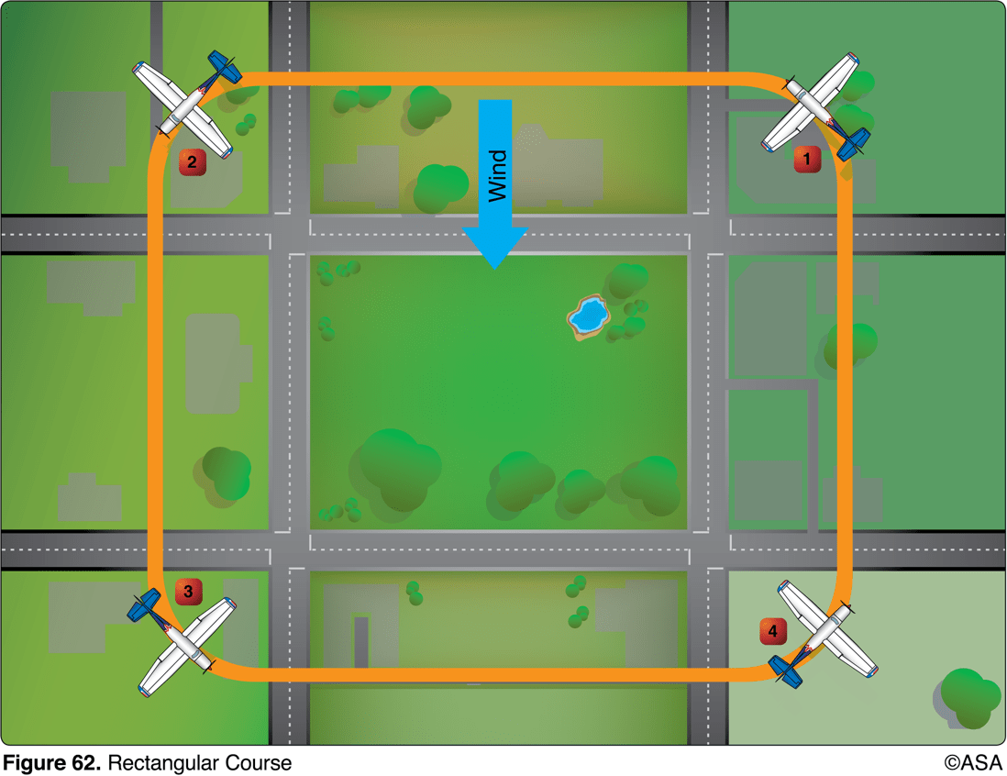
5. (3202.2) (Refer to figure 62.) In flying the rectangular course, when would the aircraft be turned less than 90°?
a. Corners 1 and 4. b. Corners 1 and 2. c. Corners 2 and 4.

Slide 10
5. (3202.2) (Refer to figure 62.) In flying the rectangular course, when would the aircraft be turned less than 90°?
*a. Corners 1 and 4. b. Corners 1 and 2. c. Corners 2 and 4.
The airplane will turn less than 90° at corners 1 and 4. At corner 1, the airplane turns to a heading that is crabbed into the wind, which makes the turn less than 90°. At corner 4, the airplane is crabbed into the wind when the turn is started, and the turn will be less than 90°.

Slide 11
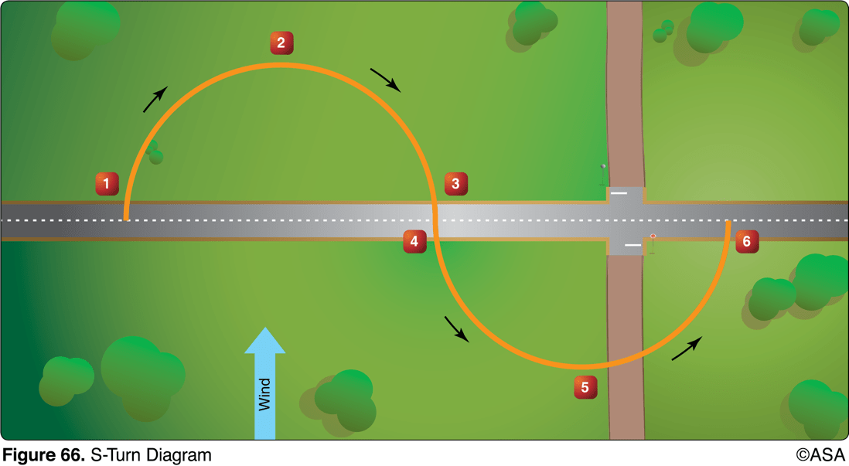
6. (3202.3) (Refer to figure 66.) While practicing S-turns, a consistently smaller half-circle is made on one side of the road than on the other, and this turn is not completed before crossing the road or reference line. This would most likely occur in turn
a. 1-2-3 because the bank is decreased too rapidly during the latter part of the turn. b. 4-5-6 because the bank is increased too rapidly during the early part of the turn. c. 4-5-6 because the bank is increased too slowly during the latter part of the turn.

Slide 12
6. (3202.3) (Refer to figure 66.) While practicing S-turns, a consistently smaller half-circle is made on one side of the road than on the other, and this turn is not completed before crossing the road or reference line. This would most likely occur in turn
a. 1-2-3 because the bank is decreased too rapidly during the latter part of the turn. *b. 4-5-6 because the bank is increased too rapidly during the early part of the turn. c. 4-5-6 because the bank is increased too slowly during the latter part of the turn.
In the half of an S-turn labeled 4-5-6, the bank should begin shallow and increase in steepness as the airplane turns crosswind and become steepest at point 6 where the turn is downwind. If the turn at point 4 is started with too steep a bank angle, the bank will increase too rapidly, and the upwind half of the S will be smaller than the downwind half. The turn will not be completed by the time the airplane is over the reference line.

Slide 13
7. (3202.4) If an emergency situation requires a downwind landing, pilots should expect a faster
a. airspeed at touchdown, a longer ground roll, and better control throughout the landing roll. b. groundspeed at touchdown, a longer ground roll, and the likelihood of overshooting the desired touchdown point. c. groundspeed at touchdown, a shorter ground roll, and the likelihood of undershooting the desired touchdown point.

Slide 14
7. (3202.4) If an emergency situation requires a downwind landing, pilots should expect a faster
a. airspeed at touchdown, a longer ground roll, and better control throughout the landing roll. *b. groundspeed at touchdown, a longer ground roll, and the likelihood of overshooting the desired touchdown point. c. groundspeed at touchdown, a shorter ground roll, and the likelihood of undershooting the desired touchdown point.
A downwind landing, using the same airspeed as is used on a normal upwind landing, will result in a higher approach ground speed, with the likelihood of overshooting the desired touchdown point. The ground speed at touchdown will be higher than normal, and the ground roll will be longer. Answer (A) is incorrect because the airspeed will be the same, and the control throughout the landing roll will be less due to the higher ground speed. Answer (C) is incorrect because the ground roll will be longer, and there will be a greater likelihood of overshooting the touchdown point.

Slide 15
8. (3202.5) When executing an emergency approach to land in a single-engine airplane, it is important to maintain a constant glide speed because variations in glide speed
a. increase the chances of shock cooling the engine. b. assure the proper descent angle is maintained until entering the flare. c. nullify all attempts at accuracy in judgment of gliding distance and landing spot.

Slide 16
8. (3202.5) When executing an emergency approach to land in a single-engine airplane, it is important to maintain a constant glide speed because variations in glide speed
a. increase the chances of shock cooling the engine. b. assure the proper descent angle is maintained until entering the flare. *c. nullify all attempts at accuracy in judgment of gliding distance and landing spot.
A constant gliding speed should be maintained because variations of gliding speed nullify all attempts at accuracy in judgment of gliding distance and the landing spot.

Slide 17
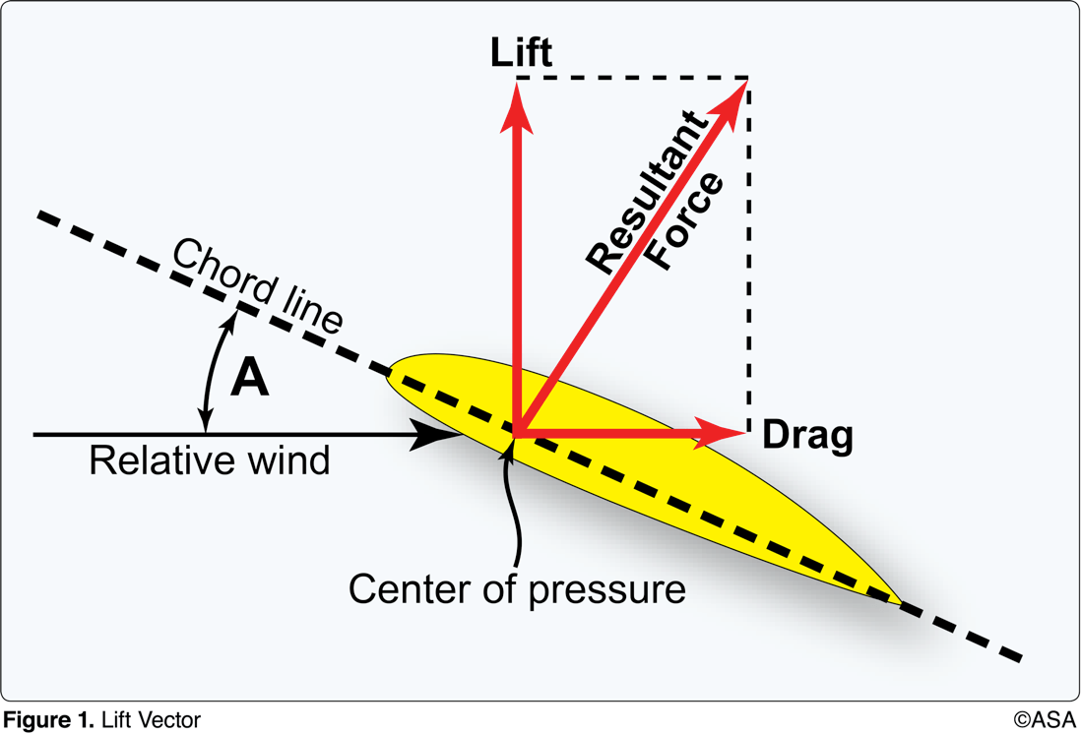
9. (3203) (Refer to Figure 1.) The acute angle A is the angle of
a. incidence. b. attack. c. dihedral.

Slide 18
9. (3203) (Refer to Figure 1.) The acute angle A is the angle of
a. incidence. *b. attack. c. dihedral.
The angle of attack is the acute angle between the relative wind and the chord line of the wing. Answer (A) is incorrect because the angle of incidence is the angle formed by the longitudinal axis of the airplane and the chord line. Answer (C) is incorrect because the dihedral is the upward angle of the airplane's wings with respect to the horizontal.

Slide 19
10. (3204) The term 'angle of attack' is defined as the angle
a. between the wing chord line and the relative wind. b. between the airplane's climb angle and the horizon. c. formed by the longitudinal axis of the airplane and the chord line of the wing.

Slide 20
10. (3204) The term 'angle of attack' is defined as the angle
*a. between the wing chord line and the relative wind. b. between the airplane's climb angle and the horizon. c. formed by the longitudinal axis of the airplane and the chord line of the wing.
The angle of attack is the acute angle between the relative wind and the chord line of the wing. Answer (B) is incorrect because there is no specific aviation term for this. Answer (C) is incorrect because this is the definition of the angle of incidence.

Slide 21
11. (3204.1) The angle between the chord line of an airfoil and the relative wind is known as the angle of
a. lift. b. attack. c. incidence.

Slide 22
11. (3204.1) The angle between the chord line of an airfoil and the relative wind is known as the angle of
a. lift. *b. attack. c. incidence.
The angle of attack is the acute angle between the chord line of the wing and the direction of the relative wind. Answer (A) is incorrect because the angle of lift is not an aerodynamic term used in aviation. Answer (C) is incorrect because the angle between the chordline of an airfoil and the longitudinal axis of an aircraft is known as the angle of incidence.

Slide 23
12. (3205) What is the relationship of lift, drag, thrust, and weight when the airplane is in straight-and-level flight?
a. Lift equals weight and thrust equals drag. b. Lift, drag, and weight equal thrust. c. Lift and weight equal thrust and drag.

Slide 24
12. (3205) What is the relationship of lift, drag, thrust, and weight when the airplane is in straight-and-level flight?
*a. Lift equals weight and thrust equals drag. b. Lift, drag, and weight equal thrust. c. Lift and weight equal thrust and drag.
Lift and thrust are considered positive forces, while weight and drag are considered negative forces and the sum of the opposing forces is zero. That is, lift = weight and thrust = drag

Slide 25
13. (3210) An airplane said to be inherently stable will
a. be difficult to stall. b. require less effort to control. c. not spin.

Slide 26
13. (3210) An airplane said to be inherently stable will
a. be difficult to stall. *b. require less effort to control. c. not spin.
A stable airplane will tend to return to the original condition of flight if disturbed by a force such as turbulent air. This means that a stable airplane is easy to fly. Answer (A) is incorrect because stability of an airplane has an effect on its stall recovery, not the difficulty of stall entry. Answer (C) is incorrect because an inherently stable aircraft can still spin.

Slide 27
14. (3211) What determines the longitudinal stability of an airplane?
a. The location of the CG with respect to the center of lift. b. The effectiveness of the horizontal stabilizer, rudder, and rudder trim tab. c. The relationship of thrust and lift to weight and drag.

Slide 28
14. (3211) What determines the longitudinal stability of an airplane?
*a. The location of the CG with respect to the center of lift. b. The effectiveness of the horizontal stabilizer, rudder, and rudder trim tab. c. The relationship of thrust and lift to weight and drag.
The location of the CG with respect to the CL determines to a great extent the longitudinal stability of an airplane. Center of gravity aft of the center of lift will result in an undesirable pitch-up moment during flight. An airplane with the CG forward of the center of lift will pitch down when power is reduced. This will increase the airspeed and the downward force on the elevators. This increased downward force on the elevators will bring the nose up, providing positive stability. The farther forward the CG is, the more stable the airplane. Answer (B) is incorrect because the rudder and rudder trim tab control the yaw. Answer (C) is incorrect because the relationship of thrust and lift to weight and drag affects speed and altitude.

Slide 29
15. (3211.1) Changes in the center of pressure of a wing affect the aircraft`s
a. lift/drag ratio. b. lifting capacity. c. aerodynamic balance and controllability.

Slide 30
15. (3211.1) Changes in the center of pressure of a wing affect the aircraft`s
a. lift/drag ratio. b. lifting capacity. *c. aerodynamic balance and controllability.
The center of pressure of an asymmetrical airfoil moves forward as the angle of attack is increased, and backward as the angle of attack is decreased. This backward and forward movement of the point at which lift acts, affects the aerodynamic balance and the controllability of the aircraft. Answer (A) is incorrect because the lift/drag ratio is determined by the angle of attack. Answer (B) is incorrect because lifting capacity is determined by angle of attack and airspeed.

Slide 31
16. (3212) What causes an airplane (except a T-tail) to pitch nosedown when power is reduced and controls are not adjusted?
a. The CG shifts forward when thrust and drag are reduced.
b. The downwash on the elevators from the propeller slipstream is reduced and elevator effectiveness is reduced.
c. When thrust is reduced to less than weight, lift is also reduced and the wings can no longer support the weight.

Slide 32
16. (3212) What causes an airplane (except a T-tail) to pitch nosedown when power is reduced and controls are not adjusted?
a. The CG shifts forward when thrust and drag are reduced.
*b. The downwash on the elevators from the propeller slipstream is reduced and elevator effectiveness is reduced.
c. When thrust is reduced to less than weight, lift is also reduced and the wings can no longer support the weight.
The location of the CG with respect to the CL determines to a great extent the longitudinal stability of an airplane. Center of gravity aft of the CL will result in an undesirable pitch-up moment during flight. An airplane with the CG forward of the CL will pitch down when power is reduced. This will increase the airspeed and the downward force on the elevators. This increased downward force on the elevators will bring the nose up, providing positive stability. The farther forward the CG is, the more stable the airplane. Answer (A) is incorrect because the CG is not affected by changes in thrust or drag. Answer (C) is incorrect because thrust and weight have a small relationship to each other, unless thrust is opposite weight, as in the case of jet fighters and space shuttles.

Slide 33
17. (3213) What is the purpose of the rudder on an airplane?
a. To control yaw. b. To control overbanking tendency. c. To control roll.

Slide 34
17. (3213) What is the purpose of the rudder on an airplane?
*a. To control yaw. b. To control overbanking tendency. c. To control roll.
The purpose of the rudder is to control yaw. Answer (B) is incorrect because the ailerons control overbanking. Answer (C) is incorrect because roll is controlled by the ailerons.

Slide 35
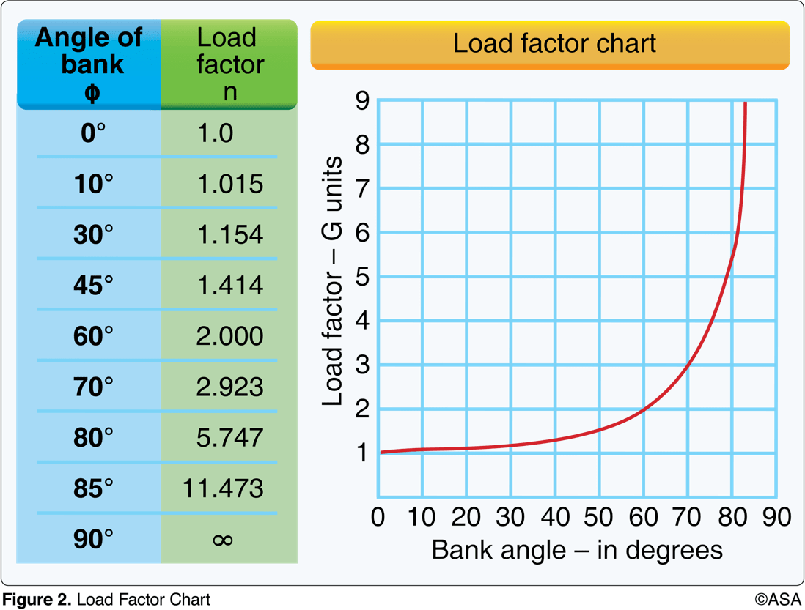
18. (3214) (Refer to Figure 2.) If an airplane weighs 2,300 pounds, what approximate weight would the airplane structure be required to support during a 60° banked turn while maintaining altitude?
a. 2,300 pounds. b. 3,400 pounds. c. 4,600 pounds.

Slide 36
18. (3214) (Refer to Figure 2.) If an airplane weighs 2,300 pounds, what approximate weight would the airplane structure be required to support during a 60° banked turn while maintaining altitude?
a. 2,300 pounds. b. 3,400 pounds. *c. 4,600 pounds.
Referencing FAA Figure 2, use the following steps: 1. Enter the chart at a 60° angle of bank and proceed upward to the curved reference line. From the point of intersection, move to the left side of the chart and read a load factor of 2 Gs. 2. Multiply the aircraft weight by the load factor: 2,300 x 2 = 4,600 lbs Or, working from the table: 2,300 x 2.0 (load factor) = 4,600 lbs. Alternative by trig: for bank angle 𝜭, Load Factor is the ratio Hyp/Adj i.e. the inverse of the cosine. For 45°: 1/(cos(45))=1.414~ (as the chart says). The entry sequence in your calc is 45, cos, 1/x

Slide 37
19. (3215) (Refer to Figure 2.) If an airplane weighs 3,300 pounds, what approximate weight would the airplane structure be required to support during a 30° banked turn while maintaining altitude?
a. 1,200 pounds. b. 3,100 pounds. c. 3,960 pounds.

Slide 38
19. (3215) (Refer to Figure 2.) If an airplane weighs 3,300 pounds, what approximate weight would the airplane structure be required to support during a 30° banked turn while maintaining altitude?
a. 1,200 pounds. b. 3,100 pounds. *c. 3,960 pounds.
Referencing FAA Figure 2, use the following steps: 1. Enter the chart at a 30° angle of bank and proceed upward to the curved reference line. From the point of intersection, move to the left side of the chart and read an approximate load factor of 1.2 Gs. 2. Multiply the aircraft weight by the load factor: 3,300 x 1.2 = 3,960 lbs Or, working from the table: 3,300 x 1.154 (load factor) = 3,808 lbs Answer C is the closest. Answer (A) is incorrect because they are less than 3,300 pounds; load factor increases with bank for level flight. Answer (B) is incorrect because they are less than 3,300 pounds; load factor increases with bank for level flight.

Slide 39
20. (3216) (Refer to Figure 2.) If an airplane weighs 4,500 pounds, what approximate weight would the airplane structure be required to support during a 45° banked turn while maintaining altitude?
a. 4,500 pounds. b. 6,750 pounds. c. 7,200 pounds.

Slide 40
20. (3216) (Refer to Figure 2.) If an airplane weighs 4,500 pounds, what approximate weight would the airplane structure be required to support during a 45° banked turn while maintaining altitude?
a. 4,500 pounds. *b. 6,750 pounds. c. 7,200 pounds.
Referencing FAA Figure 2, use the following steps: 1. Enter the chart at a 45° angle of bank and proceed upward to the curved reference line. From the point of intersection, move to the left side of the chart and read a load factor of 1.5 Gs. 2. Multiply the aircraft weight by the load factor. 4,500 x 1.5 = 6,750 lbs Or, working from the table: 4,500 x 1.414 (load factor) = 6,363 lbs Answer B is the closest. Alternative by trig: for bank angle 𝜭, Load Factor is the ratio Hyp/Adj i.e. the inverse of the cosine. For 45°: 1/(cos(45))=1.414~ (as the chart says). The entry sequence in your calc is 45, cos, 1/x

Slide 41
21. (3217) The amount of excess load that can be imposed on the wing of an airplane depends upon the
a. position of the CG. b. speed of the airplane. c. abruptness at which the load is applied.

Slide 42
21. (3217) The amount of excess load that can be imposed on the wing of an airplane depends upon the
a. position of the CG. *b. speed of the airplane. c. abruptness at which the load is applied.
At slow speeds, the maximum available lifting force of the wing is only slightly greater than the amount necessary to support the weight of the airplane. However, at high speeds, the capacity of the elevator controls, or a strong gust, may increase the load factor beyond safe limits. Answer (A) is incorrect because the position of the CG affects the stability of the airplane, but not the total load the wings can support. Answer (C) is incorrect because abrupt control inputs do not limit load.

Slide 43
22. (3218) Which basic flight maneuver increases the load factor on an airplane as compared to straight-and-level flight?
a. Climbs. b. Turns. c. Stalls.

Slide 44
22. (3218) Which basic flight maneuver increases the load factor on an airplane as compared to straight-and-level flight?
a. Climbs. *b. Turns. c. Stalls.
A change in speed during straight flight will not produce any appreciable change in load, but when a change is made in the airplane's flight path, an additional load is imposed upon the airplane structure. This is particularly true if a change in direction is made at high speeds with rapid, forceful control movements. Answer (A) is incorrect because the load increases only as the angle of attack is changed, momentarily. Once the climb attitude has been set, the wings only carry the load produced by the weight of the aircraft. Answer (C) is incorrect because in a stall, the wings are not producing lift.

Slide 45
23. (3219) One of the main functions of flaps during approach and landing is to
a. decrease the angle of descent without increasing the airspeed. b. permit a touchdown at a higher indicated airspeed. c. increase the angle of descent without increasing the airspeed.

Slide 46
23. (3219) One of the main functions of flaps during approach and landing is to
a. decrease the angle of descent without increasing the airspeed. b. permit a touchdown at a higher indicated airspeed. *c. increase the angle of descent without increasing the airspeed.
Flaps increase drag, allowing the pilot to make steeper approaches without increasing airspeed. Answer (A) is incorrect because extending the flaps increases drag, which enables the pilot to increase the angle of descent without increasing the airspeed. Answer (B) is incorrect because flaps increase lift at slow airspeed, which permits touchdown at a lower indicated airspeed.

Slide 47
24. (3220) What is one purpose of wing flaps?
a. To enable the pilot to make steeper approaches to a landing without increasing the airspeed. b. To relieve the pilot of maintaining continuous pressure on the controls. c. To decrease wing area to vary the lift.

Slide 48
24. (3220) What is one purpose of wing flaps?
*a. To enable the pilot to make steeper approaches to a landing without increasing the airspeed. b. To relieve the pilot of maintaining continuous pressure on the controls. c. To decrease wing area to vary the lift.
Flaps increase drag, allowing the pilot to make steeper approaches without increasing airspeed. Answer (B) is incorrect because trim tabs help relieve control pressures. Answer (C) is incorrect because wing area usually remains the same, except for certain specialized flaps which increase the wing area

Slide 49
25. (3263) As altitude increases, the indicated airspeed at which a given airplane stalls in a particular configuration will
a. decrease as the true airspeed decreases. b. decrease as the true airspeed increases. c. remain the same regardless of altitude.

Slide 50
25. (3263) As altitude increases, the indicated airspeed at which a given airplane stalls in a particular configuration will
a. decrease as the true airspeed decreases. b. decrease as the true airspeed increases. *c. remain the same regardless of altitude.
An increase in altitude has no effect on the indicated airspeed at which an airplane stalls at altitudes normally used by general aviation aircraft. This means that the same indicated airspeed should be maintained during the landing approach regardless of the elevation or the density altitude at the airport of landing. Answer (A) is incorrect because true airspeed does not decrease with increased altitude, and indicated airspeed at which an airplane stalls does not change. Answer (B) is incorrect because the indicated airspeed of the stall does not decrease with increased altitude.

Slide 51
26. (3287) An airplane has been loaded in such a manner that the CG is located aft of the aft CG limit. One undesirable flight characteristic a pilot might experience with this airplane would be
a. a longer takeoff run. b. difficulty in recovering from a stalled condition. c. stalling at higher-than-normal airspeed.

Slide 52
26. (3287) An airplane has been loaded in such a manner that the CG is located aft of the aft CG limit. One undesirable flight characteristic a pilot might experience with this airplane would be
a. a longer takeoff run. *b. difficulty in recovering from a stalled condition. c. stalling at higher-than-normal airspeed.
Loading in a tail-heavy condition can reduce the airplane's ability to recover from stalls and spins. Tail-heavy loading also produces very light stick forces, making it easy for the pilot to inadvertently overstress the airplane. Answer (A) is incorrect because an airplane with an aft CG has less drag from a reduction in horizontal stabilizer lift, resulting in a short takeoff run. Answer (C) is incorrect because an airplane with an aft CG flies at a lower angle of attack, resulting in a lower stall speed.

Slide 53
27. (3288) Loading an airplane to the most aft CG will cause the airplane to be
a. less stable at all speeds. b. less stable at slow speeds, but more stable at high speeds. c. less stable at high speeds, but more stable at low speeds.

Slide 54
27. (3288) Loading an airplane to the most aft CG will cause the airplane to be
*a. less stable at all speeds. b. less stable at slow speeds, but more stable at high speeds. c. less stable at high speeds, but more stable at low speeds.
Loading in a tail-heavy condition can reduce the airplane's ability to recover from stalls and spins. Tail-heavy loading also produces very light stick forces at all speeds, making it easy for the pilot to inadvertently overstress the airplane. Answer (B) is incorrect because an aft CG location causes an aircraft to be less stable at all airspeeds, due to less elevator effectiveness. Answer (C) is incorrect because an aft CG location causes an aircraft to be less stable at all airspeeds, due to less elevator effectiveness.

Slide 55
28. (3301) What force makes an airplane turn?
a. The horizontal component of lift. b. The vertical component of lift. c. Centrifugal force.

Slide 56
28. (3301) What force makes an airplane turn?
*a. The horizontal component of lift. b. The vertical component of lift. c. Centrifugal force.
As the airplane is banked, lift acts horizontally as well as vertically and the airplane is pulled around the turn. Answer (B) is incorrect because the vertical component of lift has no horizontal force to make the airplane turn. Answer (C) is incorrect because the centrifugal force acts against the horizontal component of lift.

Slide 57
29. (3309) In what flight condition must an aircraft be placed in order to spin?
a. Partially stalled with one wing low. b. In a steep diving spiral. c. Stalled.

Slide 58
29. (3309) In what flight condition must an aircraft be placed in order to spin?
a. Partially stalled with one wing low. b. In a steep diving spiral. *c. Stalled.
A spin results when a sufficient degree of rolling or yawing control input is imposed on an airplane in the stalled condition. If the wing is not stalled, a spin cannot occur. Answer (A) is incorrect because the aircraft must be at a full stall in order to spin. Answer (B) is incorrect because an airplane is not necessarily stalled when in a steep diving spiral.

Slide 59
30. (3310) During a spin to the left, which wing(s) is/are stalled?
a. Both wings are stalled. b. Neither wing is stalled. c. Only the left wing is stalled.

Slide 60
30. (3310) During a spin to the left, which wing(s) is/are stalled?
*a. Both wings are stalled. b. Neither wing is stalled. c. Only the left wing is stalled.
One wing is less stalled than the other, but both wings are stalled in a spin. Answer (B) is incorrect because both wings must be stalled through the spin. Answer (C) is incorrect because both wings are stalled; but the right wing is less fully stalled than the left.

Slide 61
31. (3311) The angle of attack at which an airplane wing stalls will
a. increase if the CG is moved forward. b. change with an increase in gross weight. c. remain the same regardless of gross weight.

Slide 62
31. (3311) The angle of attack at which an airplane wing stalls will
a. increase if the CG is moved forward. b. change with an increase in gross weight. *c. remain the same regardless of gross weight.
When the angle of attack is increased to between 18° and 20° (critical angle of attack) on most airfoils, the airstream can no longer follow the upper curvature of the wing because of the excessive change in direction. The airplane will stall if the critical angle of attack is exceeded. The indicated airspeed at which stall occurs will be determined by weight and load factor, but the stall angle of attack is the same. Answer (A) is incorrect because an airplane will always stall at the same angle of attack, regardless of the CG position or gross weight. Answer (B) is incorrect because an airplane will always stall at the same angle of attack, regardless of the CG position or gross weight.

Slide 63
32. (3312) What is ground effect?
a. The result of the interference of the surface of the Earth with the airflow patterns about an airplane. b. The result of an alteration in airflow patterns increasing induced drag about the wings of an airplane. c. The result of the disruption of the airflow patterns about the wings of an airplane to the point where the wings will no longer support the airplane in flight.

Slide 64
32. (3312) What is ground effect?
*a. The result of the interference of the surface of the Earth with the airflow patterns about an airplane. b. The result of an alteration in airflow patterns increasing induced drag about the wings of an airplane. c. The result of the disruption of the airflow patterns about the wings of an airplane to the point where the wings will no longer support the airplane in flight.
Ground effect is the result of the interference of the surface of the Earth with the airflow patterns about an airplane. Answer (B) is incorrect because induced drag is decreased. Answer (C) is incorrect because the disruption of wing-tip vortices increases lift.

Slide 65
33. (3313) Floating caused by the phenomenon of ground effect will be most realized during an approach to land when at
a. less than the length of the wingspan above the surface. b. twice the length of the wingspan above the surface. c. a higher-than-normal angle of attack.

Slide 66
33. (3313) Floating caused by the phenomenon of ground effect will be most realized during an approach to land when at
*a. less than the length of the wingspan above the surface. b. twice the length of the wingspan above the surface. c. a higher-than-normal angle of attack.
When the wing is at a height equal to its span, the reduction in induced drag is only 1.4%. However, when the wing is at a height equal to one-fourth its span, the reduction in induced drag is 23.5% and when the wing is at a height equal to one-tenth its span, the reduction in induced drag is 47.6%. Answer (B) is incorrect because ground effect extends up to one wingspan length. Answer (C) is incorrect because floating will result from higher-than-normal angle of attack.

Slide 67
34. (3314) What must a pilot be aware of as a result of ground effect?
a. Wingtip vortices increase creating wake turbulence problems for arriving and departing aircraft. b. Induced drag decreases; therefore, any excess speed at the point of flare may cause considerable floating. c. A full stall landing will require less up elevator deflection than would a full stall when done free of ground effect.

Slide 68
34. (3314) What must a pilot be aware of as a result of ground effect?
a. Wingtip vortices increase creating wake turbulence problems for arriving and departing aircraft. *b. Induced drag decreases; therefore, any excess speed at the point of flare may cause considerable floating. c. A full stall landing will require less up elevator deflection than would a full stall when done free of ground effect.
The reduction of the wing-tip vortices, due to ground effect, alters the spanwise lift distribution and reduces the induced angle of attack, and induced drag causing floating. Answer (A) is incorrect because wing-tip vortices are decreased. Answer (C) is incorrect because a full stall landing will require more up-elevator deflection, due to the increased lift in ground effect.

Slide 69
35. (3315) Ground effect is most likely to result in which problem?
a. Settling to the surface abruptly during landing. b. Becoming airborne before reaching recommended takeoff speed. c. Inability to get airborne even though airspeed is sufficient for normal takeoff needs.

Slide 70
35. (3315) Ground effect is most likely to result in which problem?
a. Settling to the surface abruptly during landing. *b. Becoming airborne before reaching recommended takeoff speed. c. Inability to get airborne even though airspeed is sufficient for normal takeoff needs.
Due to the reduced drag in ground effect, the airplane may seem capable of takeoff well below the recommended speed. It is important that no attempt be made to force the airplane to become airborne with a deficiency of speed. The recommended takeoff speed is necessary to provide adequate initial climb performance. Answer (A) is incorrect because the airplane gains lift from a reduction in induced drag while entering ground effect; therefore, it does not cause the airplane to settle abruptly. Answer (C) is incorrect because ground effect helps the airplane become airborne before the airspeed is sufficient for a normal takeoff.

Slide 71
36. (3316) During an approach to a stall, an increased load factor will cause the airplane to
a. stall at a higher airspeed. b. have a tendency to spin. c. be more difficult to control.

Slide 72
36. (3316) During an approach to a stall, an increased load factor will cause the airplane to
*a. stall at a higher airspeed. b. have a tendency to spin. c. be more difficult to control.
Stall speed increases in proportion to the square root of the load factor. Thus, with a load factor of 4, an aircraft will stall at a speed which is double the normal stall speed. Answer (B) is incorrect because an airplane's tendency to spin does not relate to an increase in load factors. Answer (C) is incorrect because an airplane's stability determines its controllability.

Slide 73
37. (3317) The term angle of attack is defined as the angle between the
a. chord line of the wing and the relative wind.
b. airplane's longitudinal axis and that of the air striking the airfoil.
c. airplane's center line and the relative wind.

Slide 74
37. (3317) The term angle of attack is defined as the angle between the
*a. chord line of the wing and the relative wind.
b. airplane's longitudinal axis and that of the air striking the airfoil.
c. airplane's center line and the relative wind.
The angle of attack is the angle between the chord line of the airfoil and the direction of the relative wind.

Slide 75
38. (3824) Wingtip vortices are created only when an aircraft is
a. operating at high airspeeds. b. heavily loaded. c. developing lift.

Slide 76
38. (3824) Wingtip vortices are created only when an aircraft is
a. operating at high airspeeds. b. heavily loaded. *c. developing lift.
Lift is generated by the creation of a pressure differential over the wing surface. The lowest pressure occurs over the wing surface and the highest pressure occurs under the wing. This pressure differential triggers the roll up of the airflow aft of the wing, resulting in wing-tip vortices. Vortices are generated from the moment an aircraft leaves the ground, since trailing vortices are a by-product of wing lift. Answer (A) is incorrect because the greatest turbulence is produced from an airplane developing lift at a slow airspeed. Answer (B) is incorrect because even though a heavily loaded airplane may produce greater turbulence, an airplane does not have to be heavily loaded in order to produce wing-tip vortices.

Slide 77
39. (3825) The greatest vortex strength occurs when the generating aircraft is
a. light, dirty, and fast. b. heavy, dirty, and fast. c. heavy, clean, and slow.

Slide 78
39. (3825) The greatest vortex strength occurs when the generating aircraft is
a. light, dirty, and fast. b. heavy, dirty, and fast. *c. heavy, clean, and slow.
The strength of the vortex is governed by the weight, speed, and shape of the wing of the generating aircraft. The greatest vortex strength occurs when the generating aircraft is heavy, clean, and slow. Answer (A) is incorrect because light aircraft produce less vortex turbulence than heavy aircraft. Answer (B) is incorrect because in order to be fast, the wing tip must be at a lower angle of attack, thus producing less lift than during climbout. Also, being dirty presents less of a danger than when clean and/or slow.

Slide 79
40. (3826) Wingtip vortices created by large aircraft tend to
a. sink below the aircraft generating turbulence. b. rise into the traffic pattern. c. rise into the takeoff or landing path of a crossing runway.

Slide 80
40. (3826) Wingtip vortices created by large aircraft tend to
*a. sink below the aircraft generating turbulence. b. rise into the traffic pattern. c. rise into the takeoff or landing path of a crossing runway.
Flight tests have shown that the vortices from large aircraft sink at a rate of about 400 to 500 feet per minute. They tend to level off at a distance about 900 feet below the path of the generating aircraft. Answer (B) is incorrect because wing-tip vortices sink toward the ground; however, they may move horizontally depending on crosswind conditions. Answer (C) is incorrect because wing-tip vortices sink toward the ground; however, they may move horizontally depending on crosswind conditions.

Slide 81
41. (3827) When taking off or landing at an airport where heavy aircraft are operating, one should be particularly alert to the hazards of wingtip vortices because this turbulence tends to
a. rise from a crossing runway into the takeoff or landing path. b. rise into the traffic pattern area surrounding the airport. c. sink into the flightpath of aircraft operating below the aircraft generating the turbulence.

Slide 82
41. (3827) When taking off or landing at an airport where heavy aircraft are operating, one should be particularly alert to the hazards of wingtip vortices because this turbulence tends to
a. rise from a crossing runway into the takeoff or landing path. b. rise into the traffic pattern area surrounding the airport. *c. sink into the flightpath of aircraft operating below the aircraft generating the turbulence.
Flight tests have shown that the vortices from large aircraft sink at a rate of about 400 to 500 feet per minute. They tend to level off at a distance about 900 feet below the path of the generating aircraft. Answer (A) is incorrect because wing-tip vortices always trail behind an airplane and descend toward the ground; they will also drift with the wind. Answer (B) is incorrect because wing-tip vortices descend.

Slide 83
42. (3828) The wind condition that requires maximum caution when avoiding wake turbulence on landing is a
a. light, quartering headwind. b. light, quartering tailwind. c. strong headwind.

Slide 84
42. (3828) The wind condition that requires maximum caution when avoiding wake turbulence on landing is a
a. light, quartering headwind. *b. light, quartering tailwind. c. strong headwind.
A tailwind condition can move the vortices of a preceding aircraft forward into the touchdown zone. A light quartering tailwind requires maximum caution. Pilots should be alert to large aircraft upwind from their approach and takeoff flight paths. Answer (A) is incorrect because headwinds push the vortices out of the touchdown zone when landing beyond the touchdown point of the preceding aircraft. Answer (C) is incorrect because strong winds help diffuse wake turbulence vortices.

Slide 85
43. (3829) When landing behind a large aircraft, the pilot should avoid wake turbulence by staying
a. above the large aircraft's final approach path and landing beyond the large aircraft's touchdown point. b. below the large aircraft's final approach path and landing before the large aircraft's touchdown point. c. above the large aircraft's final approach path and landing before the large aircraft's touchdown point.

Slide 86
43. (3829) When landing behind a large aircraft, the pilot should avoid wake turbulence by staying
*a. above the large aircraft's final approach path and landing beyond the large aircraft's touchdown point. b. below the large aircraft's final approach path and landing before the large aircraft's touchdown point. c. above the large aircraft's final approach path and landing before the large aircraft's touchdown point.
When landing behind a large aircraft, stay at or above the large aircraft's final approach path. Note its touchdown point and land beyond it. Answer (B) is incorrect because below the flight path, you will fly into the sinking vortices generated by the large aircraft. Answer (C) is incorrect because by landing before the large aircraft's touchdown point, you will have to fly below the preceding aircraft's flight path and into the vortices.

Slide 87
44. (3829.2) When landing behind a large aircraft, which procedure should be followed for vortex avoidance?
a. Stay above its final approach flightpath all the way to touchdown. b. Stay below and to one side of its final approach flightpath. c. Stay well below its final approach flightpath and land at least 2,000 feet behind.

Slide 88
44. (3829.2) When landing behind a large aircraft, which procedure should be followed for vortex avoidance?
*a. Stay above its final approach flightpath all the way to touchdown. b. Stay below and to one side of its final approach flightpath. c. Stay well below its final approach flightpath and land at least 2,000 feet behind.
When landing behind a large aircraft, stay at or above the large aircraft's final approach path. Note its touchdown point and land beyond it.

Slide 89
45. (3829.3) How does the wake turbulence vortex circulate around each wingtip?
a. Inward, upward, and around each tip. b. Inward, upward, and counterclockwise. c. Outward, upward, and around each tip.

Slide 90
45. (3829.3) How does the wake turbulence vortex circulate around each wingtip?
a. Inward, upward, and around each tip. b. Inward, upward, and counterclockwise. *c. Outward, upward, and around each tip.
The vortex circulation is outward, upward, and around the wing tips when viewed from either ahead or behind the aircraft.

Slide 91
46. (3830) When departing behind a heavy aircraft, the pilot should avoid wake turbulence by maneuvering the aircraft
a. below and downwind from the heavy aircraft. b. above and upwind from the heavy aircraft. c. below and upwind from the heavy aircraft.

Slide 92
46. (3830) When departing behind a heavy aircraft, the pilot should avoid wake turbulence by maneuvering the aircraft
a. below and downwind from the heavy aircraft. *b. above and upwind from the heavy aircraft. c. below and upwind from the heavy aircraft.
When departing behind a large aircraft, note the large aircraft's rotation point, rotate prior to it, continue to climb above it, and request permission to deviate upwind of the large aircraft's climb path until turning clear of the aircraft's wake.

